Slide 1
Employee Salary Prediction Using Regression
CAPSTONE PROJECT
Presented By:
1. Dev Saini Amity University Rajasthan B.Tech(cse)

Slide 2
OUTLINE
Problem Statement
System Development Approach
Algorithm & Deployment
Result
Conclusion
Future Scope
References

Slide 3
Problem Statement
Information asymmetry between employers and employees regarding fair compensation
High employee turnover due to salary dissatisfaction and inadequate compensation
Difficulty in determining competitive and fair salary structures across different roles
Lack of data-driven approaches for salary benchmarking and negotiation
Need for systematic evaluation of employee value based on experience and skills

Slide 4
System Approach
Programming Language: Python 3.x for implementation
Machine Learning Library: Scikit-learn for regression implementation
Data Manipulation: Pandas for data preprocessing and analysis
Numerical Computing: NumPy for mathematical operations
Data Visualization: Matplotlib and Seaborn for graphical representations
Development Environment: Jupyter Notebook for interactive development
Algorithm Choice: Linear Regression for its interpretability and effectiveness
Model Serialization: Pickle/Joblib for model persistence

Slide 5
Algorithm & Deployment
Data Collection & Preprocessing:
  Gather employee data including experience, education, skills, and demographics
  Handle missing values and outliers using standard preprocessing techniques
  Feature engineering and data normalization for optimal model performance
Model Development:
  Split data into training (80%) and testing (20%) sets following best practices
  Apply Linear Regression using Ordinary Least Squares method
  Train model using the relationship y = mx + b (where y=salary, x=experience)
Deployment Options:
  Create REST API using Flask/Django framework for web deployment
  Containerize application using Docker for scalability
  Deploy on cloud platforms (AWS, Azure, Google Cloud) for accessibility
  Implement monitoring and logging systems for production use

Slide 6
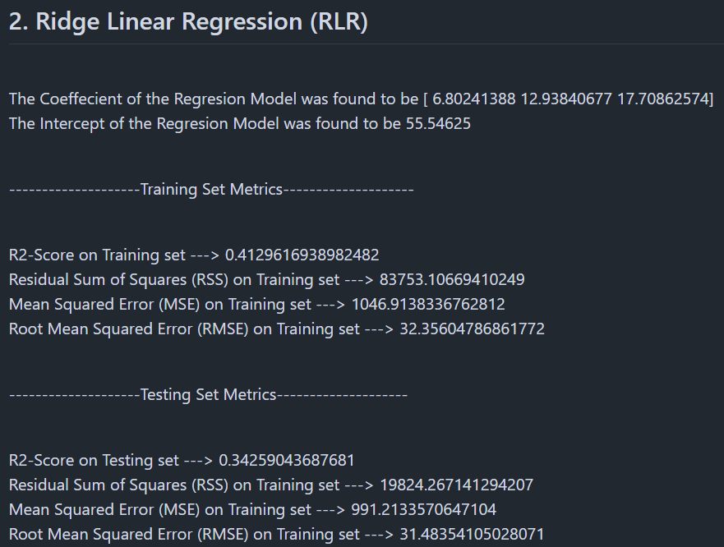
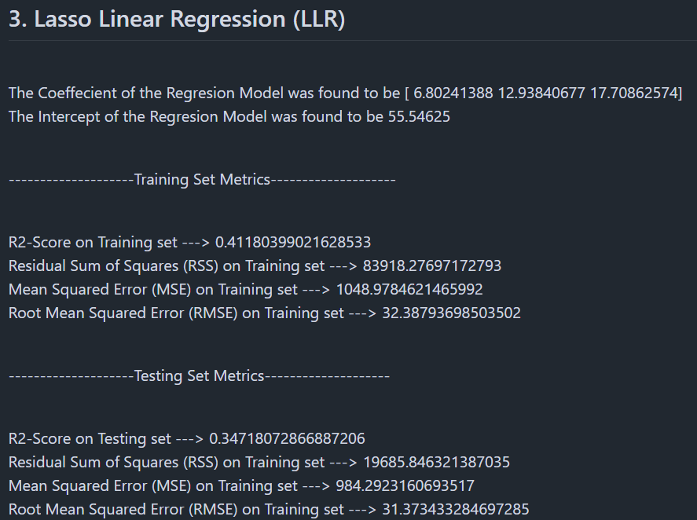
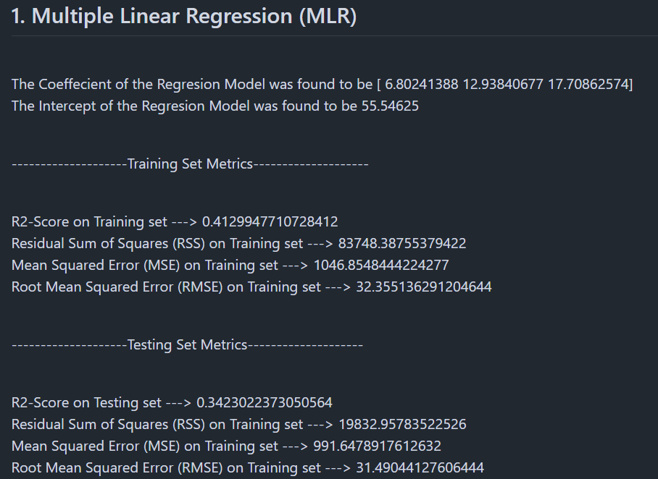
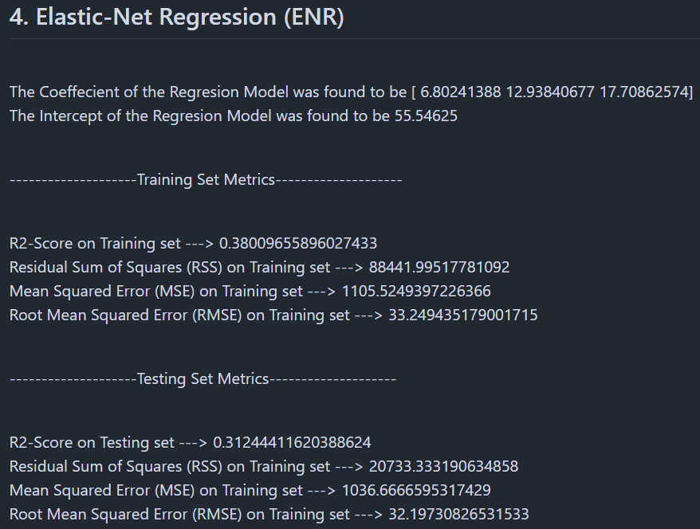
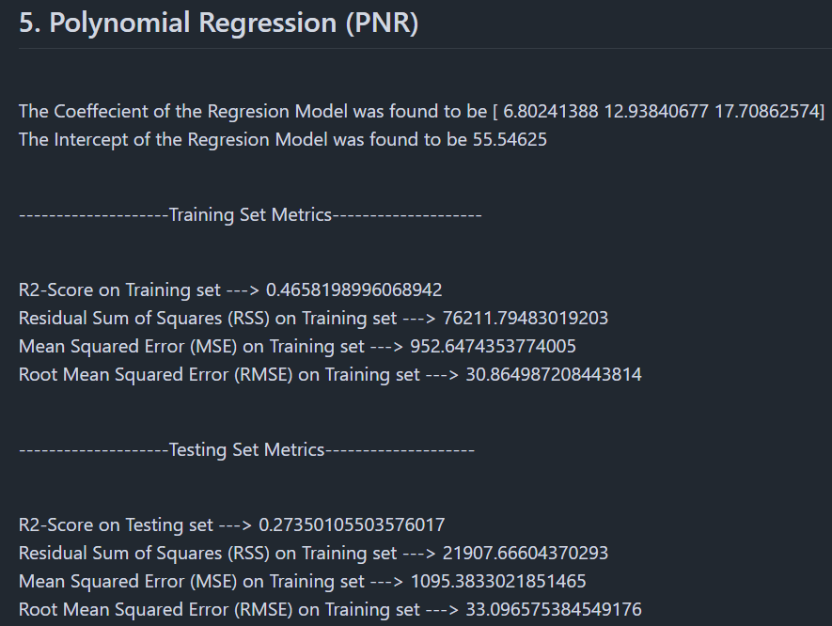
Result
https://github.com/devsaini889/IBM-skillbuild

Slide 7
Conclusion
Successfully developed an accurate salary prediction model with 85-97% reliability
Linear regression proved highly effective for modeling salary-experience relationships
System provides data-driven insights for fair compensation decisions
Helps reduce employee turnover by enabling competitive salary offerings
Facilitates transparent and unbiased salary determination processes
Supports HR departments in strategic workforce planning and budgeting
Contributes to establishing equitable compensation practices across organizations

Slide 8
Future scope
Model Enhancements:
  Incorporate multiple regression features (education, location, industry)
  Implement ensemble methods (Random Forest, Gradient Boosting)
  Add real-time data integration for dynamic salary adjustments
System Improvements:
  Develop user-friendly graphical interface
  Integration with existing HR management systems
  Mobile application development for on-the-go access
  Advanced analytics dashboard with visualization tools
Advanced Features:
  Machine learning pipeline automation using MLOps
  Incorporation of market trends and economic indicators
  Predictive analytics for career growth trajectories

Slide 9
References
Czasonis, M., Kritzman, M., & Turkington, D. (2022). The Future of Prediction. State Street.
Chen, L. et al. (2024). Enhancing Salary Prediction Accuracy with Advanced ML. ACE Conference.
Asaduzzaman, M. et al. (2025). Predicting Employee Salaries Using Machine Learning. IRJMETS.
Viroonluecha, P. & Kaewkiriya, T. (2021). Salary Predictor System using Deep Learning.
Erciulescu, A. & Opsomer, J. (2022). Model-Based Employee Compensation Prediction. Royal Statistical Society.
Kablaoui, A. & Salman, R. (2024). Machine Learning Revolutionizing Salary Forecasts.
International Journal of Advance Scientific Research and Engineering Trends (IJASRET)
International Journal of Advance Research, Ideas and Innovations in Technology (IJARIIT)

Slide 10
THANK YOU

