Slide 1

Monitoring analyst position
Rodrigo da silva sakae
27/09/2023

Slide 2

Tópicos
desafios
objetivo
Metodologia
indicadores
ferramentas

Slide 3

desafios
Prazo
Conciliar processo seletivo com a rotina
Definir prioridades
Planejar etapas
Ignorar dados externos
Focar na visão micro

Slide 4
objetivo
Criar possibilidades

Slide 5

metodologia
Análise
Compreensão dos dados, objetivos e entregáveis
planejamento
Definir prazos, ferramentas, métodos e limites
execução
API em Python e sistema de monitoramento em Next (Javascript)
testes
Insomnia e Microsoft Excel

Slide 6

indicadores
Checkouts_1 & checkouts_2
3.1 - Get your hands dirty
Using this csv and using this csv with hypothetical checkout data, imagine that you are trying to understand if there is any kind of anomaly behavior.
Analyze the data provided and present your conclusions .
In addition to the spreadsheet data, make a query in SQL and make a graphic of it and try to explain the anomaly behavior you found.
In this csv you have the number of sales of POS by hour comparing the same sales per hour from today, yesterday and the average of other days. So with this we can see the behavior from today and compare to other days

Slide 7
3.1. Get your hands dirty
checkouts_1.csv + checkouts_2.csv
Notes:
1) Dar zoom e detalhar a legenda da tabela
2) D3-LW = Valor do D3 na última semana
3) D3-LW_AVG = Média de todos os dias da última semana
4) D3-LM_AVG = Média do mesmo dia em 4 semanas (1 mês)

Slide 8
Var-cur Query sql
SELECT time,
TRUNCATE(
(today –
((same_day_last_week + avg_last_week + avg_last_month) / 3))
,2) AS D3-VAR_CUR
FROM checkouts
WHERE
TRUNCATE(
(today –
((same_day_last_week + avg_last_week + avg_last_month) / 3))
,2)
<
(ÍNDICE * -1)

Slide 9
D3 (checkouts_2)

Slide 10
D2 (checkouts_1)

Slide 11
indicadores
transactions
3.2 - Solve the problem
Alert incident in transactions: Implement the concept of a simple monitoring with real time alert with notifications to teams.
Your Monitoring alert system must have at least: 1 endpoint that receives transaction data and returns a recommendation to “alert” the anomalies found in transactions. A query to organize the data on the data and a graphic to see the data in real time. A model to determine anomalies and a system to report the anomalies automatically.
You are free to determine the methods to approve/deny the transactions, but a few ways to do it are:
rule-based - you define which cases get alerted based on predefined rules;
score-base - you create a method/model (you could use machine learning models here if you want) to determine the anomaly -- score of a transaction and make your decision based on it;
a combination of both;

Slide 12
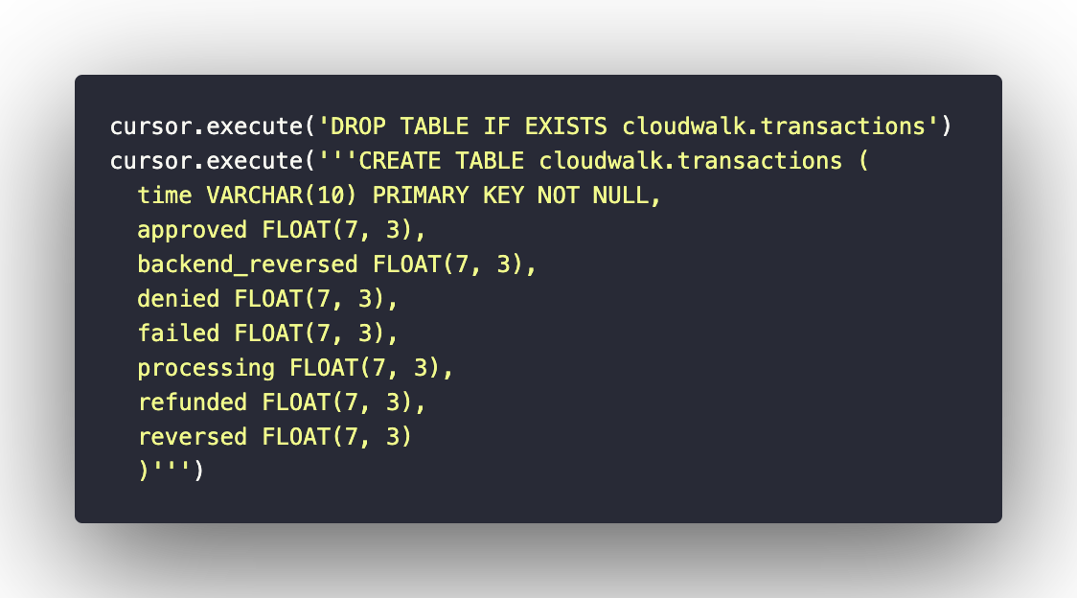
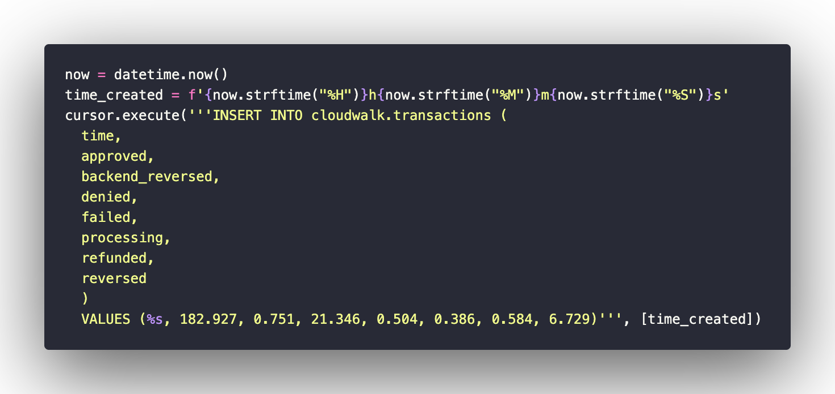
Query sql

Slide 13
Cálculo de índices
legenda | approved | backend_reverse | denied | failed | processing | refunded | reversed | total
SUB TOTAL T1 | 208838 | 1619 | 26126 | 68 | 970 | 953 | 16096 | 254670
AVERAGE | 157,97 | 1,22 | 19,76 | 0,05 | 0,73 | 0,72 | 12,18 | 192,64
PERCENTUAL | 82,00% | 0,64% | 10,26% | 0,03% | 0,38% | 0,37% | 6,32% | 100,00%
SUB TOTAL T2 | 274197 | 367 | 30245 | 1263 | 51 | 591 | 1692 | 308406
AVERAGE | 207,88 | 0,28 | 22,93 | 0,96 | 0,04 | 0,45 | 1,28 | 233,82
PERCENTUAL | 88,91% | 0,12% | 9,81% | 0,41% | 0,02% | 0,19% | 0,55% | 100,00%
GRAND TOTAL | 483035 | 1986 | 56371 | 1331 | 1021 | 1544 | 17788 | 563076
AVERAGE (MINUTE) | 182,93 | 0,75 | 21,35 | 0,50 | 0,39 | 0,58 | 6,73 | 213,23
PERCENTUAL (TOTAL) | 85,79% | 0,35% | 10,01% | 0,24% | 0,18% | 0,27% | 3,16% | 100,00%
ERR MARGIN |  |  |  | ✅ |  |  | ✅ | 7,23 (3,40%)
INDEXES (AVG) | (– reversed) 172,20 | 0,75 | 21,35 | 0,5 | ignored | condensed | 6,73 | -
INDEXES (%) | 85,73% | 0,36% | 10,39% | 0,24% |  |  | 3,27% | 3,52%

Slide 14

model
Índices
Warning index: 3.52% (scored + rule-based)
Critical index: 20% (rule-based)
regras
[Warning]
Failed + Reversed transactions > Warning index
AND
Failed, reversed or denied transactions are higher than it’s own history average
[Critical]
Failed + Reversed transactions are higher than critical index

Slide 15



Obrigado
Rodrigo sakae
+55 48 99137 1440
devsakae@gmail.com

