Slide 1
PFEC GLOBAL
AI Calling Solution
A vendor-agnostic tech stack, feasibility study & cost estimate for Zoho CRM–driven, Bangla + English AI outbound calling
Prepared for: PFEC Global — Offshore (India / Sri Lanka / Bangladesh) & Onshore (Australia) Date: 23 July 2026

Slide 2






AGENDA
What this deck covers
The brief
Architecture
Feasibility study
What PFEC actually needs, in one page
A composable, best-of-breed tech stack
How 6 vendors/frameworks stack up
Zoho CRM integration
Roadmap & pilot
Cost estimate
No Zapier — native workflow + webhooks
Phase 1 Warmer → Phase 2 Full Agent
Build cost + running cost, by volume
02

Slide 3
01 — UNDERSTANDING THE BRIEF
One integrated problem, two source documents
Vendor Requirements Brief
Business Requirements Document (BRD)
Outbound calling via API
Bangla + English, with code-switching (critical must-have)
Bring-your-own SIP trunk (local BD caller ID)
End-of-call webhook: transcript, summary, structured data
leadId round-trips through the whole call
Call recording by URL
Function-calling mid-call (Phase 2 booking)
Configurable concurrency, batch/campaign dialing
Direct Zoho CRM integration only — no Zapier, anywhere in production
11-stage lead lifecycle, exact stage names required
7 call attempts over 5 days before disqualification
Offshore (India/Sri Lanka/Bangladesh) + Onshore (Australia: Education & Migration)
Script must adapt to campaign, UTM, branch, enquiry type
Migration/visa talking points from a PFEC-governed knowledge base only
Zoho CRM owns downstream Email/WhatsApp triggers
03

Slide 4

THE CORE CHALLENGE
No single off-the-shelf vendor clears every bar
Authentic Bangladesh-dialect Bangla and a Zapier-free, fully-owned Zoho CRM contract are two different specialisms — and most “all-in-one” voice platforms only cover one of them well.
Bangla quality
Zoho, not Zapier
Two regions, two journeys
Most global platforms treat Bengali as an afterthought; Indic-specialist vendors nail the accent but aren't built for enterprise CRM orchestration.
The BRD explicitly bans iPaaS in production. That write-back logic has to be owned and built, not bought as a plug-in.
Offshore batch/real-time calling and Onshore Education vs. Migration flows need different scripts, driven by live CRM context.
04

Slide 5



02 — ARCHITECTURE
A composable, best-of-breed stack — not one monolith
1. CRM system of record
Lead intake, 11-stage model, downstream Email/WhatsApp automation
Zoho CRM (existing)
2. Integration middleware
Zoho ↔ voice-platform contract, retry scheduler, migration knowledge base
Custom-built microservice
3. Voice orchestration
BYO-SIP, mid-call function-calling, webhook + leadId round-trip
Vapi or Retell AI
4. Speech + language
Bangla + English STT/TTS and conversational reasoning
Azure bn-BD / Sarvam + GPT-4o
05

Slide 6


02 — ARCHITECTURE
How one call flows, end to end
1
2
3
4
5
6
Lead eligible in Zoho CRM
Native Zoho webhook fires
Middleware triggers the call
AI calls over BYO-SIP
End-of-call webhook returns
Zoho CRM stage updated
Stage = Not Yet Contacted, context fields populated
Workflow Rule → middleware. No Zapier, anywhere.
leadId + context sent to Vapi/Retell outbound API
Bangla/English script, mid-call function-calling (Ph.2)
Transcript, summary, outcome, recording, leadId
Middleware writes stage + attempt + follow-up via API
Zoho CRM owns every downstream trigger (confirmations, nudges, disqualification) once the stage is written — exactly as Business Rule BR-10 requires.
06

Slide 7

02 — ARCHITECTURE
The Bangla decision — validate before you commit
This is PFEC's own “critical” must-have and pilot go/no-go gate. We recommend a cheap A/B test across three vendors before locking in production spend.
PRIMARY PICK
STRONG CANDIDATE
STT COMPANION
Azure AI Speech
Sarvam AI
Deepgram Nova-3
bn-BD neural (Nabanita, Pradeep)
Saarika STT + Bulbul v3 TTS
Bengali STT added Jan 2026
Authentic Dhaka dialect — closest match to real leads; enterprise SLA
Purpose-built for Indic code-switching; very low cost per minute
Best for the English-heavy legs of a code-switched call
07

Slide 8
03 — FEASIBILITY STUDY
Six platforms evaluated against PFEC's must-haves
Platform
Bangla
BYO-SIP
Webhook +
leadId
Fn-calling
(Ph.2)
Fit
Vapi + Azure/Sarvam
✓
✓
✓
✓
BEST FIT
Retell AI + Azure/Sarvam
✓
✓
✓
✓
STRONG ALT
Bland.ai
△
△
✓
✓
BANGLA RISK
Bolna AI (India-native)
✓
△
✓
✓
COST OPTION
Gnani.ai (enterprise)
✓
△
✓
✓
FALLBACK
Full custom build
✓
✓
✓
✓
PHASE 3
✓ meets requirement △ partial / needs validation — full detail in the written proposal, Section 5
08

Slide 9

03 — FEASIBILITY STUDY
Two questions PFEC will ask us
“We already looked at Bland.ai — why not just use it?”
Bland is fast and low-latency, but it's a closed platform: you use its own speech stack rather than swapping in a Bangla specialist, and public docs are inconsistent on native Bengali support outside enterprise BYOK deals. Given Bangla quality is PFEC's own go/no-go gate, we're not comfortable betting the pilot on it without a confirmed enterprise call — it stays on the shortlist as a fallback.
“Why not just build everything in-house for full control?”
A fully custom build (Twilio + hand-rolled STT/LLM/TTS) gives PFEC zero vendor lock-in, but industry data puts that at 8–16 weeks and $35,000–$150,000+ before any Zoho work. That's the wrong first move for a program whose immediate goal is a fast, cheap, 200–300-lead pilot. We've scoped it as an optional Phase 3, once volume justifies it.
09

Slide 10

04 — ZOHO CRM INTEGRATION
Zapier-free, by construction — not by promise
What we use
What we deliberately avoid
Zoho CRM Workflow Rules + native Instant Webhooks → middleware
Deluge custom functions for any in-CRM logic
Zoho CRM REST API for stage / attempt / appointment write-back
Zoho CRM's own automation for Email + WhatsApp triggers on stage change
Zapier for lead handoff, call triggering, or stage sync (explicitly out of scope, BRD §3.2)
Any generic iPaaS as the system of record for retry logic
Voice-platform-side WhatsApp/Email sending — Zoho stays the single owner (BR-10)
Hard-coded visa/migration content in the voice script — it lives in a PFEC-governed knowledge base
10

Slide 11
04 — ZOHO CRM INTEGRATION
The 11-stage lead lifecycle the middleware enforces
Not Yet Contacted
→
1st–7th Contact Attempted
→
In Contact Interested
→
Appointment Booked
→
Disqualified
1st – 7th Contact Attempted runs over 5 configurable days; the 7th unanswered attempt auto-disqualifies with reason “No Response After 7 Attempts.”
BR-05 / BR-06
BR-07 / BR-08
BR-09 / BR-10
Answers + interested → In Contact Interested; books → Appointment Booked (retries stop)
Declines → Disqualified (Not Interested); unreachable after 7 → Disqualified (No Response)
No further AI retries once Booked/Disqualified; Zoho CRM owns all downstream messaging
11

Slide 12

05 — ROADMAP
Phase 1 Warmer → Phase 2 Full Agent
WEEK 1
WEEK 2
WEEK 3
WEEK 4
WEEK 5
WEEK 6
Discovery & design
Platform & speech setup
Zoho CRM configuration
Middleware build
QA + Bangla review
Pilot: 200–300 leads
CRM field mapping, script v1, stage rules
BYO-SIP live, Bangla A/B configured
Fields, Workflow Rules, webhooks — no Zapier
Webhook receiver, write-back, retry scheduler
Native-speaker review, end-to-end test calls
Measured on PFEC's own go/no-go criteria
Phase 2 — Full Agent (weeks 7–12, after the pilot clears go/no-go)
Mid-call function-calling for live booking • Migration knowledge base (RAG), governed by PFEC • WhatsApp Business API wired to Zoho CRM • Full BRD §12 reporting dashboard
12

Slide 13

05 — ROADMAP
Pilot, mapped to PFEC's own success criteria
% Answered
% Bangla-completed
% Marked Warm
Connected ÷ total dialed
Native-speaker recording review
Interested + Booked ÷ connected
Counselor conversion
Cost per warm lead
Hang-up / complaint rate
Booked ÷ In Contact Interested
Pilot spend ÷ Warm-stage leads
Short calls + logged feedback
Go / no-go: more appointments per counselor-hour than cold calling, and acceptable Bangla quality on recording review — PFEC's own bar, unchanged.
13

Slide 14
06 — COST ESTIMATE
Indicative cost — build once, scale with usage
One-time implementation
Recurring running cost (voice AI usage)
Phase 1 — Warmer
$9,000 – $16,000
Pilot (200–300 leads)
$75 – $225 (one-time)
4–6 weeks
500–750 min blended
Phase 2 — Full Agent
$11,000 – $20,000
Early production (~1,000 leads/mo)
$375 – $1,050 / mo
4–6 weeks
2.5k–3.5k min blended
Total, Phase 1 + 2
$20,000 – $36,000
Scaled production (~5,000 leads/mo)
$1,800 – $4,800 / mo
12k–16k min blended
Plus: middleware hosting ~$50–150/mo • WhatsApp API ~$50–300/mo (Phase 2) • optional tuning retainer $800–2,000/mo. Zoho CRM licensing assumed already in place.
Indicative planning figures based on public vendor pricing, July 2026 — to be firmed into a formal SOW after discovery.
14

Slide 15



07 — RISKS & ASSUMPTIONS
What we'd flag before you sign off
Bangla dialect accuracy
Data residency
Zoho CRM edition/API limits
Most vendors tune for bn-IN, not bn-BD — mitigated by the pilot A/B
Recordings carry student PII; confirm policy, use regional hosting where offered
Workflow Rules + webhooks need a sufficient edition — confirm week 1
WhatsApp channel ownership
Migration content governance
Vendor pricing volatility
No native Zoho channel — direct Meta Cloud API vs. a BSP, decided in Ph.2
Visa talking points must be PFEC-approved before Phase 2 go-live
Contract usage-based, not fixed-commitment, wherever possible
15

Slide 16
NEXT STEPS
Let's de-risk Bangla quality first, then build
1
30-min discovery call — confirm Zoho CRM edition & BYO-SIP details
2
Approve Phase 1 scope and budget range
3
Lock the Bangla + English script v1 with PFEC's counseling team
4
Run the Azure vs. Sarvam vs. Deepgram Bangla A/B alongside CRM setup
5
Execute the 200–300-lead pilot and review against go/no-go
PFEC Global × AI Technology Consulting Engagement
23 July 2026

Slide 17
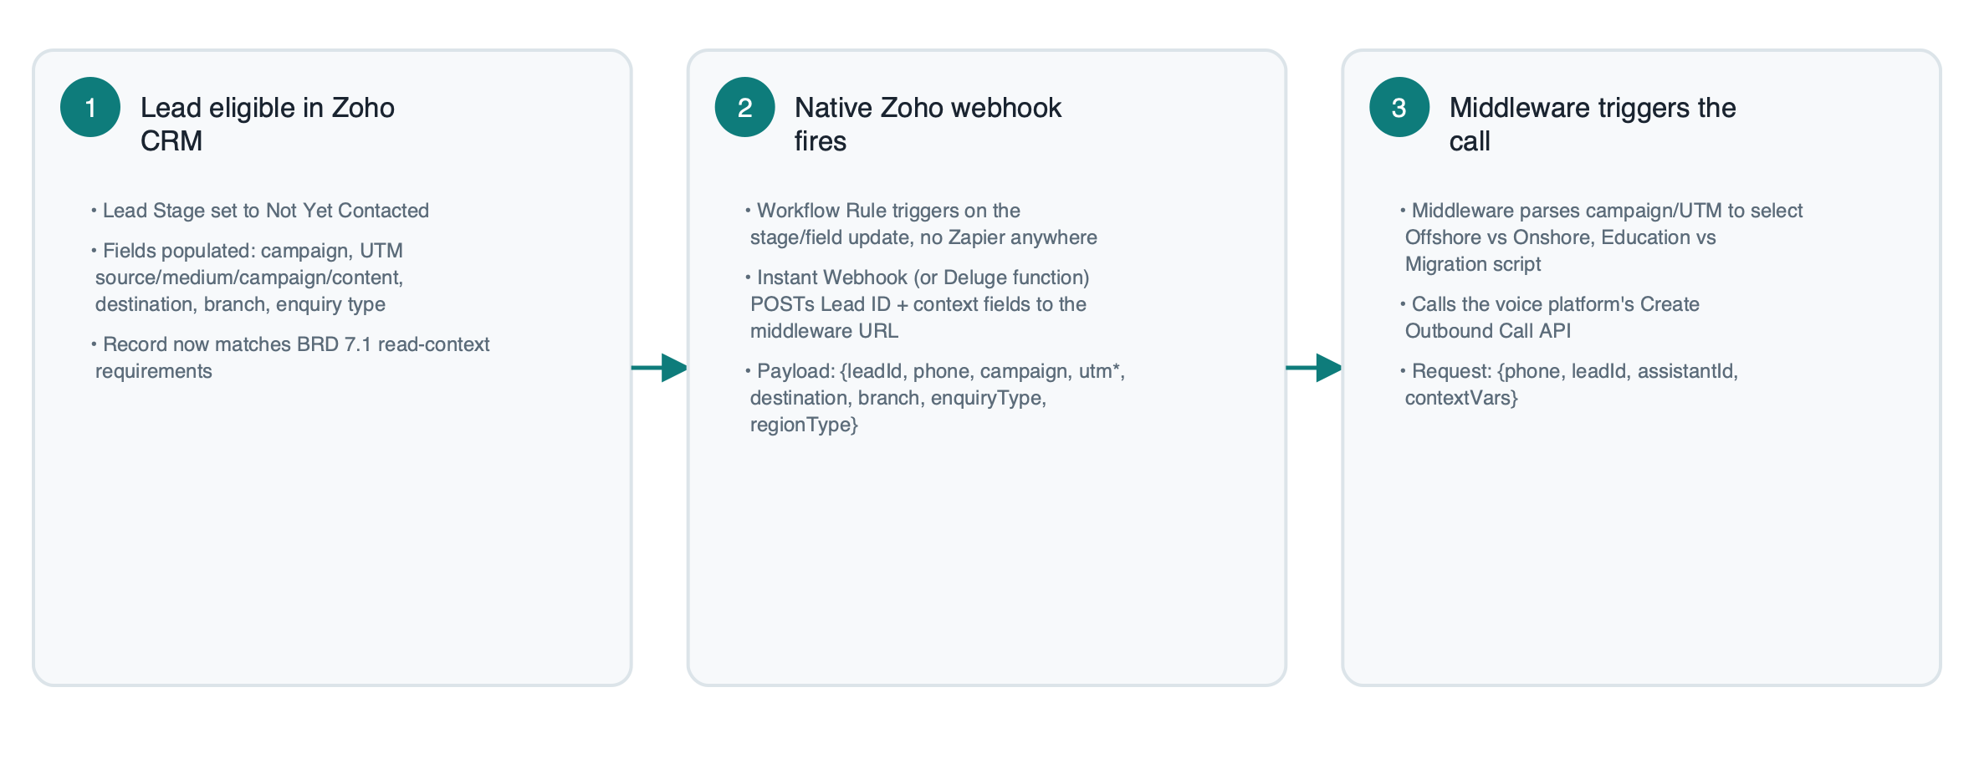
08 — TECHNICAL APPENDIX
How each step actually works (1 of 2)
The six-step call flow from the architecture section, expanded into the actual request/response detail at each hop.
17

Slide 18
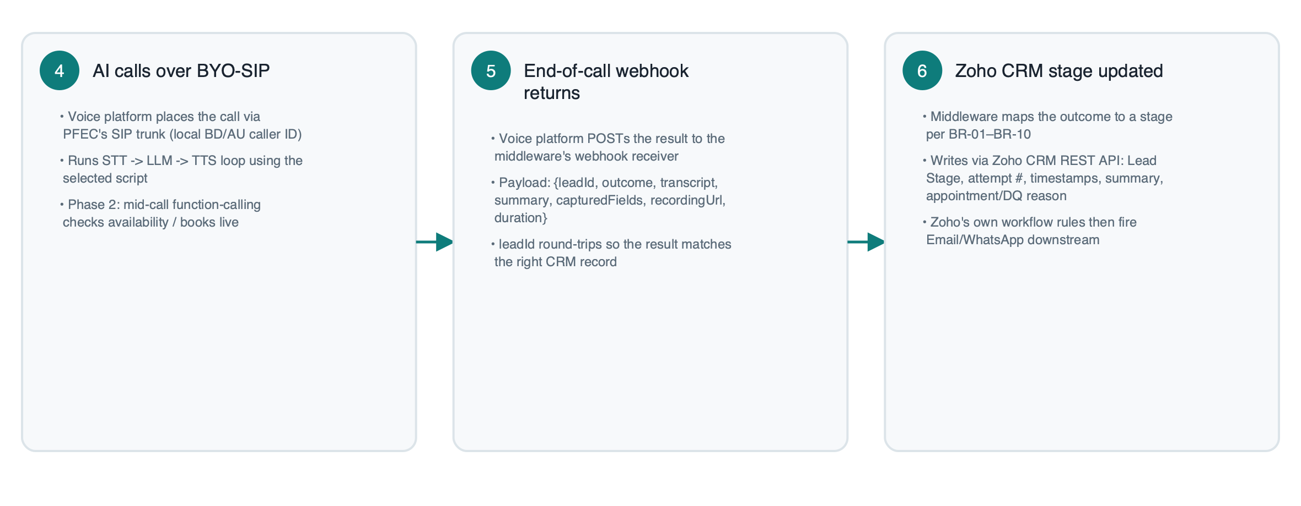
08 — TECHNICAL APPENDIX
How each step actually works (2 of 2)
The six-step call flow from the architecture section, expanded into the actual request/response detail at each hop.
18

Slide 19
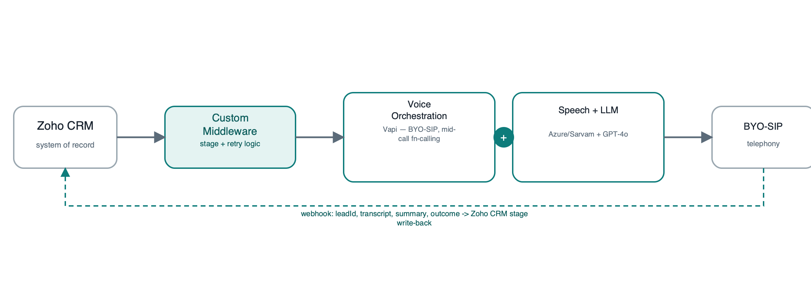

08 — TECHNICAL APPENDIX
Vendor deep-dive — the two composable front-runners
Vapi
Retell AI
• Pricing: $0.05/min platform fee + pass-through STT/TTS/LLM/telephony (all-in ~$0.13–$0.31/min)
• Concurrency: usage-based, scales on demand
• Docs: deep tooling ecosystem, documented custom-voice/webhook pattern
• Best fit: primary recommendation
• Pricing: $0.055/min infra + pass-through TTS/LLM + $0.015/min telephony (waived with BYO-SIP)
• Concurrency: 20 concurrent included free, +$8/slot/mo beyond that
• Docs: explicit BYO-SIP guidance (Twilio, Vonage, Telnyx, direct carrier)
• Best fit: strong alternative / fallback
19

Slide 20
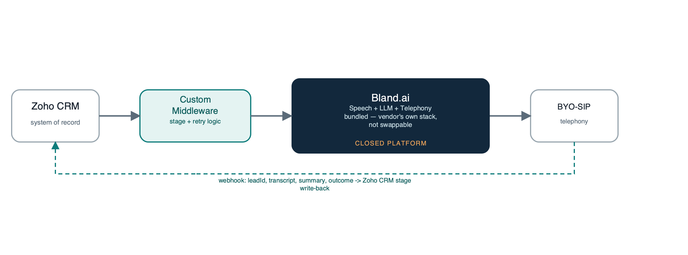
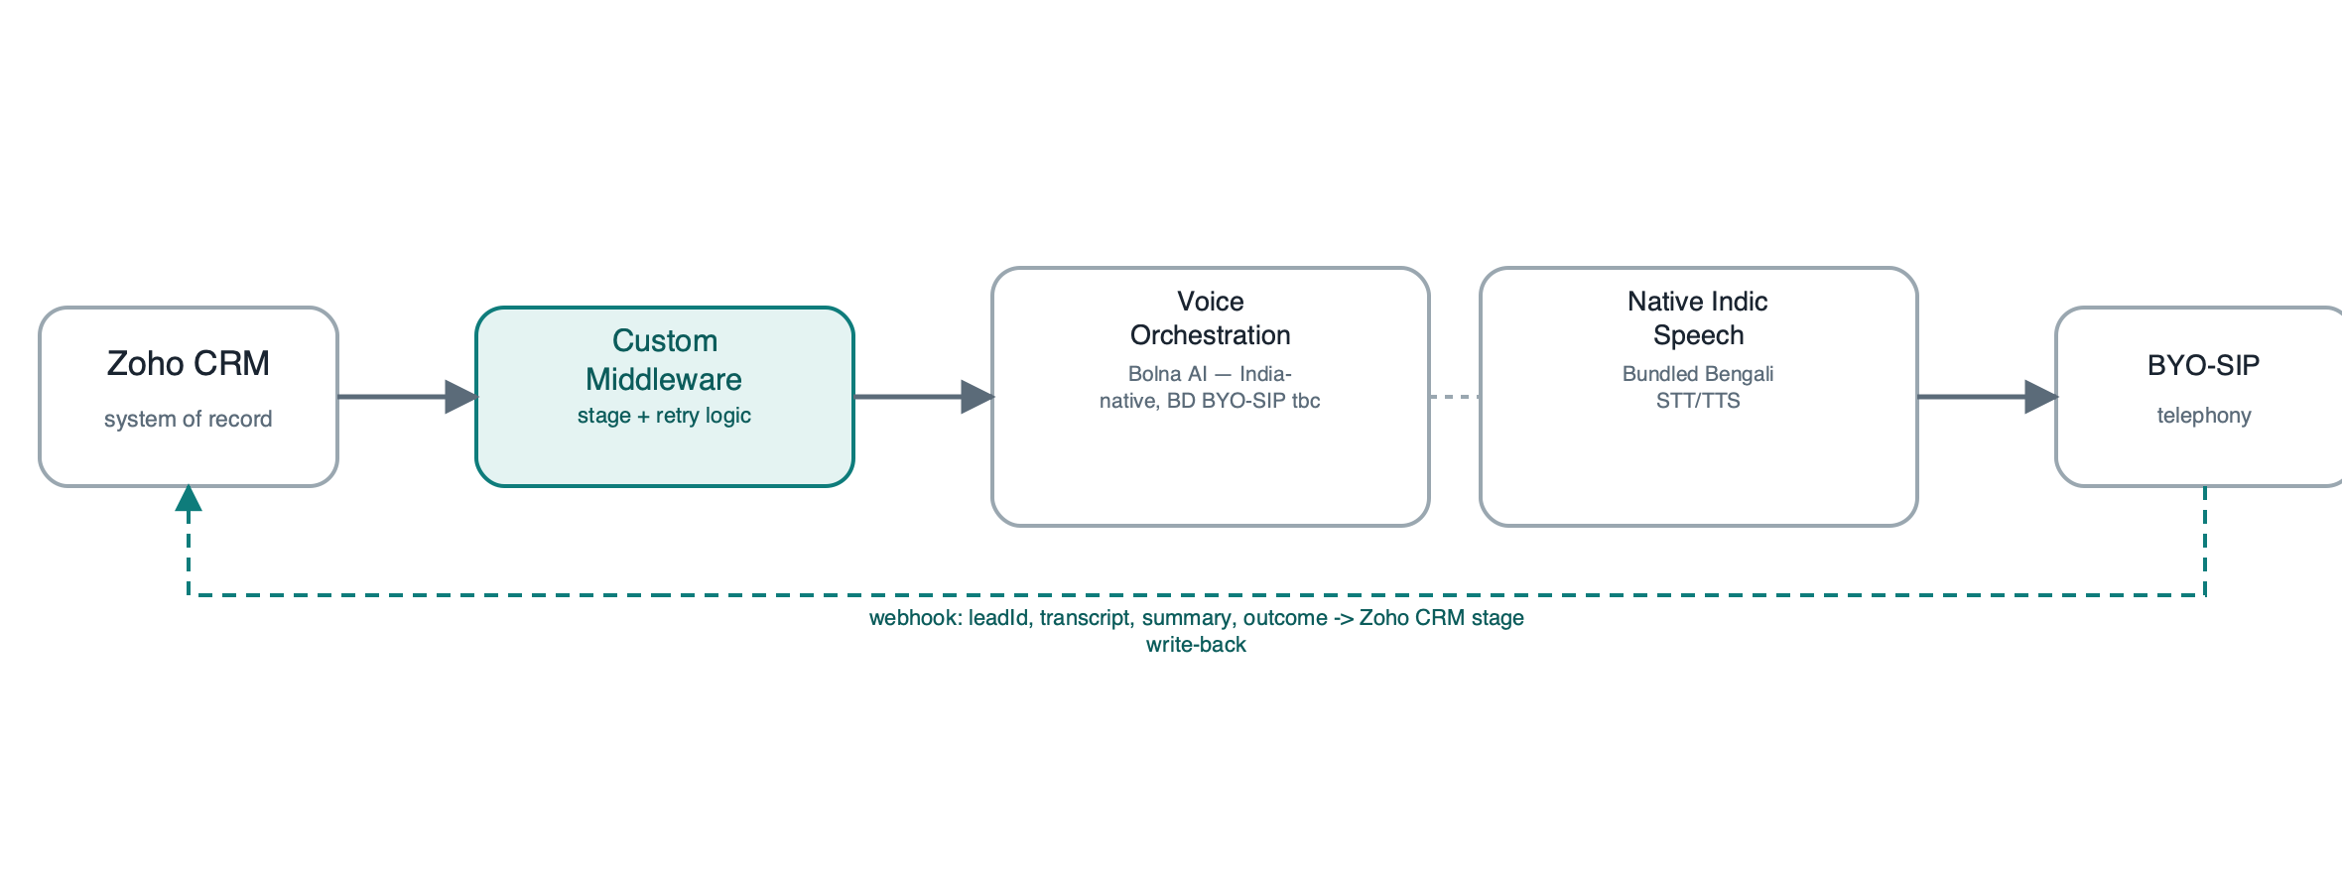
08 — TECHNICAL APPENDIX
Vendor deep-dive — closed platform vs. India-native
Bland.ai
Bolna AI
• Bangla support unconfirmed in public docs; 3rd-party ASR only via enterprise BYOK tier
• BYO-SIP supported but less documented for Bangladesh numbers specifically
• Closed speech stack — can't swap in a Bangla specialist engine
• Verdict: workable, but Bangla risk + platform lock-in
• Native Bengali, purpose-built for Indic languages and code-mixed speech
• India-first telephony — Bangladesh BYO-SIP needs vendor confirmation
• Attractive cost point relative to Vapi/Retell + Azure/Sarvam pass-through
• Verdict: attractive cost, worth a pilot slot
20

Slide 21

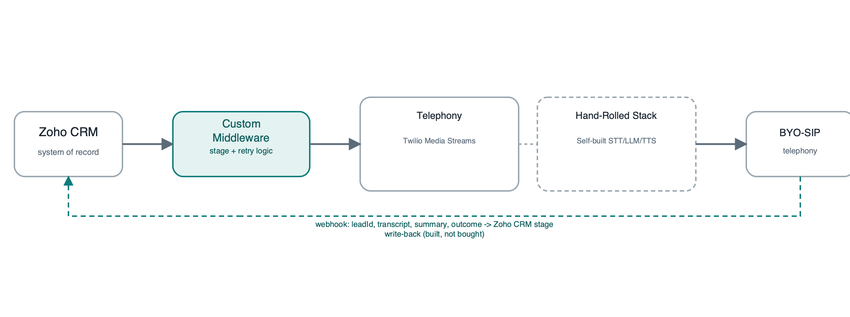
08 — TECHNICAL APPENDIX
Vendor deep-dive — enterprise fallback vs. full ownership
Gnani.ai
Full Custom Build
• Native Bengali, strong BFSI enterprise track record
• Enterprise / sales-led onboarding — less self-serve than Vapi/Retell
• Function-calling available at enterprise tier
• Verdict: good fallback if Vapi/Retell Bangla quality underperforms
• Twilio Media Streams + hand-rolled STT/LLM/TTS — full control, zero lock-in
• Industry estimate: 8–16 weeks, $35,000–$150,000+ before Zoho work
• No vendor dependency, but slowest path to the 200–300-lead pilot
• Verdict: optional Phase 3, once volume justifies it
21

Slide 22
08 — TECHNICAL APPENDIX
Implementation runbook — what actually gets built
The concrete build steps behind the Phase 1 roadmap — one workstream per card.
1
2
3
Zoho CRM fields & stages
Workflow Rule + webhook
Middleware: webhook receiver
Custom fields/picklists for the 11-stage model; campaign, UTM, destination, branch, enquiry-type fields
Instant Webhook or Deluge custom function fires on stage-eligible update — posts Lead ID + context, no Zapier
Receives Zoho's trigger and the voice platform's end-of-call webhook; maps outcome to stage per BR-01–BR-10
4
5
6
Middleware: retry scheduler
Voice platform + BYO-SIP
Speech A/B + test calls
Seven-attempt / five-day retry logic with configurable calling windows (NFR-04)
Assistant/script config in Vapi or Retell; BYO-SIP trunk connected; leadId + context wired to the outbound API
Azure bn-BD vs Sarvam vs Deepgram scored by native-speaker review; end-to-end test calls with real leadId round-trip
22

