Slide 1

Startup Status Prediction – To predict if company is acquired / closed

Slide 2
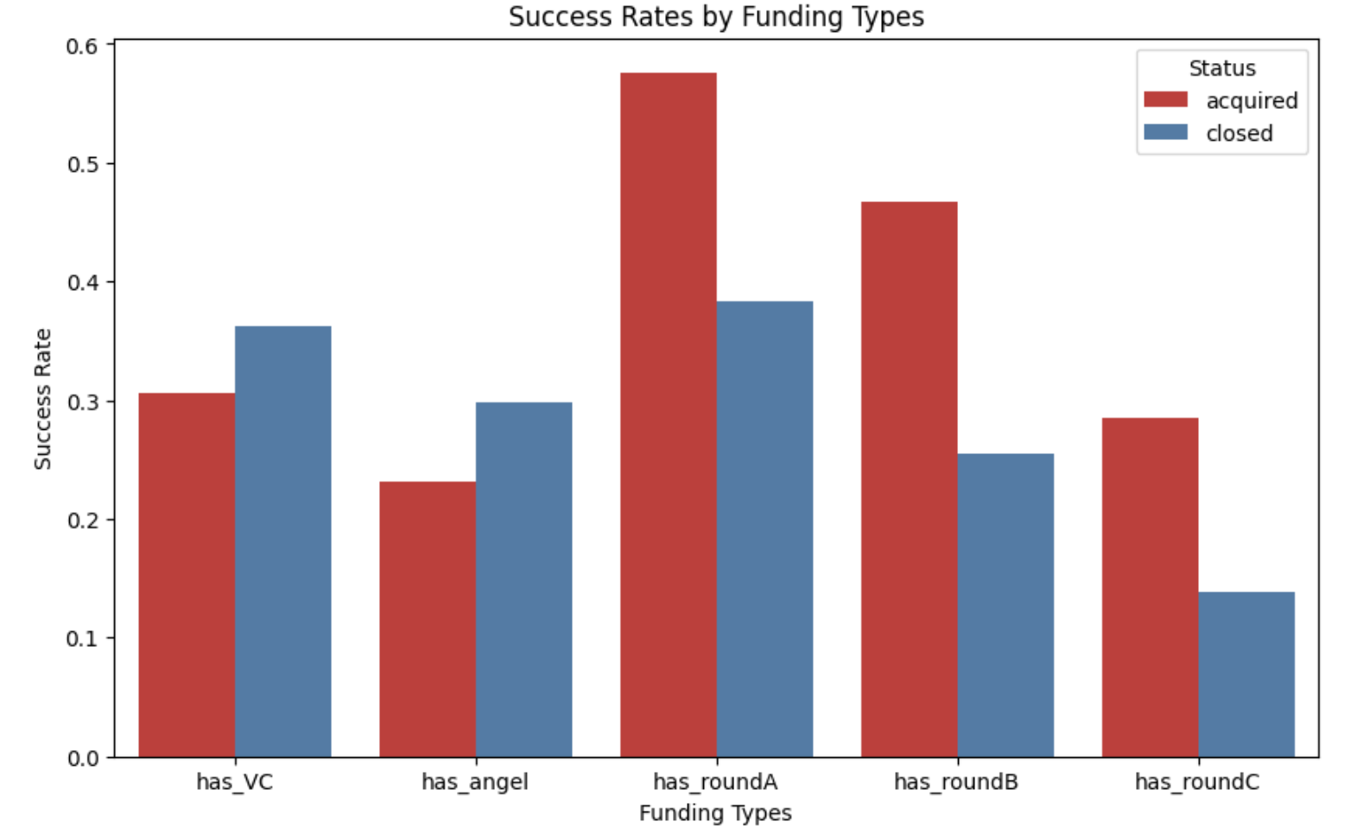
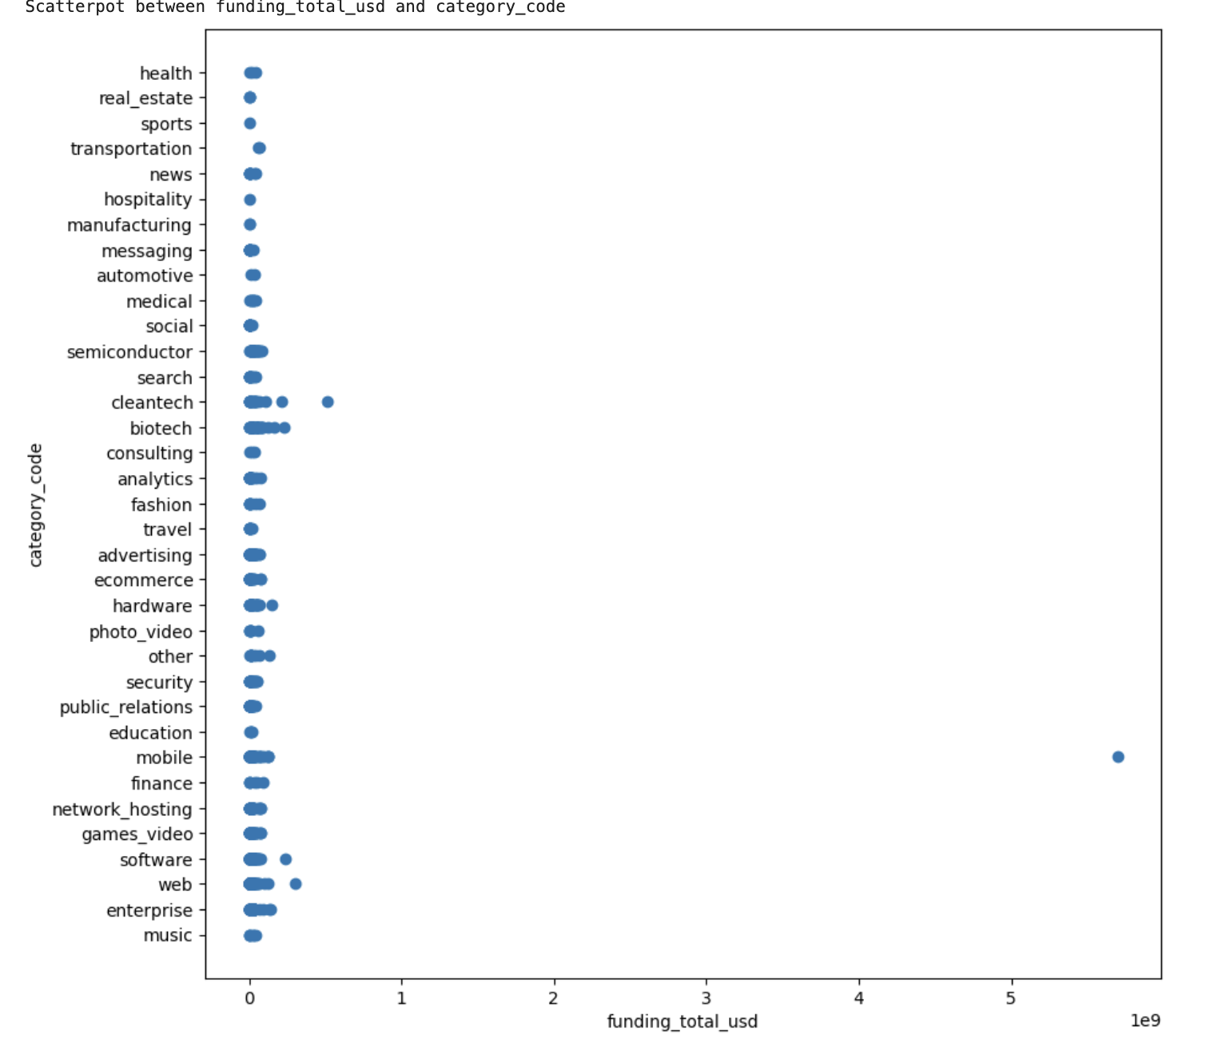
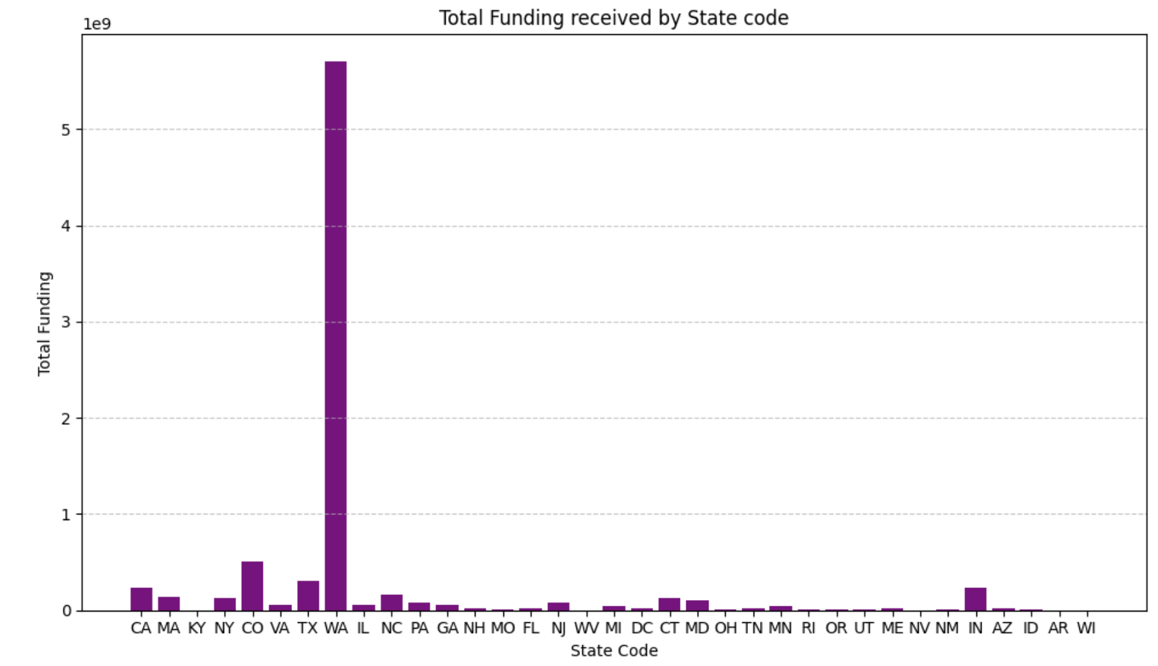
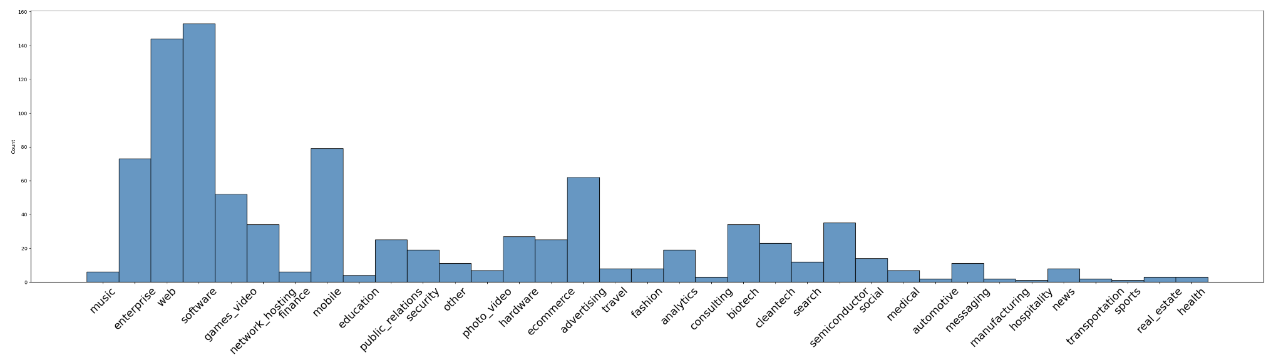
KEY METRICS
922 Company status collected
35 States company info collected
The success rate of a company is higher if it has received a Series A or Series B funding round. The success rate is lower when company received series C funding round.
Interesting thing to note is that Redwood Systems company is repeated twice only having difference in lat n long by around .10. We need to check and get clarification on this data from the team if its duplicate or wrong entry or valid entry.
The mobile category is having the largest funding followed by cleantech. Sports, hospitality, manufacturing are having the smallest funding. This can help startups understand which industries are currently doing well before they build their business.
The companies that receive the most funding are from Washington state indicating this state has the presence of businesses that are valued highly by investors.
Top 10 category are: - Software, Web, Mobile, Enterprise, Advertising, Games video, Network hosting, Biotech, Semiconductor, Hardware

