Slide 1
Real Time AUV Interpolation for deep sea mapping
Dev Saxena

Slide 2
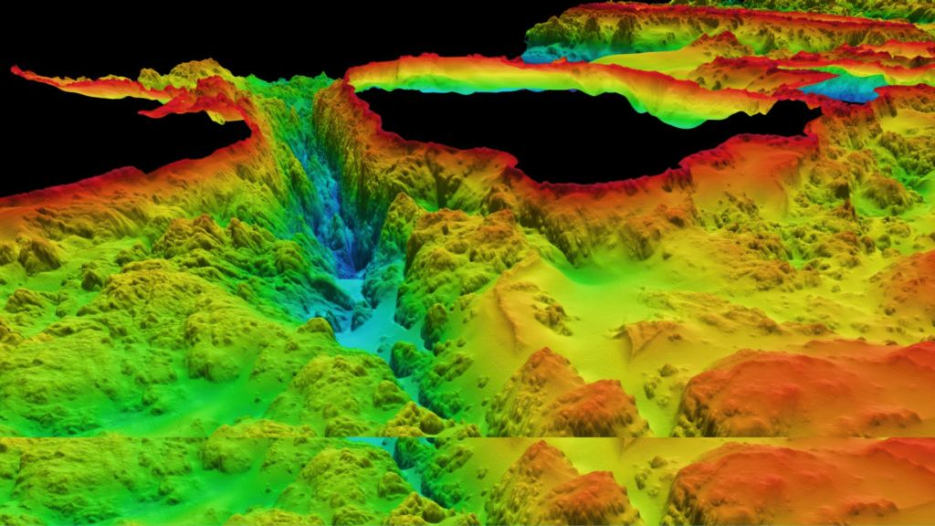
Bathymetry data
Measurement of the depth of the seafloor, similar to elevation on land
Notes:
This is the type of data I’ll be focusing on
Best data to represent mapping of the sea floor
Pretty accurate

Slide 3
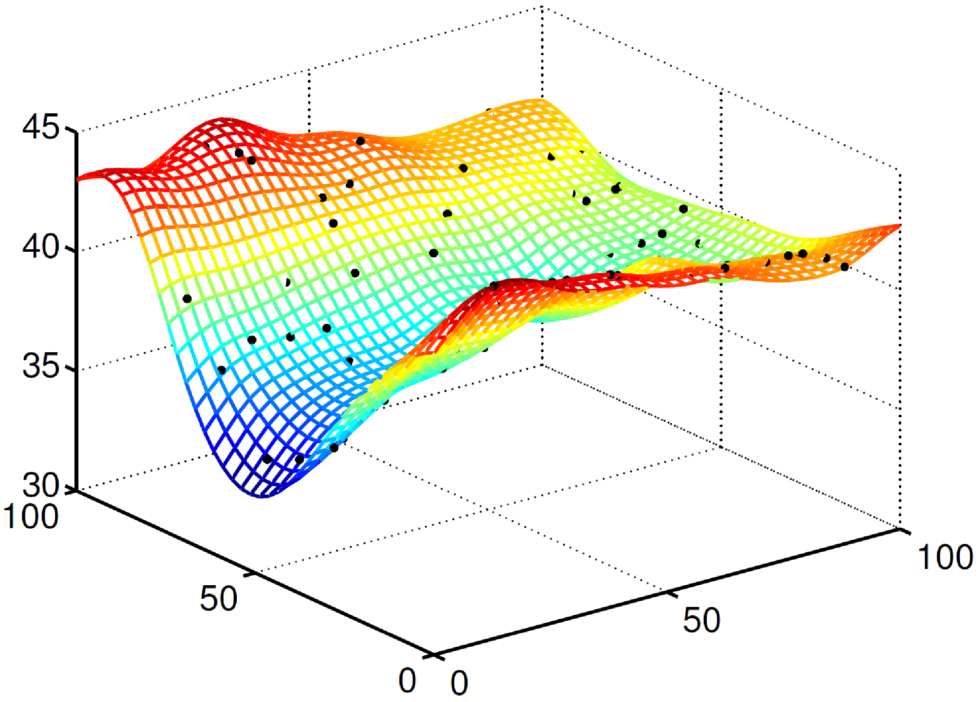
interpolation
Spatial technique that uses a limited number of data points to estimate other values
Notes:
Interpolation constructs new data points based on a known discrete set of points
Many different techniques: Spline, inverse distance weighted, and the one we will use is called kriging
After initial collection of data, we can increase resolution, construct mapping, and fix original points with the help of interpolation

Slide 4
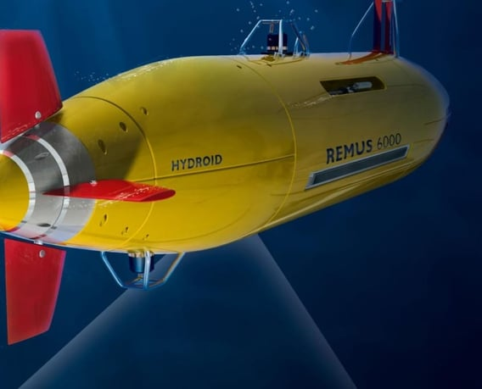

Real time processing
GPU implementation with hardware on the AUV
Saves mission time and money
Notes:
The way to do this is by parallelizing the computation -> GPU’s!!
The hardware is cased and protected on the AUV so that it can run correctly
Has already been done by company called Greensea IQ who ran ML models on their AUVs

Slide 5
Experimental Findings

Slide 6
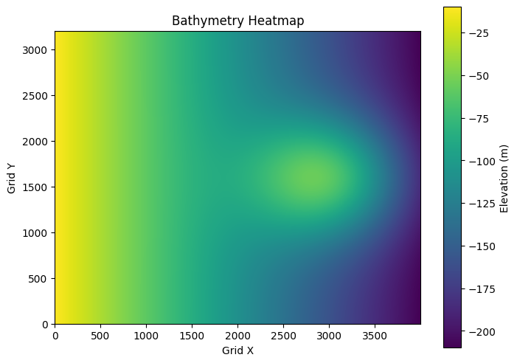
Grid A
Designed with each latitude completely filled with longitudes
Simulates situations to artificially increase data collection frequency
Accounts for hardware or geographical limitations

Slide 7
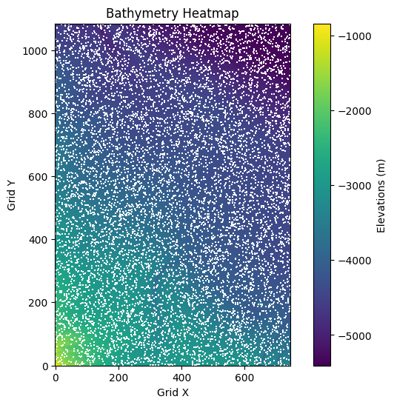
Grid B
Designed to have missing longitude data in each latitude
Simulates situations where noise or hardware limitations miss certain coordinates

Slide 8
Testing Design
Parameters
Parameters
Grid A
Grid B
Number of Points to generate:
{1000, 5000,…}
Removal Fraction:
{0.01, 0.1 ,…}
CPU & GPU Bilinear Interpolation
CPU & GPU Bilinear Interpolation
CPU & GPU Cubic Spline Interpolation
CPU & GPU Cubic Spline Interpolation
CPU & GPU Ordinary Kriging Interpolation
CPU & GPU Ordinary Kriging Interpolation
Runtimes & Results
Runtimes & Results

Slide 9
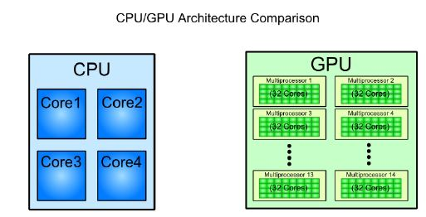
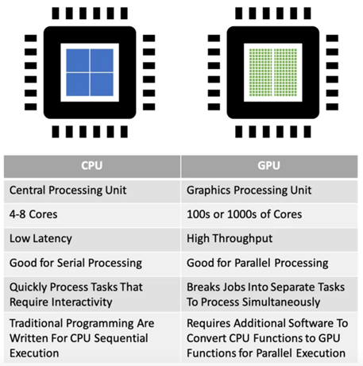
GPU parallel processing
Notes:
CPU is better for more complex tasks, but GPU is better for pre-programmed, more mundane tasks on a large amount of memory
We can load different parts of our grid (matrix) into

Slide 10
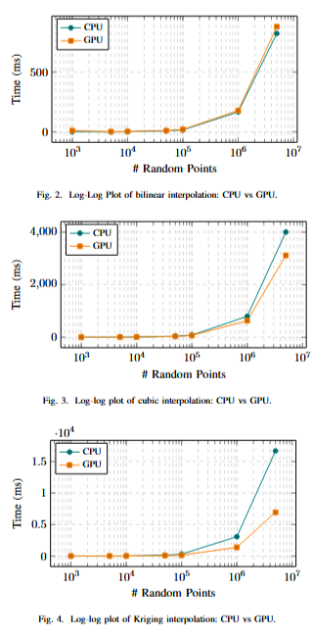
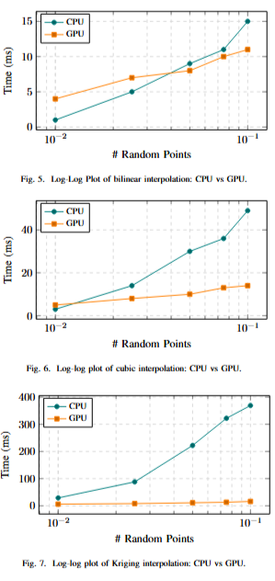
results
Grid A
Grid B

Slide 11
Further work
Test on more powerful GPUs
Larger sets for batch sizes and removal fractions
Implement higher-performing variants of each interpolation method

