Slide 1

{Dev}School DevOps Edition 2022
Maria Jianu, Andrada Raducanu, Wouter Ligtenberg
April 2022

Slide 2
Agenda
Who are we?
Welcome talk from Marian Ion
Describing the program
Discussing the calendar
DevOps lifecycle & CI/CD
Machine set-up
Feedback time!

Slide 3
Who are we?

Slide 4




Maria Jianu

Slide 5
Who are you?

Slide 6
What is DevSchool?
What is our goal?
Why are you here?
Why are we here?

Slide 7
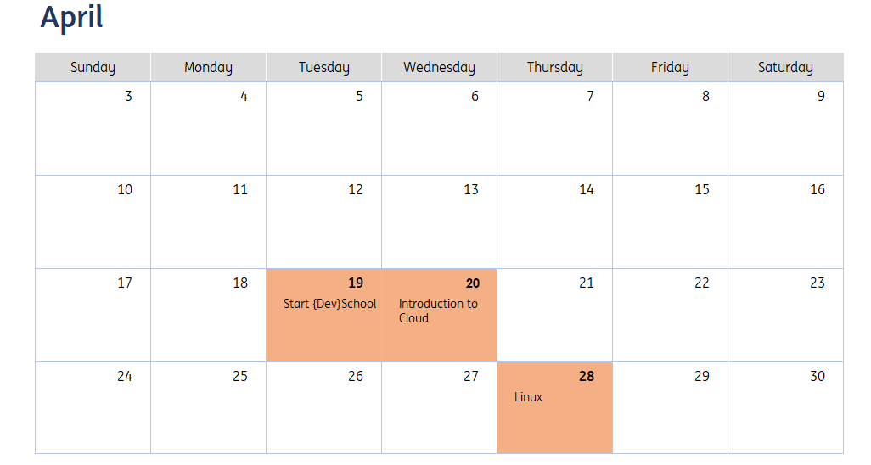
The calendar

Slide 8
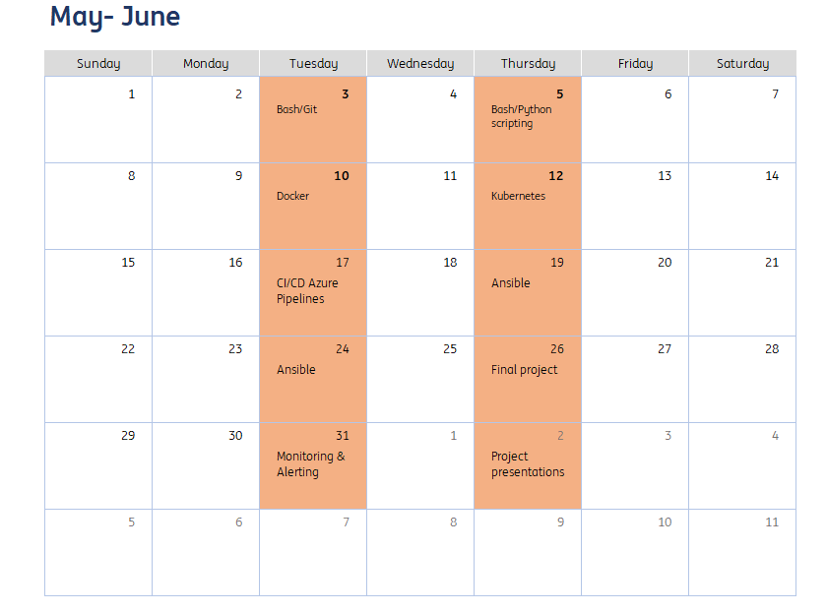
The calendar

Slide 9
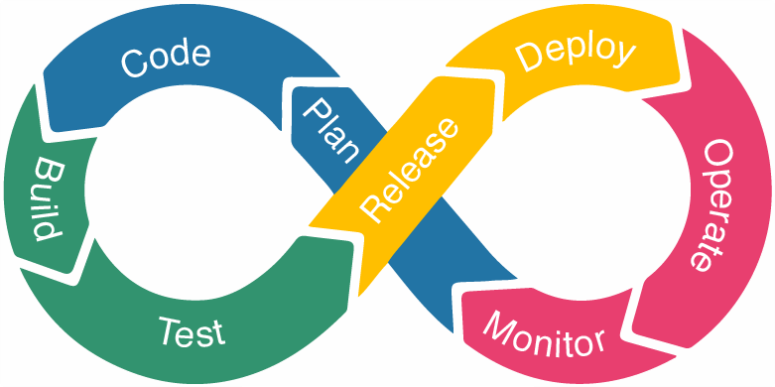
DevOps Lifecycle
Notes:
So we’re going to start by assessing what is devops. The word its composed by two terms: development and operations. In essenece, it’s a practice that allows a single team to manage the whole lifecycle of the application. The DevOps model was born because of what previous models had lacked. Now im not going to spend to much time on explaining the older ones, but I do want to say that before there was the Waterfall method that was linear, as opposed to the devops one which is a cycle as you see. The main disadvantage of a linear model is that everything in a stage needs to be finished before moving to the next stage, and this is a pain when dealing with big applications or projects like we do now. So one of the biggest advantages of devops is shorteining the app development lifecycle by delivering features, fixes and updates quickly and frequently, but more on that later. Now let’s have a look at the devops lifecycle:
CONTINUOUS DEPLOYMENT - switch

Slide 10
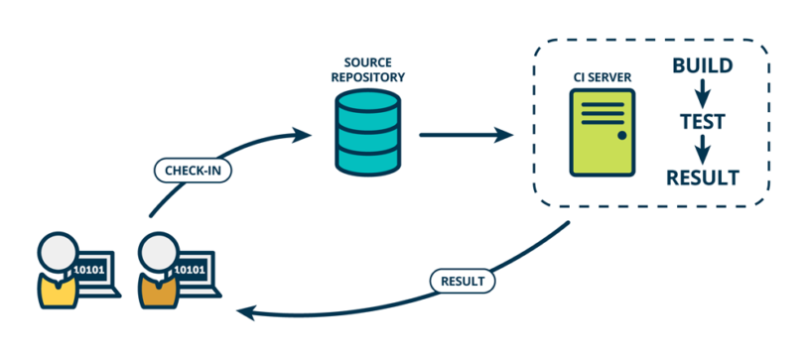
Continuous Development & Continuous Integration
Notes:
The first phase of the lifecycle is the CONTINUOUS DEVELOPMENT and remembering the first diagram this is the blue part: the planning and the coding of the application functionality. For the planning there is no specific tool, but there are quite a few for maintain the code. So after the planning is thoroughly done, the code is maintained using the version control tools. I’m sure most of you have heard about Git, we will also have a lesson on that later in the programme.
The next stage of the devops lifecycle is CONTINOUS INTEGRATION and here the new functionalities are integrated with the existing code. From the first diagram this stage is composed by the BUILD and TEST and steps. It is very important that in this stage the changes are tested thoroughly in order for them not to break the existing functionalities. So what really happens here is that after the code is pushed (in the code step) the build comes in and detects the changes, now the code is build again and packaged in an archive like type of file, that is forwarded to the testing step. And this takes us to the next stage:

Slide 11
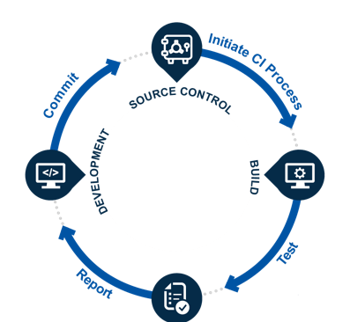
Continuous Testing
Notes:
CONTINOUS TESTING. So like I said before it’s very important that these new changes are tested very well and that they don’t break the existing code, there are a lot of tools for this like Selenium, TestNG or J unit but these are for the QA engineers to figure out. So assuming our code has been well tested and all is well we move on to one of the most important stages:

Slide 12
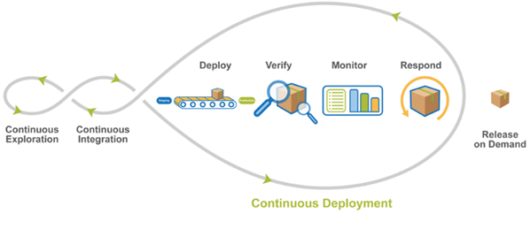
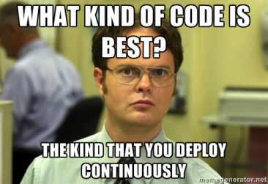
Continuous Deployment
Notes:
CONTINUOUS DEPLOYMENT, where the code is deployed to production environment. Now we need to understand why DevOps is incomplete without configuration management and containerization tools. Configuration management, although is might sound fancy is just the act of releasing deployments to servers, and making sure we have the same configuration across all servers. Why do we need this? Mainly because if we are the developers of a big application like Facebook or Google or whatever we don’t want users from Europe to have a different app than the users from Australia.
So in order to help us reach that, we use some tools that we will learn more deeply throught this DevSchool like Ansible, Docker or Kubernetes.
Now let’s take a look at the last stage from the devops lifecycle:

Slide 13
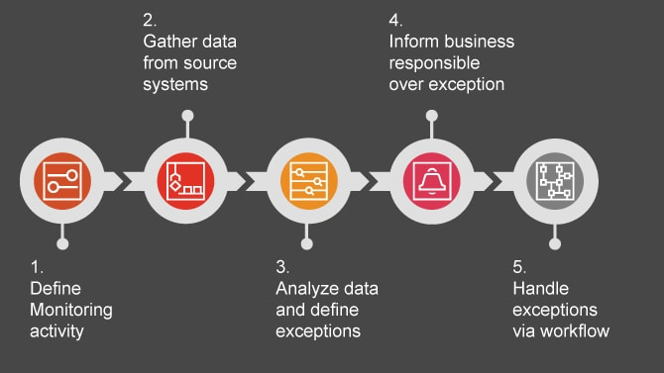
Continuous Monitoring
Notes:
CONTINUOUS MONITORING is a very important part of the cycle and it’s aim is improving the quality of the software by monitoring its performance. Usually the operation team is looking closely at the user activity for any bugs or improper usage of the system. There are also tools for monitoring applications like Prometheus or Grafana, but more on that at the end of the devschool.

Slide 14
Why CI/CD matters
Smaller code changes
Fault isolations
Faster Mean Time To Resolution (MTTR)
Faster Release Rate
More Test Reliability
Notes:
So, why are all these stages important?
1. One technical advantage of continuous integration and continuous delivery is that it allows you to integrate small pieces of code at one time. These code changes are simpler and easier to handle than huge chunks of code and as such, have fewer issues that may need to be repaired at a later date.
Using continuous testing, these small pieces can be tested as soon as they are integrated into the code repository, allowing developers to recognize a problem before too much work is completed afterward.
2. Fault isolation refers to the practice of designing systems such that when an error occurs, the negative outcomes are limited in scope. Limiting the scope of problems reduces the potential for damage and makes systems easier to maintain.
Designing your system with CI/CD ensures that fault isolations are faster to detect and easier to implement. Fault isolations combine monitoring the system, identifying when the fault occurred, and triggering its location. Thus, the consequences of bugs appearing in the application are limited in scope.
3. MTTR measures the maintainability of repairable features and sets the average time to repair a broken feature. Basically, it helps you track the amount of time spent to recover from a failure.
CI/CD reduces the MTTR because the code changes are smaller and fault isolations are easier to detect. One of the most important business risk assurances is to keep failures to a minimum and quickly recover from any failures that do happen.
4. Failures are detected faster and as such, can be repaired faster, leading to increasing release rates. However, frequent releases are possible only if the code is developed in a continuously moving system.
5. Using CI/CD, test reliability improves due to the bite-size and specific changes introduced to the system, allowing for more accurate positive and negative tests to be conducted. Test reliability within CI/CD can also be considered Continuous Reliability.

Slide 15
Let’s set up your machines!

Slide 16
Feedback time ☺

Slide 17








Thank you!
ing.com
@ING_News
LinkedIn.com/company/ING
SlideShare.net/ING
Medium.com/ing-blog
ingwb.com
Facebook.com/ING
YouTube.com/ING
Flickr.com/INGGroup

