Slide 1

{Dev}School DevOps Edition 2022
Andrada Raducanu, Maria Jianu, Wouter Ligtenberg
April 2022

Slide 2
Agenda
What is cloud? Different perspectives
What was there before cloud?
What is the added value of cloud?
Types of cloud
Virtualisation
Cloud in ING
Labs

Slide 3
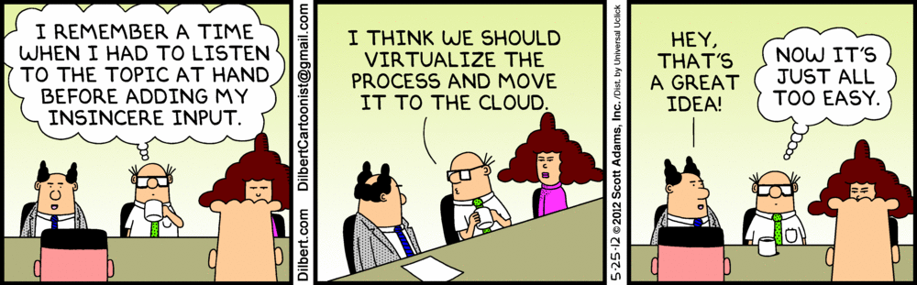
Cloud
The on-demand availability of computer system resources, especially data storage and computing power, without direct active management by the user
Notes:
Question to the group, what is cloud?
How do users interpret cloud, take gmail as an example
How do engineers interpret cloud, take your own application as example
Technical definition
When people talk about cloud they normally think about icloud google cloud one drive etc, and this is also what cloud means for them. A way to reach the services that they need through the internet through different devices. But what is cloud in the backend? How does it actually work and what was there before cloud? Those are some of the topics we will be discussing
Let’s start with some cloud applications, let’s say gmail, you can access your gmail through your internet browser but also through your phone application on different operating systems, you can even use it through your watch. And it’s fast, no matter whether you’re in asia, the US or Europe somehow the application works fast, and this might be a silly explanation since how much data is gmail actually about, but now think about Netflix.
Before we go into the cloud computing, let’s think about what was there before cloud

Slide 4

Pre cloud
Service oriented architecture (SOA)
Notes:
Create a web application w audience, location, target audience, product, shape, funny name, hobby? Sport
SOA, what is it?
We actually used bits and pieces of what we call cloud today
Saying that cloud is running on different servers is kind of saying that before cloud we did everything on single machines or servers, but that’s not true.
There were plenty of companies who already had a range of servers and used similar cloud compyuting techniques we use today. So saying cloud computing or doing things on the cloud is not new, but it becoming a normal thing is.
Let’s say a decade ago it was very normal to use SOA, service oriented architectures. You might’ve had this in your studies as well, you start with the “what should my application do” and then you start designing your application around it. You might start with the interface, probably monolithical to keep things easy and if you want to store some data you add a database. Now your application is finished and can be used by your users.
Now we move to the next chapter, your server is not strong enough because your idea was kind of succesfull, on one hand this is good because you’re probably making money of it now, on the other side you need better hardware to serve all the requests, well easy peasy you buy a bigger server, now you see your latency is too low and your users are complaining, so you buy a rack in a data center, pay some more money for maintenance and your users are happy again. But now you get to a ceiling, the amount of users is growing exponentially, and you cannot grow your server the same way, you might even already have the strongest server there is, this is where you have to start using distributed servers, and this might be the point at which you can consider yourself doing cloud computing.
While this might all sound tedious, this is actually how big brands like google facebook etc started. Google started on a home computer and was run on a single server for quite some time, similar as facebook which was even completely written in php which can be debated whether it’s efficient
Before cloud there was soa, short for service oriented architecture.

Slide 5
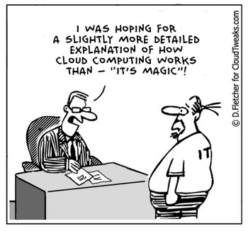

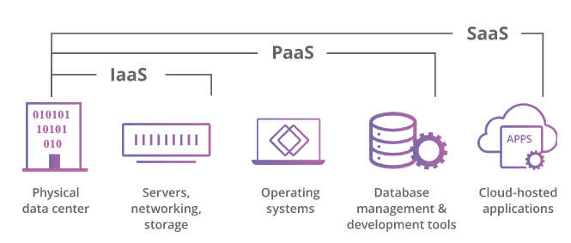
What is cloud?
Resilience
Always available
Fast everywhere
Notes:
What makes something cloud, audience question, what are our requirements?
Let’s go through our application we thought of
Go through challenges, it grows
Cloud computing can be as simple as having another server process your request. This makes sense if your machine does not have the same computing power, let’s say you have a really difficult algorithm that would takes ages on your own machine, so you send it to a server which computes it and sends back the result. This is already cloud computing, now it get’s more complicated… and fun if we add some requirements in the bucket
Remember that server we talked about? Well we don’t want it to stop when a disk breaks down, and they do break down. And when someone trips over the electrical wire, shutting down the server, we still want it to work. And we want it to be fast, everywhere in the world
So first things first, we don’t want our website to go down when a disk breaks, so we add more servers and more disks with a load balancer that detects when the website on one of these servers is not working anymore.
We also want to make sure that when something goes wrong with the data center our application stays running, so we duplicate the same setup to another data center. Now we’ve fixed one issue but created another one. We also had a database, and while it’s easy to distribute stateless applications, it’s difficult to distribute stateful applications. But we can even fix that, we use Cassandra and hire some expensive consultants to maintain our solution.
Our last challenge is to make it fast everywhere in the world, for this we need to do the same but in different regions in the world.
I think you see where I’m going with this, it’s pretty expensive to keep everything running for this website that you created, you need all kinds of operation engineers to keep your services up, you need infra engineers to replace services and you have a pretty complicated architecture with this distributed setup which can be difficult to debug when it goes wrong, let’s say when one of your routes or networks is not configured correctly or someone updates a switch routing the traffic in the wrong server, so yeah you need someone to monitor that as well.
So we go to the first topic of serice models, IAAS, you don’t really want to take care of all that maintenance,
Who has ever been in a data center?
There are quite a few people there working for different companies maintaining those racks for those companies
https://www.youtube.com/watch?v=rdYtuMnlu1I&ab_channel=Gediminas
So we take it as a service, no more replacing those faulty disks, and no more checking if the hardware is running
What about that platform you were running, we still had people running clusters, and remember that Cassandra database that was kind of complex? Well, let’s use that as a service, platform as a service
But we can do more, why do we even write our own application, we only had a simple website, we can move that to software as a service, and no need to worry about that anymore.
Cloud providers are doing this for everyone, therefor they can do it cheaper than you if you only do it for your own company. And since they can pour a lot of money into innovation you’re always up to date, for example with making sure your data is replicated everywhere in for example CDN’s,
Last one, FaaS only pay for when you use it, aka serverless computing

Slide 6
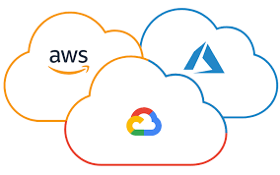
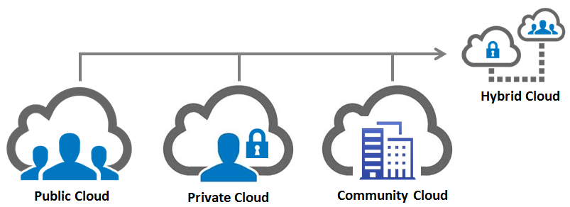
Types of cloud deployment models
Private cloud
Public cloud
Hybrid cloud
Community cloud
5. Multi cloud
Notes:
Source: https://www.cloudflare.com/learning/cloud/what-is-the-cloud/
Due to various necessities, currently there are multiple types of cloud services you can use. Most commonly known ones are public, private and hybrid cloud. Then, business can also benefit from the community cloud or multi cloud.
Public Cloud: this the cloud as we all know it and is available to the general public. This usually is a pay-as-you-go service, where you are using the resources and computing power of a vendor. The big giants on this market: Microsoft Azure, Amazon Web Services, Google Cloud Platform and my others.
Private Cloud: this type of deployment model is most common encountered in enterprise settings. It’s basically a personal cloud for that certain organization, everything is in-house, managed and created by that said organization.
Hybrid Cloud: the name says it all: this is a combination of public and private cloud. An organization can make use of the public cloud services from Microsoft for instance, but at the same time, they can also have an in-house cloud solution where they keep the sensitive information.
Community Cloud: this one can also be called a hybrid form of private cloud: multiple organization only accessing a shared cloud platform. The community cloud can be owned and manage by either a vendor, the members of the said organizations, or both.
Multi Cloud: one organization using Cloud services from multiple vendors.

Slide 7
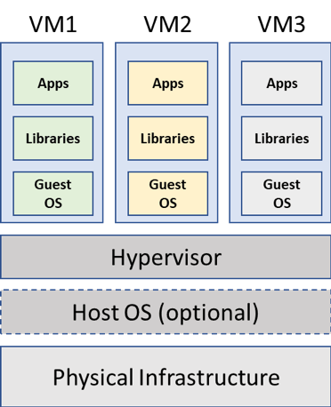
Virtualization
Notes:
Andrada:
The technology that stands at the root of the Cloud we all know today is virtualization: running multiple VMs (virtual machines) on the same hardware.
How virtualization works?
Over the physical infrastructure or a base OS (or host OS), you install a piece of software called a hypervisor. The role of the hypervisor is to create abstract layers so that you can benefit from sharing your hardware resources (CPU, memory, storage etc.) between virtual instances. In shorter terms: the hypervisor lies to the VM OS that it is installed on a separate piece of hardware and that it is all alone in this environment. Of course, you can set up VMs to communicate between each other by abstracting the network layer as well.
There are 2 types of hypervisors:
Type 1, or “bare-metal”: this one is installed directly on the hardware. Some examples: from Vmware: the Vmware ESXi, from Microsoft: Hyper-V
Type 2: this one is installed over the host OS (like in the image). Some examples: from Oracle: VirtualBox, from Vmware: Vmware Workstation
You can virtualize almost everything, using a hypervisor fit for that technology. In the above explanations and examples, the virtualization type I spoke about is OS virtualization. Other examples for different technologies are: data, servers and network.
How is virtualization related with the Cloud today?
Cloud is responsible of automating the virtual resources of a system for on-demand usage. Imagine this: you’re using a cloud provider (can be anything: Azure, AWS or Google Cloud) and you create a Linux VM. That VM behind closed doors, is actually created using an orchestrator that interacts with the hypervisor installed on a piece of hardware somewhere in a datacenter on the other side of the world.
With virtualization you don’t really care where or on what it’s running, you care about the end result.
Notes from Wouter:
All of these things wouldn’t be possible without virtualization, running the same program on different machines and getting the same outcome, also splitting up a server in running multiple virtual machines such that you can share the hardware underneath.
With virtualization you now could get a whole OS for yourself without paying for all the hardware underneath, some of you might know the term VPS, a virtual private server, this is a server that you can manage yourself, nobody can touch it and since it’s shared it’s cheaper. There are many ways of sharing servers and I’m not going into the details of all of them, but what’s important to know that they all share different things, some share processing power, some share memory, and this has effect on your application. If you share processing and another vps is doing some heavy processing every day at 5pm, the you might notice that your service/website is slow every day at 5pm.
The nice thing being of course that you can get some computing power for a super cheap price. And you don’t have to maintain all those hardware, IaaS remember?
With virtualization you don’t really care where or on what it’s running, you care about the end result. The other nice thing about virtualization is also that you can run it locally

Slide 8
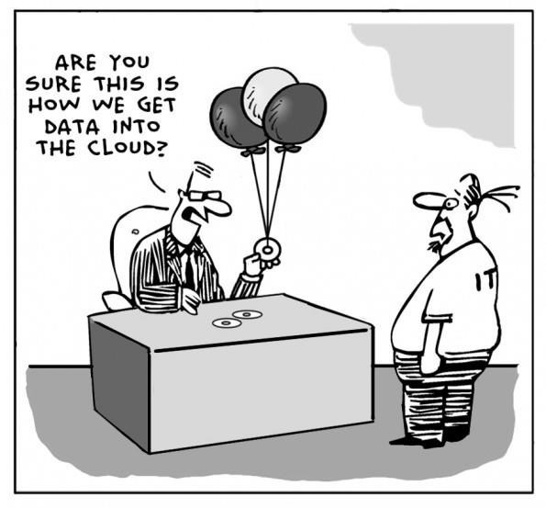
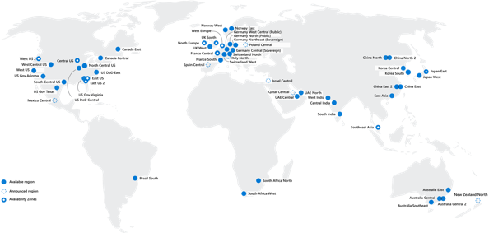
What does it look like in ING
Running a company with multi cloud across the world
Conway's law

Slide 9
Azure Regions
An Azure region consists of one or more datacenters deployed within a latency-defined perimeter and connected through a dedicated low-latency network. A region can have multiple availability zones.
Note: Not all services are available in all regions.
Examples
North Europe (Ireland)
West Europe (Netherlands)
Germany North
Germany West Central
East Asia (Hong Kong)
Southeast Asia (Singapore)
Australia Central
Australia Central 2

Slide 10
Azure Geography per continent

Slide 11
Labs
Request student license
Install visual studio code & python
Create azure function
set up Azure Student subscription with student email address;
set up Azure DevOps organization using https://azuredevopsdemogenerator.azurewebsites.net;
play around in Azure DevOps (10-15 mins) and answer questions;
set up an Azure Function;
if we don’t have any agent available in the demo ADO organization, set up with the students an agent by creating a VM in Azure Portal and setting it up;

Slide 12
Feedback time ☺
Notes:
SCC = intergam cate o bucata mica de cod pe rand, nu big chunks
FI = atunci cand avem un system CI/CD gasim bug-uri mai repede, rezolvam bug-ul mai repde
MTTR = timpul de la momentul cand detectam problema pana cand o rezolvam => CI/CD reduce aceasta bucata de timp
FRR = avand in vedere ca problemele sunt detectata si fix-uite mai repede, putems a facem si release-uri mai frecvente
.MTR = Testele din CI?CD se mai numestc si continuos reliability. Datorat de cerintele mai clare => testele devin mai clare si dau rezultate pozitiv/negative mult mai accurate

Slide 13








Thank you!
ing.com
@ING_News
LinkedIn.com/company/ING
SlideShare.net/ING
Medium.com/ing-blog
ingwb.com
Facebook.com/ING
YouTube.com/ING
Flickr.com/INGGroup

