Slide 1



Consumer Goods
Ad Hoc analysis
- Presented by Devarshi

Slide 2

Introduction
Atliq Hardwares (imaginary company) is one of the leading computer hardware producers in India and well expanded in other countries too.
However, the management noticed that they do not get enough insights to make quick and smart data-informed decisions. They want to expand their data analytics team by adding several junior data analysts. Tony Sharma, their data analytics director wanted to hire someone who is good at both tech and soft skills. Hence, he decided to conduct a SQL challenge which will help him understand both the skills.

Slide 3

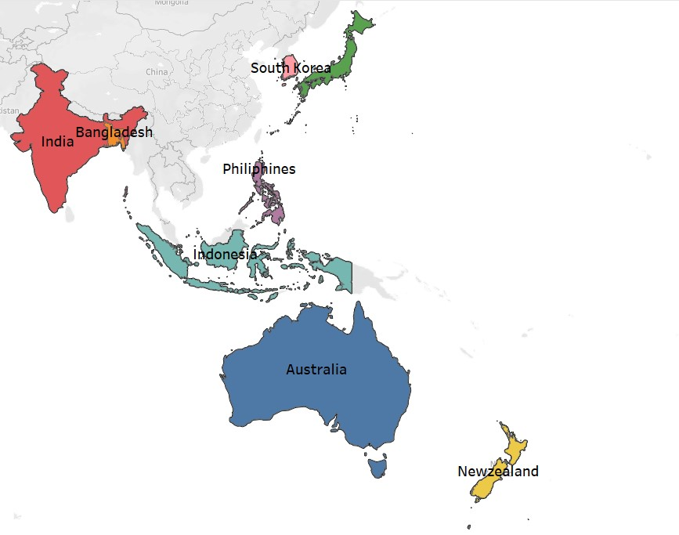
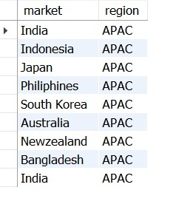
Request 1:
- Provide the list of markets in which customer "Atliq Exclusive" operates its business in the APAC region.
Data Visualization
SQL Output:

Slide 4

SQL Query

Slide 5
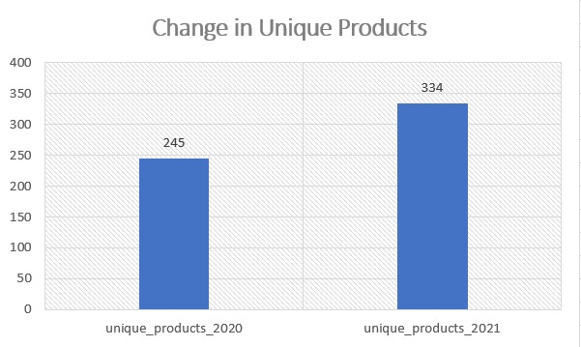

Request 2:
- What is the percentage of unique product increase in 2021 vs. 2020? The final output contains these fields: unique_products_2020, unique_products_2021 and percentage_chg
Data Visualization
SQL Output:
Insights:
A total rise of 36.27% occurred as the number of unique goods climbed from 245 to 334.

Slide 6
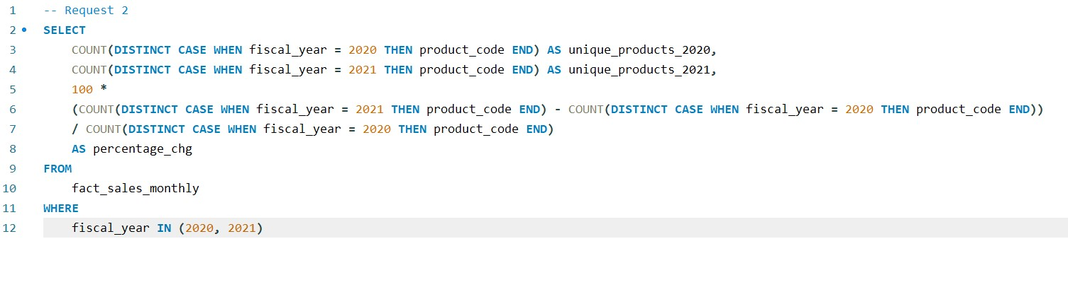
SQL Query

Slide 7
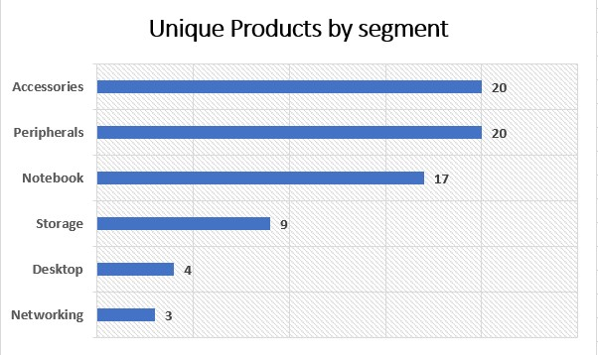
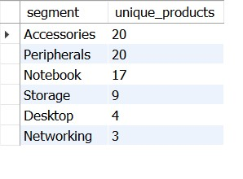
Request 3:
- Provide a report with all the unique product counts for each segment and sort them in descending order of product counts. The final output contains 2 fields: segment, product_count
Data Visualization
SQL Output:
Insights:
Products from Atliq Hardware are divided into 6 main categories.
The most diverse products are found in the accessories and peripherals segment.

Slide 8
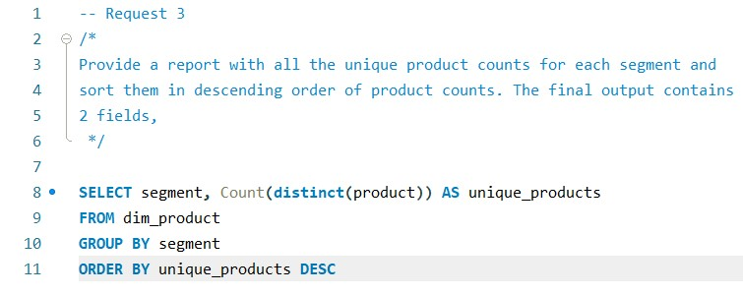
SQL Query

Slide 9
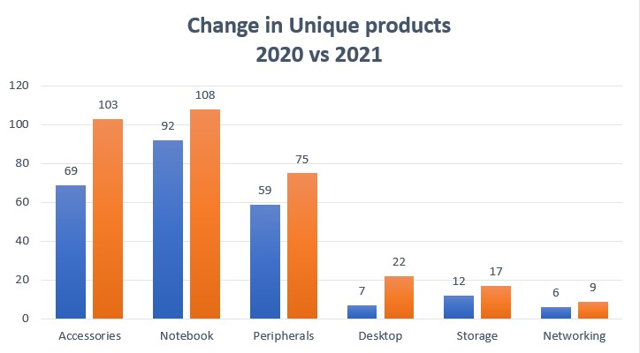
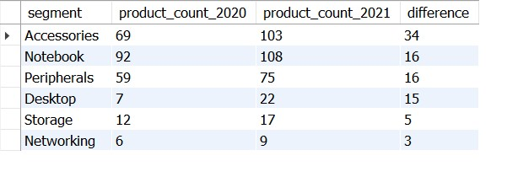
Request 4:
- Follow-up: Which segment had the most increase in unique products in
2021 vs 2020? The final output contains these fields,
segment
product_count_2020
product_count_2021
difference
Data Visualization
SQL Output:
Insights:
- The accessories segment experienced the greatest growth in original products, with the addition of 34 new items in the segment in just 1 year.

Slide 10
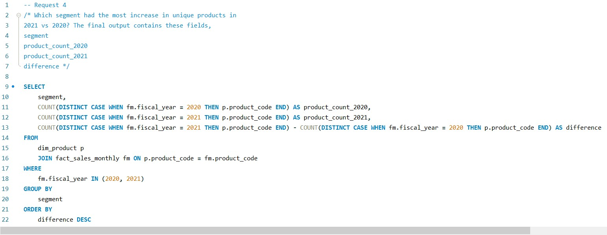
SQL Query

Slide 11
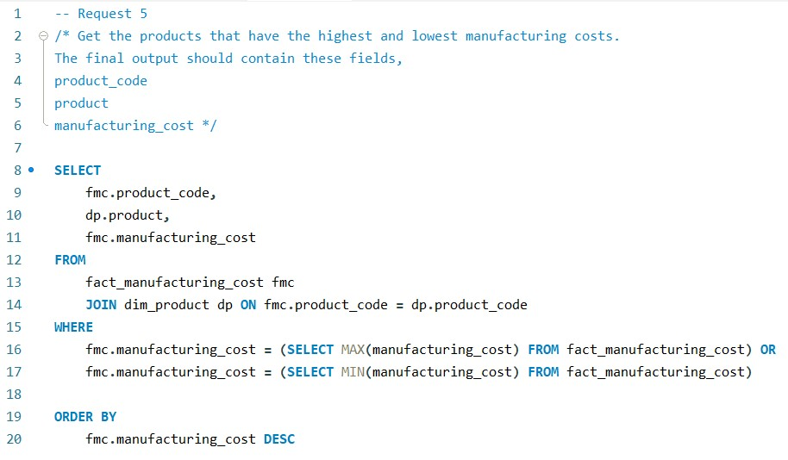

Request 5:
- Get the products that have the highest and lowest manufacturing costs. The final output should contain these fields: product_code and product manufacturing_cost
SQL Query
SQL Output:
Insights:
The cost of manufacturing for AQ Home Allin1 Gen 2 is greatest at $240.53.
The cost of manufacturing for AQ Master Wired x1 Ms is lowest at $0.892.

Slide 12
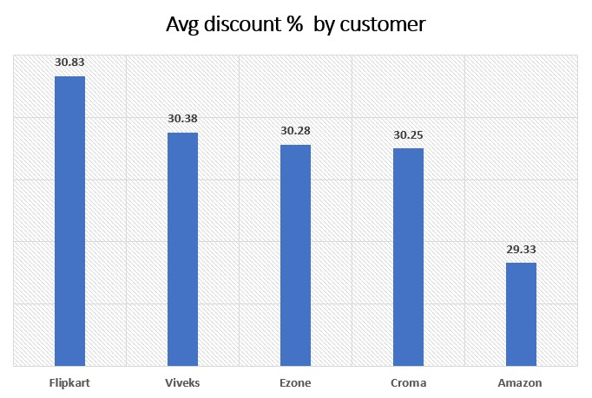
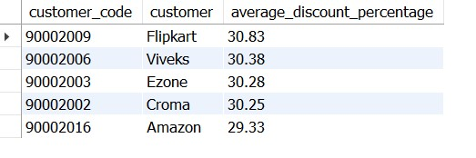
Request 6:
- Generate a report which contains the top 5 customers who received an average high pre_invoice_discount_pct for the fiscal year 2021 and in the Indian market. The final output contains these fields: customer_code, customer, and average_discount_percentage
Data Visualization
SQL Output:
Insights:
- Flipkart, Viveks, Ezone, Croma, and Amazon are the top 5 customers who received the highest average pre-invoice discounts, with Flipkart leading the pack at 30.83%.

Slide 13
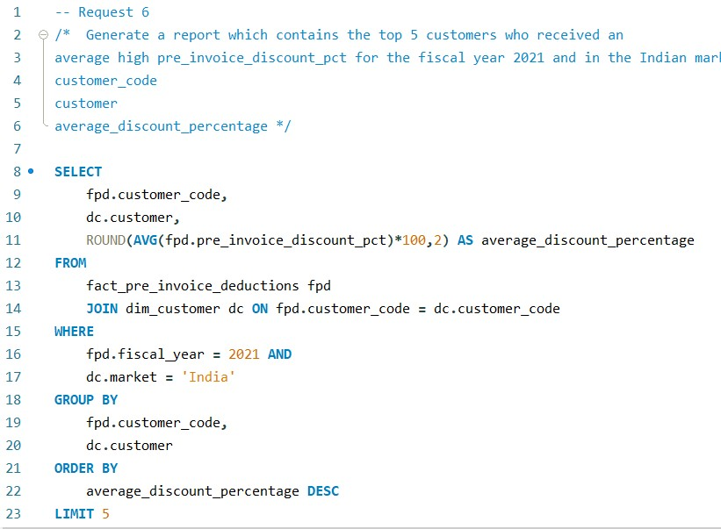
SQL Query

Slide 14
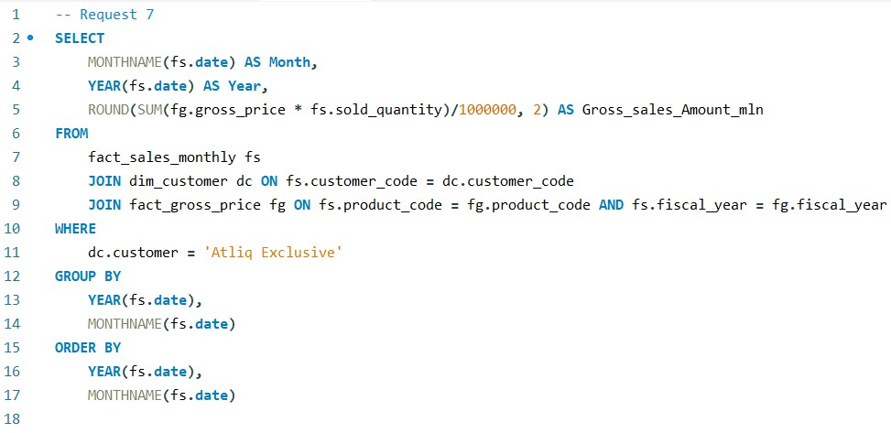
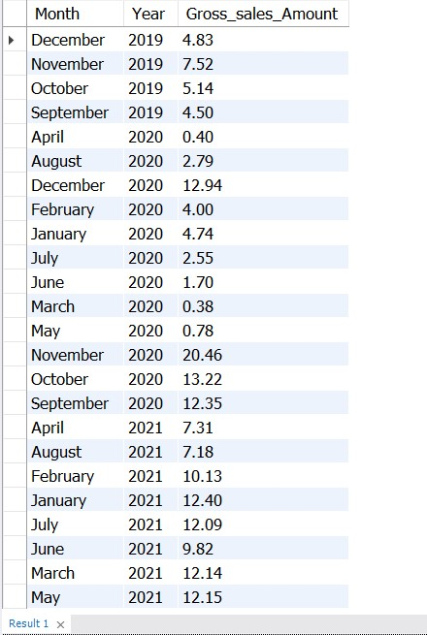
Request 7:
- Get the complete report of the Gross sales amount for the customer “Atliq Exclusive” for each month. This analysis helps to get an idea of low and high-performing months and take strategic decisions. The final report contains these columns: Month, Year and Gross sales Amount
SQL Query
SQL Output::

Slide 15
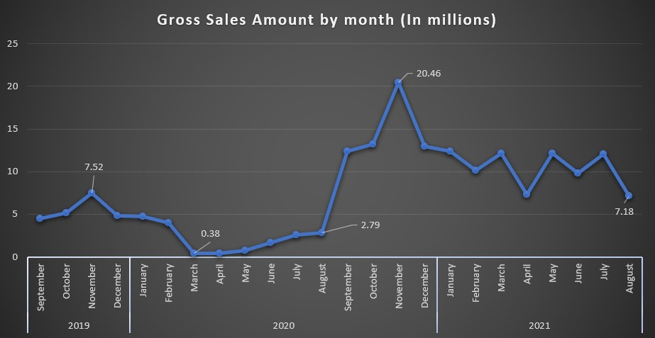
Data Visualization
Insights:
In March 2020, gross sales hit a low point of $380,000.
By August 2020, we managed to see a slight recovery with gross sales reaching $2.78 million.
Sales witnessed a very sharp increase from September to November 2020, peaking at $20.46 million in that month.
Sales began to decline the next month, and by August 2021, they had fallen to $7.18 million, just shy of the record of 2019.

Slide 16
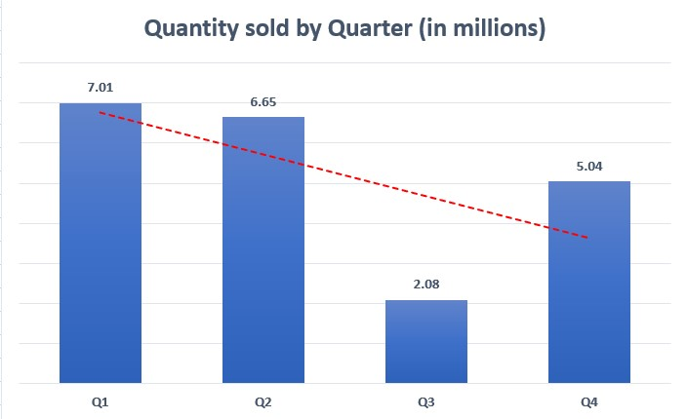
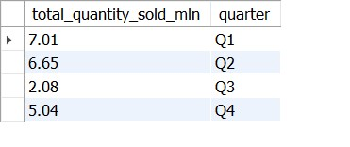
Request 8:
- In which quarter of 2020, got the maximum total_sold_quantity? The final output contains these fields sorted by the total_sold_quantity, Quarter and total_sold_quantity
Data Visualization
SQL Output:
Insights:
The highest amount of sales were recorded in Q1 2020.
The least amount of units were sold in Q3 2020.

Slide 17
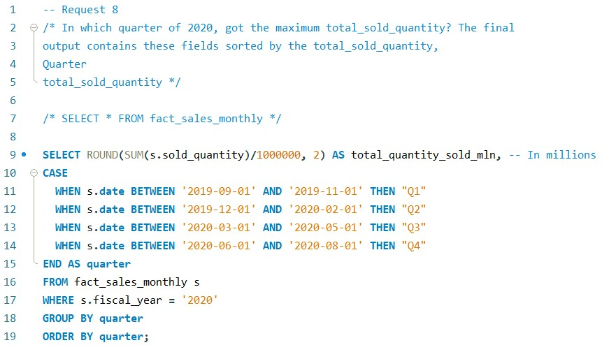
SQL Query

Slide 18
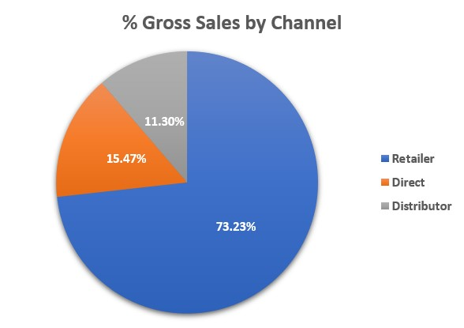
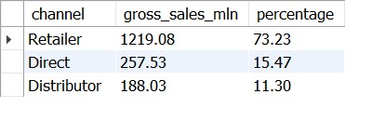
Request 9:
- Which channel helped to bring more gross sales in the fiscal year 2021 and the percentage of contribution? The final output contains these fields, channel gross_sales_mln percentage
Data Visualization
SQL Output:
Insights:
The retail channel accounts for the majority of the sales, accounting for 73.23% of the total sales with gross sales of $1.21 billion.

Slide 19
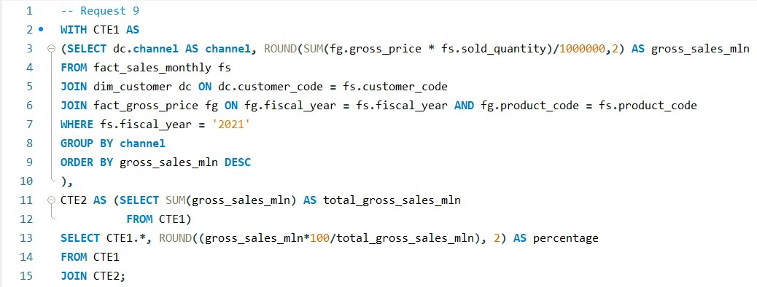
SQL Query

Slide 20
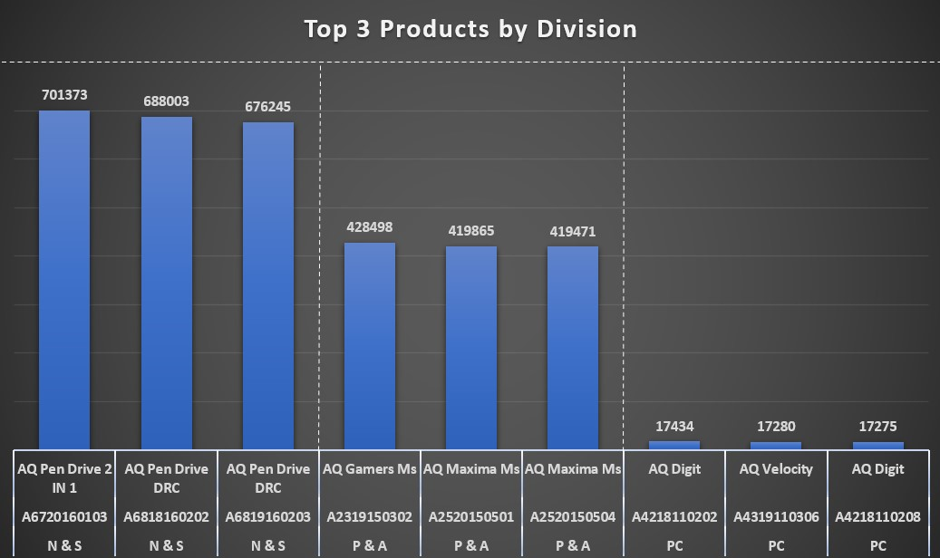
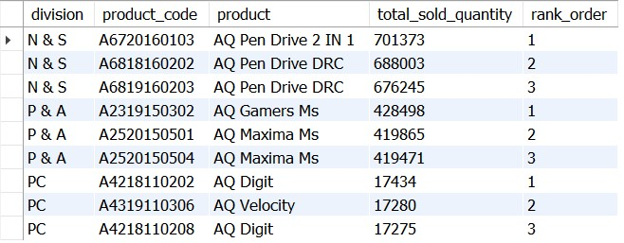
Request 10:
- Get the Top 3 products in each division that have a hightotal_sold_quantity in the fiscal_year 2021? The final output contains these fields: Division, product_code, product, total_sold_quantity and rank_order
Data Visualization
SQL Output:
Insights:
The best-selling item in the N&S division is the AQ Pendrive 2 IN 1.
The product that sells the most in the P&A division is AQ Gamers Ms.
The best-selling product in the PC sector is AQ Digit.

Slide 21
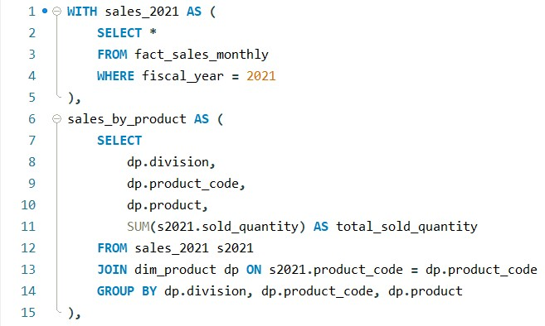
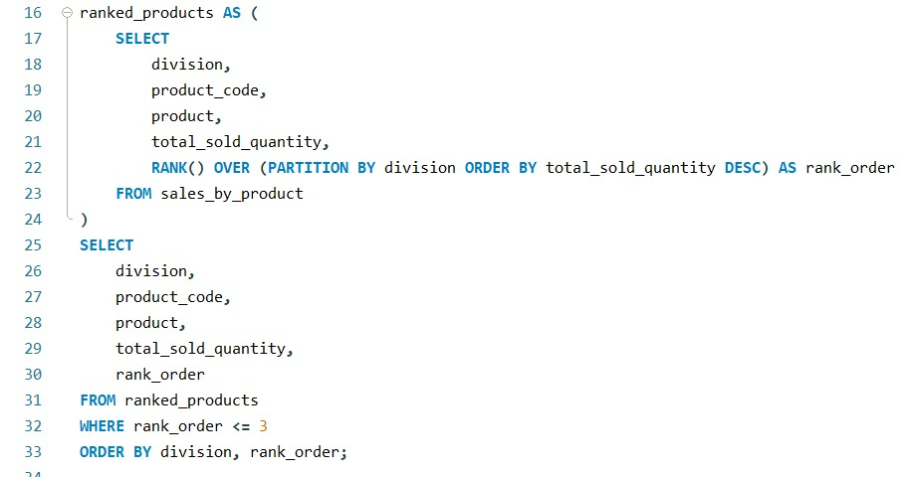
SQL Query

Slide 22
Thank You!

