Slide 1


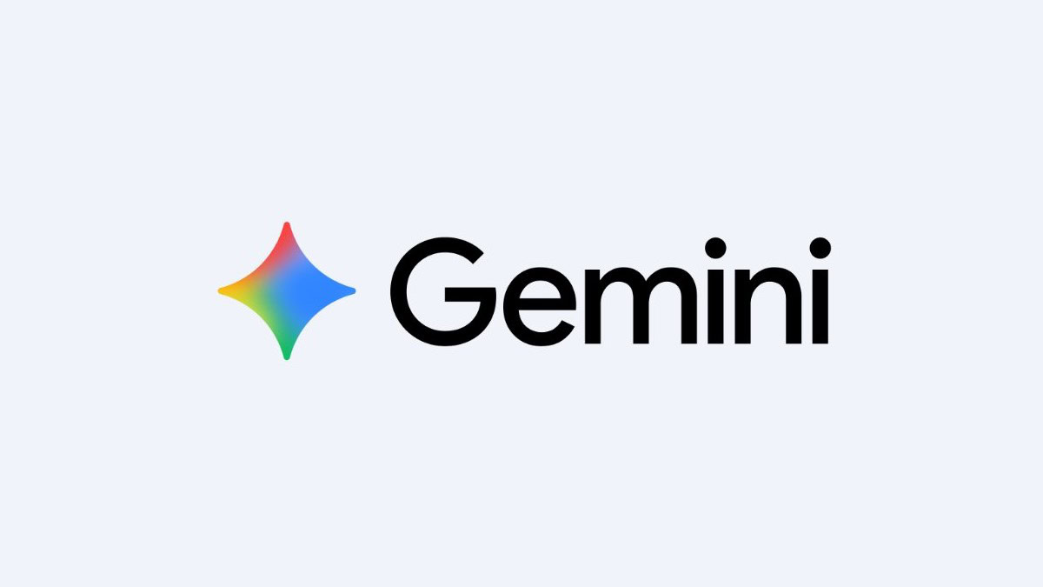
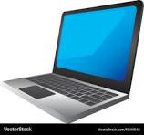
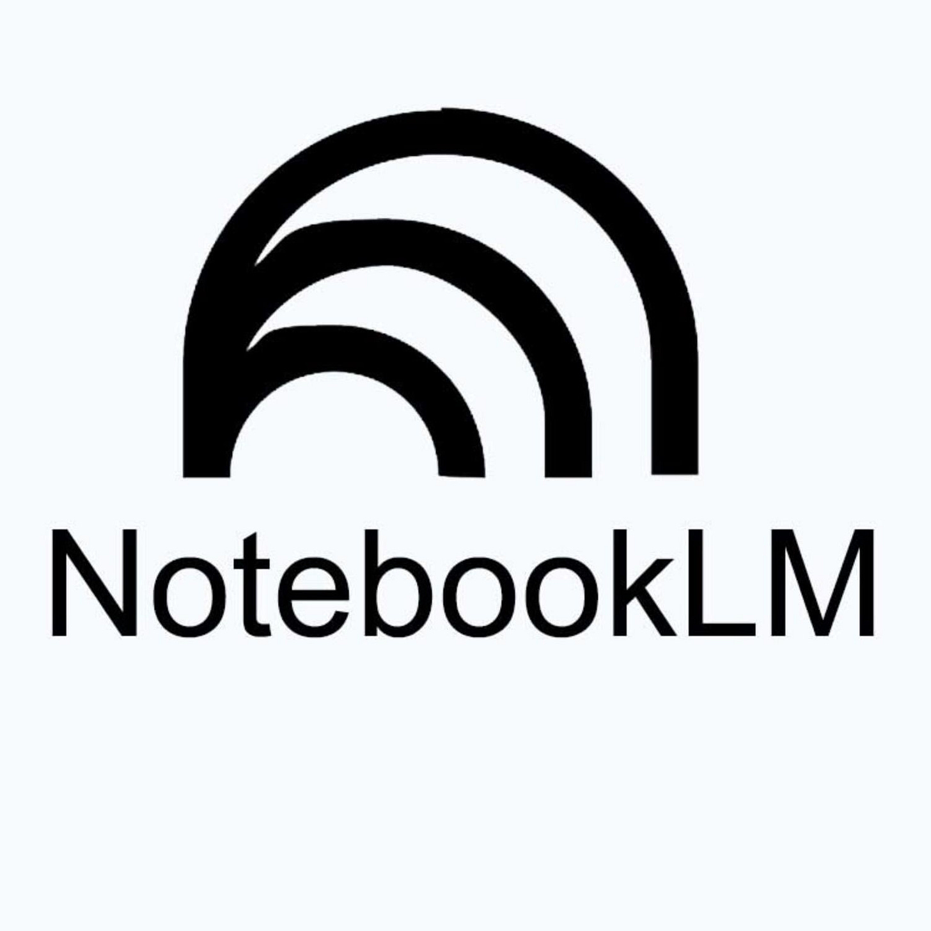



Gathering the Data
Your laptop, with your
G drive mounted on
your local filesystem
Creation of an “expert gem” in gemini, that is informed by our latest sources.
NotebookLM is the source for gemini
Gdrive is notebook source
Add links to zoom artifacts to notebookLM source.
Google
drive
Bit bucket, git lab, git hub, etc.
Notes:
Use this paradigm to start:
Example: create a customer focused AI workflow:
Create a folder in google drive. Place your relevant items here including PDF, docs, images, slides, code and scripts, etc.
Use the “google drive for desktop” to connect your laptop to your google drive folders: https://support.google.com/drive/answer/10838124?hl=en
Create a new notebook in notebook LM. Add the files from the google drive folder as sources.
From Gemini, add your NotebookLM chat as a sources for Gemini.
Tell Gemini to create an “expert gem” that can help you narrow focus, make better inference, and help you with research.
Execute Use Cases

Slide 2
How to Configure

Slide 3
Notebook LM Introduction
The Notebook is a collection of links, documents, images, and other internal only artifacts that make up the “brain” of our setup.
Switch from “fast” to “deep” thinking model.
Connect your sources from google drive
Notes:
Notebook sources will be used to inform gemini.
Notebook can be used to generate slide decks and custom reports.
We should be doing this: https://agentnativedev.medium.com/automate-google-notebooklm-from-your-ai-agent-with-notebooklm-mcp-3c513a37396a
This folder in drive has our data: https://drive.google.com/drive/u/0/folders/1bQH7H4Z8oF8ZmbWNNS2Noy7rFY2xslF8
Link to the Professional Service Documentation Library as a notebookLM back end.

Slide 4
2. Google Drive Setup
“Mount” your google drive as a “local folder” on your laptop
The steps are here. https://support.google.com/drive/answer/10838124?hl=en
Once this is complete. Let NotebookLM know to add this as a project source.
  As you work in a git repo on your laptop, the changes happen in the mounted drive, and the LLM has full visibility to this as a source..

Slide 5
3. Notebook LM Setup
Switch from “fast” to “deep” thinking model.
Connect your sources from google drive
  This folder in drive has our data: https://drive.google.com/drive/u/0/folders/1bQH7H4Z8oF8ZmbWNNS2Noy7rFY2xslF8
If you have “many documents” don’t add them individually. Use a single “notes” document that includes the links to all the files. The reason for this is, the “number of sources” has a limit.
Notes:
Notebook sources will be used to inform gemini.
Notebook can be used to generate slide decks and custom reports.

Slide 6
4. Gemini Introduction
Connect the Notebook LM as a source

Slide 7
4. Gemini Setup
Connect the Notebook LM as a source

Slide 8
5. Create a new gem file
Notes:
https://support.google.com/gemini/answer/15235603?hl=en

Slide 9
Use Cases
Notes:
I can think of more but this is just to give you an idea.

Slide 10
Use Case 1: Updating the gmail sources for your LLM
Tag all your customer/project mails with the proper label.
Tell Gemini to search your gmail for all items with the same label, and use this information to update it’s sources.
Now you can easily generate status reports, new emails, etc.
GRAPHIC
GOES HERE
Notes:
You will want to tell the LLM to refresh your sources periodically.
Should we number the use cases, since you want to run an update on the sources before doing some other operations?

Slide 11
Use Case: Generate a Biography
Notes:
https://notebooklm.google.com/notebook/7b36d8e0-0f13-49a2-8d9b-73ed6f138c7d my bio files in notebook
https://gemini.google.com/app/a3a8cf6dd51d816a my bio files in gemini

Slide 12
Use Case: Generate a summary weekly report
Add the report template to Notebook LM.
Tell Gemini to “update sources from gmail with items that have the MYCUSTOMER label” or something similar.
  Try running the same query twice in a row to help the LLM refine the results.
Prompt Gemini to “generate a bulleted weekly report. It should include a summary section, upcoming action items and note any risks to the project.
Carefully review the output for any “extra” details, internal information, stats the the customer doesn’t want in writing, flat out mistakes, etc.

Slide 13
Use Case: Generate Slides from NotebookLM
Confirm that NotebookLM is using a “deep research” model rather than a “fast” model.
Prompt notebook to update it’s sources from gmail and google drive.
Craft a prompt that tells Notebook to generate a slide deck. Use iterative prompts to refine the side deck.
Notes:
To generate a slide deck in NotebookLM, upload your sources (PDFs, docs, sites, YouTube videos) to a notebook, then select "Slide Deck" in the Studio panel
You can customize the deck by selecting the style (detailed vs. presenter), length, and providing a prompt to guide the AI-generated content and visual style.

Slide 14
Use Case: Generate a BASH script for XML API work
Use the example I did for $customer

Slide 15
Use Case: customer project research
Use the example I did for $customer

Slide 16
Training

Slide 17
General
Prompting:
  Prompting guide: http://kaggle.com/whitepaper-prompt-engineering START HERE!
  Introduction to prompting: ​​https://docs.cloud.google.com/vertex-ai/generative-ai/docs/learn/prompts/introduction-prompt-design
FREE AI certification from Google: https://developers.google.com/program/gear/getcertified
  Generative AI Leader (GAIL) Guide business strategy and lead responsible AI adoption across your organization.
  The Generative AI Leader learning path is 5 weeks in duration.

