Slide 1
Argo cd

Slide 2
Introduction
A GitOps Continuous Deployment tool
It monitors the cluster and declarative yamls stored in Git repository and resolves differences
ArgoCD automatically deploys new configuration and new version of code to target environment
This tool is great for complex application rollout

Slide 3
Installation and tools
Follow following URL for installation –
https://argo-cd.readthedocs.io/en/stable/getting_started/
kubectl create namespace argocd
kubectl apply -n argocd -f https://raw.githubusercontent.com/argoproj/argo-cd/stable/manifests/install.yaml
Ensure all pods are running
kubectl get pods –n argocd -w
To get admin password for UI, command is –
curl -sSL -o argocd-linux-amd64 https://github.com/argoproj/argo-cd/releases/latest/download/argocd-linux-amd64
sudo install -m 555 argocd-linux-amd64 /usr/local/bin/argocd
rm argocd-linux-amd64
argocd admin initial-password -n argocd
Port forwarding –
kubectl port-forward svc/argocd-server -n argocd 8080:443
Notes:
097ewooJJXkHU4NM

Slide 4
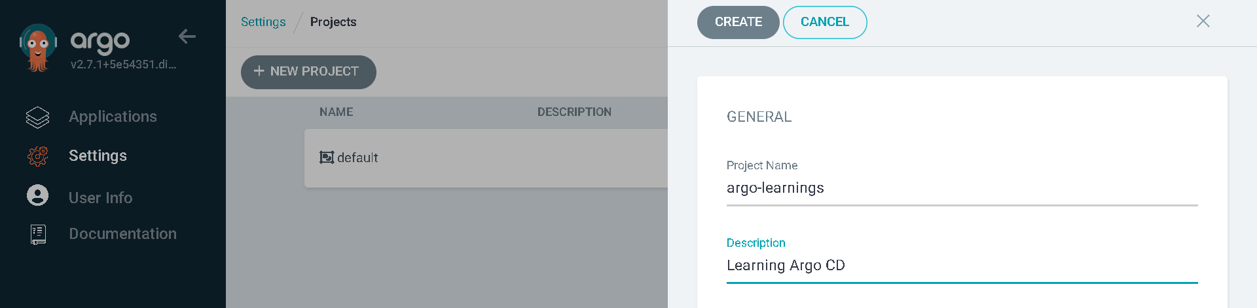
Over THE Argo cd UI – Add Project
ArgoCD ‘Application’ is a yaml manifest which tells ArgoCD, how the application should be deployed
Clone following repo
https://github.com/<user>/argocd-code-application-one.git
Login to UI and on Settings, Project, create new Project
Setting, Project, click on project and add Source repository, Destinations, Cluster Resource Allow List, Namespace Resource Allow List as *
Don’t put any entry for Cluster Resource Deny List, Namespace Resource Deny List

Slide 5
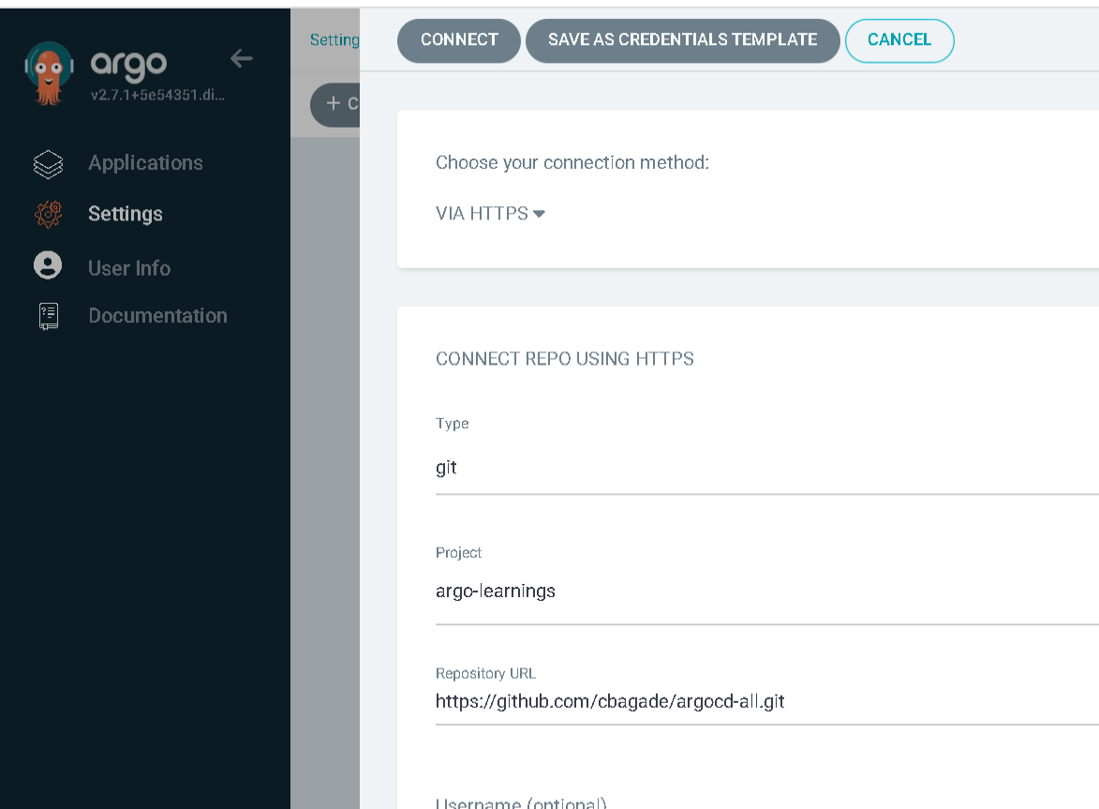
Over THE Argo cd UI – Add Git REPO
On Settings, Connect Repo , add the git repository containing code (configurations branch)
Put appropriate username and token as password
Configure your argocd-configuration and argocd-code repo

Slide 6
Over THE Argo cd UI – create application
On Application -> New App and Input following
Once application is created, do hard refresh and sync
Ensure docker login on host
Ensure pods are running in namespace nginx-ns
Once done , delete learning-app from argocd UI
Field | Value
Application Name | learning-app
Project Name | argo-learnings
SYNC Policy | Automatic
Repository URL | https://github.com/<user>/argocd-code-application-one.git
Revision (branch name) | master
Path | applications
Cluster URL | https://kubernetes.default.svc
Namespace (in which argocd is deployed) | argocd
Notes:
Also ensure to turn off ZScaler

Slide 7
Over THE Argo cd UI – create application
Clone https://github.com/user/argocd-code-application-two.git
Over argo UI, add this as repository
On Application -> New App and Input following
Once application is created, do hard refresh and sync
Ensure docker login on host
Ensure pods are running in namespace nginx-ns
Field | Value
Application Name | learning-app
Project Name | argo-learnings
SYNC Policy | Automatic
Repository URL | https://github.com/cbagade/argocd-code-application-two.git
Revision (branch name) | master
Path | applications
Cluster URL | https://kubernetes.default.svc
Namespace (in which argocd is deployed) | argocd
Notes:
Also ensure to turn off ZScaler

Slide 8
Experiments
On Ubuntu machine, try following
kubectl get deployment –n helloworld-ns
kubectl delete deployment <deployment_name> -n helloworld-ns
The deployment will be recreated
Delete the entire helloworld application from Argo UI
ArgoCD will recreate it again

Slide 9
More into argo
Argo CD ApplicationSet is a feature in Argo CD that allows users to define and manage applications across multiple clusters. It's an evolution of the "App of Apps" deployment pattern, and it runs as its own controller.
Clone https://github.com/user/argocd-code-application-three.git
This has 2 branches , ‘configuration’ and ‘code’
‘configuration’ branch git application set, which deploy various applications inside code branch
On Application -> New App and Input following
Field | Value
Application Name | learning-app
Project Name | argo-learnings
SYNC Policy | Automatic
Repository URL | https://github.com/<user>/argocd-code-application-three.git
Revision (branch name) | configuration
Path | applicationsets/development
Cluster URL | https://kubernetes.default.svc
Namespace (in which argocd is deployed) | argocd

Slide 10
Further learning
ArgoCD is well integrated with Helm. The values can be externalized to manage in better way.
Implement ArgoCD with helm templating
Explore more on ArgoCD plugins

Slide 11
SUMMARY
We learnt a complete CICD process with Jenkins and ArgoCD.
ArgoCD is widely used in industry for complex application deployment.

