Slide 1

TASKMATCH
Design & Deployment of a Scalable, Highly Available
Web Application on AWS
Cloud Computing Project Report
github.com/devsharma1209/taskmatch-aws-deployment

Slide 2








CONTENTS
What We'll Cover
01
Project Overview
05
Database & Storage
Objectives & scope
RDS, S3, parameters
02
Architecture
06
Compute & Scaling
Three-tier system design
EC2, ALB, ASG
03
Networking
07
Verification
VPC, subnets, gateways
Database & app testing
04
Security
08
Testing & Validation
Security groups & access
HA & failover tests
2 / 25

Slide 3


PROJECT OVERVIEW
TaskMatch is a scalable web application deployed on AWS that enables users to browse odd jobs, post tasks, and submit offers. Built with a multi-tier architecture, it demonstrates real-world cloud deployment practices for performance, reliability, and security.
KEY OBJECTIVES
High Availability
Managed Database
Fault-tolerant system across multiple AZs
RDS for reliable data storage & retrieval
Secure Communication
Real-World Architecture
Controlled access between all components
Production-grade cloud deployment
Auto Scaling
Demand-based automatic capacity adjustment
3 / 25

Slide 4


ARCHITECTURE OVERVIEW
Multi-tier design separating presentation, application, and data layers
PRESENTATION
APPLICATION
DATABASE
STORAGE
MANAGEMENT
Application Load Balancer
EC2 + Auto Scaling Group
Amazon RDS (MySQL)
Amazon S3
AWS Systems Manager
Distributes incoming user traffic
Hosts app logic, scales with demand
Stores & retrieves user/job data
Application code storage
Secure instance access
4 / 25

Slide 5
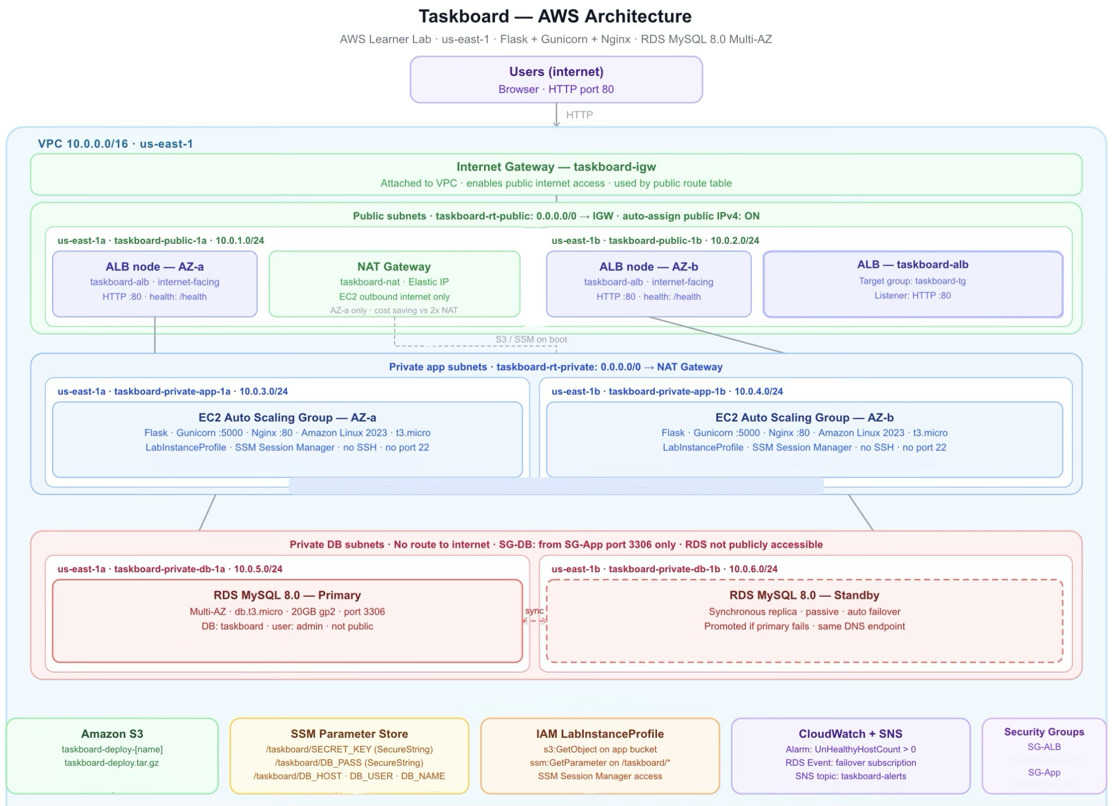
SYSTEM ARCHITECTURE DIAGRAM
End-to-end view of the TaskMatch infrastructure on AWS
5 / 25

Slide 6

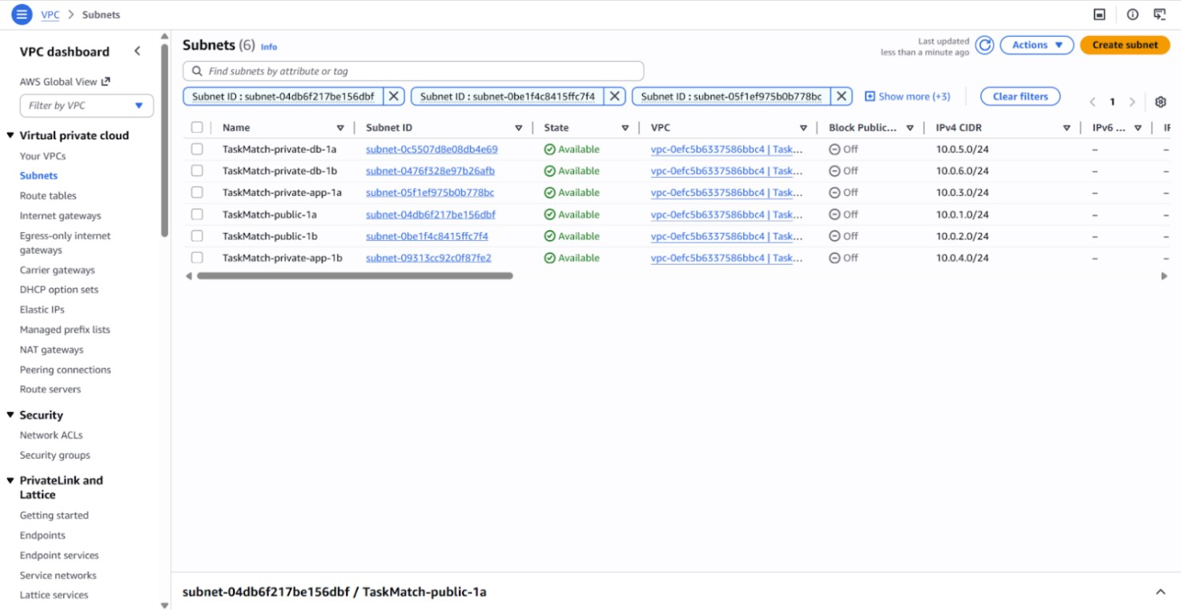
NETWORKING SETUP
Custom VPC with CIDR 10.0.0.0/16
Subnet Name | Type | AZ | CIDR Block
Public Subnet 1a | Public | us-east-1a | 10.0.1.0/24
Public Subnet 1b | Public | us-east-1b | 10.0.2.0/24
App Private 1a | Private (App) | us-east-1a | 10.0.3.0/24
App Private 1b | Private (App) | us-east-1b | 10.0.4.0/24
DB Private 1a | Private (DB) | us-east-1a | 10.0.5.0/24
DB Private 1b | Private (DB) | us-east-1b | 10.0.6.0/24
6 subnets across 2 Availability Zones (N. Virginia)
Public subnets host ALB & NAT Gateway
App servers in private subnets (no direct internet)
Database in dedicated private subnets for isolation
/24 CIDR for optimal IP capacity
All six subnets created in the VPC
6 / 25

Slide 7
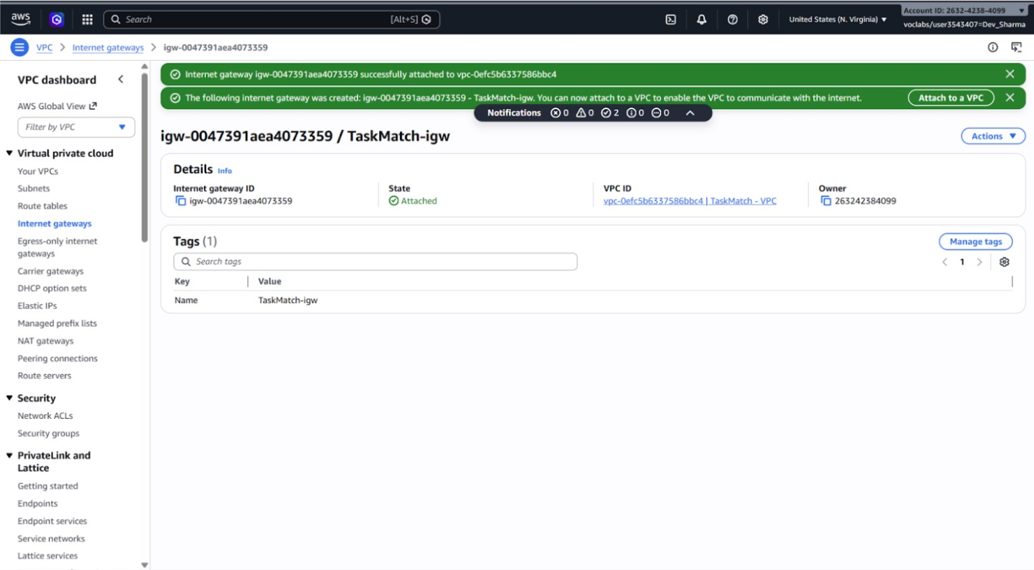
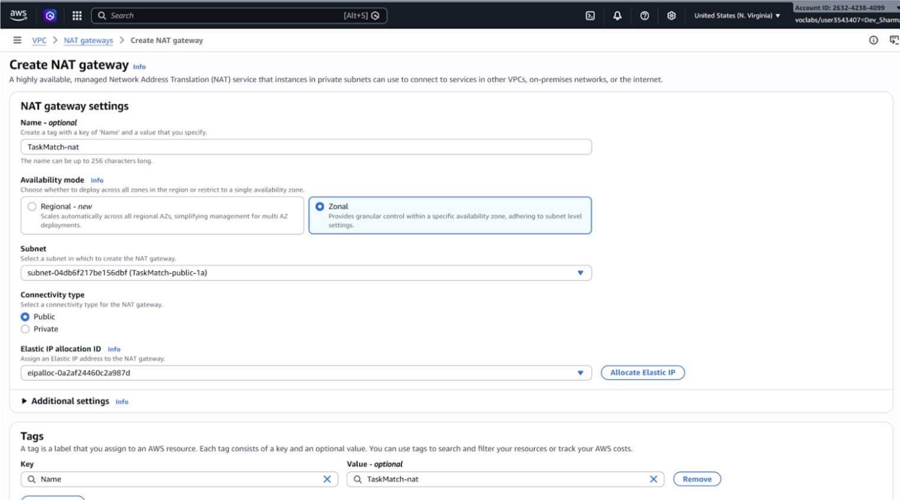
INTERNET & NAT GATEWAYS
Internet Gateway
NAT Gateway
Allows communication between public resources and the Internet. Attached to the VPC for external accessibility.
Deployed in public subnet with Elastic IP. Enables private subnet outbound internet without inbound public access.
7 / 25

Slide 8
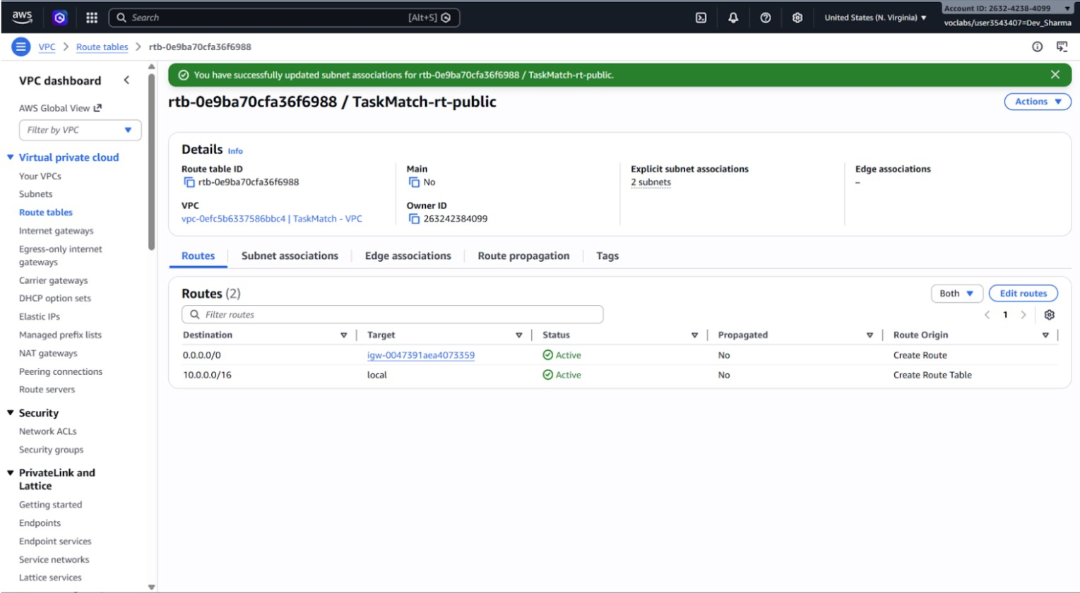
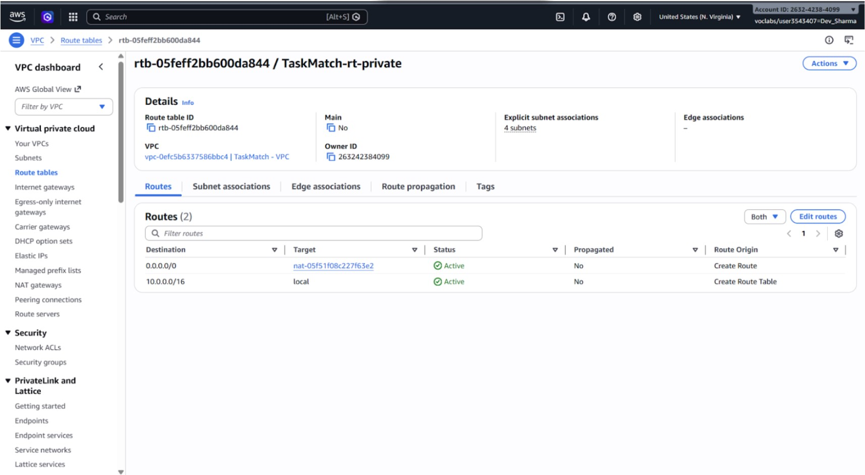
ROUTE TABLES
Directing traffic through Internet Gateway (public) and NAT Gateway (private)
Public Route Table
Private Route Table
Destination | Target | Purpose
0.0.0.0/0 | Internet Gateway | Internet-bound traffic
10.0.0.0/16 | Local | Internal VPC traffic
Destination | Target | Purpose
0.0.0.0/0 | NAT Gateway | Outbound internet
10.0.0.0/16 | Local | Internal VPC traffic
App & DB private subnets (1a, 1b) associated
Public subnets 1a and 1b explicitly associated
8 / 25

Slide 9

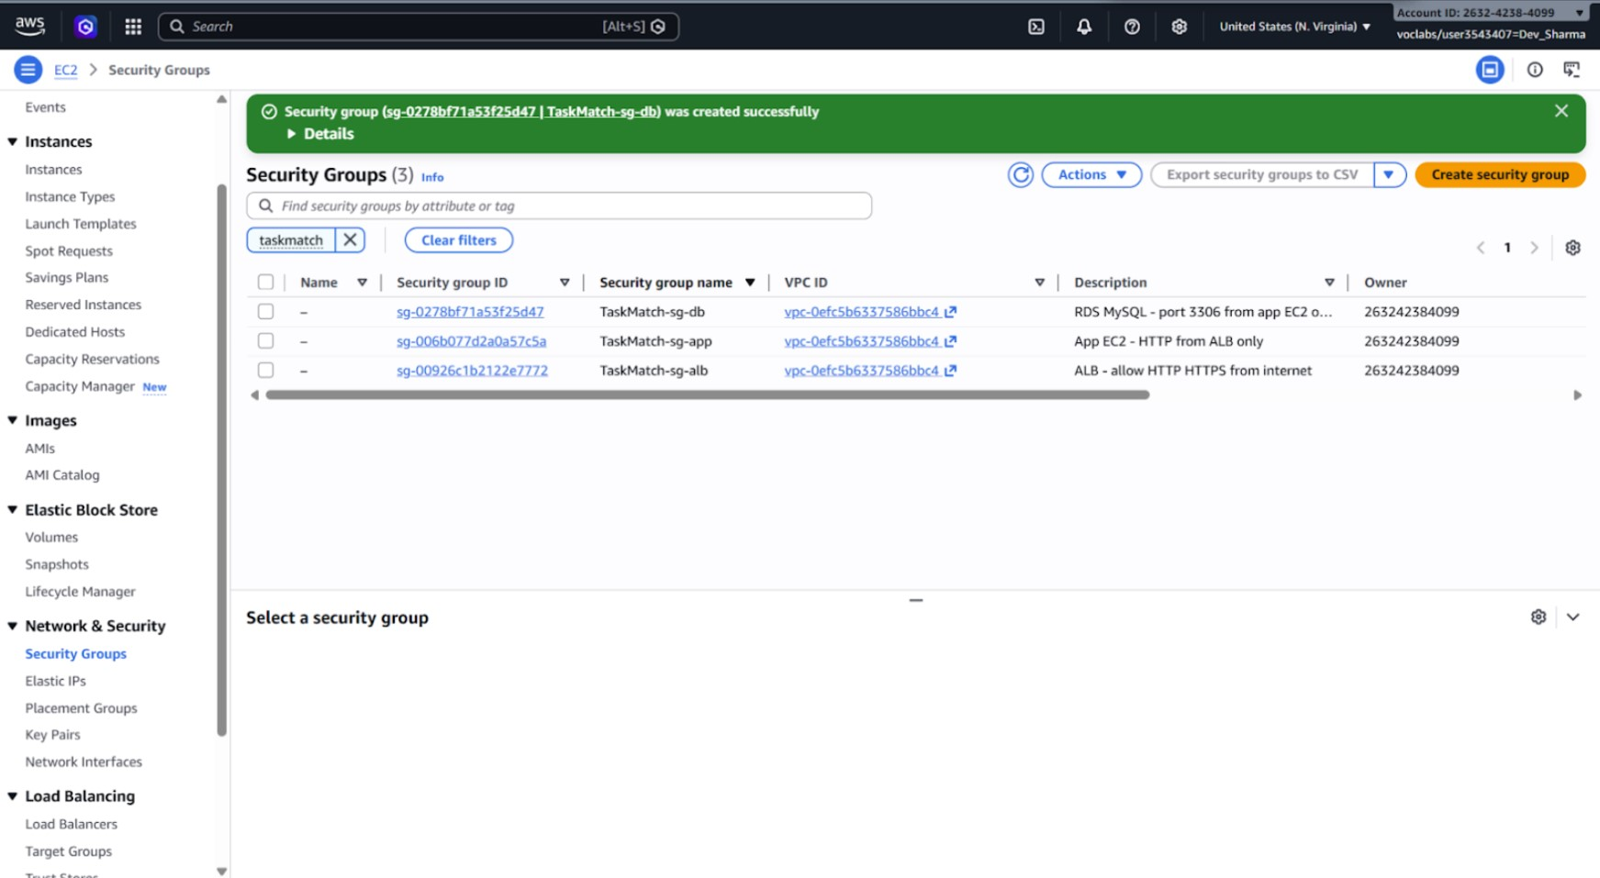
SECURITY IMPLEMENTATION
Multi-layered security architecture with controlled access between tiers
Security Group | Protocol | Port | Source | Purpose
ALB SG | HTTP/HTTPS | 80/443 | 0.0.0.0/0 | Public web access
App SG | HTTP | 80 | ALB SG | ALB-only EC2 access
DB SG | MySQL | 3306 | App SG | App-only DB access
THREE-TIER SECURITY GROUP ARCHITECTURE
9 / 25

Slide 10
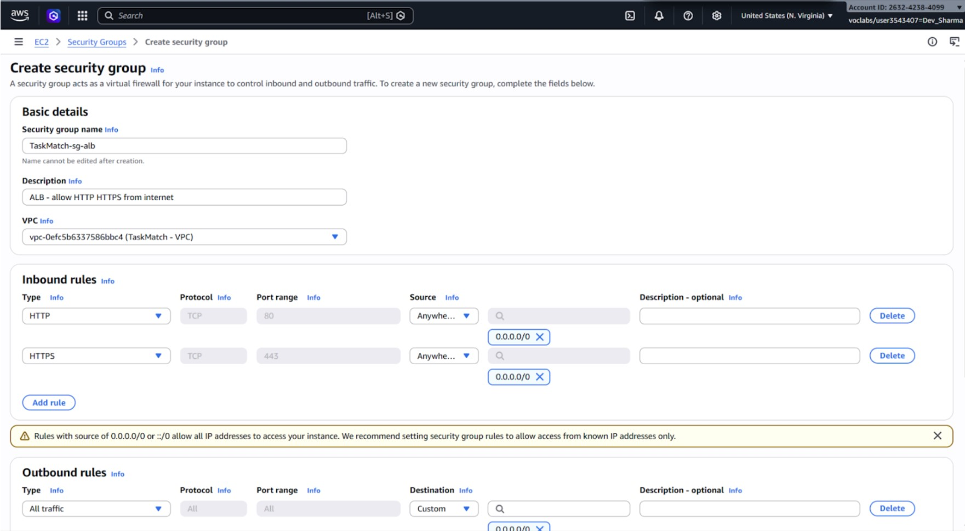
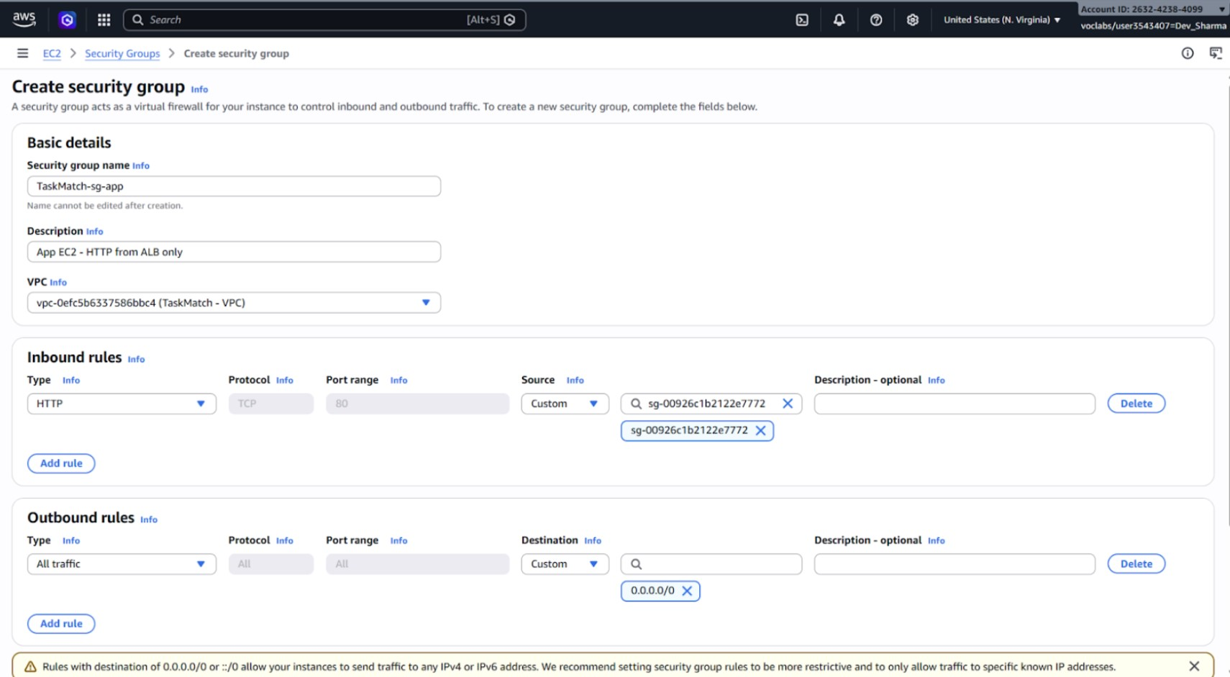
SECURITY GROUPS: INBOUND RULES
ALB Security Group
Application Security Group
HTTP/HTTPS traffic from 0.0.0.0/0 which allows public web access
HTTP only from ALB SG (EC2 instances not directly accessible)
10 / 25

Slide 11
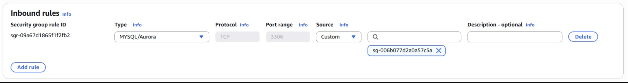
DATABASE SG & THREE-TIER ARCHITECTURE
Database Security Group
Three-Tier SG Architecture
MySQL (port 3306) only from App SG (no external database access)
All three security groups working together to control traffic flow
11 / 25

Slide 12

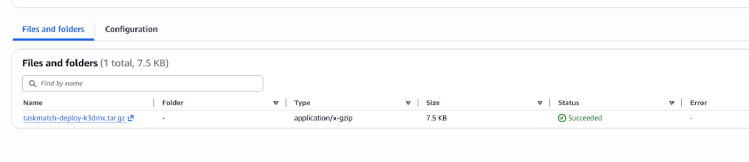
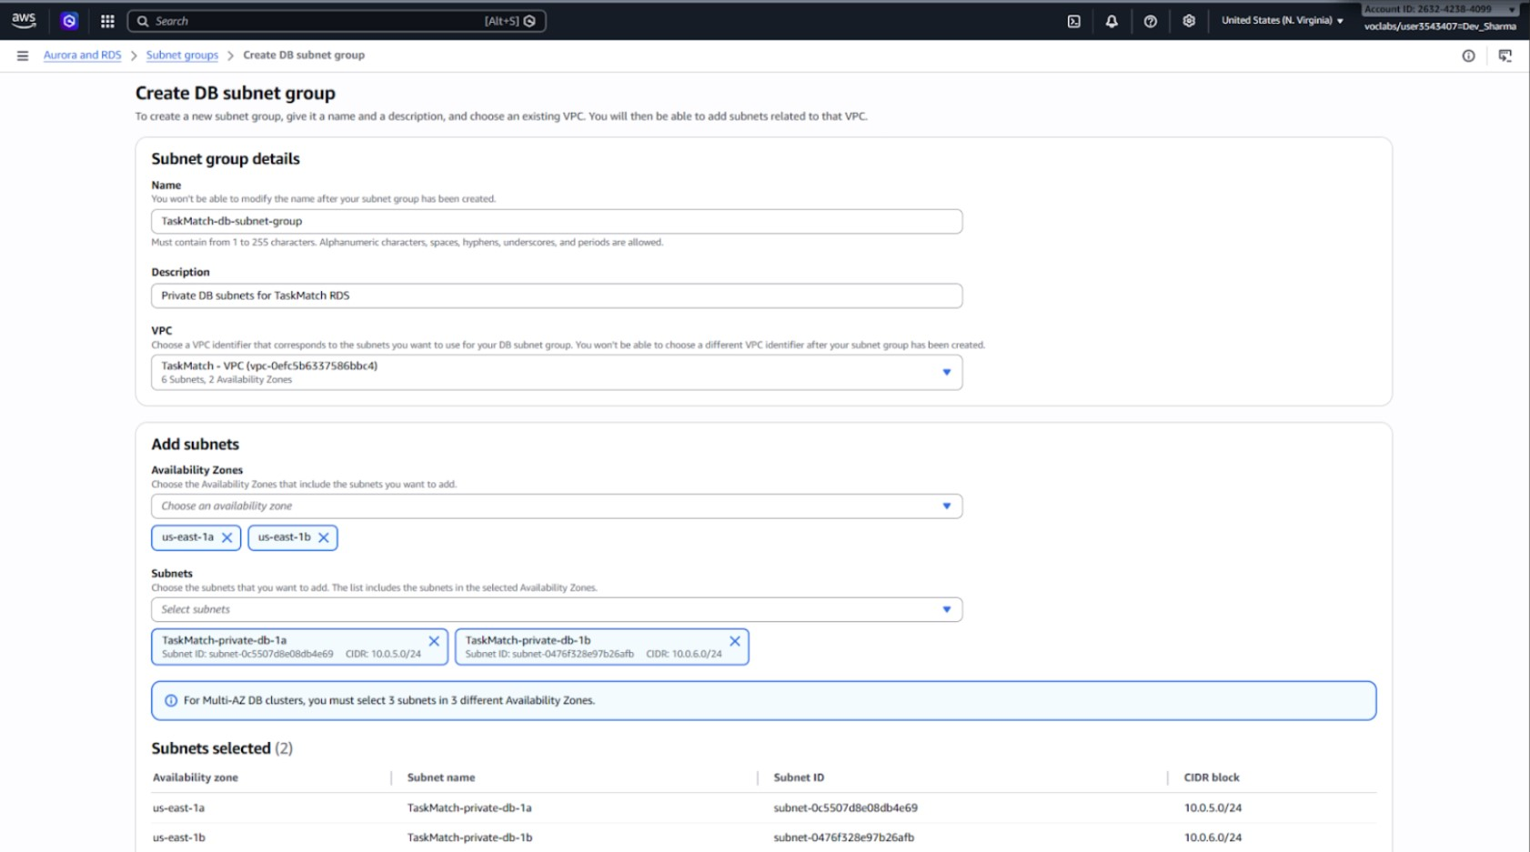
DATABASE & STORAGE
S3 Bucket
Parameter Store
Application source code uploaded to S3 for automated deployment to EC2 instances.
Sensitive data (DB credentials, secret keys) stored as encrypted SecureString (no hardcoding).
DB SUBNET GROUP
Dedicated private subnets across us-east-1a & us-east-1b for database isolation.
RDS INSTANCE
Engine: MySQL
Instance: db.t3.micro
Multi-AZ deployment
Private subnets only
Public access: Disabled
Credentials: SSM Parameter Store
12 / 25

Slide 13
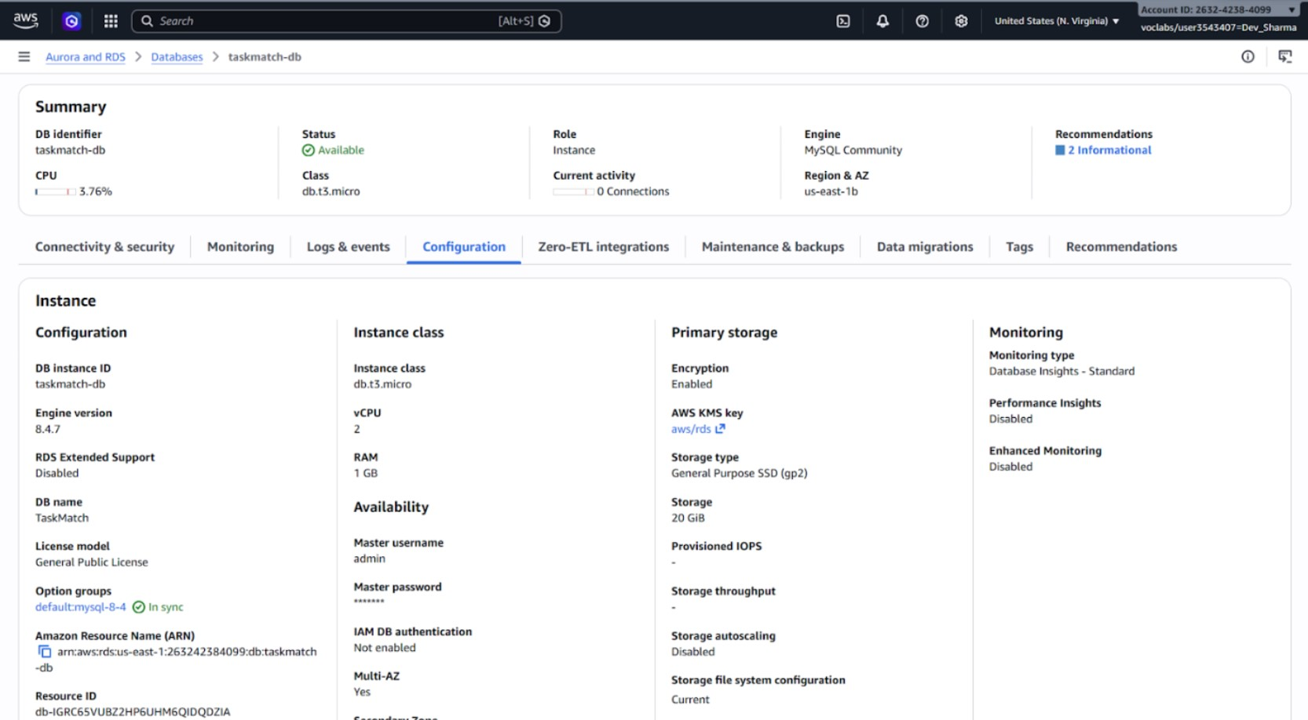
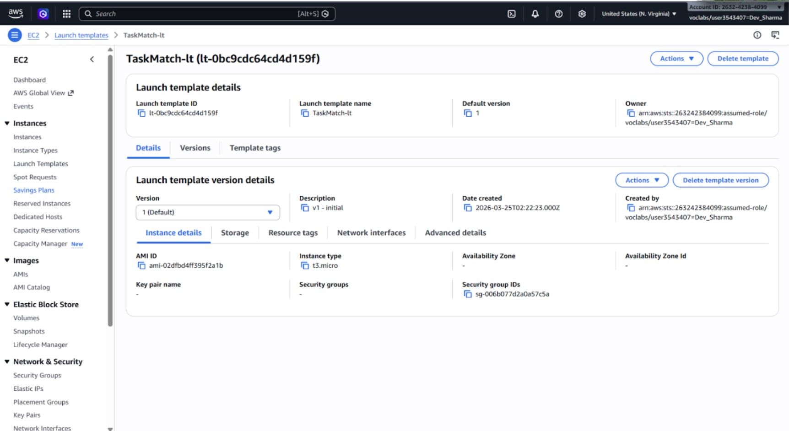
RDS INSTANCE & EC2 LAUNCH TEMPLATE
RDS MySQL Instance
EC2 Launch Template
db.t3.micro selected for cost & performance efficiency. Endpoint enables seamless, secure application integration.
Defines instance type, AMI, and security settings for consistent, automated EC2 deployments.
13 / 25

Slide 14

COMPUTE & SCALING
TaskMatch uses an Auto Scaling Group (ASG) to automatically adjust EC2 instances based on demand. An Application Load Balancer distributes traffic across healthy instances, with health checks continuously monitoring status. EC2 instances connect to RDS via secure Parameter Store credentials.
14 / 25

Slide 15

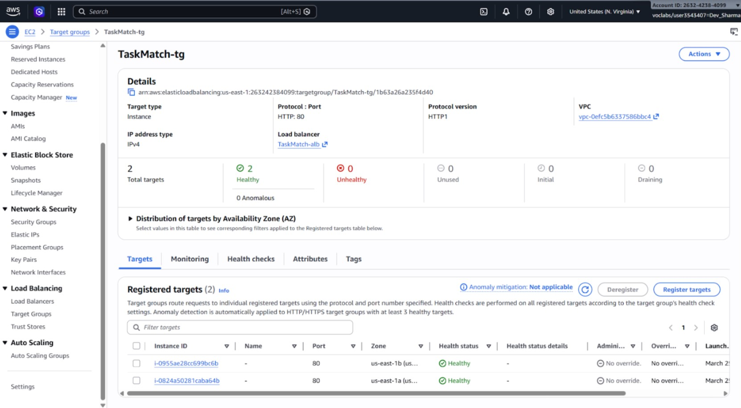
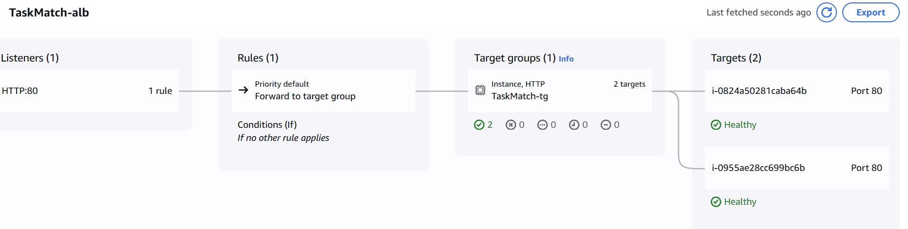
TARGET GROUP & LOAD BALANCER
Target Group
Application Load Balancer
ALB directs requests to port 80 application instances. Health checks ensure only healthy targets receive traffic.
Listener on port 80. Default rule forwards all traffic to the TaskMatch target group for distribution.
15 / 25

Slide 16

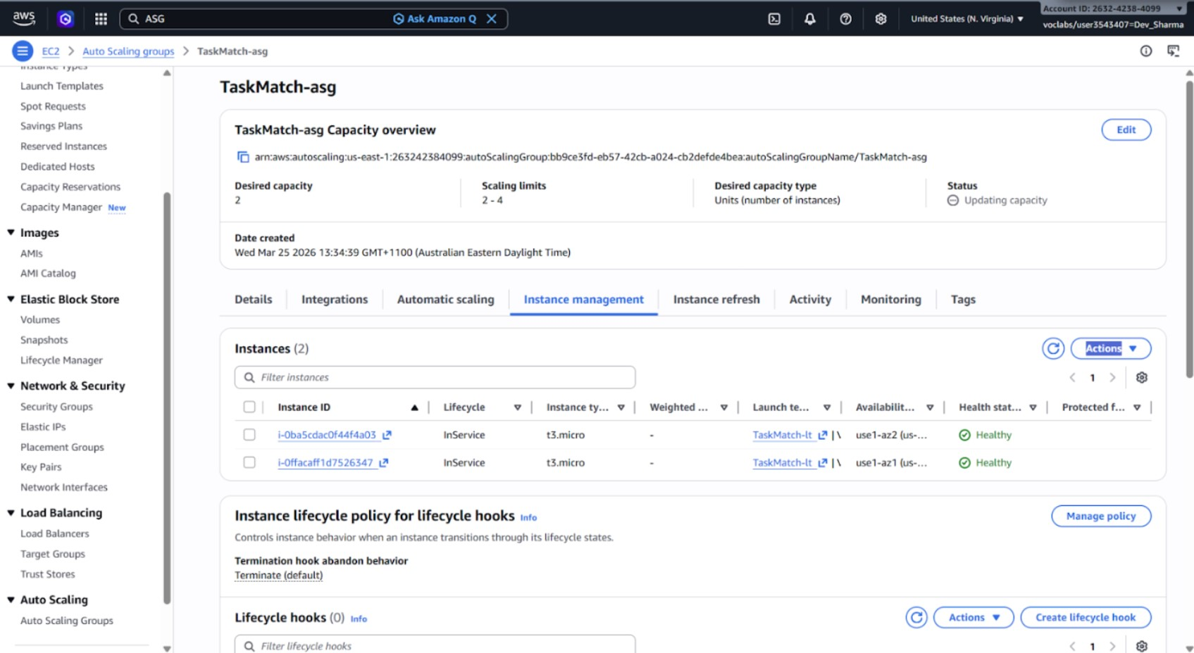
AUTO SCALING GROUP
Maintains adequate EC2 instances across multiple Availability Zones that are all healthy and in-service
Auto Scaling Group: Healthy Instances
The ASG ensures fault tolerance by automatically replacing failed instances and scaling capacity based on demand. Both instances shown are healthy and in-service across multiple AZs.
16 / 25

Slide 17
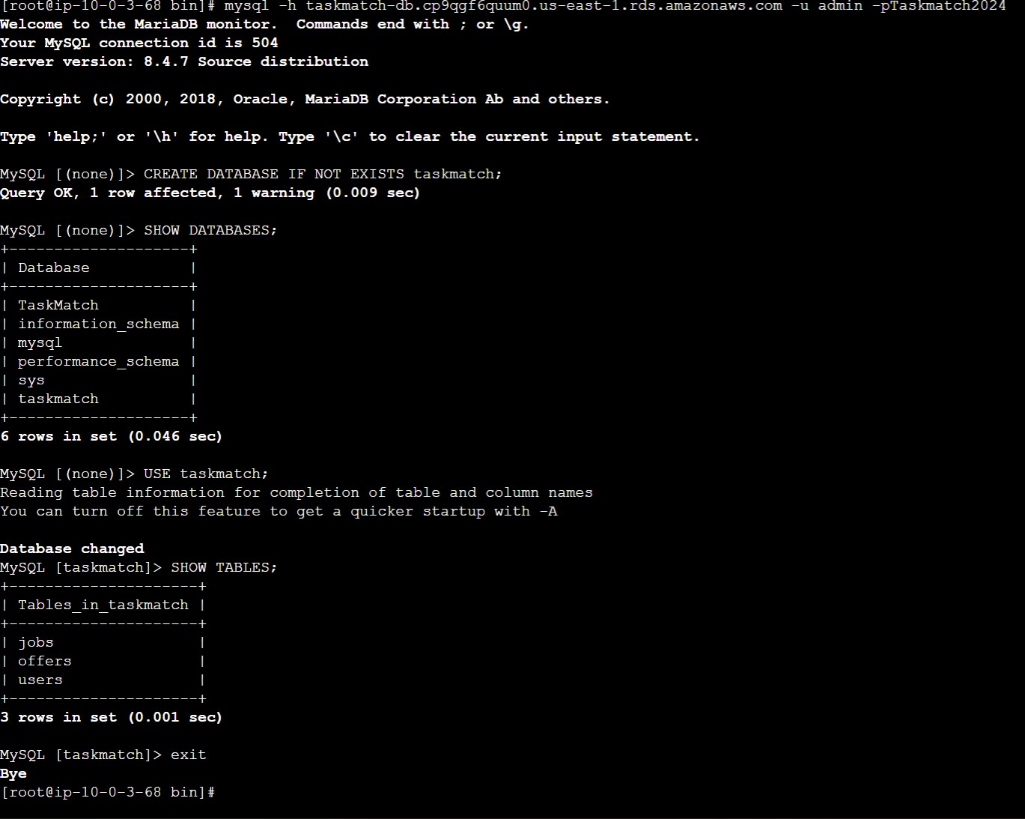
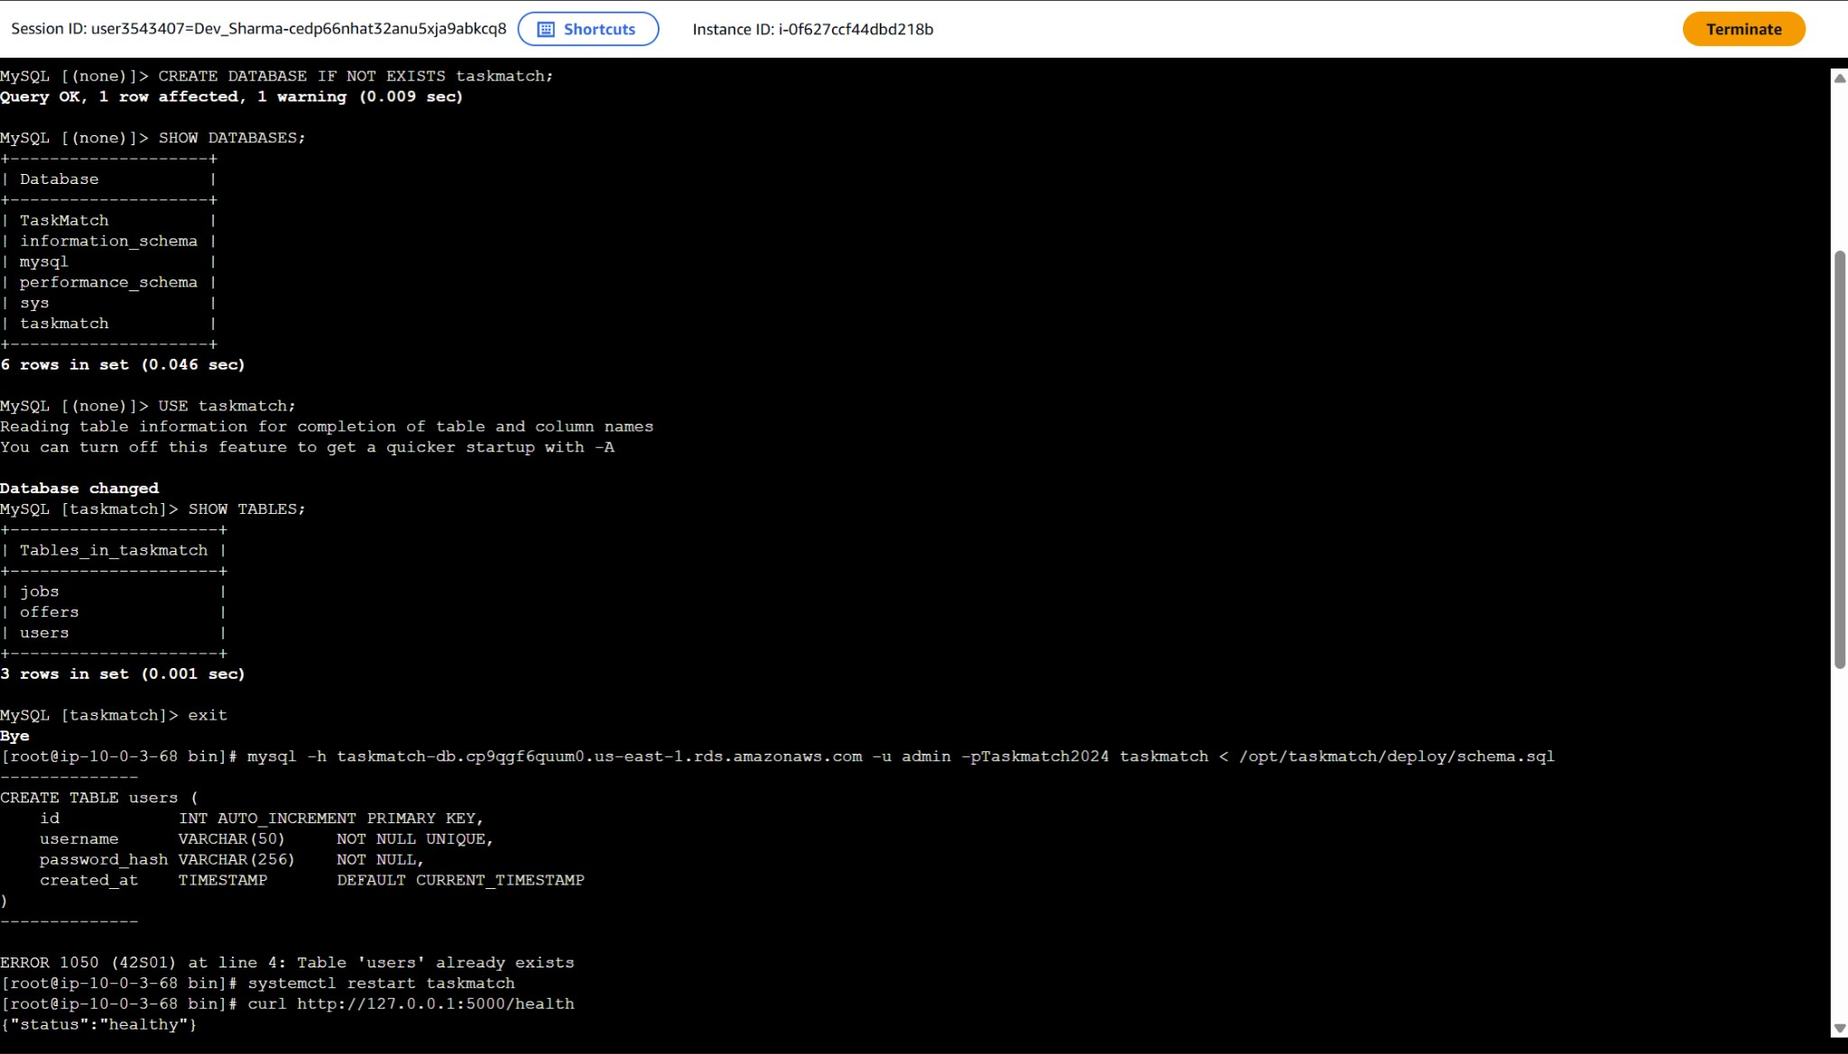
DATABASE VERIFICATION
SSM Terminal DB Verification
Schema Setup & Health Check
SHOW DATABASES confirmed taskmatch exists. SHOW TABLES verified all three tables: jobs, offers, and users.
schema.sql applied to RDS. ERROR 1050 confirms pre-existing tables. systemctl restart + curl health check returns healthy.
17 / 25

Slide 18
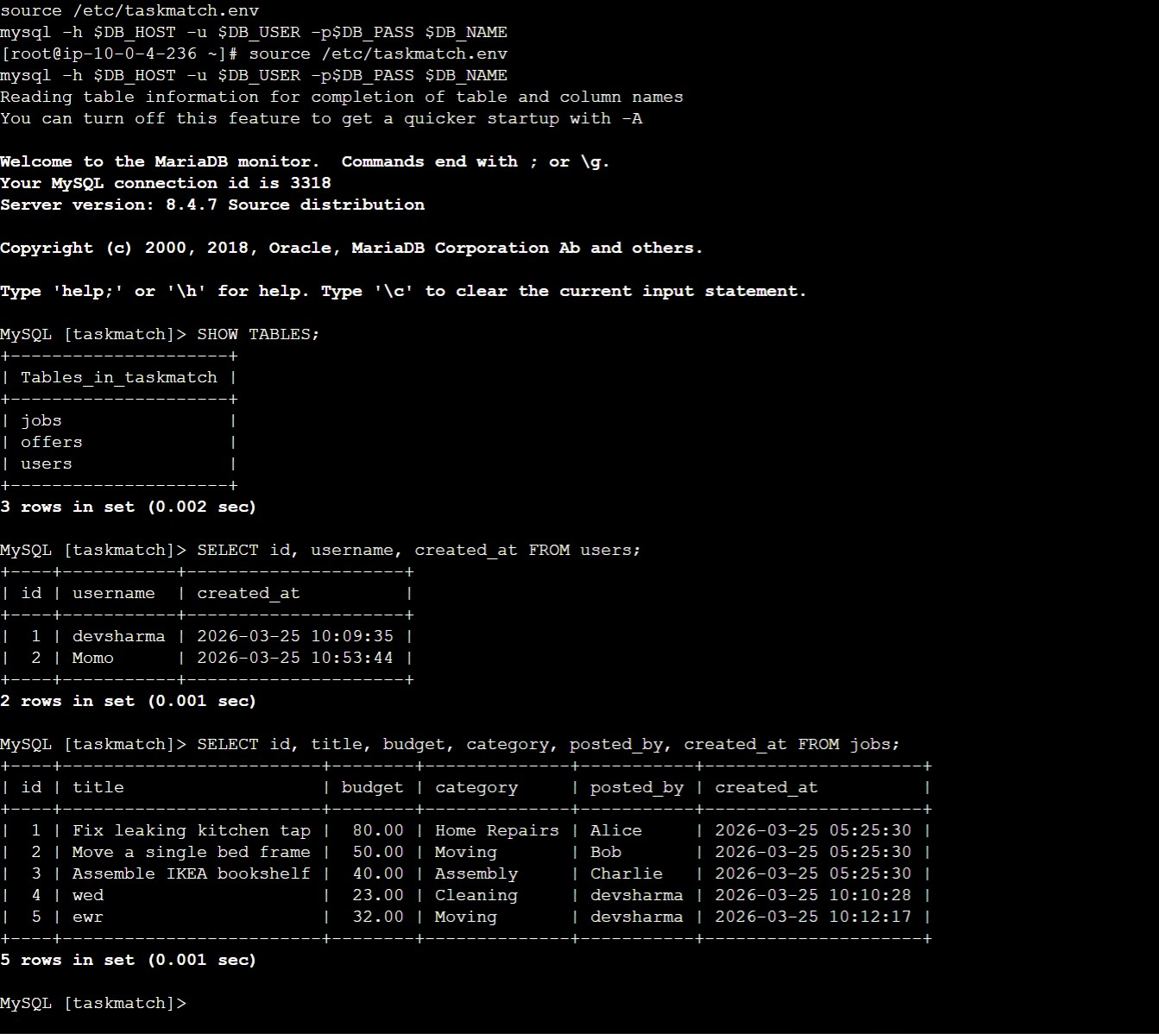
SQL QUERY REFERENCE & RESULTS
SQL Commands Used
Query Results
Description | SQL Command
See all tables | SHOW TABLES;
See all users | SELECT id, username, created_at FROM users;
See all jobs | SELECT id, title, budget, category, posted_by, created_at FROM jobs;
See all offers | SELECT id, job_id, user_id, amount, message, created_at FROM offers;
Offers with names | SELECT o.id, j.title, u.username, o.amount FROM offers o JOIN jobs j...
Count records | SELECT COUNT(*) FROM users/jobs/offers;
SQL output confirming all tables and data are successfully created
SSM Connection Commands:
sudo su -
source /etc/taskmatch.env
mysql -h $DB_HOST -u $DB_USER -p$DB_PASS $DB_NAME
18 / 25

Slide 19
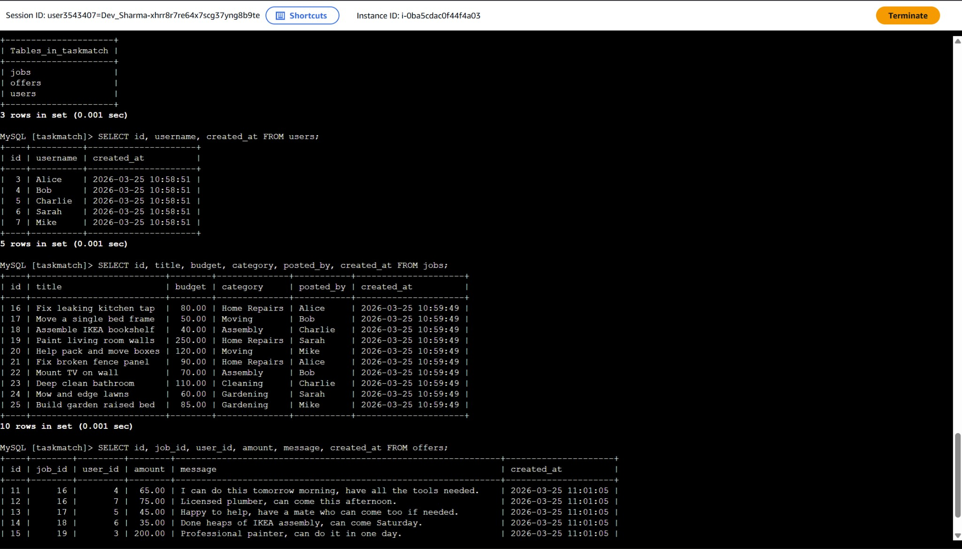
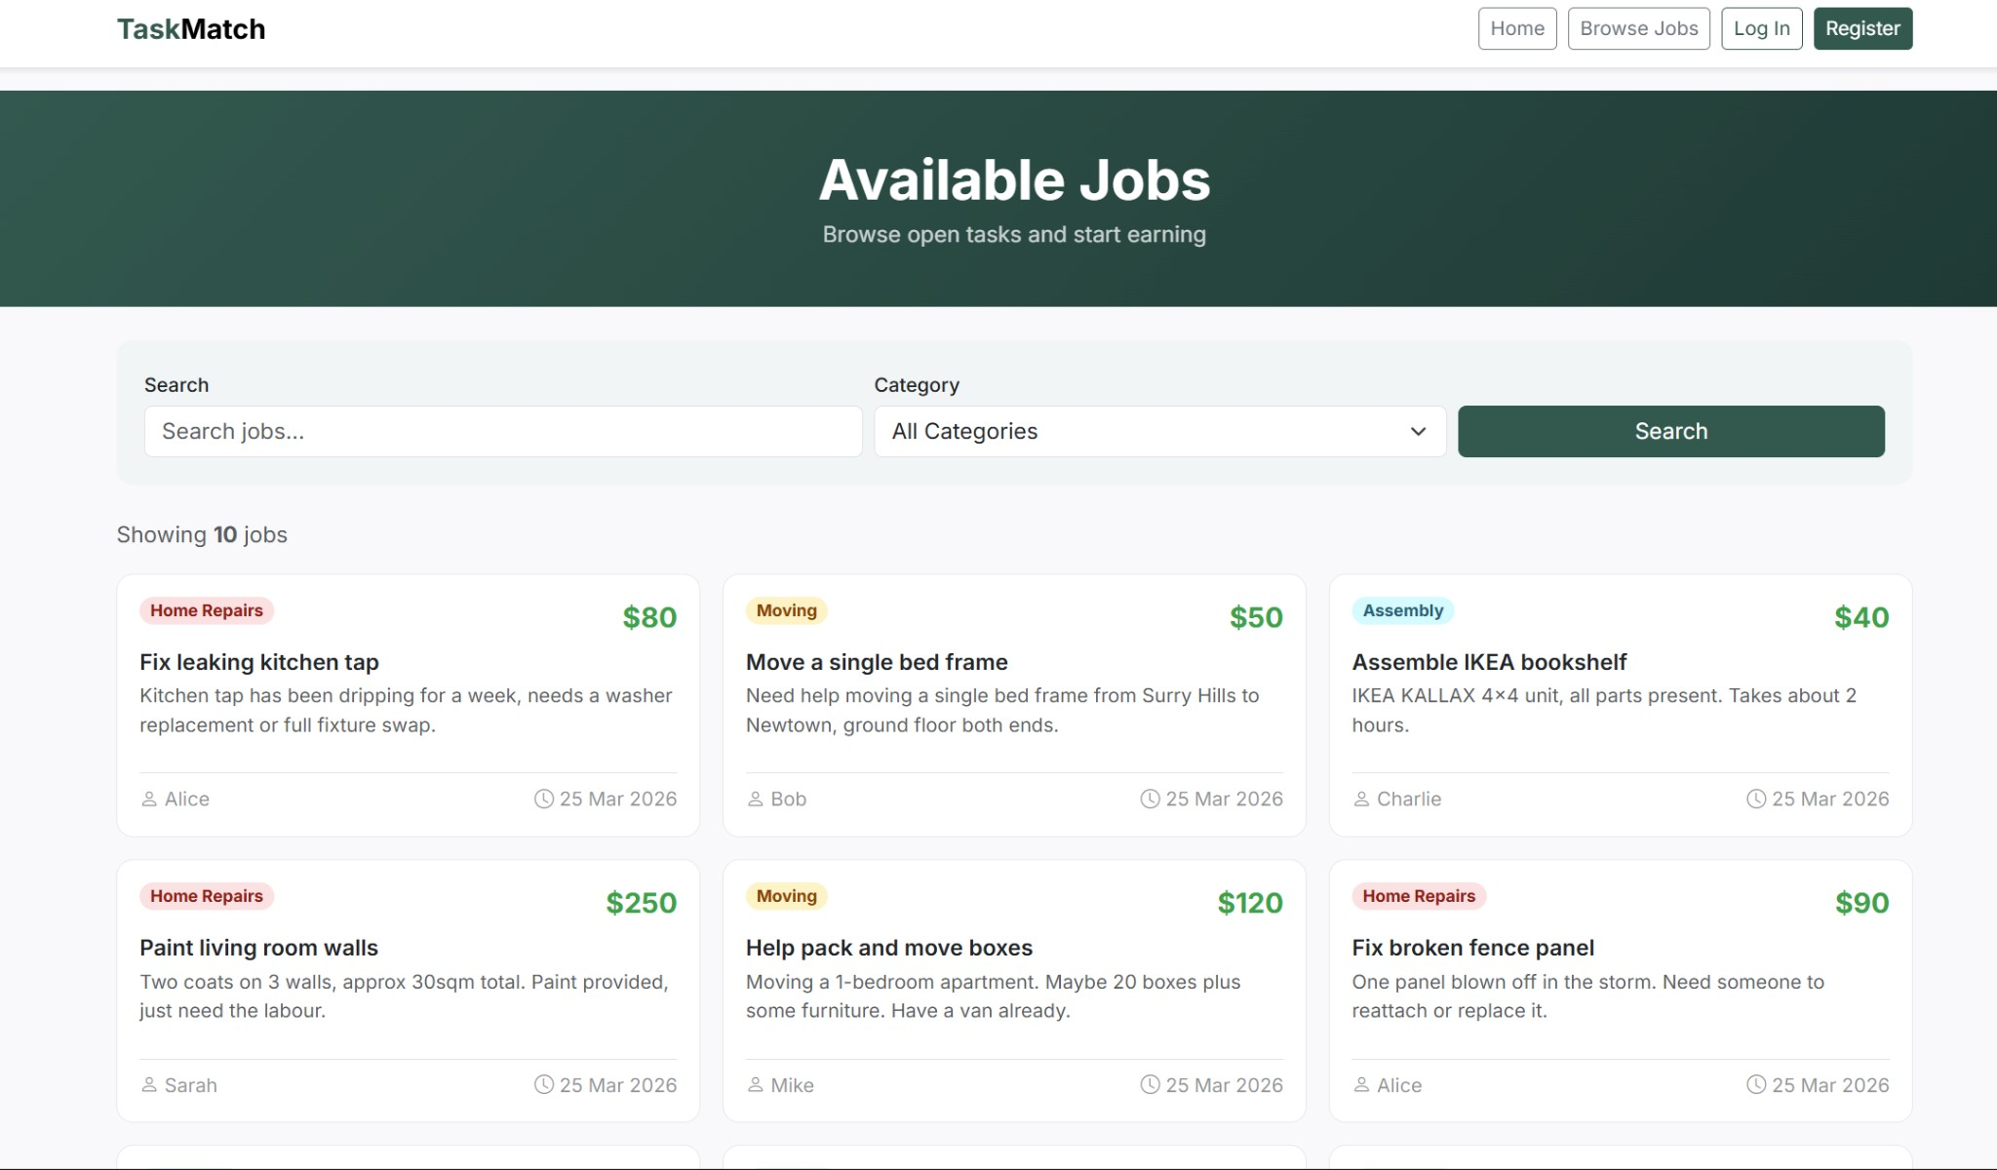
APPLICATION VERIFICATION
Frontend data matches SQL query results confirming end-to-end integration
Job Listings Display
19 / 25

Slide 20

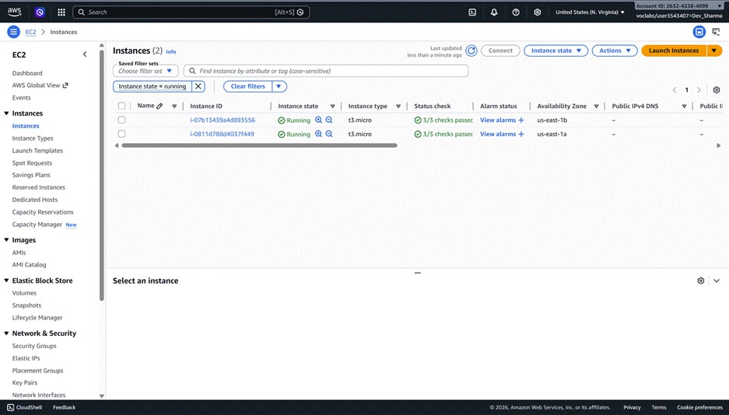
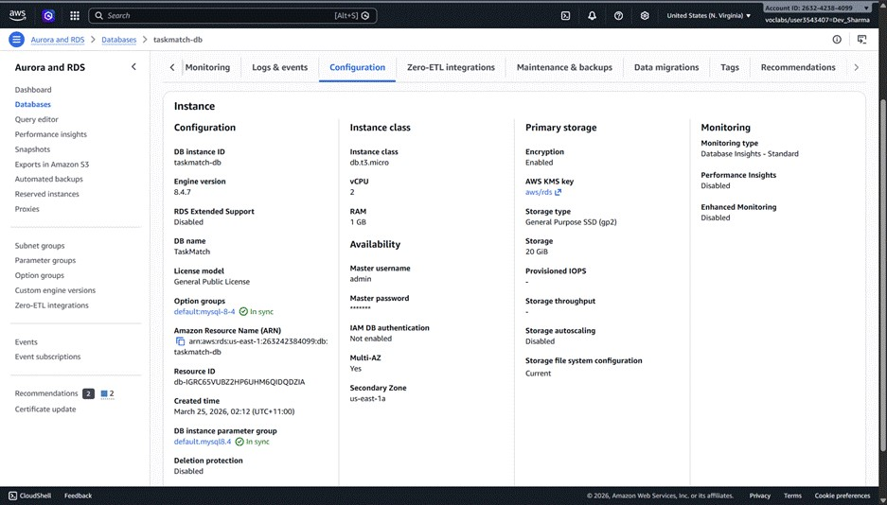
TESTING & VALIDATION
Simulated failure scenarios to validate high availability, fault tolerance, and reliability
TEST 1
TEST 2
Compute Tier HA
Database Tier HA
Method: Manual termination of EC2 instance
Method: Manual RDS failover reboot
Expected: ASG replaces instance, ALB reroutes traffic automatically
Expected: Standby promotes to primary, app reconnects automatically
20 / 25

Slide 21
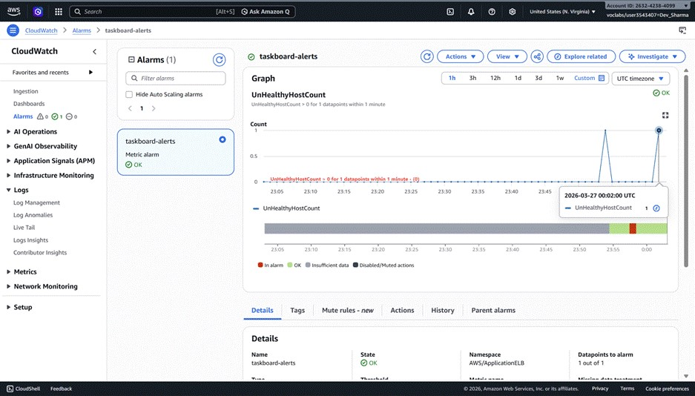
TEST 1: COMPUTE TIER HA
Step 1: Instance Termination → Step 2: CloudWatch Detection
1
Instance Terminated
2
CloudWatch Alarm Triggered
A working EC2 instance (ID ...3556) was manually stopped to simulate an unexpected server crash. Two healthy instances were initially serving traffic via the ASG.
The ALB detected the unresponsive instance. The CloudWatch alarm (taskboard-alerts) monitoring UnHealthyHostCount exceeded the threshold and entered ALARM state.
21 / 25

Slide 22
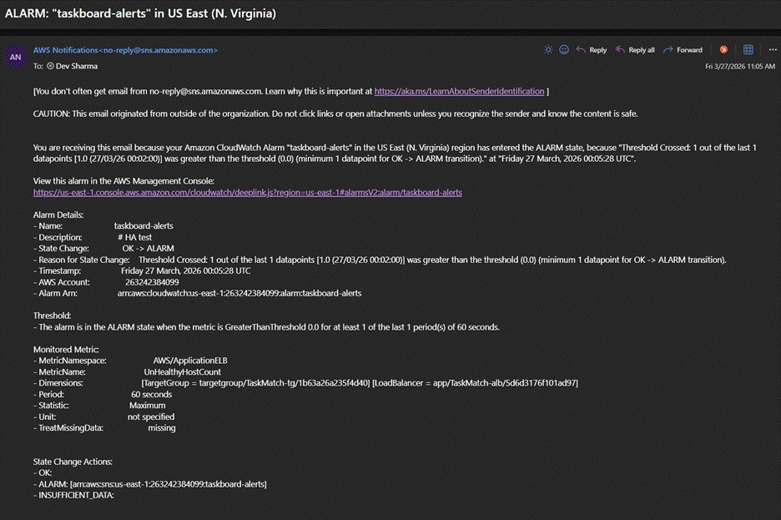
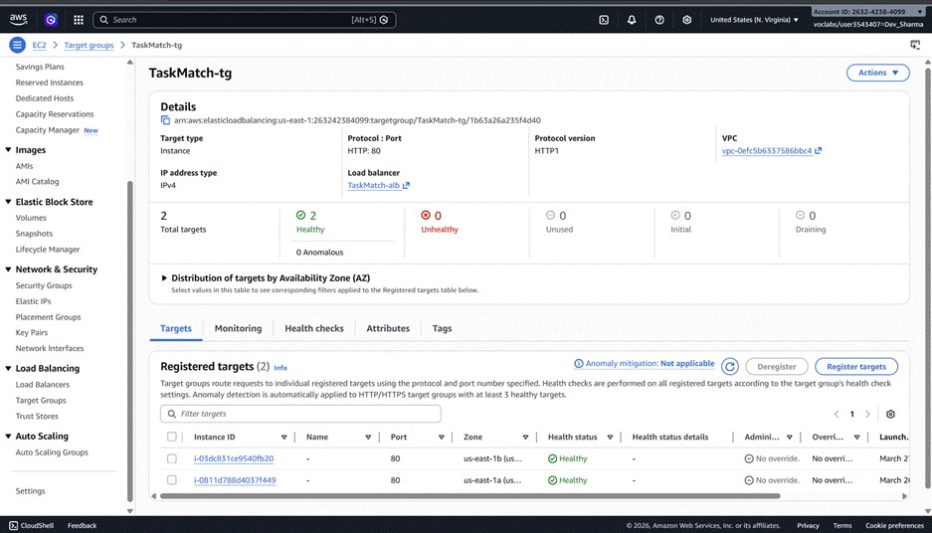
TEST 1: COMPUTE TIER HA (cont.)
Step 3: SNS Notification → Step 4: Auto Recovery & Stabilization
3
SNS Email Notification
4
ASG Recovery: 2 Healthy Targets
An automated SNS email notification was sent to the administrator, alerting them that the UnHealthyHostCount alarm threshold had been breached.
The ASG automatically launched a replacement instance (ID ...fb20). After passing health checks, it registered into the Target Group, restoring two healthy targets with zero manual intervention.
22 / 25

Slide 23
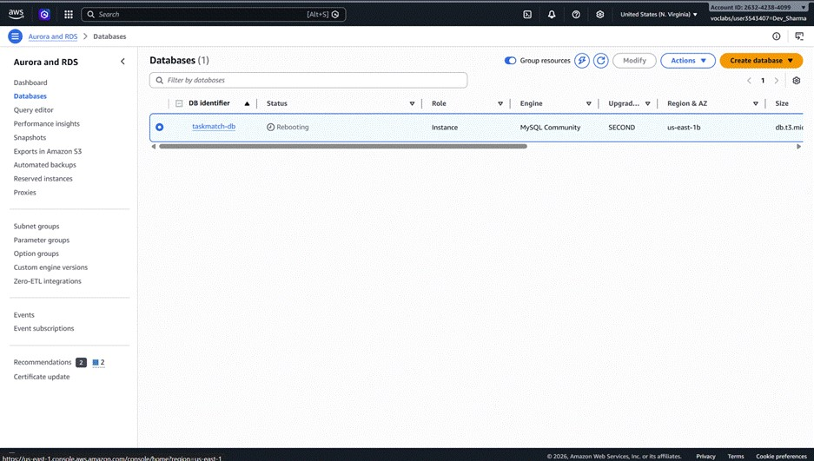
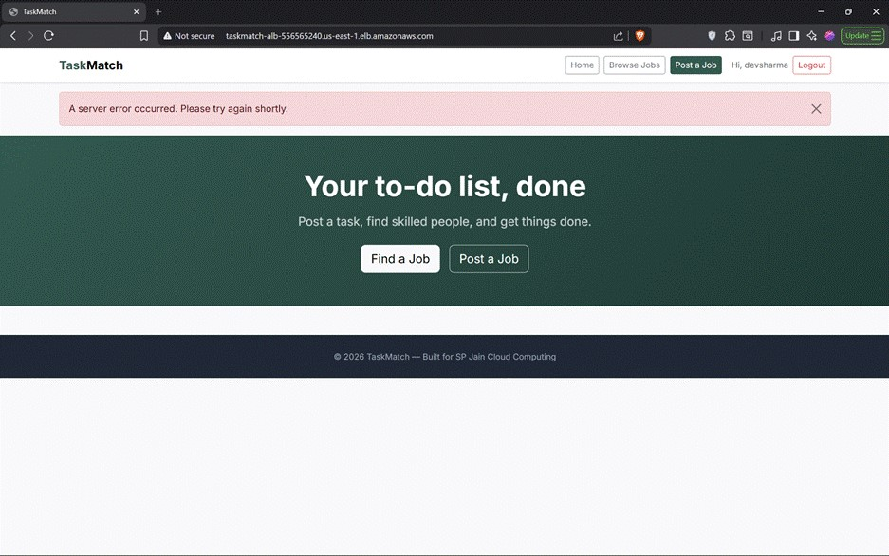
TEST 2 — DATABASE TIER HA
Step 1: Failover Initiated → Step 2: Expected Disruption
1
Failover Initiated
2
Brief Expected Disruption
The RDS primary instance was rebooted with the failover option selected. The Multi-AZ deployment ensured a synchronous standby replica existed in a secondary AZ. Status changed to "Rebooting."
During DNS propagation to the standby instance, the application temporarily lost database connectivity. Users saw a brief server error. This is expected and confirms the failover process was in progress.
23 / 25

Slide 24
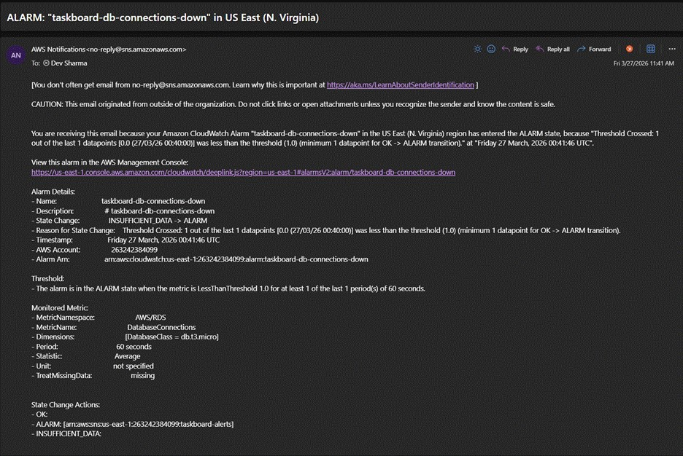
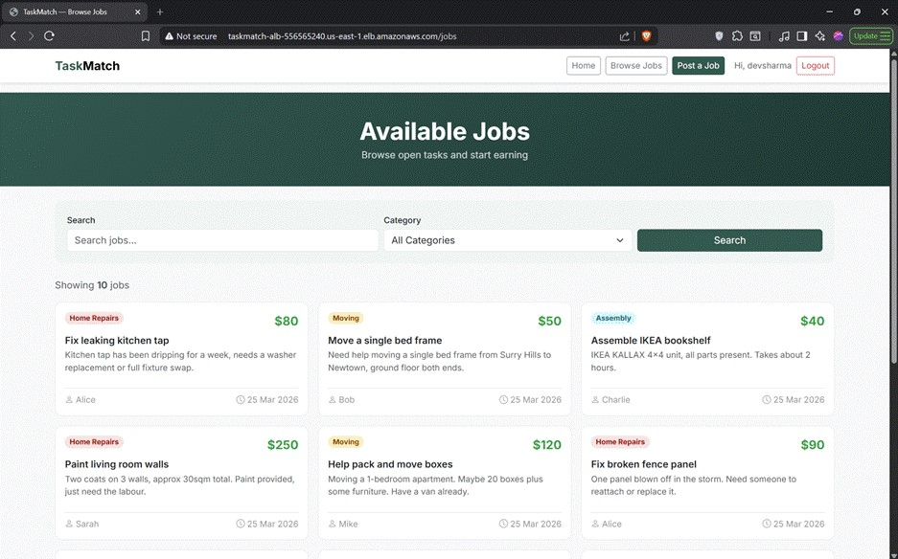
TEST 2: DATABASE TIER HA (cont.)
Step 3: SNS Alert → Step 4: Full Recovery with Zero Data Loss
3
SNS Notification: DB Alarm
4
Fully Restored: Zero Data Loss
The CloudWatch alarm (taskboard-db-connections-down) detected zero active database connections and triggered an SNS email notification to the administrator.
The standby instance promoted to primary. RDS status returned to "Available" and the application automatically reconnected. Refreshing the app confirmed all job listings displayed correctly with zero data loss.
24 / 25

Slide 25

CONCLUSION
TaskMatch successfully demonstrates a production-grade, multi-tier AWS deployment with high availability, automated scaling, layered security, and verified fault tolerance across both compute and database tiers.
Multi-AZ High Availability
Three-Tier Security
Auto Scaling & Recovery
Managed RDS with Failover
github.com/devsharma1209/taskmatch-aws-deployment
25 / 25

