Slide 1
CSS Grid Basics
Shay Nadav

Slide 2
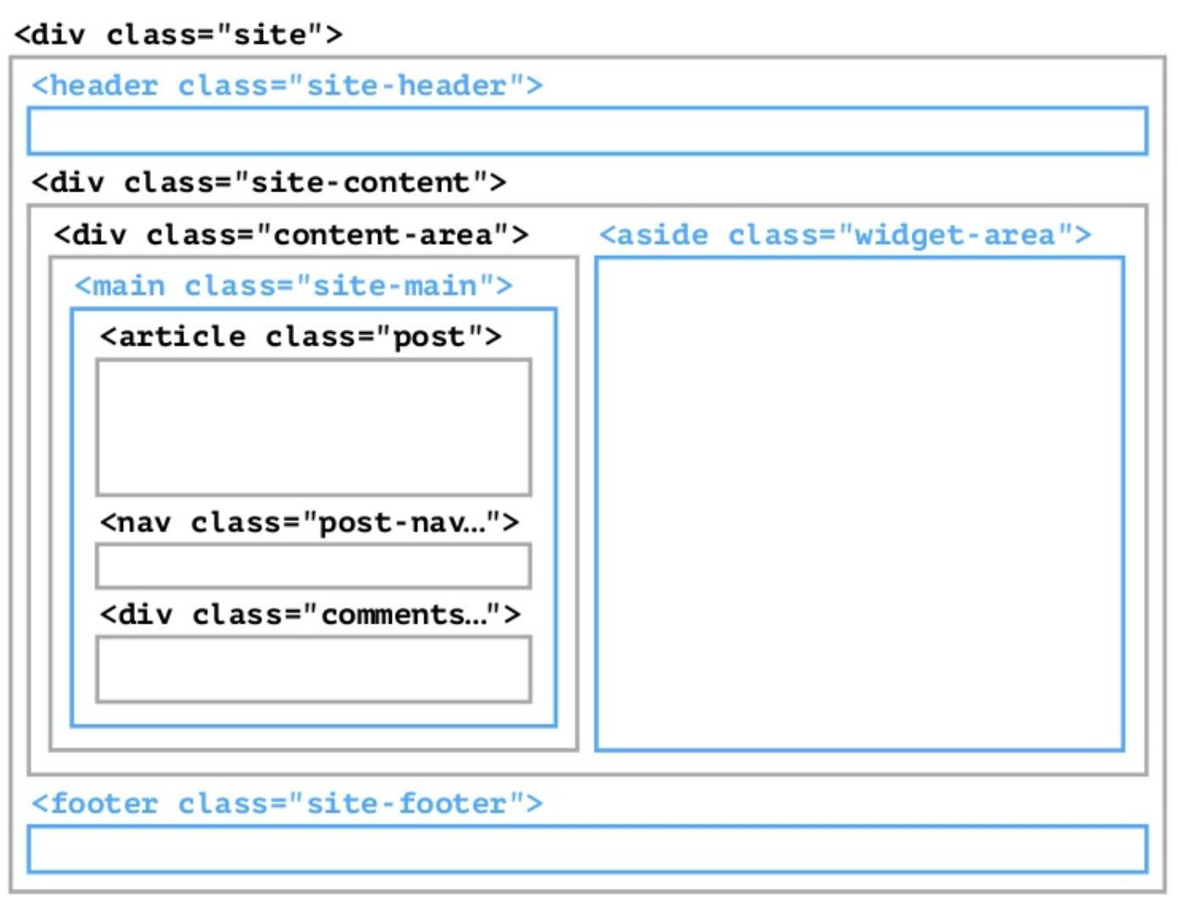
Before CSS Grid

Slide 3
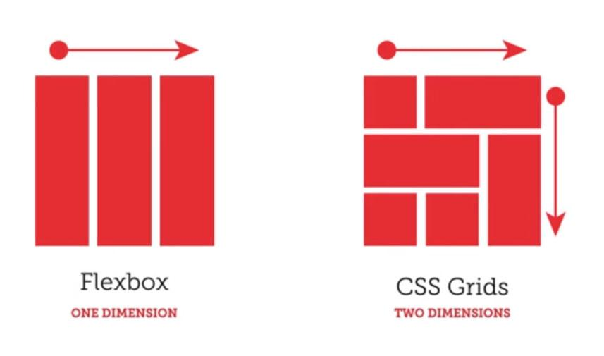
Advantage of CSS Grid
Has the advantages of flexbox, and works in 2 dimensions.

Slide 4
Grid Terminology

Slide 5
Grid Container
<div class=”site”>
<header class=”child”></header>
<main class=”child”></main>
<aside class=”child”>
<div class=”child-of-child”></div>
<!-- doesn’t get effected-->
</aside>
<footer class=”child”></footer>
</div>
CSS
.site {
display:grid;
}

Slide 6
Grid Item
Any element that is a direct descendant of the grid.
<div class=”site”>
<header class=”child”></header>
<main class=”child”></main>
<aside class=”child”>
<div class=”child-of-child”></div>
<!-- doesn’t get effected-->
</aside>
<footer class=”child”></footer>
</div>

Slide 7
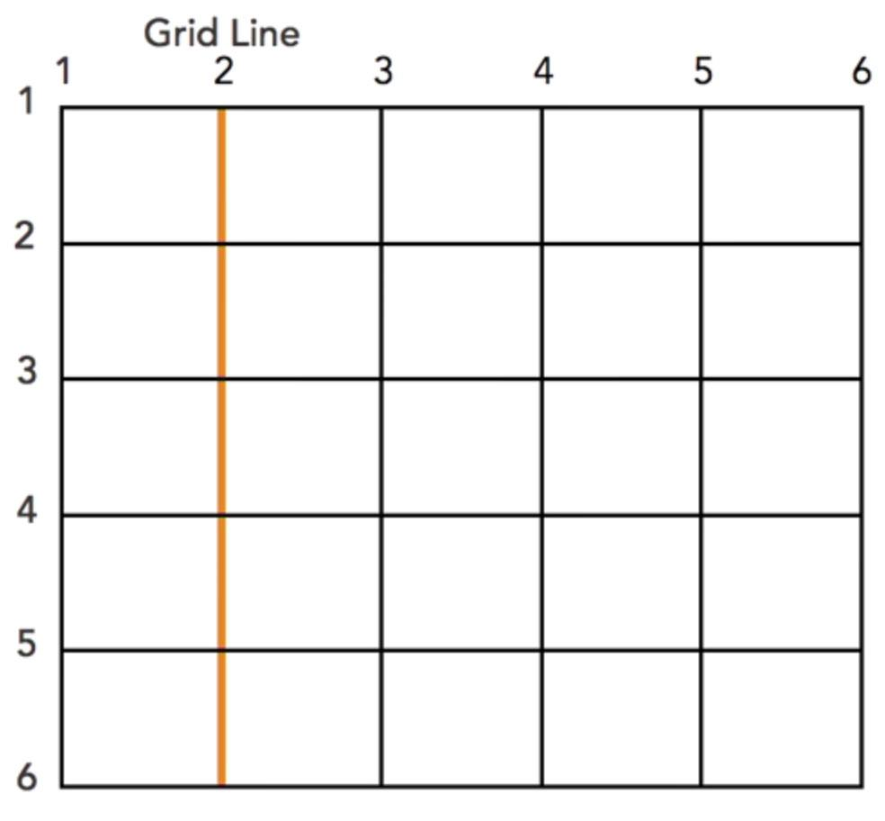
Grid Line
The horizontal and vertical lines that make up the grid.

Slide 8
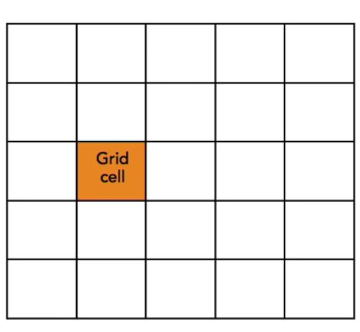
Grid Cell
The smallest space between four grid lines

Slide 9
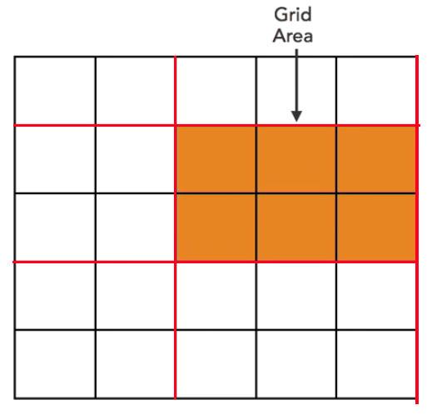
Grid Area
The area between four grid lines
That can contain multiple Grid Cells.

Slide 10
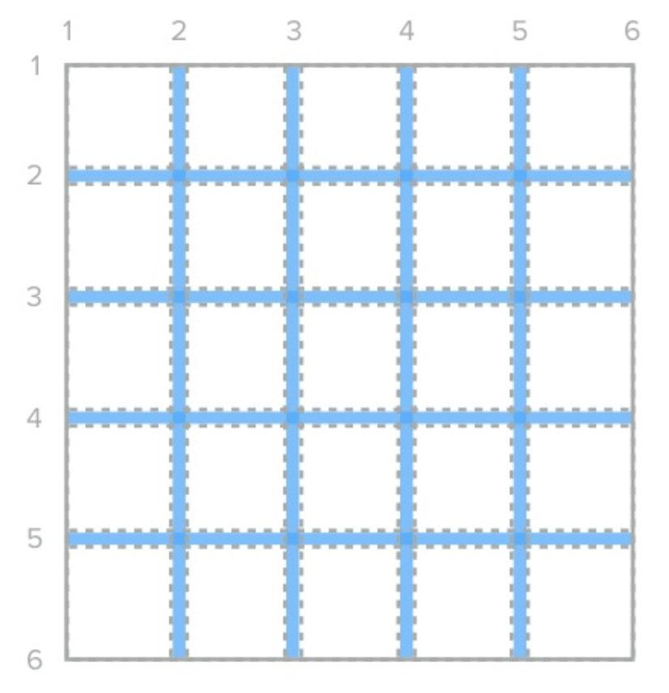
Grid Gap
Empty space between grid cells/areas
grid-column-gap:10px;
grid-row-gap:10px;
=
grid-gap:10px;

Slide 11
Grid Gap
Empty space between grid tracks
column-gap:10px;
row-gap:10px;
=
gap:10px;

Slide 12
Let’s Start Gridding

Slide 13
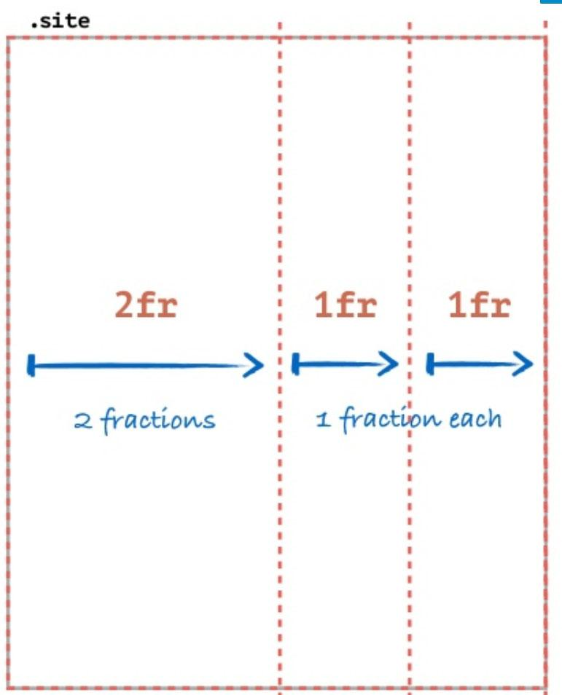
Grid-Template
.site {
display: grid;
grid-template-columns: 2fr 1fr 1fr;
}

Slide 14
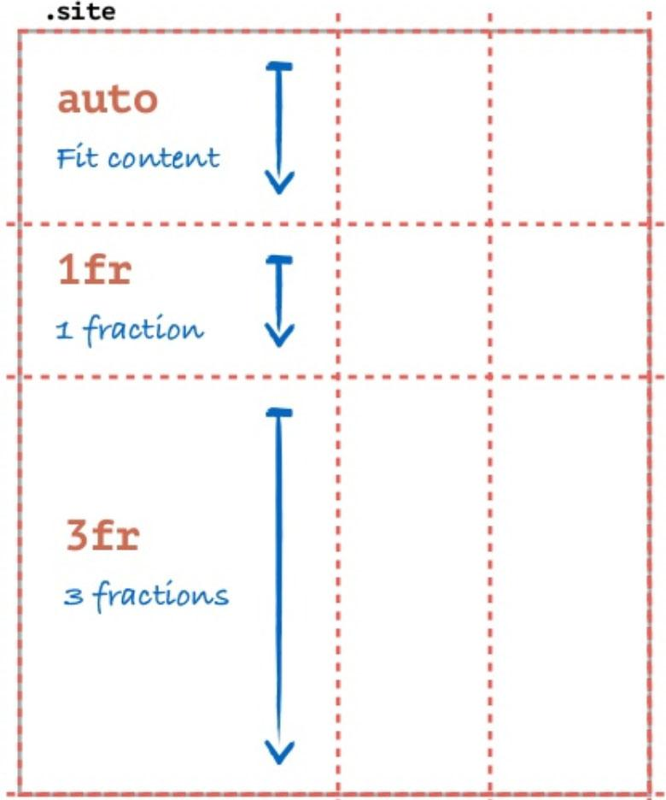
Grid-Template
.site {
display: grid;
grid-template-columns: 2fr 1fr 1fr;
grid-template-rows: auto 1fr 3fr;
}

Slide 15
CSS Grid Methods

Slide 16
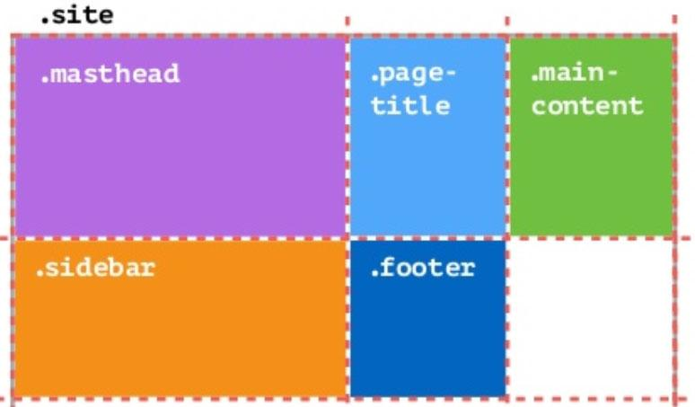
Base method
.site {
display: grid;
grid-template-columns: 2fr 1fr 1fr;
}
<div class=”site”>
<header class=”mastheader”></header>
<h1 class=”page-title”></h1>
<main class=”main-content”></main>
<aside class=”sidebar”></aside>
<footer class=”footer”></footer>
</div>
Example:
http://127.0.0.1:5500/cg1.html

Slide 17
Say hello to the
repeat function
grid-template-columns: 1fr 1fr 1fr 1fr 1fr;
=
grid-template-columns:repeat(5 , 1fr);

Slide 18
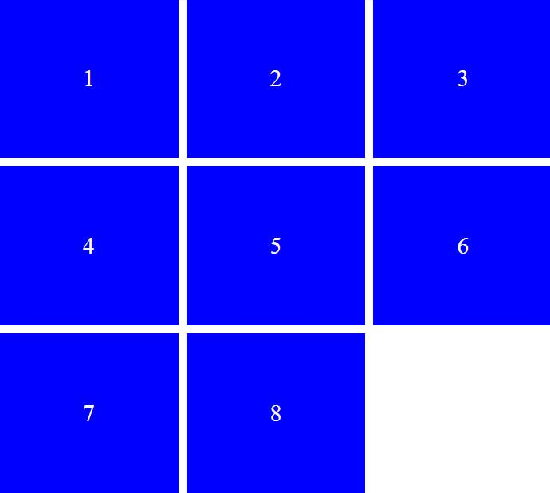
List Method
Using the “base method”and the “repeat function” we can easily achieve list sequence of items.
.site {
display: grid;
grid-template-columns: repeat(3, 1fr);
grid-gap: 10px;
}
<ul class=”common-list”>
<li class=”common-list-item”>1</li>
<li class=”common-list-item”>2</li>
<li class=”common-list-item”>3</li>
…
</ul>
Example:
http://127.0.0.1:5500/cg2.html

Slide 19
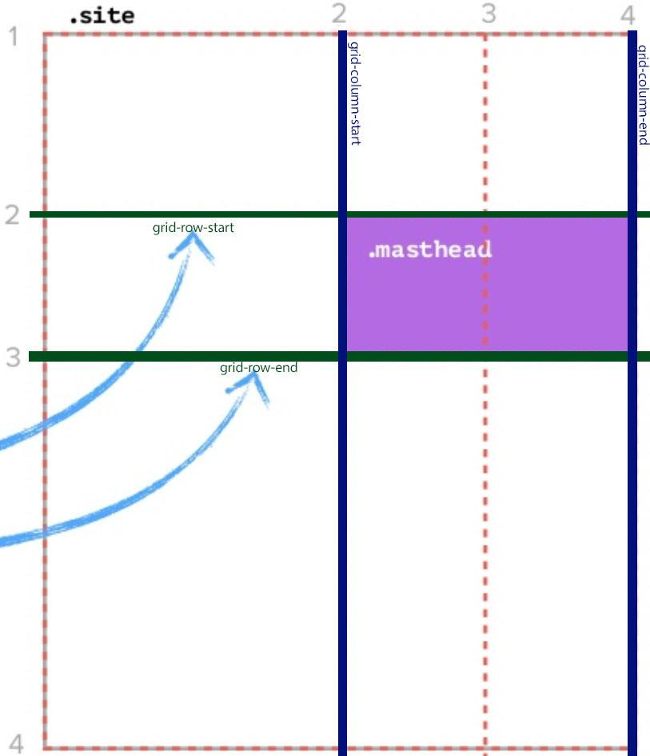
Positioning Method
Position grid item according the grid lines.
.site {
display: grid;
grid-template-columns: 2fr 1fr 1fr;
grid-template-rows: auto 1fr 3fr;
}
.masthead {
grid-column-start: 2;
grid-column-end: 4;
grid-row-start: 2;
grid-row-end: 3;
}
same as:
.masthead {
grid-row: 2 / 3;
grid-column: 2 / 4;
}
Example:
http://127.0.0.1:5500/cg3.html

Slide 20
Positioning Method
More syntax options
grid-row: 2 / 3;
=
grid-row: 2; /*will take one cell*/
grid-column: 2 / 4;
=
grid-column: 2 / span 2; /*will take 2 cells;
area is another option:
.masthead {
grid-area: 2 / 2 / 3 / 4;
}
Example:
http://127.0.0.1:5500/cg3.html

Slide 21
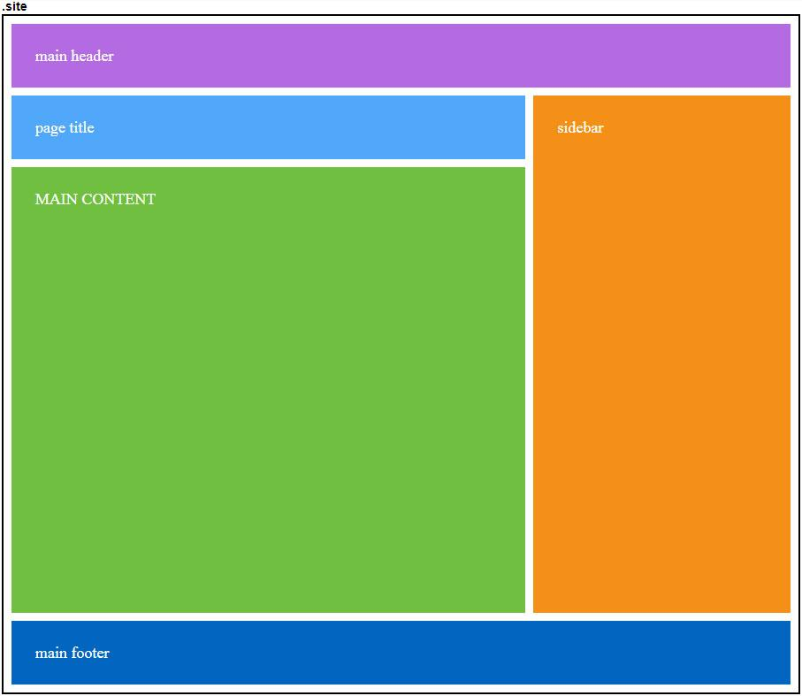
Areas/Mapping Method
Positioning grid items according grid map.
<div class="site">
<header class="mastheader">main header</header>
<h1 class="page-title">page title</h1>
<main class="main-content">MAIN CONTENT</main>
<aside class="sidebar">sidebar</aside>
<footer class="footer">main footer</footer>
</div>
.site {
display: grid;
grid-template-columns: 2fr 1fr; grid-gap: 10px;
grid-template-areas:"header header"
"title sidebar"
"main sidebar"
"footer footer";
}
.mastheader { background: #b46ae3; grid-area: header; }
.page-title { background: #51a7fa; grid-area: title; }
.main-content {
background: #70bf40; grid-area: main; min-height: 500px;
}
.sidebar { background: #f49018; grid-area: sidebar; }
.footer { background: #0265c0; grid-area: footer; }
Example: http://127.0.0.1:5500/cg4.html

Slide 22
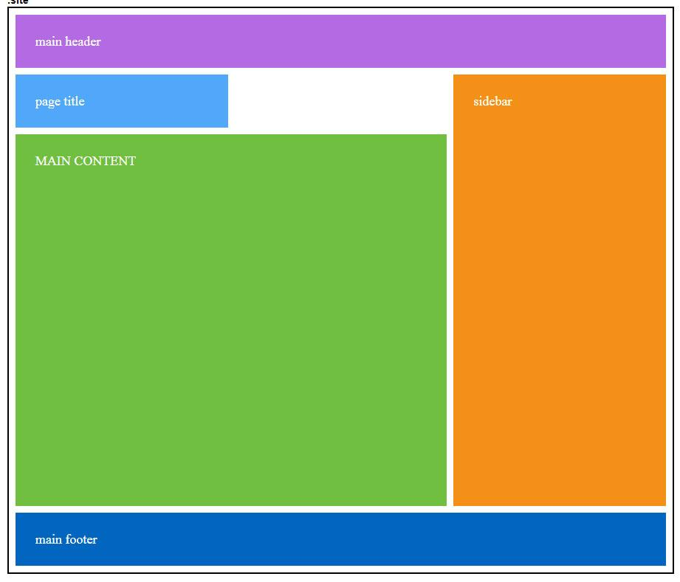
Areas/Mapping Method
Saving EMPTY space with dot(.)
.site {
display: grid;
grid-template-columns: 1fr 1fr 1fr; grid-gap: 10px;
grid-template-areas:"header header header"
"title . sidebar"
"main main sidebar"
"footer footer footer";
}
Example: http://127.0.0.1:5500/cg5.html

Slide 23
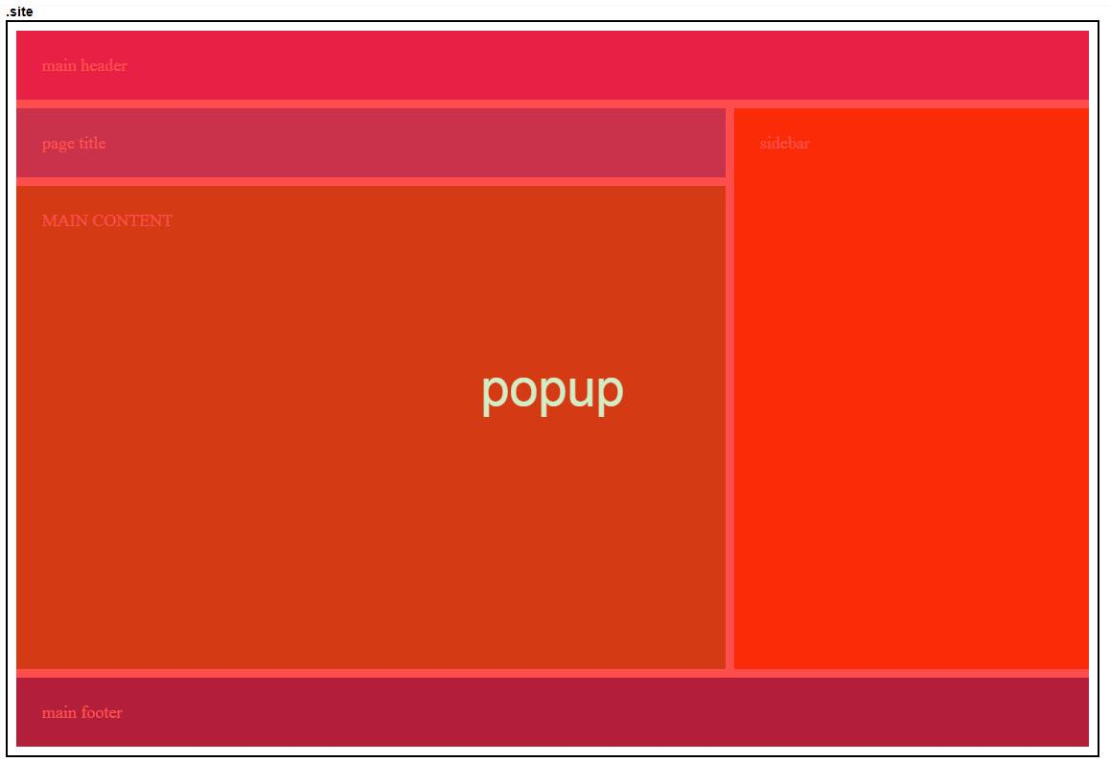
Overlapping Grid items
Grid items can be layered/stacked by properly positioning them (and assign z-index when necessary).
Example: http://127.0.0.1:5500/cg6.html

Slide 24
Done with the Basics

Slide 25
Some More Stuff

Slide 26
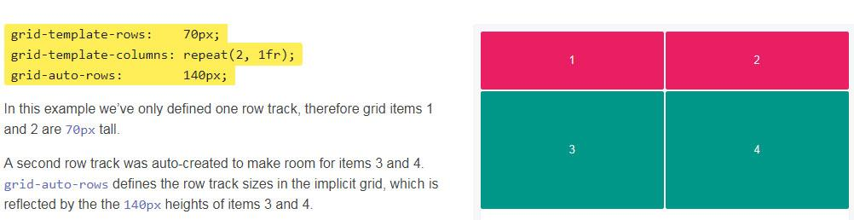
grid-auto-rows/columns
When columns or rows aren't declared you can use this property to declare fix height/width to undeclared columns or rows.

Slide 27
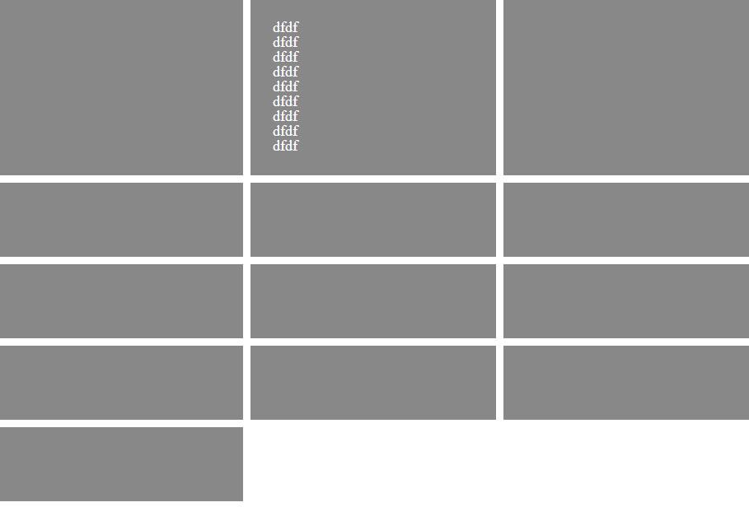
MinMax Function
.site {
display: grid;
grid-template-columns: 1fr 1fr 1fr;
grid-auto-rows: minmax(100px, auto);
grid-gap: 10px;
}
Minimum height of 100px
Example:
http://127.0.0.1:5500/cg7.html

Slide 28
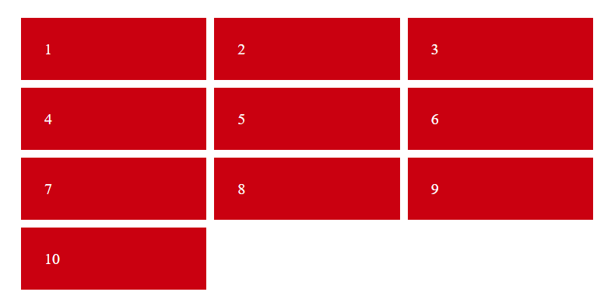
grid-auto-flow
The default flow (direction) of a grid is row, It means if there isn’t more space the left item will drop to new row. But like every definition it is changeable.
.site {
display: grid;
grid-template-columns: repeat(3, 1fr);
grid-template-rows: repeat(3, 1fr);
}
http://127.0.0.1:5500/cg8.html

Slide 29
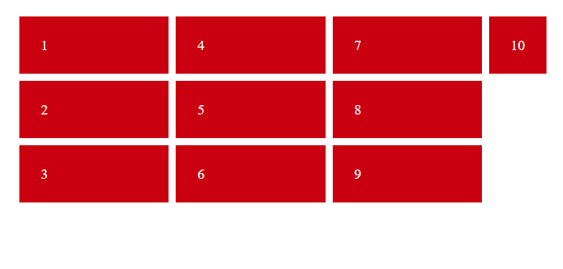
grid-auto-flow
The default flow (direction) of a grid is row, It means if there isn’t more space the left item will drop to new row. But like every definition it is changeable.
.site{
display:grid;
grid-template-columns:repeat(3,1fr);
grid-template-rows:repeat(3,1fr);
grid-auto-flow:column;
}
http://127.0.0.1:5500/cg9.html

Slide 30
We’re done

