Slide 1

Operating Systems
CPU Scheduling Algorithms Implementation In Java
GROUP 20
Instructors: Prof. Mansukh Savaliya Prof. Siddhi Shah
Ratnam Parikh(1741036) Devshree Patel(1741075)

Slide 2

Algorithms Implemented:
Round Robin Algorithm: It is a preemptive algorithm where each process is assigned a fixed time in a cyclic way. It eradicates the problem of starvation faced by processes in FCFS. Only disadvantage of this method is the overhead of context switching.
First Come First Serve Algorithm: is the simplest scheduling algorithm. FIFO simply queues processes in the order that they arrive in the ready queue.In this, the process that comes first will be executed first and next process starts only after the previous gets fully executed.

Slide 3
Assumptions:
In our case, the processes are shifted to ready queue only when the new queue size is greater than or equal to 5. This is done in order to show a transition of a process from new queue to the ready queue(task of long term scheduler).
A new process is generated only when a random number generated in the range of 5-10 gives a number which is either 8,9 or 10. Also another random number is used to decide for “Processor Bound” or “I/O Bound”.
A process is shifted from block queue to ready queue only when a random number generated in the range of 5-10 gives 10.
The system works for 20 processes along with GUI display and can work for any number of processes without GUI display.
Whenever an I/O bound process moves to ready queue from the block queue it is directly sent for running.
The size of the ready queue is fixed which is 6.

Slide 4
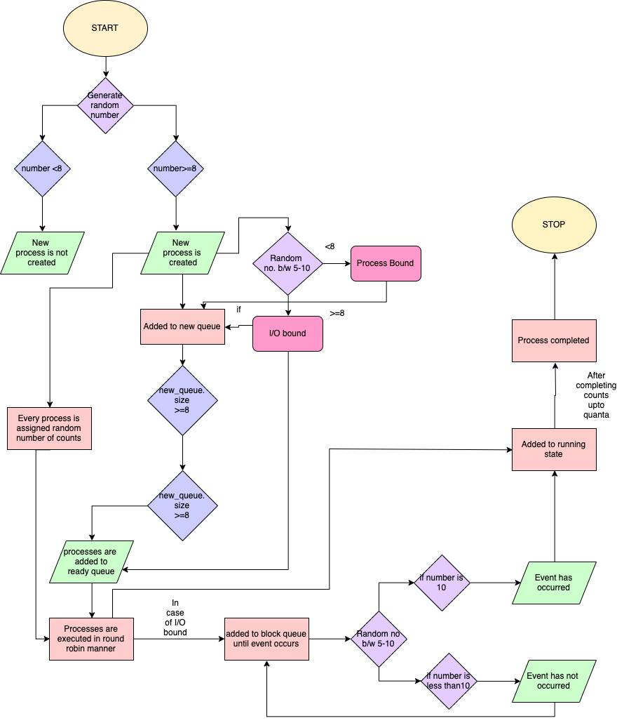
Working Flow of Round Robin:

Slide 5
Classes Implemented In The Code:
Process Creation
A random number is generated between 5 to 10. Now, a decision over the number is taken for creating a process or not.
Once that decision is taken a new process is then created which is added to new queue.
When number of processes is greater than a threshold the long term scheduler is invoked for further execution of program. This is done so that once processes are generated the execution will not have to remain idle.
Long Term Scheduler
After the new processes are generated the work of long term scheduler is to shift the new processes to ready queue.
After every space that is created in ready queue the long term scheduler checks for process in new queue and shifts to ready queue.
This way multiprogramming is taken care of using long term scheduler.

Slide 6
Classes Implemented In The Code:
Execution
In this class the execution of processes is done in a Round-Robin fashion.
The process in the ready queue is removed and brought in for execution. Here the while loop is kept running for the time quantum or for process count is not zero i.e. process completion.
Afterwards the process is checked for process type. If the process type is “I/O Bound” the process is shifted to block queue to wait for the event to occur. Else the process is placed at the end of the ready queue for further execution or it is removed from the program if it is completed.
Medium Term Scheduler
The implementation of medium term scheduler is to make shifts between processes from block queue to ready queue.
For an event to occur in real OS implementation many interrupts and signals are used.
Here, we implement it in a different manner where again a random number is used for taking decisions for event occurrence.
A number between 5 to 10 is generated and when the number is equal to 10 an event occurrence is portrayed.
The process then moves from block queue to running state, which states high priority for block process when an event occurs.

Slide 7
Classes Implemented In The Code:
Analysis
This class is implemented to make analysis for processes which are created and serviced by the program.
Different parameters Start Time, End Time, Turn Around Time, Burst Time, Completion Time etc. are calculated.
These are done by real time analysis using System call for time i.e. System.currentTimeMillis()
Process
This class is the thread or process that are scheduled in our program.
Process is given attributes like Process Id, Process Type, Process Count.
GUI
We have implemented 2 GUI classes: One is for the process execution display and another is for analysis of process execution.

Slide 8
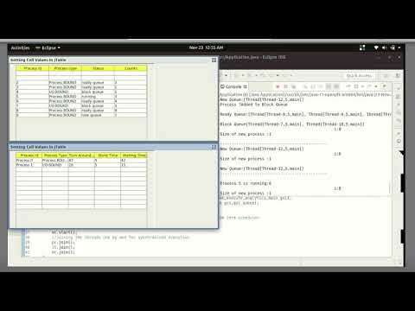
Video Of Execution(Round Robin):

Slide 9
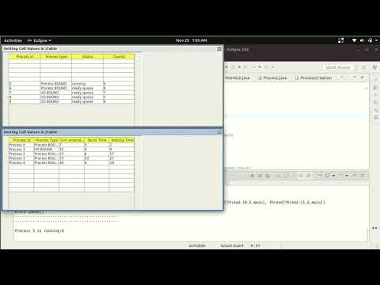
Video Of Execution(FCFS):

Slide 10
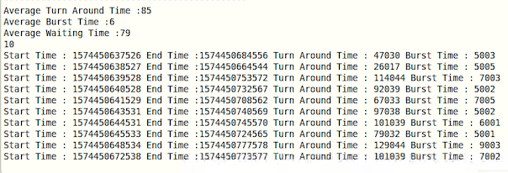
Screenshots Of Analysis(RR):

Slide 11
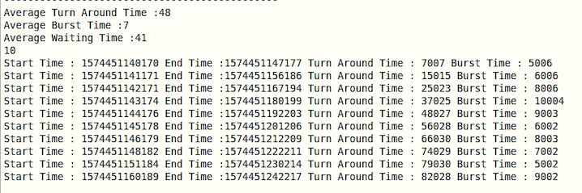
Screenshots Of Analysis(FCFS):

Slide 12
Results for various no. of processes
Round Robin
No.of processes | Avg. Turnaround Time | Avg. Burst Time | Avg. Waiting Time
5 10 | 28 47 | 7 7 | 21 40
B. First Come First Serve
No.of processes | Avg. Turnaround Time | Avg. Burst Time | Avg. Waiting Time
5 10 | 63 113 | 8 7 | 54 105

Slide 13
References:
https://www.geeksforgeeks.org/cpu-scheduling-in-operating-systems/
https://www.tutorialspoint.com/operating_system/os_process_scheduling_algorithms.htm
https://www.geeksforgeeks.org/program-round-robin-scheduling-set-1/
https://www.geeksforgeeks.org/program-for-fcfs-cpu-scheduling-set-1/
https://www.geeksforgeeks.org/process-schedulers-in-operating-system/
Internals and Design Principles, Seventh Edition, by William Stallings

Slide 14
Thank You

