Slide 1

MENTAL HEALTH ANALYSIS
Name = Dev Sinha Roll no.= 2312res786

Slide 2
📝 Dataset Description
This dataset contains information on mental health, lifestyle, and demographics of 1,200 individuals. It includes measures of anxiety, depression, stress, sleep, physical activity, self-esteem, loneliness, and life satisfaction, along with demographic details like age, gender, education, and employment status. The data helps in analyzing patterns, risk factors, and protective factors affecting mental well-being.

Slide 3
Demographics
Dataset covers 1,200 individuals, aged 18–74 years (average ~46).
Gender distribution: Majority Female, followed by Male, smaller Non-binary/Other groups.
Education: Most common = PhD (262 participants).
Employment: Largest group = Employed (320 participants).
2. Lifestyle Patterns
Sleep: Average = 6.5 hours/day (many below recommended 7–8).
Physical Activity: Avg. 2 hrs/day, but varies widely (0–10+ hrs).
Meditation: ~40% practice regularly.
Substance Use: Most = "None", but frequent users show higher depression scores.
3. Mental Health Scores
Anxiety: Avg. 10.5 / 20 (moderate).
Depression: Avg. 10.7 / 20 (moderate).
Stress Level: Avg. 5 / 9 (moderate).
Self-esteem & Life Satisfaction: ~5 / 9 (medium).
Loneliness: Avg. ~5 / 9.
4. Group Differences
Gender:
Females → slightly higher anxiety, lower depression than males.
Non-binary/Other → higher depression & stress.
Employment:
Students → highest depression.
Unemployed → higher anxiety.
Employed/Retired → closer to average stress levels.

Slide 4
Key Risk Factors for High Stress
Work Stress
Financial Stress
High Anxiety & Depression Scores
Low Sleep Hours
Low Self-Esteem & Life Satisfaction
Stress is influenced most by work, financial, and emotional factors.
Students & unemployed groups are more vulnerable.
Lifestyle improvements (sleep, physical activity, meditation) can reduce stress.
Intervention focus: Support programs for students/unemployed, stress management at workplace, and promoting healthy routines.

Slide 5
Title:
"Key Factors Driving Stress Prediction (ML Model)“
Layout:
Left side → A bar chart (horizontal) showing feature importance (Top 5):
Work Stress
Financial Stress
Anxiety Score
Depression Score
Sleep Hours
Right side → Icons + Short Notes
🏢 Work Stress → Biggest driver of stress.
💰 Financial Stress → Strong contributor to high stress.
😟 Anxiety → Strongly correlated with high stress.
😔 Depression → Amplifies stress risk.
😴 Sleep Hours → Low sleep increases stress probability.
Bottom footer → “Lifestyle improvements & emotional support can reduce high stress risk.”

Slide 6
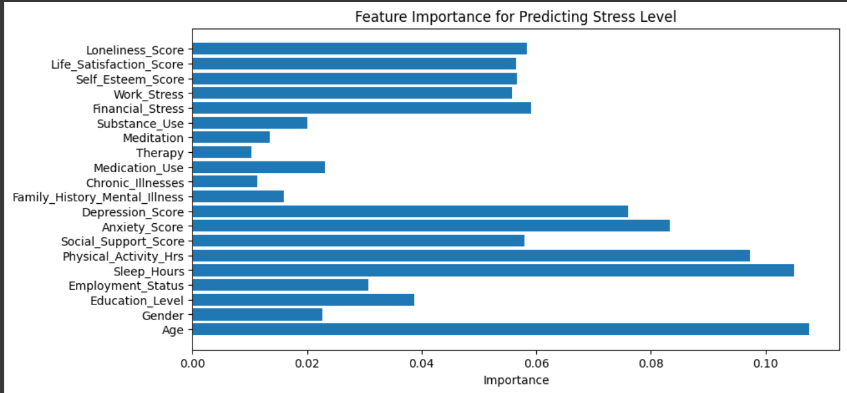

Slide 7
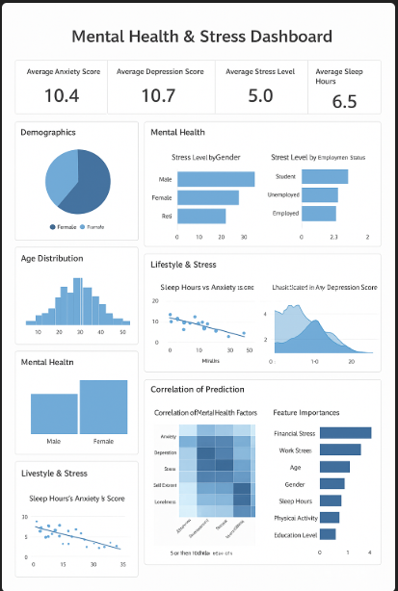

Slide 8
"Mental health is not just the absence of illness, but the presence of balance, support, and care—together, we can make it stronger."

