Slide 1
Devcreate buildfest 1.0
Team Name: CodeXplore (T-015)
Team Members:
Dev Soni (Team Leader)
Rishi Bisht
Sunny Yadav
Mukesh Yadav
Vivek Sharma

Slide 2
Student Dropout Prediction System

Slide 3
Problem Statement
Student dropout is a critical challenge in education.
Many students disengage before results reveal struggles.
Institutions need early intervention to support at-risk students.
Predictive analytics can help counselors take timely action.

Slide 4
Solution Overview
We developed a web-based dropout prediction system:
Upload student data (CSV format).
Predict dropout risks using Random Forest ML model.
Categorize students into LOW, MEDIUM, HIGH risk.
Visualize risk distribution with interactive charts.
Send automatic email alerts to mentors for HIGH-risk students.

Slide 5
Technology Stack
Python
Streamlit (Web UI)
Scikit-learn (Machine Learning)
Plotly (Visualizations)
Pandas & Numpy (Data Handling)
Yagmail (Email Notifications)
Pickle (Model Serialization)

Slide 6
Workflow
1. Upload student data (CSV).
2. Preprocess and load trained model.
3. Predict dropout probabilities.
4. Map probabilities into LOW, MEDIUM, HIGH risk categories.
5. Display interactive charts.
6. Send automated email alerts to mentors.

Slide 7
Features
User-friendly Streamlit web app.
Upload CSV directly into app.
Risk prediction using trained model.
Data visualization (bar chart & pie chart).
Export results to CSV.
Automated mentor email alerts.

Slide 8
Impact
Early identification of at-risk students.
Helps mentors provide timely support.
Reduces student dropout rates.
Encourages data-driven decision making in education.

Slide 9
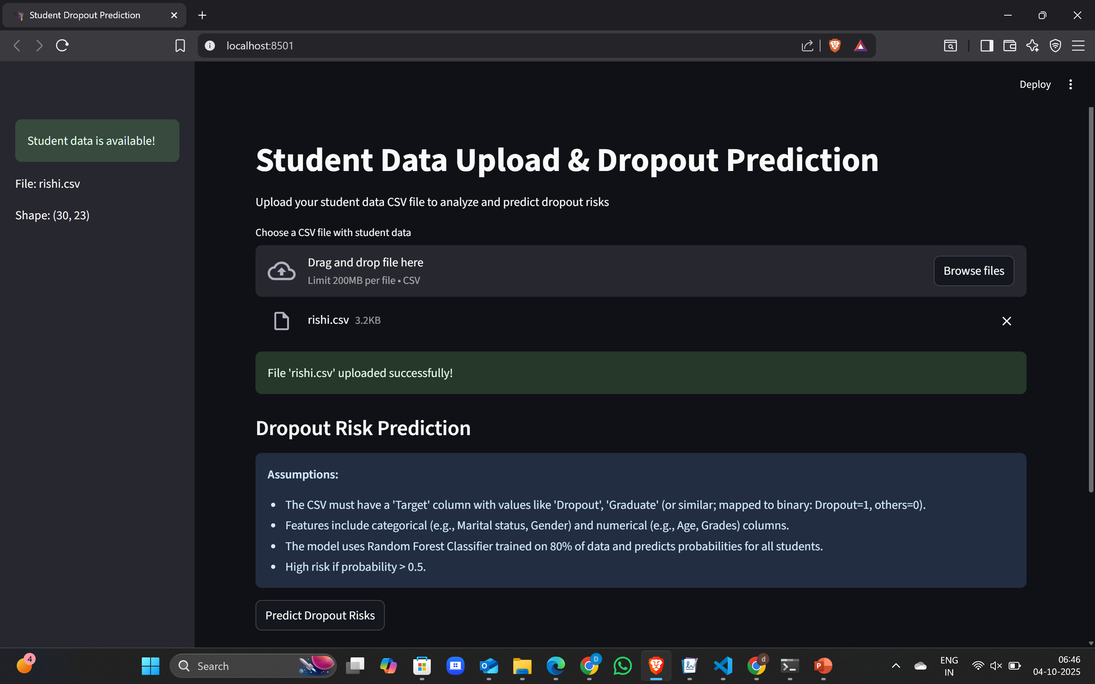

Slide 10
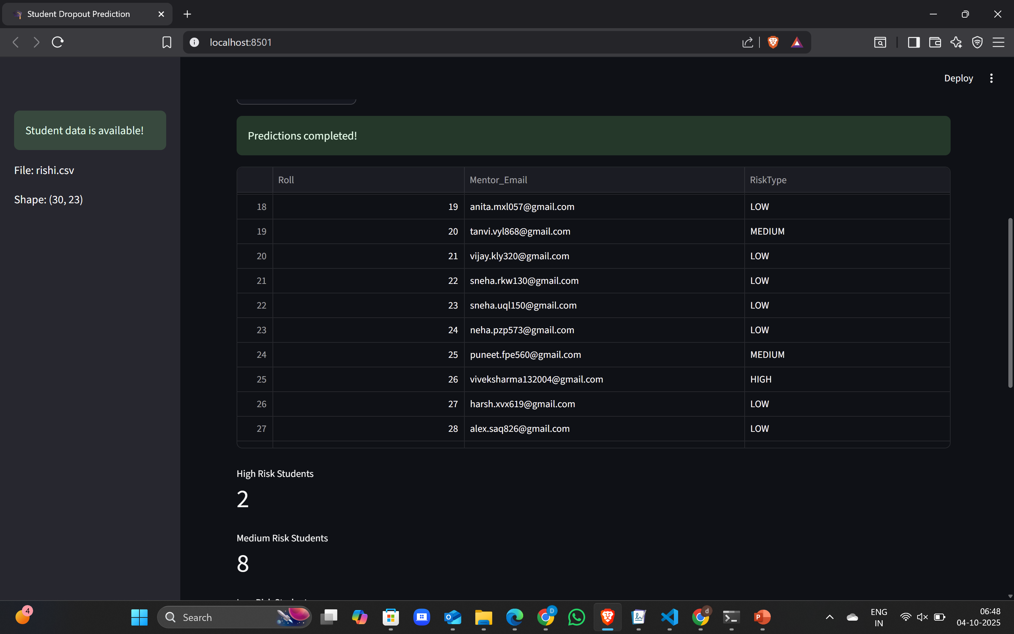

Slide 11
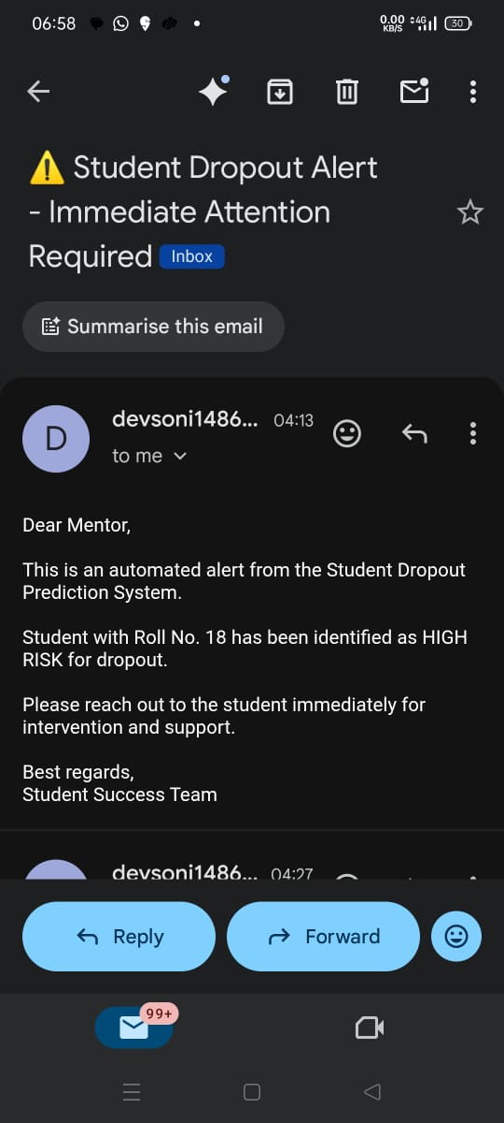
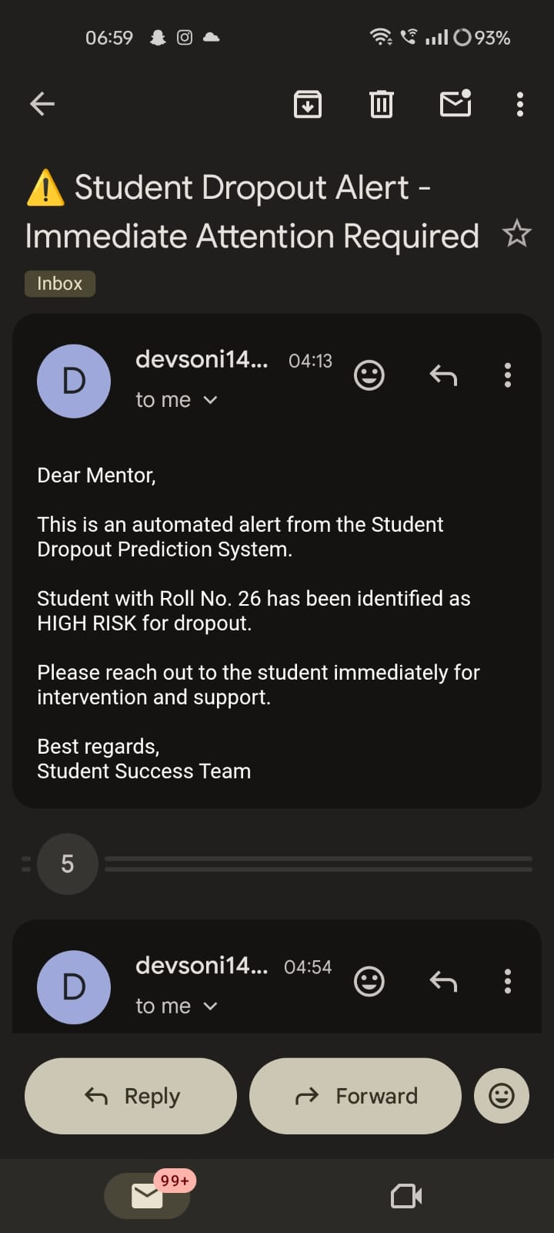

Slide 12
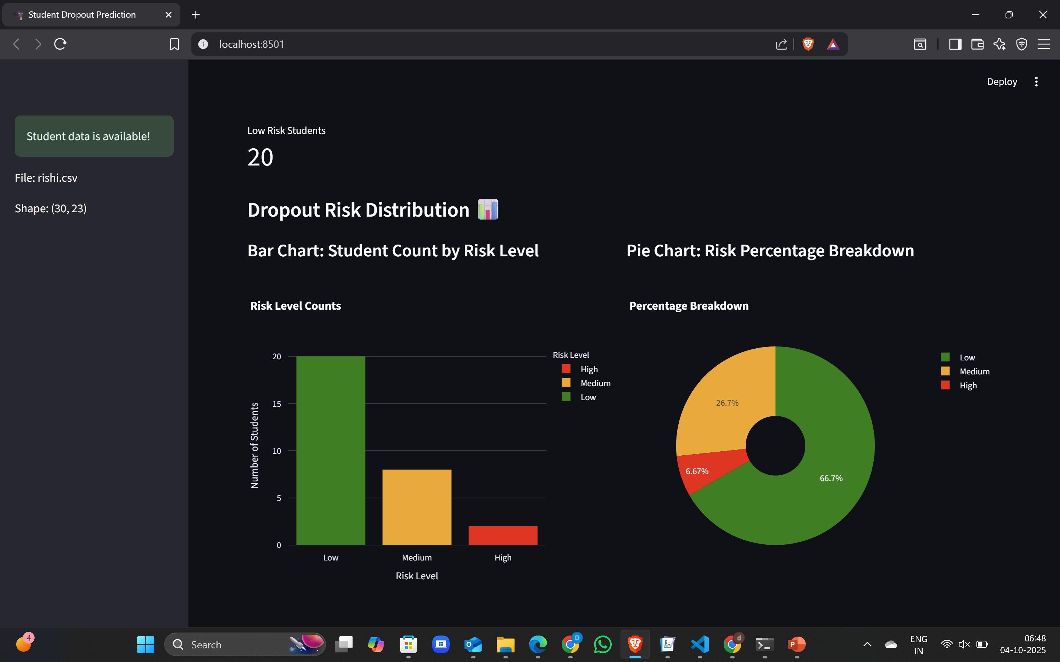

Slide 13
