Slide 1

Introduction to Mobile App Development
Symianakis Sifis
Sofware Engineer @Pancreta Bank
https://www.linkedin.com/in/sifis-symianakis/

Slide 2
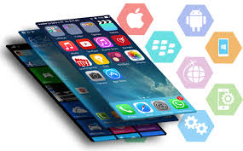
Mobile Development
Mobile Devices
  Smartphones/Tablet
  Wearables
  Smartwatches
  Info-systems
  VR devices
  Gaming Consoles
App Types
  Native
  Hybrid
  Web apps
  Progressive

Slide 3
Terminology
Mobility
Connectivity
Context- awareness
Cross-platform
Mobile HCI
Distraction
Privacy
Mbaas
Emulator/Simulator
Instrumental-tests
I/O sensors
Accelerator
Adaptive layout
MVP
Resources
Gestures
Compatibility
Orientation
Ubiquitous

Slide 4
Challenges
Development on desktop while targeting on a different device
Different I/O types instead of traditional (mouse-keyboard)
  Touchsreen, Sensors(GPS, GS), Microphone
Wide range of screen sizes
Hardware Specifications
Device compatibility / Different OS
Emphasizing on context

Slide 5
Developer should consider
Constants
Mobility
Connectivity – Offline
Low Resources (battery, processor, memory)
Privacy
Security
  (Apple strict guidelines https://developer.apple.com/app-store/resources/ )

Slide 6
Context awareness
“Ability of the system to gather information about environment at any given time and adapt behaviors accordingly.”
Variety of sensors
User personalization
UI / User involvement
Ubiquitous system integration

Slide 7
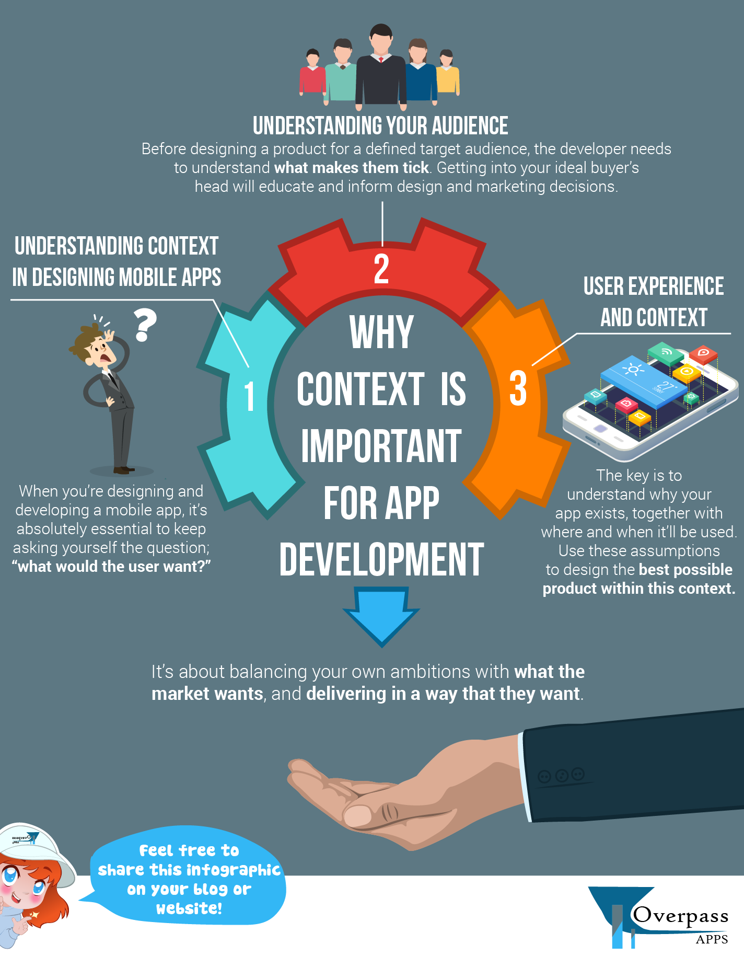
Is really context important ?
Source: https://www.overpass.co.uk/infographic-context-important-app-development/
Learn what people want
Make use of environment info
Improves functionality
Improves usability
Adapt accordingly
Minimizes user distraction
Maximizes offered value

Slide 8

UI/UX
Great functionality without focus on user interaction → app failure
Non–distractive
  sensors output vs screen
  gestures
Adaptive UI
Space limitations
View Consistency
Simplicity - Usability
Self-explanatory

Slide 9
Mobile App Statistics
In 2018, there were 194 billion mobile app downloads.
12 mn mobile developers globally
In 2018, the average mobile user spent three hours a day on their smartphone
Mobile apps accounted for 57 percent of all digital media usage in 2018.
app store consumer spending increased by 75 percent to $101 billion worldwide.
Source: https://clearbridgemobile.com/50-mobile-app-stats-you-need-to-know-before-you-start-building-your-app/

Slide 10
Market (1/2)
Competition
  Building a robust does not mean it is successful.
  Measurement of success: No of users
Define your target group
  Attract attention of the users
  Offered Value
Promoting, branding and marketing

Slide 11
Market (2/2)
Customer Reviews, experience & feedback
Funding
Numerous development framework and platforms to choose
Quick prototype → Fail fast → Feedback loops

