Slide 1


Slide 2
Angular 17 updates
Up to 90% faster runtime with the new built-in control flow loops, that also contains a migrations script to do it automatically
Up to 87% faster builds for server-side rendering and 67% for client-side rendering
Brand new interactive learning journey on angular.dev
Node.js version 18.13.0 or higher requirement for Angular 17
Added Support for TypeScript 5.2

Slide 3
Angular 17 updates
Improved Signals and Effects
Efficient CSS removal upon component destruction
Stable server-side rendering (SSR) and static site generation (SSG)
New lifecycle hooks
Vite and esbuild are the default for new projects
Deferrable views

Slide 4
Efficient CSS removal upon component destruction
Angular 17 introduces a new built-in mechanism that streamlines the process of removing CSS from the DOM when a component is destroyed, contributing to smoother application functioning and improved resource management

Slide 5
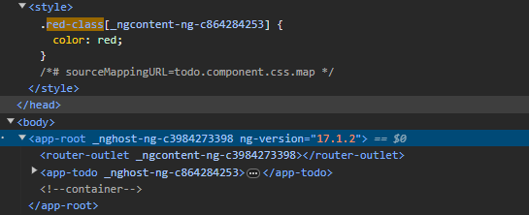
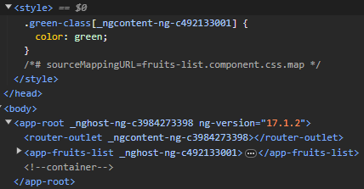
Efficient CSS removal upon component destruction
Moving from one component to another, no CSS classes are left in the template

Slide 6
Efficient CSS removal upon component destruction
The Importance of Efficient CSS Removal
• memory leaks
• degraded performance
• unnecessary resource consumption
• unnecessary bloat styles

Slide 7
Stable server-side rendering (SSR) and static site generation (SSG)
Server-side rendering (SSR) is a process that involves rendering pages on the server, resulting in initial HTML content which contains initial page state. Once the HTML content is delivered to a browser, Angular initializes the application and utilizes the data contained within the HTML

Slide 8
Stable server-side rendering (SSR) and static site generation (SSG)
Static site generation (SSG) is when you render the website during the build process. The Angular compiler will build your website and pre-render the HTML pages during this process. Pre-rendering only works for websites with static content; that is pages that are exactly the same for each person that loads and sees them.

Slide 9
Stable server-side rendering (SSR) and static site generation (SSG)
Why SSR/SSG
• Improved performance
• Improved Core Web Vitals(First Contentful Pain, Largest Contentful Paint, Time To First Byte)
• Better SEO

Slide 10
Stable server-side rendering (SSR) and static site generation (SSG)
How it was done before
In order to activate the SSR in older versions we should install the angular-universal and Scully for SSG

Slide 11

Stable server-side rendering (SSR) and static site generation (SSG)
How to enable SSR in Angular 17
SSR is now is now available when creating a new application: ng new or by adding it afterwords on your existing application: ng add @angular/ssr

Slide 12
New lifecycle hooks
afterRender — register a callback to be invoked each time the application finishes rendering. This is perfect to update the DOM every time Angular detects a change. You could use it to make additional writes to (or reads from) the DOM based on an app update.

Slide 13
New lifecycle hooks
afterNextRender — register a callback to be invoked the next time the application finishes rendering. So that makes this event perfect for any initialization code that you need in your app, for example any third-party libraries, or browser-only APIs (for example initializing ResizeObserver API).

Slide 14
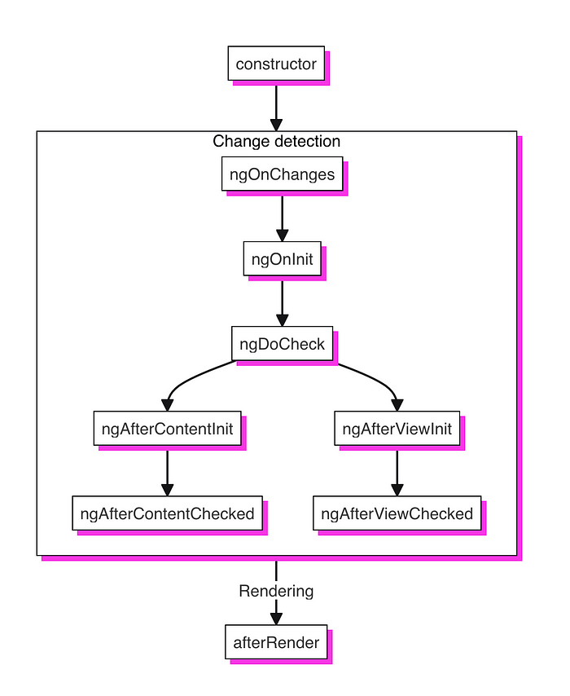
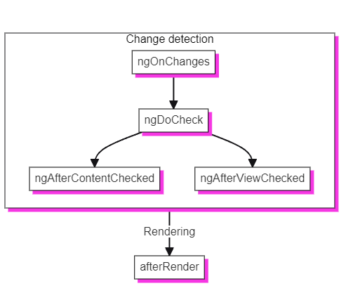
New lifecycle hooks

Slide 15
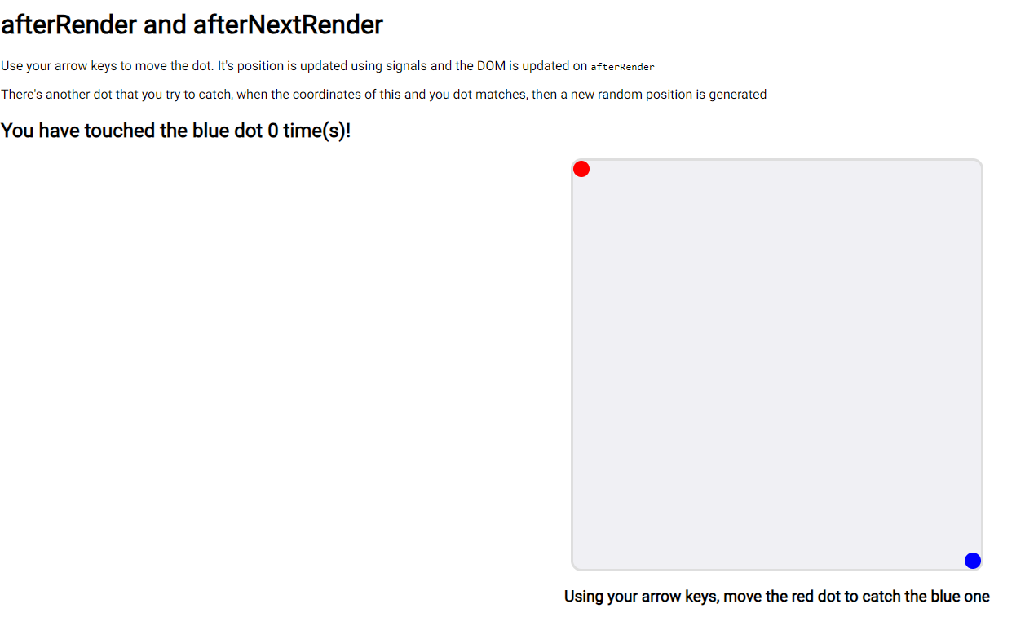
New lifecycle hooks
You can try the game here: https://after-render.netlify.app/ and review the code at GitHub https://github.com/eduardoRoth/after-render

Slide 16
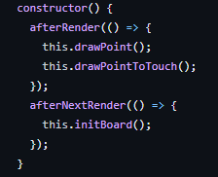
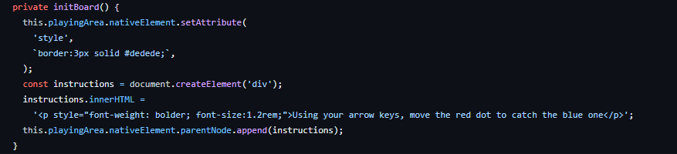
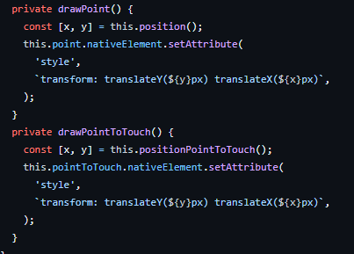
New lifecycle hooks

Slide 17

Vite and esbuild the default for new projects

Slide 18
Vite and esbuild the default for new projects
In v16, esbuild plus Vite powered build experience was introduced as developer preview. Since then a lot of developers experimented with it and some enterprise partners, reported 67% build time improvement in some of their apps!
With SSR & SSG you can observe up to 87% speed improvement in ng build and 80% faster edit-refresh loop in for ng serve.

Slide 19
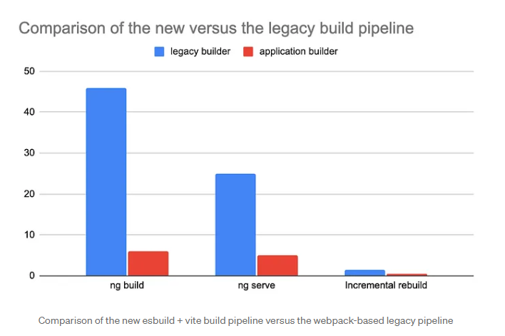
Vite and esbuild the default for new projects

Slide 20
Added Support for TypeScript 5.2
Explicit Resource Management : a common pattern in software development regarding the lifetime and management of various resources (memory, I/O, etc.). This pattern generally includes the allocation of a resource and the ability to explicitly release critical resources.

Slide 21
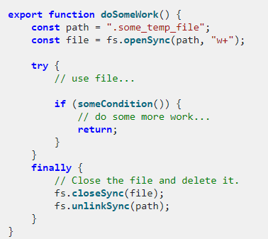
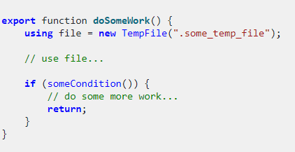
Added Support for TypeScript 5.2

Slide 22
Added Support for TypeScript 5.2
Decorator Metadata: TypeScript 5.2 introduces an exciting new feature called decorator metadata. This feature allows decorators to create and consume metadata on any class they’re used on or within. With decorator metadata, you can easily attach additional information to classes, properties, or methods.

Slide 23
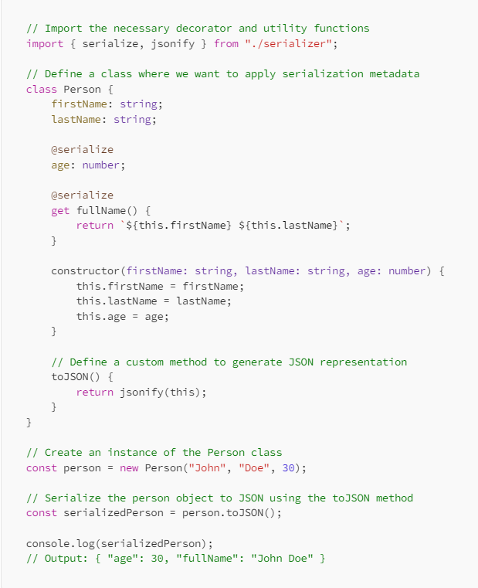
Added Support for TypeScript 5.2

Slide 24
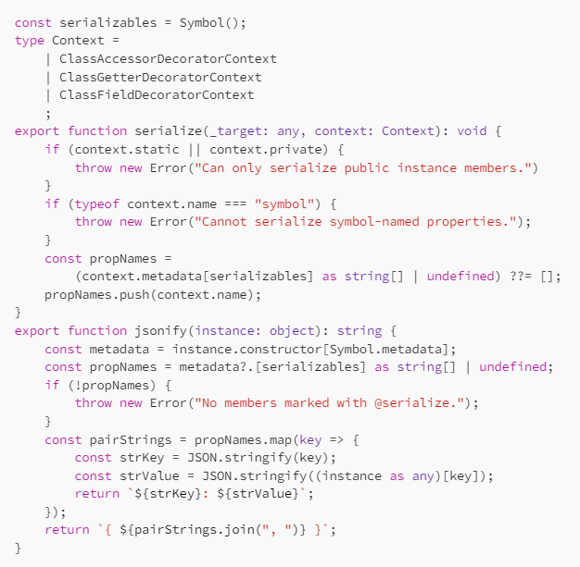
Added Support for TypeScript 5.2

Slide 25
Added Support for TypeScript 5.2
Named and Anonymous Tuple Elements: In TypeScript 5.2, the all-or-nothing restriction on tuple labels has been lifted. The language can now also preserve labels when spreading into an unlabeled tuple.

Slide 26
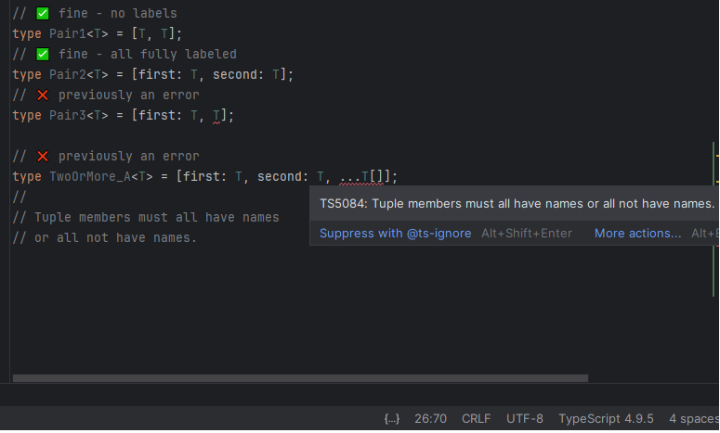
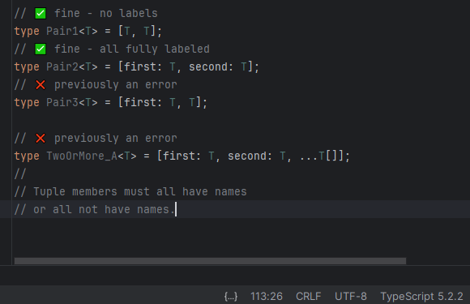
Added Support for TypeScript 5.2

Slide 27
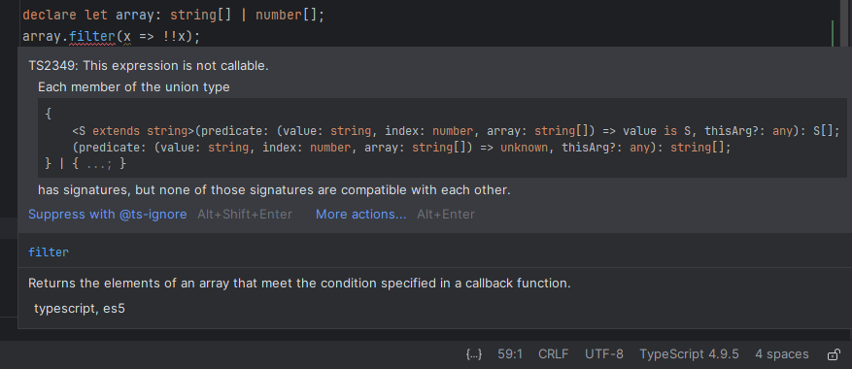
Added Support for TypeScript 5.2
Easier Method Usage for Unions of Arrays
string[] | number[] is transformed into (string | number)[] (or Array<string | number>)

Slide 28
Added Support for TypeScript 5.2
Copying Array Methods: Often, it’s desirable to create a completely separate array without affecting the original. To do this, you could use slice() or an array spread (like [...myArray]) to get a copy first, and then perform the operation. Now Typescript 5.2 includes the new methods added to ECMAScript proposal

Slide 29
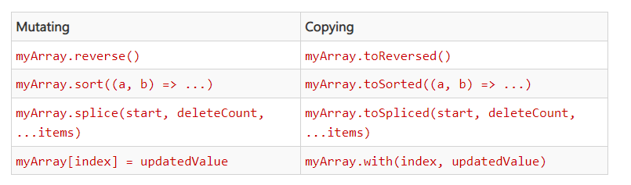

Added Support for TypeScript 5.2
In order to enable them to your typescript files you should add the ESNext.Array:

Slide 30
Added Support for TypeScript 5.2
Type-Only Import Paths with TypeScript Implementation File Extensions: TypeScript now allows both declaration and implementation file extensions to be included in type-only import paths. This means that you can now write import type statements that use .ts, .mts, .cts, and .tsx file extensions.

Slide 31
Added Support for TypeScript 5.2
Comma Completions for Object Members:

Slide 32
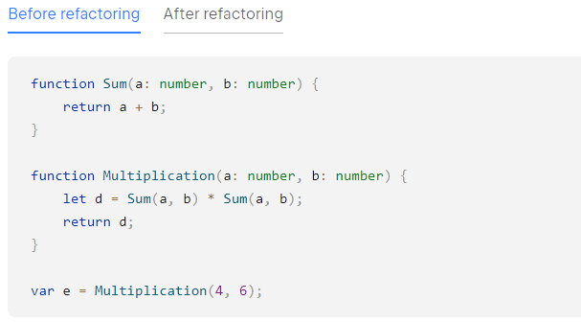
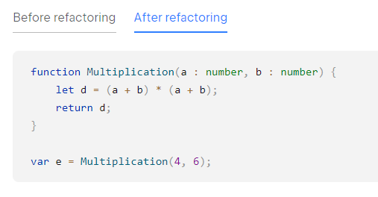
Added Support for TypeScript 5.2
Inline Variable Refactoring: Using the “inline variable” refactoring will eliminate the variable and replace all the variable’s usages with its initializer

Slide 33
Improved Signals and Effects
Signals, introduced in Angular 16 and becoming stable in 17, transforms the way you manage state and handle change detection. When you read a signal within an OnPush component's template, Angular tracks the signal as a dependency of that component. When the value of that signal changes, Angular automatically marks the component to ensure it gets updated the next time change detection runs

Slide 34
Improved Signals and Effects
What is a Signal
A signal is a wrapper around a value, which is capable of notifying interested consumers when that value changes. Signals can contain any value, from simple primitives to complex data structures.
Why Signals?
Performance

Slide 35
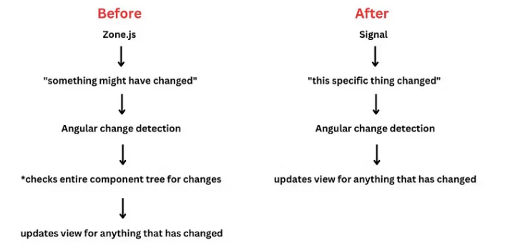
Improved Signals and Effects

Slide 36
Improved Signals and Effects

Slide 37
Improved Signals and Effects
Types of Signals
Writable Signals: These are mutable and allow you to set, get, update, or reset them. Signals are accessed using getter functions, offering a straightforward way to manage component state.
Computed Signals: Computed primitives are read-only and derive their values from signals. They automatically run a function to update their value when the signals they depend on change, simplifying complex calculations.

Slide 38

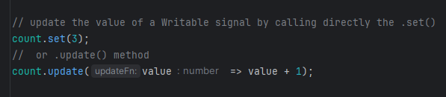
Improved Signals and Effects
Writable Signals

Slide 39
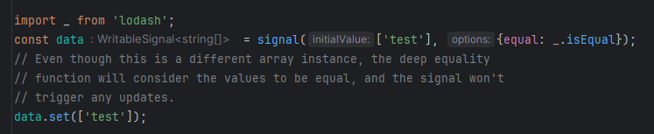
Improved Signals and Effects
Writable signals, provide equality functions
When creating a signal, you can optionally provide an equality function, which will be used to check whether the new value is actually different than the previous one.

Slide 40
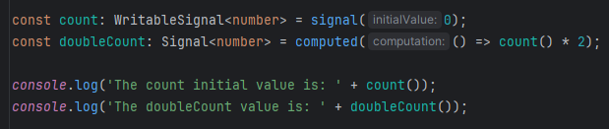
Improved Signals and Effects
Computed Signals
doubleCount's derivation function does not run to calculate its value until the first time you read doubleCount. The calculated value is then cached, and if you read doubleCount again, it will return the cached value without recalculating.
If you then change count, Angular knows that doubleCount's cached value is no longer valid, and the next time you read doubleCount its new value will be calculated.

Slide 41
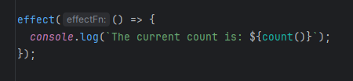
Improved Signals and Effects
What is an Effect
Effects are asynchronous functions triggered by changes in specific signals, enabling you to manage side effects based on data updates. Angular tracks these dependencies, ensuring the right effects are executed when related signals change.

Slide 42
Improved Signals and Effects
Reading without tracking dependencies
There could be some cases where we would like to have an effect that have more than 1 signal, but it should run only about the one we care. In that case, we use the untracked:

Slide 43
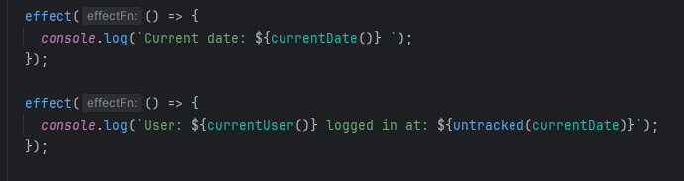
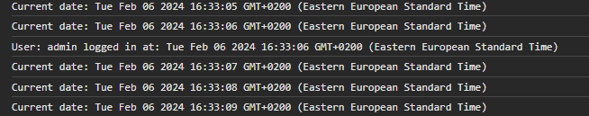
Improved Signals and Effects
Reading without tracking dependencies

Slide 44
Improved Signals and Effects
Destroying effects
When you create an effect, it is automatically destroyed when its enclosing context is destroyed. This means that effects created within components are destroyed when the component is destroyed. The same goes for effects within directives, services, etc

Slide 45
Improved Signals and Effects
Effect cleanup functions
Effects might start long-running operations, which you should cancel if the effect is destroyed or runs again before the first operation finished. When you create an effect, your function can optionally accept an onCleanup function as its first parameter. This onCleanup function lets you register a callback that is invoked before the next run of the effect begins, or when the effect is destroyed.

Slide 46
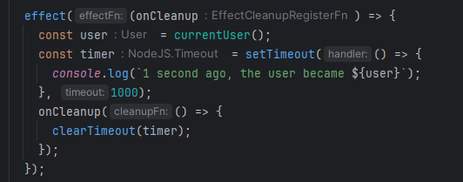
Improved Signals and Effects
Effect cleanup functions

Slide 47
Built-in control flow
After running UX research studies, Agular team released a new block template syntax that gives you powerful features with simple, declarative APIs and improvement of developer experience.

Slide 48
Built-in control flow
The built-in control flow enables:
More ergonomic syntax that is closer to JavaScript, thus more intuitive requiring fewer documentation lookups
Better type checking thanks to more optimal type narrowing
It is automatically available in your templates without additional imports
Significant performance improvements that we’ll cover in a little bit

Slide 49
Built-in control flow
*ngIf -> @if
ngSwitch/*ngSwitchCase/*ngSwitchDefault -> @switch/@case/@default
*ngFor -> @for

Slide 50
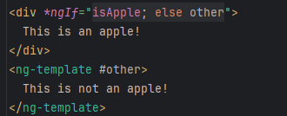
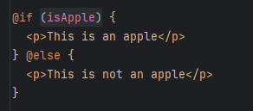
Built-in control flow
*ngIf -> @if
Being able to provide the content for @else directly is a major simplification compared to the else clause of the legacy *ngIf alternative.

Slide 51
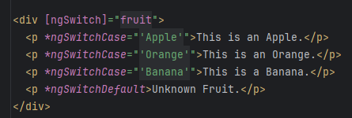
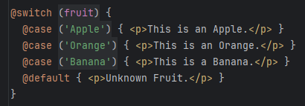
Built-in control flow
ngSwitch-> @switch
The new control flow enables significantly better type-narrowing in the individual branches in @switch which is not possible in *ngSwitch.

Slide 52
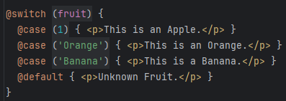
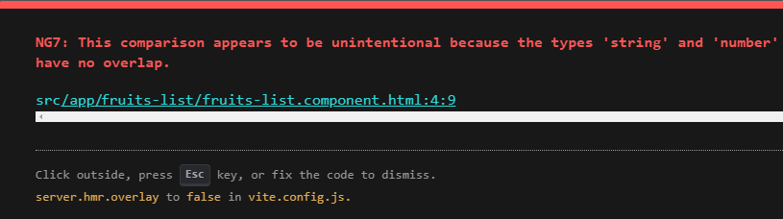
Built-in control flow
ngSwitch-> @switch
This: Will result to:

Slide 53
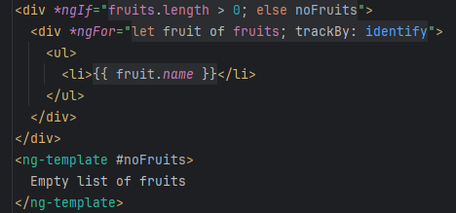
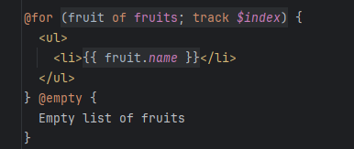
Built-in control flow
*ngFor -> @for

Slide 54
Built-in control flow
*ngFor -> @for
A few differences in @for are that track is mandatory to ensure fast diffing performance. In addition, it’s way easier to use since it’s just an expression rather than a method in the component’s class. The built-in @for loop also has a shortcut for collections with zero items via an optional @empty block.

Slide 55
Built-in control flow
*ngFor -> @for
The @for statement uses a new diffing algorithm and has more optimal implementation compared to *ngFor, which makes it up to 90% faster runtime

Slide 56
Built-in control flow
In order to automatically update the template syntax in your application you just have to run: ng generate @angular/core:control-flow

Slide 57

Deferrable views
Deferrable views can be used in component template to defer the loading of select dependencies within that template. To use this feature, you can declaratively wrap a section of your template in a @defer block which specifies the loading conditions.
More coming up with Fanis Prodromou….

Slide 58



Thank you for your time
Kostas Asargiotakis
If you need any further information, feel free to contact me:
www.linkedin.com/in/constantinos-asargiotakis-958882127
kwstas_gr@hotmail.gr

