Slide 1

Android
1st beta: Nov 2007
1st release: Sep 2008
Open Source with propriety components
Google & Open Handset Alliance
based on Linux kernel
half of the mobile developers
mobile devices
market leader
Notes:
OS → mobile devices → kernel
Google & OpenHandsetAlliance
1st beta 2007 & 1st release 2008
Open Source
mobile devices
half developers & sales

Slide 2
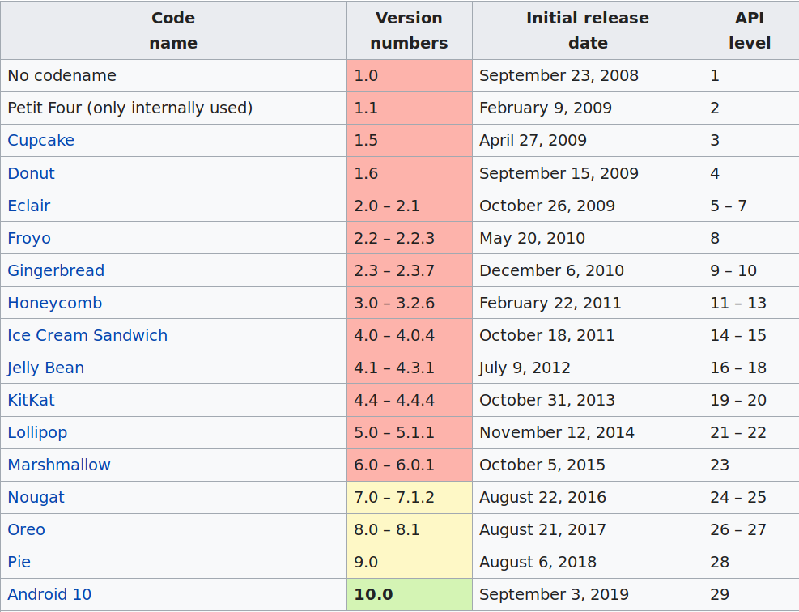
Android Versions

Slide 3
Support Libraries
Backward Compatibility
Helper classes: handle UI elements
Debugging and extra utilities
Examples:
v7 Support Library
v13 Support Library
AndroidX Library
“If you are designing only for the latest platform is a big no-no”
What are the Common Challenges Faced by Mobile Developers ? - Eminarti Sianturi

Slide 4






Setup Dev Environment
Android Studio
IntelliJ - Official Android IDE
Android SDK
Emulator
  Built-in (Studio)
  Genymotion
  Bluestacks
Build System: Gradle
Java
  Embedded OpenJDK
  Java 7 (full)
  Java 8 (subset)
  Junit 4+
Kotlin 1.3.50

Slide 5
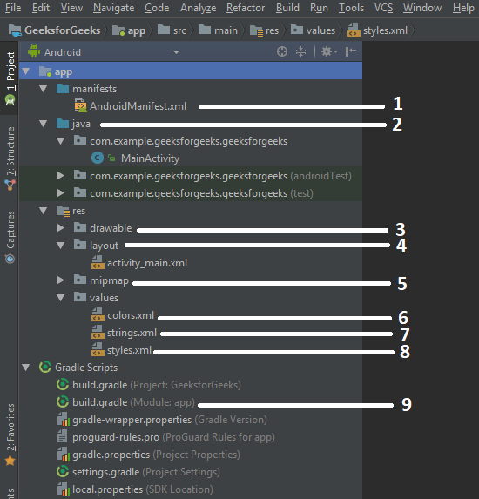
Application Structure
Manifest: app info, meta-data, components
Java: source code – logic & app behavior
Drawable: resource type files
Layout: UI files (XML)
Mipmap: launcher icons
Values: colors
Values: strings
Values: theme styles
Gradle: Build configurations
Source: https://www.geeksforgeeks.org/android-android-apps-file-structure/

Slide 6
App Manifest
essential information application
Declares package name ↔ build tools
  Source Code – App Unique Id
Declares components of the app
  Activities, Service, Receivers
Permissions
Software/Hardware requirements
Meta-data: icon, version number, themes
Notes:
Package name
Components
Permissions
Requirements
Meta-data

Slide 7
Permissions
No app has permission to perform operation that impact another app, OS or the user
Accesses sensitive user data & system features
Protects privacy of the user
Install-time vs run-time permissions (v6.0)
Examples: fine_location, wifi_state, battery_stats, read_contacts, read_sms, and more...
Notes:
Term
Access
Privacy
Asks permission
examples

Slide 8
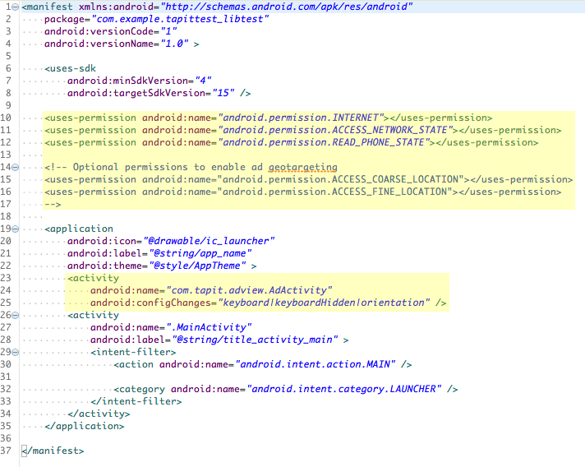
manifest.xml example

Slide 9
App components
Entry points of the system or user into the application
Activities: user-app interaction
Services: background long-running processes
Broadcast Receivers: system events delivered to the app
Content Providers: sharing data between apps

Slide 10
Activity.class
Responsible for interaction with the user
Provides the window in which app draws its UI
Generally, implements one UI screen (activity_main.xml)
MainActivity → starts Activities
Intent instance: ability to launch activity
Define in manifest
Permissions
Notes:
User interaction
Window
One screen
MainActivity
Intent
Manifest
Permissions

Slide 11
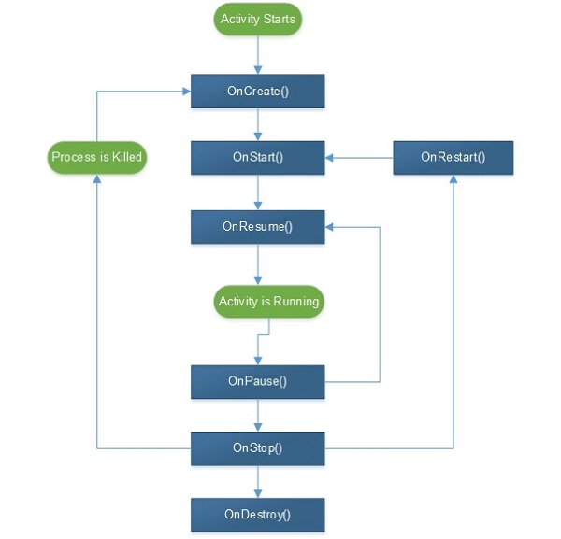
Activity Lifecycle

Slide 12
Fragment.class
Represents portion of user interface
Represents UI → app behavior
Activity combines multiple fragments
Reuse in multiple activities
Improves structure, modular, testing
its own lifecycle, its own input events
lifecycle affected by activity's lifecycle
Notes:
Portion of interface
User interaction → app behavior
Activity → Fragments
Fragment → Activities
Improvements
Lifecycle

Slide 13
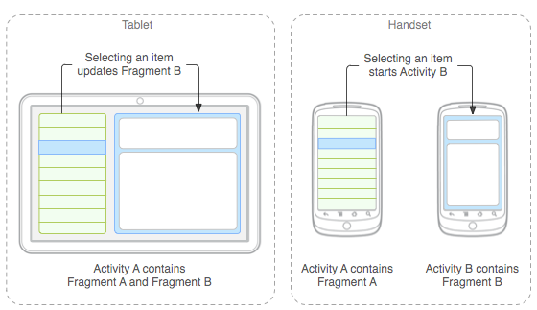
Fragment Use Case

Slide 14
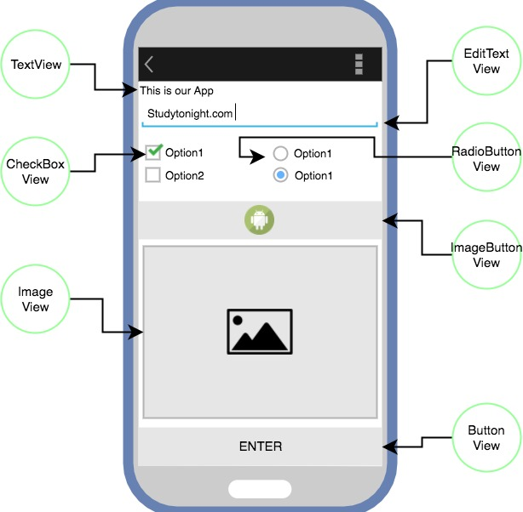
View super class
View super class for all the UI elements
Represents a rectangle on screen that shows content
User can see and interact
Event listener is an interface with a callback method (onClick, onTouch onTextChanged, onLongClick)

Slide 15
Android UI (XML)
Presentation – App behavior separation
layout
  Views – View Groups
  Different layout structure: Linear, Constraint, WebView etc
  Hierarchy
Provides different layout files
  Different screens
  Different orientation
Notes:
Separation
File
View Groups
View Group Structure
Hierarchy
Different screen sizes
Orientation

Slide 16
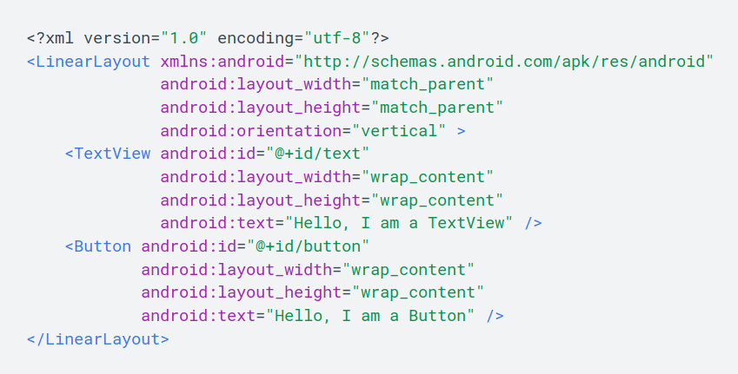
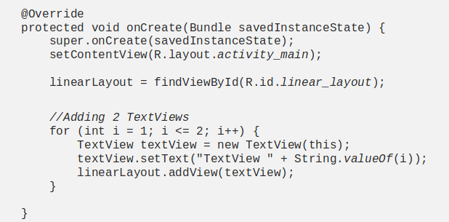
Building layouts
Declare in XML
Declare at runtime
HTML like (hierarchy)
Attributes
Events
Fragment → predefined
Dynamic UI → AdapterView
Notes:
XML
Runtime , Java
HTML like
Attributes
Events
Fragments
Adapter

Slide 17
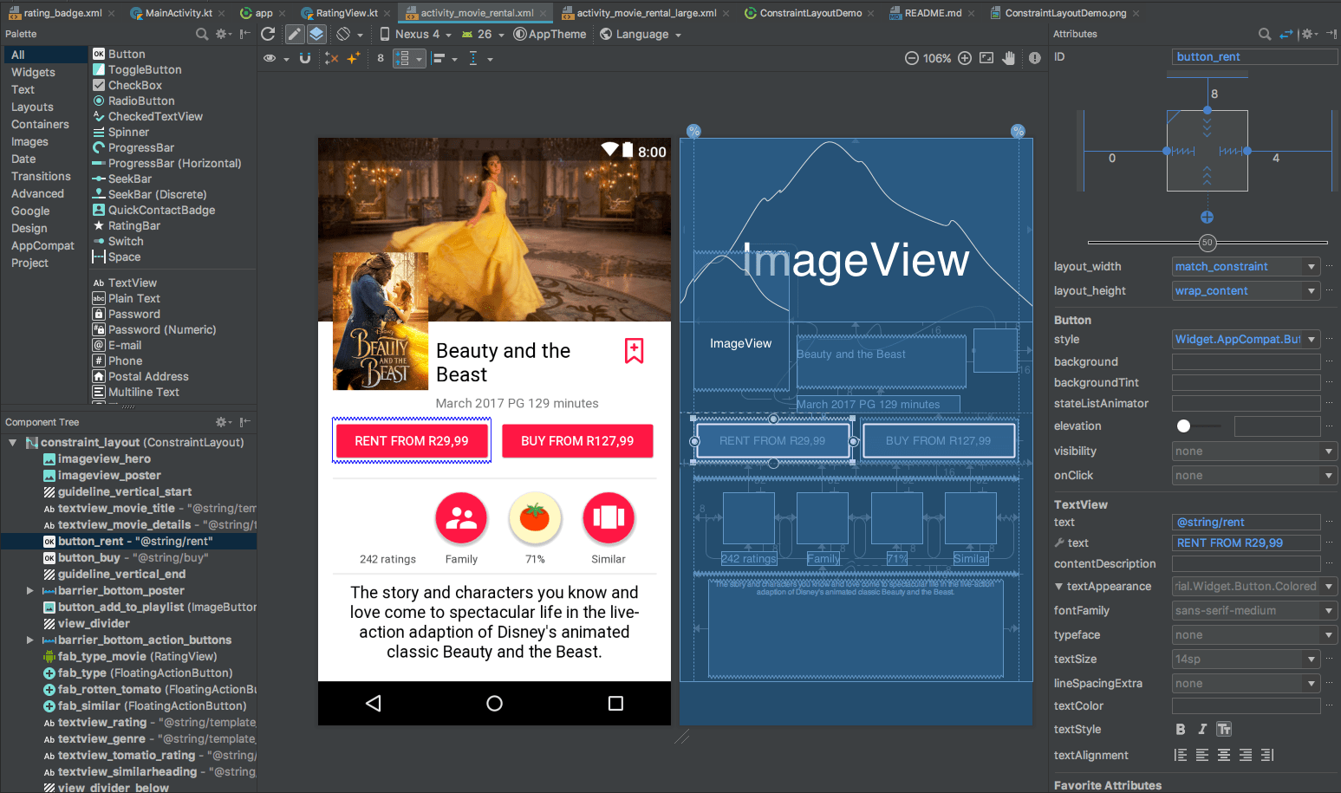
Layout Editor

Slide 18
Multiple Tests
Unit Tests
  Junit (Android independent)
  AndroidX.test framework
  Roboelectric (JVM on local machine)
Integration Tests
  Collaboration of group of units
  Espresso library
E2e Tests
  Application flow performed as designed
  Best choice: emulators (multiple screen sizes)

Slide 19
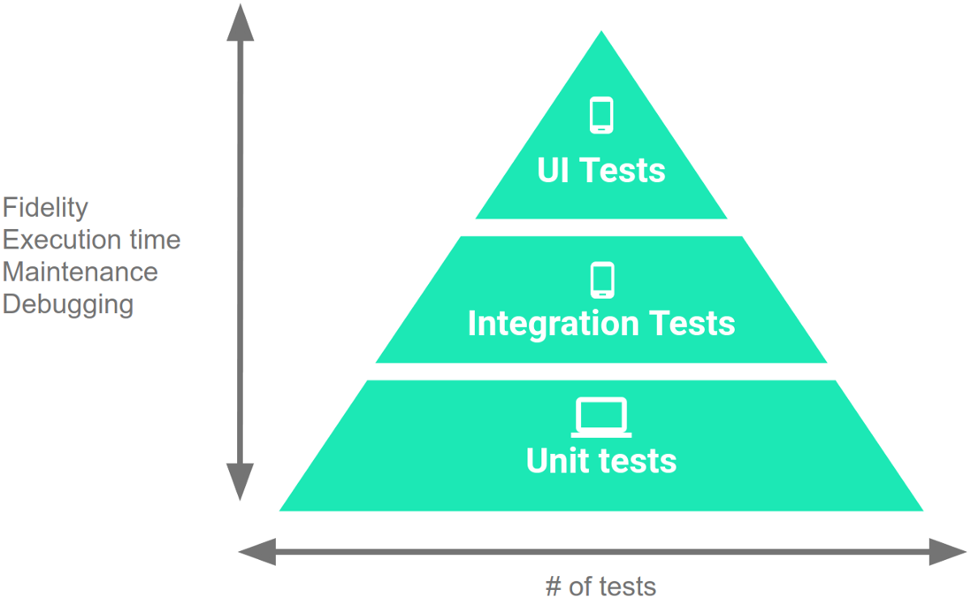
Differences..
Instrumented Tests
  Includes integration & e2e tests
  Android framework APIs
  Automate user interaction
Unit tests vs Instrumented tests
  Without – with device
  JVM – real device or emulator
  Fast – slow (building apk)
  Low – high fidelity
  test – androidTest directory (shared)

Slide 20
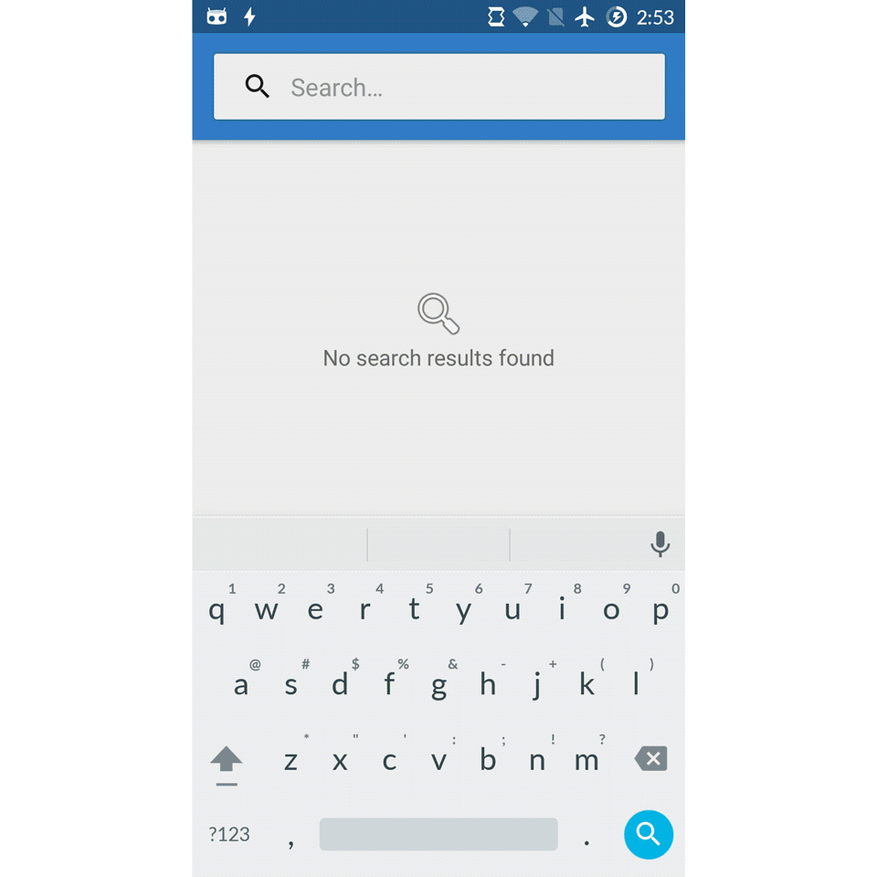
Instrumented Test

Slide 21
Extended Testing Capabilities
Mockito/Easymock: mocking dependencies
Dagger/Toothpick: dependency injection
Espresso/UI automator: instrumented tests on a real device or emulator
Robolectric: dummy implementation of the Android SDK
MockWebServer: mock server

Slide 22

Publish application
Prepare the release
  debug properties, tests, resources
Deploy signed apk
  Gradle build release / Android Studio
Distribution channel
  Play store, other markets, personal site
Play store + Developer Tools
  merchant account, promotional materials, choose market, version management

Slide 23
Books and guides...
Android Development Patterns: Best Practices for Professional Developers, Phil Dutson
Head First Android Development: A Brain-Friendly Guide, Dawn Griffiths & David Griffiths
The Busy Coder’s Guide to Android Development, Mark Murphy
Problems and Solutions for Android Developers, Ian F. Darwin
Android Programming for Beginners (Packt), John Horton
https://developer.android.com (+ “/courses”)
Practical Guide: https://medium.com/mindorks/learning-android-development-in-2019-a-practical-guide-ddc71e008696

Slide 24
..Thanks

