Slide 1

Microservices
How microservices helped us to deliver more TPS on the same hardware
Giannis Liakos
Senior Software Engineer

Slide 2
Agenda
Business requirement
The problem
Microservices to the rescue
Why spring boot?
WebFlux
Outcome

Slide 3
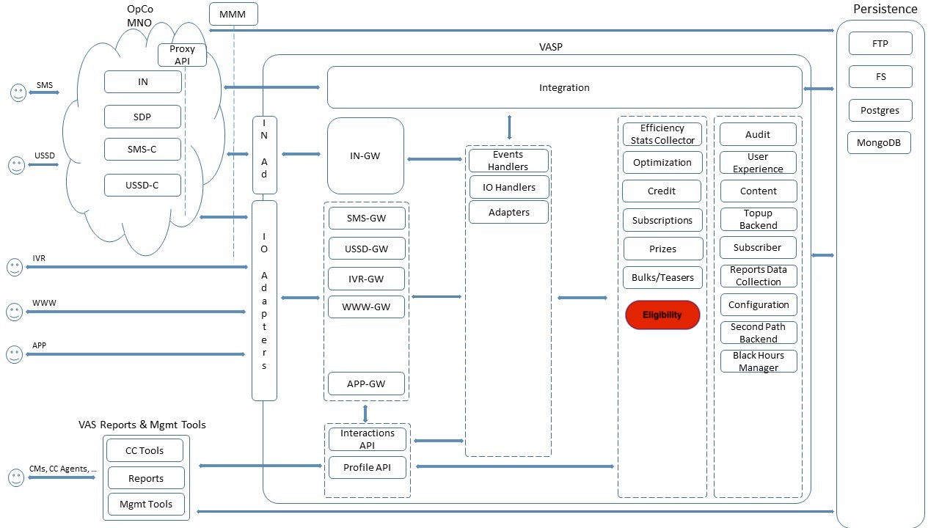
Architecture

Slide 4
Business requirement
Ability to serve 1.5k eligibility req/sec
Response time < 50ms

Slide 5
The problem
Multiple channels request for the eligibility of a customer
Current monolithic architecture does not scale
1450 transactions /sec in a single postgres node
Locking
DB Load affects application response time
Overall Performance
Limits in hardware
Notes:
up to a point to hardware not cloud

Slide 6
Microservices
Highly maintainable and testable
Loosely coupled
Scalability
Independently deployable
Organized around business capabilities.

Slide 7
Swarm vs Spring boot
Documentation
WildFly Swarm: has a decent documentation for beginners, it is easy to follow and apply.
Level of detail and conciseness compared to Spring’s Guides is a bit low but it is still good.
Spring boot : With the excellent guide and explanation for newbies Spring Boot easily wins here.
Out of the box project structure generation
WildFly Swarm : It generates the necessary maven project structure available to download.
It lacks the Gradle support though
Spring boot: more extensive set of out of box dependencies and support for Gradle support
Database layer
WildFly Swarm : JPA
Spring boot: Spring data JPA
Community
WildFly Swarm: Google results ~113K
Spring boot: Google results ~499M

Slide 8
Why did we choose Spring boot?
Configuration
Spring profiles
Non blocking I/O – the only blocking is the jdbc driver
Cloud ready – Api Gateways, Service Registry, Config server etc
Community
Know-how
Many more….

Slide 9
WebFlux
Non-blocking web stack to handle concurrency with a small number of threads and scale with fewer hardware resources
Functional programming
Netty
Reactive
Spring WebFlux offers functional web endpoints alongside annotated controllers
0..1 (Mono) and 0..N (Flux)
Notes:
The term, “reactive,” refers to programming models that are built around reacting to change — network components reacting to I/O events, UI controllers reacting to mouse events, and others. In that sense, non-blocking is reactive, because, instead of being blocked, we are now in the mode of reacting to notifications as operations complete or data becomes available.
There is also another important mechanism that we on the Spring team associate with “reactive” and that is non-blocking back pressure. In synchronous, imperative code, blocking calls serve as a natural form of back pressure that forces the caller to wait. In non-blocking code, it becomes important to control the rate of events so that a fast producer does not overwhelm its destination.
Reactive Streams is a small spec (also adopted in Java 9) that defines the interaction between asynchronous components with back pressure. For example a data repository (acting as Publisher) can produce data that an HTTP server (acting as Subscriber) can then write to the response. The main purpose of Reactive Streams is to let the subscriber to control how quickly or how slowly the publisher produces data.
Reactor is the reactive library of choice for Spring WebFlux. It provides the Mono and Flux

Slide 10
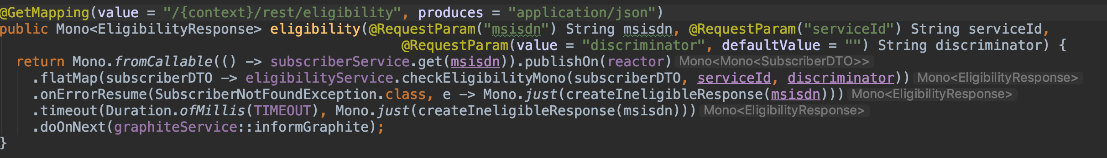
WebFlux Controller Example

Slide 11
Code sample
Mono.fromCallable(() -> subscriberService.get(msisdn)).publishOn(reactor) .flatMap(subscriberDTO -> eligibilityService.checkEligibilityMono(subscriberDTO, serviceId, discriminator)) .onErrorResume(SubscriberNotFoundException.class, e -> Mono.just(createIneligibleResponse(msisdn))) .timeout(Duration.ofMillis(TIMEOUT), Mono.just(createIneligibleResponse(msisdn))) .doOnNext(graphiteService::informGraphite);

Slide 12
Thread pool configuration
@Bean(name = "vaspExecutor") public TaskExecutor getTaskExecutor() { ThreadPoolTaskExecutor tpte = new ThreadPoolTaskExecutor(); tpte.setCorePoolSize(THREAD_POOL_INIT_SIZE); tpte.setMaxPoolSize(THREAD_POOL_MAX_SIZE); tpte.setQueueCapacity(THREAD_POOL_QUEUE_SIZE); tpte.setKeepAliveSeconds(THREAD_POOL_KEEPALIVE); tpte.initialize(); return tpte; } @Bean(name = "vaspreactorExecutor") public Scheduler vaspreactorExecutor() { return Schedulers.fromExecutor(getTaskExecutor()); }

Slide 13
Outcome
Eligibility microservice is now deployed on more than 6 countries
Startup time <3 secs
Single instance can handle more than 2.5k req/sec
Response time < 6 ms
Business is now happy ☺

Slide 14
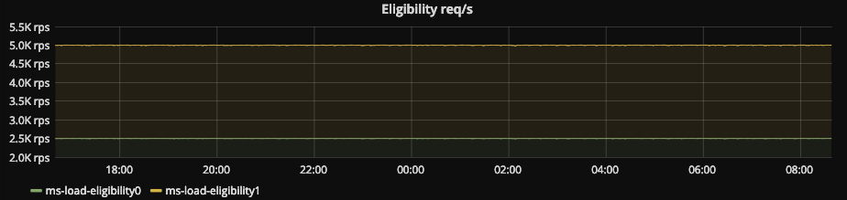
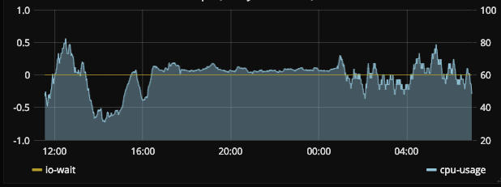
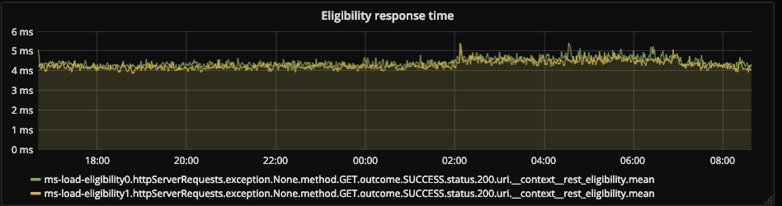
Metrics

Slide 15
THANK YOU

