Slide 1

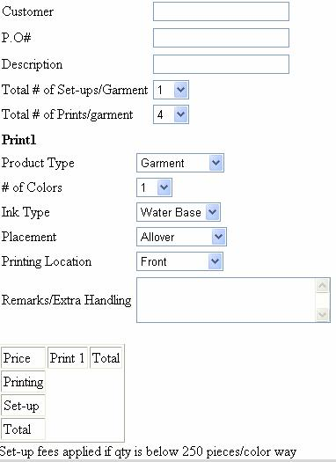

Web cam
view
Web cam
view
Once you click “snap shot” it will open a new “webcam view”

Slide 2
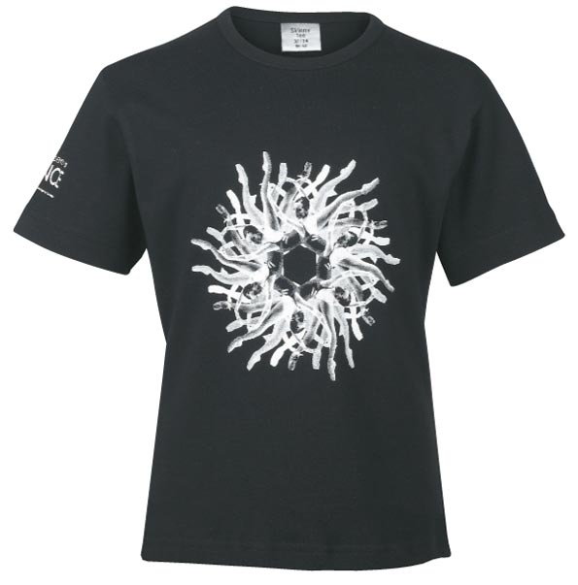


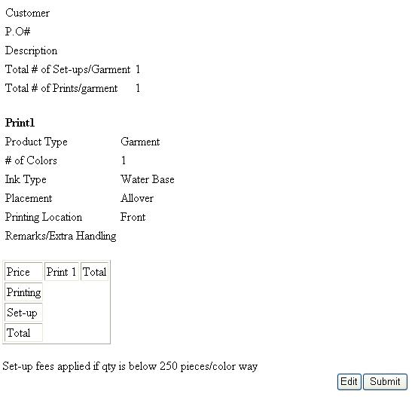
Snapshots that have been done

