Slide 1






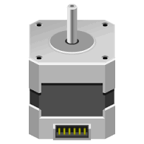







Server
Minio
Ubuntu
Web
DB
Apache
MySQL
Tomcat
PHP
Client
Device
Servo Moter
LED
SOUND
RFID
RASPI
Arduino
Web Client
Android

