Slide 1
awk

Slide 2
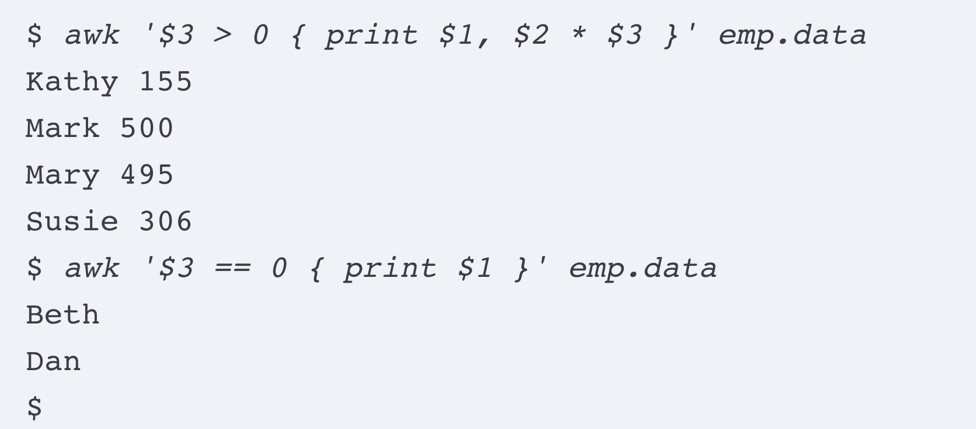

Introduction
The basic operation of Awk is to scan a sequence of input lines, from any number of files, one after another, searching for lines that are matched by any of the patterns in the program. The precise meaning of “match” depends on the pattern in question; for patterns like $3 > 0, it means “the condition is true.”

Slide 3
Printing Specific Fields
Printing Line Numbers | NR
NF, the Number of Fields | NF

Slide 4
Introduction
awk '$3 == 0 {print $1, $2 * $3}'
sudeep 0 0
Ctrl + D
This behavior makes it easy to experiment with Awk
awk '{ print }' emp.data
awk ‘{ print $0 }’ $0 = whole line
NF, the Number of Fields
prints the number of fields and the first and last fields of each input line.

