Slide 1

Project Title – Electricity Consumption Awareness Agent
Domain of Project – Energy / Sustainability / AI
Student Name | Recent Passport Photo | Email ID | Mobile number [WhatsApp]
Sujit Vishnu Patil |  | sujitpatil373750@gmail.com | 7020462425
PowerWise • 2

Slide 2
Problem Statement
Problem Statement: AI Agent for Electricity Consumption Awareness
The Challenge
Many consumers lack awareness of how daily activities and appliance usage affect electricity consumption. This can lead to inefficient usage and unnecessary energy wastage.
The challenge is to build an AI agent that educates users about electricity consumption patterns and promotes energy-efficient behavior.
Objectives
1. Analyze household electricity usage and identify unusually high consumption.
2. Explain consumption patterns in simple language.
3. Provide practical energy-saving suggestions.
4. Support conversational questions and personalized insights.
PowerWise • 3

Slide 3
Proposed Solution
Proposed Solution: PowerWise AI Agent
PowerWise is an AI-powered electricity awareness assistant built to analyze household consumption, explain usage patterns, detect high-consumption areas, and recommend practical energy-saving actions.
The solution combines IBM watsonx Orchestrate with IBM Granite models. Users interact through a conversational interface and can provide electricity or appliance usage data. The agent interprets the data, identifies trends or anomalies, and produces understandable recommendations.
Core capabilities
• Consumption analysis and trend detection
• Appliance-level usage analysis
• Electricity bill and kWh awareness
• Personalized energy-saving recommendations
• Conversational assistance
PowerWise • 4

Slide 4
Technology Used
• IBM watsonx Orchestrate – Agent building, behavior, guidelines, knowledge, tools, testing and deployment
• IBM Granite Models – Natural-language understanding, reasoning, summarization and recommendations
• IBM Cloud – Cloud infrastructure for the AI solution
• Knowledge / RAG – Ground the agent in trusted electricity and energy-efficiency information
• Speech-to-Text / Text-to-Speech – Optional voice interaction through supported providers
• HTML, CSS & JavaScript – PowerWise dashboard and conversational web interface
PowerWise • 5

Slide 5
IBM watsonx Orchestrate Components
1) Chat Input – User enters electricity questions, consumption data, appliance details or bill information.
2) IBM watsonx AI Agent – Interprets the request and coordinates the response.
3) IBM Granite Model – Provides reasoning, summarization and natural-language generation.
4) Guidelines – Define behavior for analysis, anomaly detection, recommendations and missing data.
5) Knowledge – Provides grounded electricity-awareness and energy-efficiency information.
6) Tools – Can support calculations, data processing and future integrations.
7) Chat Output – Returns clear insights, explanations and energy-saving recommendations.
PowerWise • 6

Slide 6
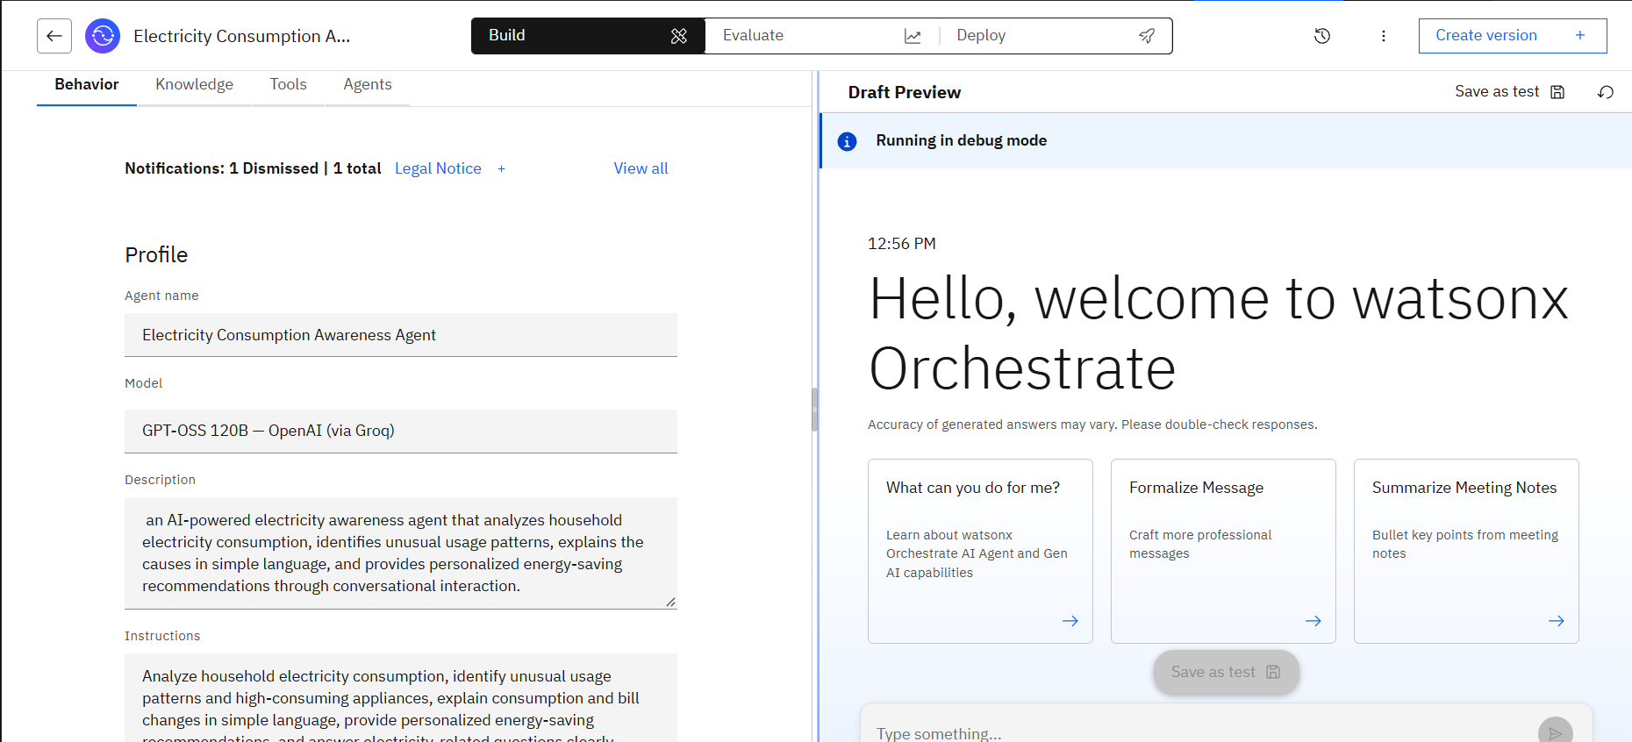
Agent Instructions – PowerWise
PowerWise • 7

Slide 7
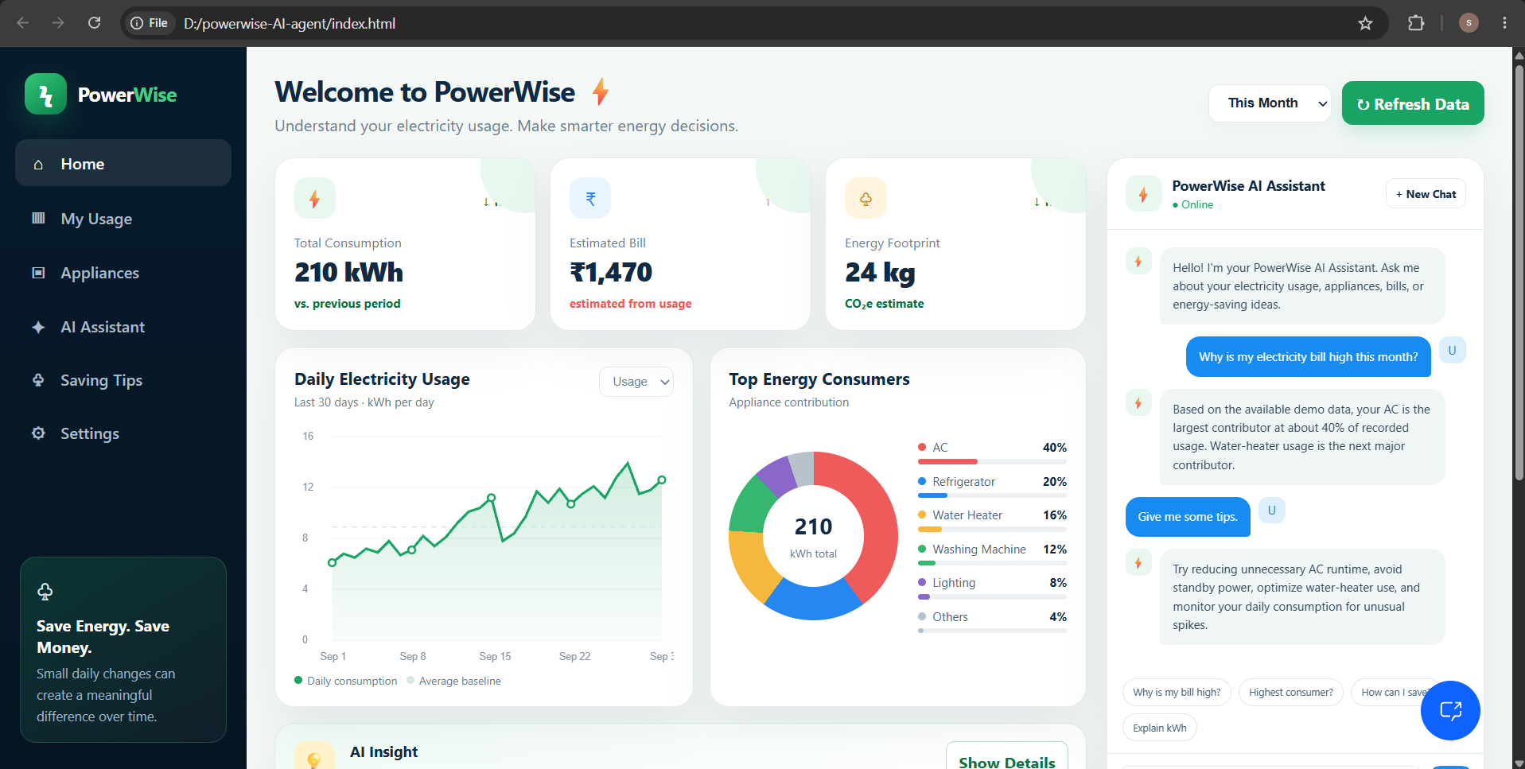
Electricity Awareness
PowerWise • 8

Slide 8
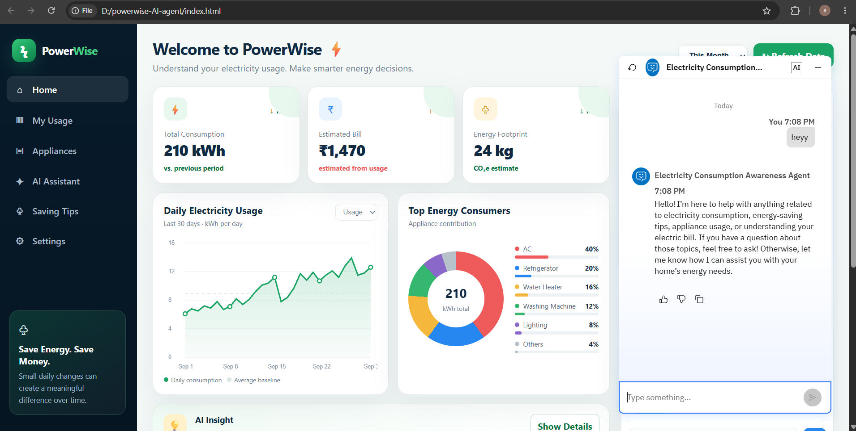
Output – PowerWise AI Chatbot
PowerWise • 9

Slide 9
Other Applicable Test Cases
Highest Consumer
Prompt: Which appliance consumes the most electricity?
Expected behavior: Identify the highest contributor and explain its percentage / kWh impact.
Saving Tips
Prompt: How can I reduce my electricity bill?
Expected behavior: Prioritize practical actions based on the biggest consumption contributors.
Explain kWh
Prompt: What is 1 unit of electricity?
Expected behavior: Explain that 1 unit corresponds to 1 kWh using a simple appliance example.
Missing Data
Prompt: Can you estimate my bill?
Expected behavior: Ask for required consumption and tariff information rather than inventing values.
PowerWise • 10

Slide 10
PowerWise – Orchestrate Architecture Blueprint
User / Web Dashboard
Questions • Usage data
Bill / appliance details
IBM watsonx
Orchestrate
Agent behavior
Guidelines • Tools
IBM Granite
Model
Reasoning
Summarization
Knowledge / RAG
Electricity facts
Energy-efficiency content
Analysis Layer
kWh calculations
Trend / anomaly detection
AI Output
Insights
Saving recommendations
PowerWise • 11

Slide 11

Role of Agentic AI in the Solution
Role of Agentic AI in Electricity Consumption Awareness Agent
Agentic AI enables PowerWise to act as an intelligent, goal-driven assistant rather than a simple question-answering chatbot. The agent interprets user intent, uses available electricity data and knowledge, applies configured guidelines, and produces a useful response.
Key roles
• Context awareness – understands the user's current electricity question and available data.
• Analysis – identifies consumption patterns, spikes and high-use areas.
• Reasoning – connects consumption information with practical energy-saving actions.
• Personalization – recommendations can reflect the user's appliances and usage pattern.
• Tool and knowledge use – can combine calculations with grounded information.
• Conversational interaction – supports follow-up questions and explanations.
PowerWise • 12

Slide 12
Novelty and Uniqueness
PowerWise combines agentic AI, electricity-data analysis, knowledge grounding, and personalized energy-awareness guidance in one conversational system.
1. Consumption-aware intelligence – focuses on actual household usage patterns rather than generic advice.
2. Explainable insights – converts raw consumption into simple, understandable observations.
3. Appliance prioritization – identifies major contributors so users can focus on the biggest opportunities.
4. Personalized recommendations – suggestions can reflect the user's consumption profile.
5. Grounded responses – knowledge sources can support trustworthy electricity and energy-efficiency explanations.
6. Conversational experience – users can ask follow-up questions naturally.
7. Extensible architecture – voice, smart-meter data and additional tools can be added later.
This makes PowerWise more than a static energy-tip application: it is designed as an interactive AI agent for electricity awareness.
PowerWise • 13

Slide 13
GitHub Repository
Create a public GitHub repository for the project and paste the working repository URL here.
Recommended repository contents:
1. index.html – PowerWise dashboard prototype
2. app.json – IBM project/application configuration, if used
3. Problem statement / project documentation PDF
4. Electricity_Consumption_Awareness_Agent.pptx
5. Screenshots of IBM watsonx Orchestrate configuration and test outputs
6. README.md with setup, architecture, features and demo instructions
GitHub URL: https://github.com/devsujit77/powerwise.git
·
·
PowerWise • 14

Slide 14
Future Scope
1. Smart Meter Integration – Connect real-time or periodic meter data for automatic consumption monitoring.
2. Appliance-Level Monitoring – Use smart plugs or IoT sensors to measure appliance-specific consumption.
3. AI-Powered Voice Assistant – Extend the agent with Speech-to-Text and Text-to-Speech for hands-free interaction.
4. Multilingual Support – Provide electricity-awareness guidance in English, Hindi, Marathi and other regional languages.
5. Personalized Energy Goals – Let users set monthly consumption and bill-reduction targets and track progress.
6. Advanced Analytics – Add forecasting, anomaly detection and time-of-use analysis.
7. Utility / Grid Integration – Future integration with utility data could support richer bill and consumption insights.
·
·
·
PowerWise • 15

Slide 15
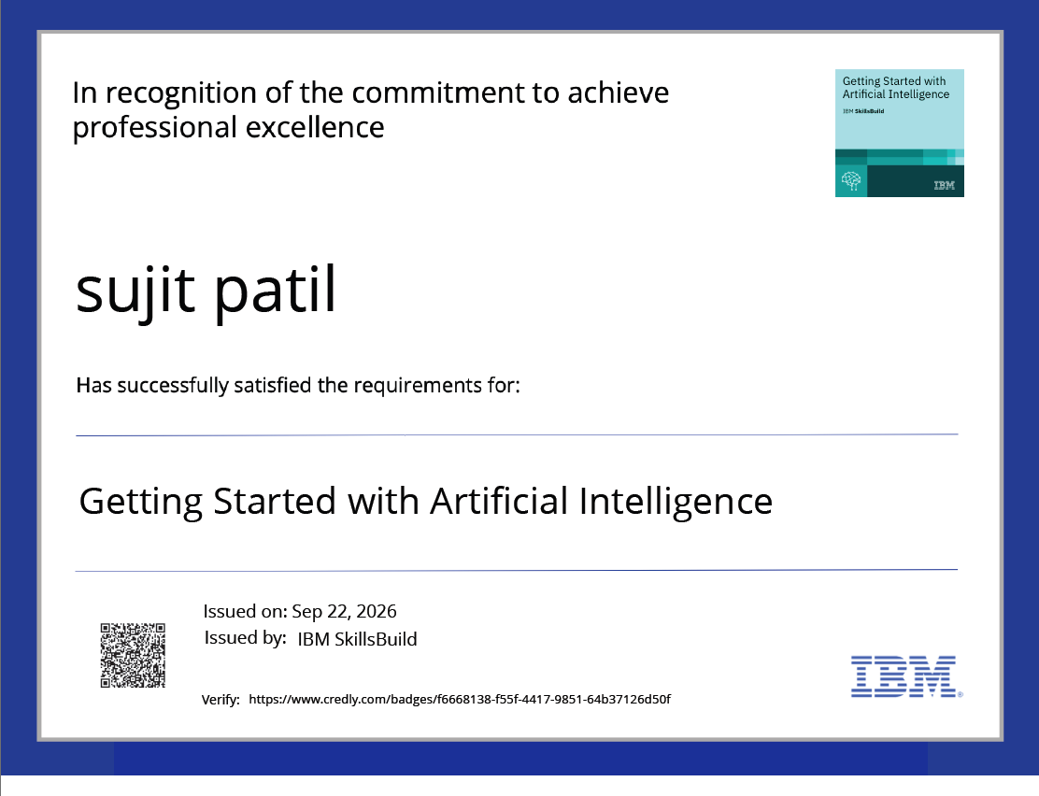
Certificates Earned
IBM SkillsBuild / Credly Certificate
PowerWise • 16

Slide 16
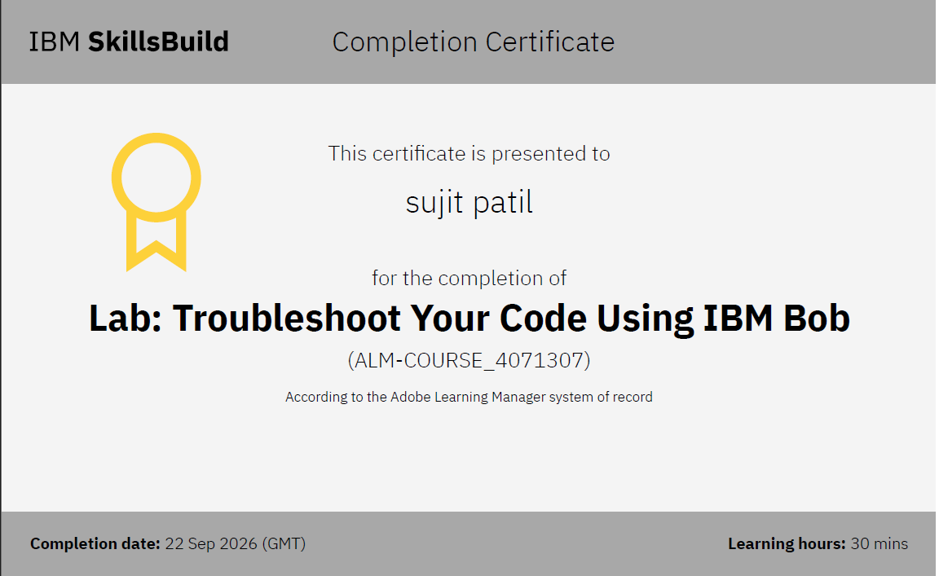
Certificates Earned
IBM BOB Certificate
PowerWise • 17

Slide 17


