Slide 1
Pre-reqs
https://bit.ly/2UutA1N

Slide 2

DEVELOPERS SOCIETY CODING101

Slide 3
The Console
In programming, the console is a command line interface which takes inputs and displays outputs
Opening the console in visual studio:
ctrl + `

Slide 4
How do we display data on the console?
console.log(“hello world”)

Slide 5
Variables
Named locations in the computer's memory in which data can be stored
Think of your computer memory as a largest set of "boxes" in which data can be stored
Boxes can be labelled with a variable name, and the values placed in the boxes can be inspected and changed

Slide 6
Maths
Basic mathematical operations are available to use:
Addition (+)
Subtraction(-)
Multiplication(*)
Division(/)

Slide 7
1) Create a story using console.log and variables similar to the examples we worked with
2) Play around with mathematical operators

Slide 8
Conditionals
True/False
Statement Y
Statement X
== equal to
!= not equal to
<= less than or equal to
>= greater than or equal to

Slide 9
Create three variables and assign values to them
Write a program that prints the largest of the three numbers.
Try mixing the numbers around.
What if two or all three numbers had the same value? Does the code still work?

Slide 10
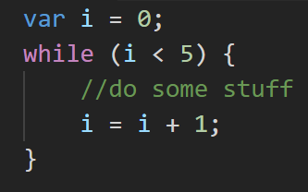
While loops
Automation and Efficiency!

Slide 11
Find out how long it takes to reach 100km/h. Every second you increase your speed by an extra 6km/h.
Now what if you had different top speeds that you want to reach? Try 50km/h.
Or what if the acceleration was different? Experiment with numbers!!

Slide 12
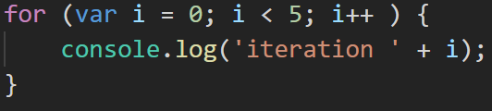
For loops
When there is a known number of iterations

Slide 13
Write a JavaScript program which iterates the integers from 1 to 100. But for multiples of three print "Fizz" instead of the number and for the multiples of five print "Buzz". For numbers which are multiples of both three and five print "FizzBuzz"

Slide 14
What is a Function
- A function is a block of code that you define and when used, performs a task.
- Functions contain instructions which use an input to create an output.
- Can use over and over again with different inputs

Slide 15

Cake Recipe Function
-Takes input: INGREDIENTS
-Performs defined tasks with the INGREDIENTS
-Produces an output, the CAKE

Slide 16
Reusability
-The main advantage of a function is that once defined, you can use it over and over again
-Can use the Cake Function many times, with different ingredients
-This will produce a different output of cakes each time

Slide 17
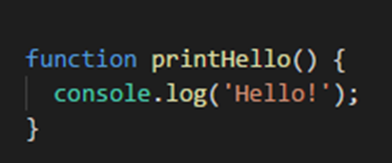
Defining a Function
-To define a function, you must use the FUNCTION keyword
-This is then followed by the NAME of your function (can be anything)
-Followed by a set of PARENTHESIS()/ brackets
-Input goes inside these brackets
-Lastly, add a pair of curly brackets
-Contains the block of code for what your function does

Slide 18
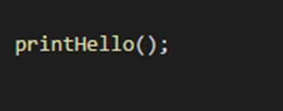
Calling a Function
-To actually use your function, you must call it
-To call a function you must start with its NAME
-Then follow it up with PARENTHESIS
- Once a function has been defined, you can call as many times as you like

Slide 19
Write a basic function and call it!

Slide 20
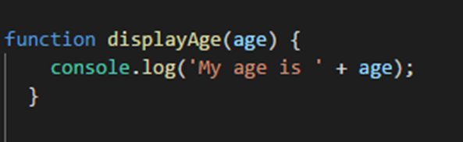
Function Parameters(Inputs)
-Inputs for functions are called PARAMETERS
-You define PARAMETERS when you define your functions
-After defining your parameters, you can use them in your function

Slide 21
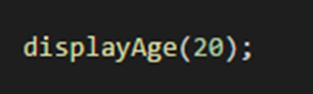
Calling Functions with a Parameter/Input
- You can now call your function and provide some input

Slide 22
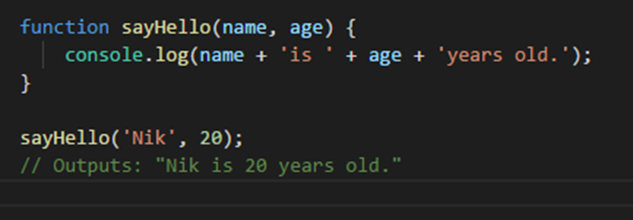
Multiple Parameters
- You can define multiple parameters/inputs for a function by comma-separating them

Slide 23
Write a Function with Parameters and call it!

Slide 24
Return Statement
-A function can have a return statement
-Return statement returns the output of a the function to where it has been called, usually to a variable

Slide 25
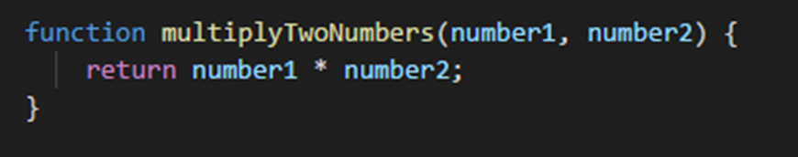

Return Statement

Slide 26
FINAL PROJECT
How Happy is Donald Trump?

Slide 27
Brief
Combine everything that we have learnt so far into a project.
Get tweets from @realDonaldTrump.
Analyse these tweets for sentiment (emotion) using AWS Comprehend.
Find out how happy Donald Trump (or any twitter user) is.
Profit??

Slide 28
What needs to be done?
DEVS has written a JavaScript module to be used for this project.
The module has functions for getting the tweets and analysing them.
Using these functions to get the sentiment for each tweet, calculate the ratio of POSTIVE, NEGATIVE, NEUTRAL and CONFUSED tweets.

Slide 29
The Module
getTweets(username): Returns a list of strings (tweets) for the specified username.
detectSentiment(tweets): Accepts a list of strings (tweets) and
returns a list of sentiments.

Slide 30
Getting Started!
Type npm init -y in the terminal to initialise the project.
Type npm install --save coding101module to install the DEVS module.
Make a new file in vscode called `index.js` and add this at the beginning of the file to use the module

Slide 31
Thanks!
Any questions?
You can find us at @devsuoa on Facebook

