Slide 1
LedgerScribe: Invoice Parser & Journal Generator
FE524-A Group Project | Stevens Institute of Technology

Slide 2
Introduction
LedgerScribe is a next-generation financial automation tool designed to intelligently parse invoice documents, extract relevant financial data, and generate structured journal entries and inventory records. Built with Python, Streamlit, GPT-4, and pandas, it aims to simplify and accelerate the end-to-end bookkeeping process.

Slide 3
Business Problem
Manual invoice processing is tedious, error-prone, and time-intensive.
Lack of automation reduces scalability for growing businesses.
In many SMEs inventory tracking is disconnected from financial records and general tally, often leading to challenges in maintaining optimal level of inventory.

Slide 4
Our Solution
PDF-based invoice uploads using Streamlit interface.
Text extraction via PDFPlumber; structured parsing using GPT-4.
Invoice field extraction, validation, and editable line-item entries.
Automatic journal entry generation and storage in ledger.
Inventory module syncs relevant purchases for stock tracking.

Slide 5
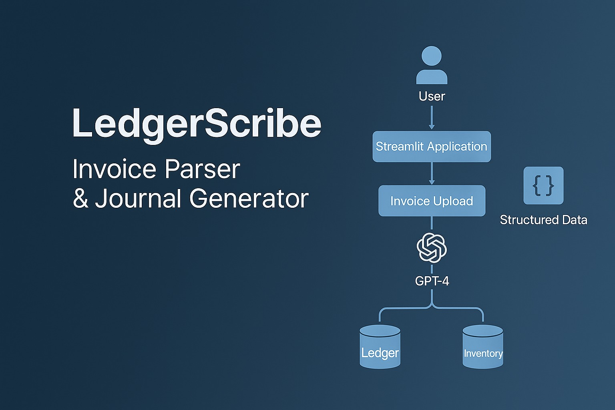
System Architecture

Slide 6
Key Features
Streamlit-based frontend with tabs for navigation.
Real-time invoice field extraction using GPT-4.
Editable journal entry suggestion with customizable values.
Persistent ledger tracking using Excel files.
Inventory aggregation with cost-per-unit calculation.

Slide 7
Use Cases
Small to medium-sized enterprises automating financial workflows.
Accountants seeking AI-powered journal entry assistance.
Procurement teams needing unified inventory and ledger systems.
Developers and analysts building AI-based document automation tools.

Slide 8
Impact
Reduced operational time and human error in invoice handling.
More accurate and auditable financial recordkeeping.
Improved inventory visibility and valuation control.
Empowered finance teams with intelligent tools to scale.

Slide 9
Future Plans
Including image scanning. (Currently only supporting PDFs)
Integration with cloud databases for real-time collaboration.
Support for multi-page, batch invoice uploads.

