Slide 1
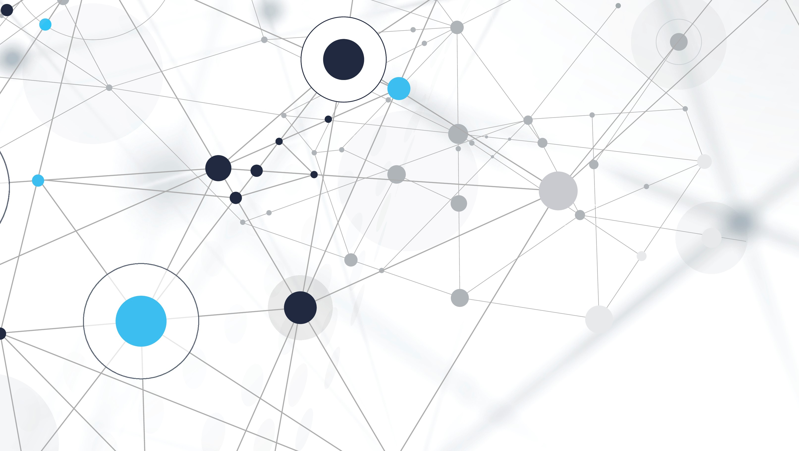
VACCBLOCKS
BLOCKCHAIN DAPP FOR RECORDING AND TRACKING IMMUNIZATION

Slide 2
Introduction/story

Slide 3
features
- Private Blockchain managed by sponsor with stakeholder dedicated nodes for proof-of-work validation and mining
- Private Decentralised file storage – IPFS
- Destkop and Mobile App for managing partner medical centers and vaccine dispensers
- Mobile App for recording patient registration and vaccine/immunization delivery
- Stakeholder dashboard for real-time visibility of immutable vaccine adoption/delivery data
- Ability to track donated/purchased vaccine S/N, transporation, and dispensing/delivery to patient.

Slide 4
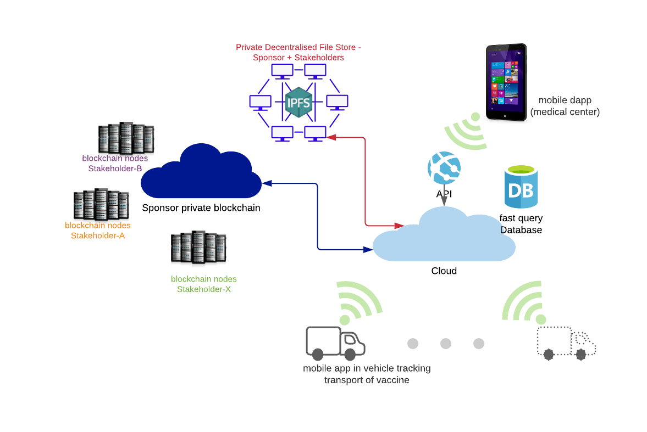
Infrastructure & Connectivity

Slide 5
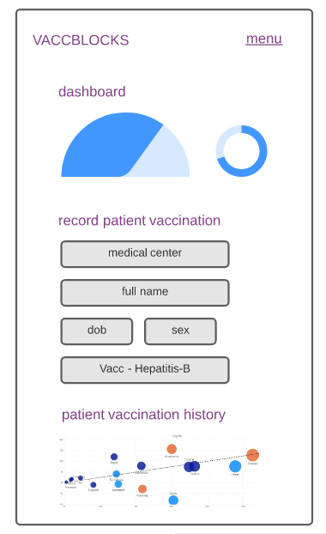
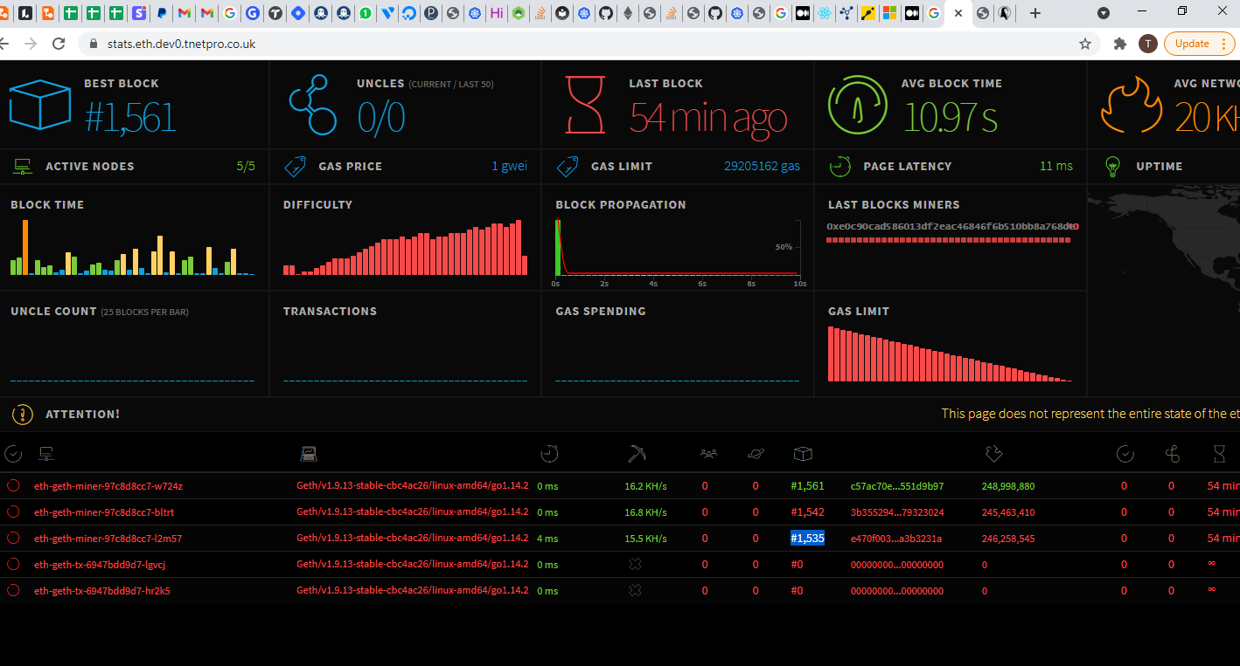
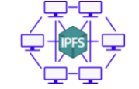
Pilot product
Pinata IPFS Account
Private Ethereum Blockchain
Mobile App to record Patient Vaccination to Blockchain and IPFS

Slide 7
VACCBLOCKS
THANKS YOU
TEAM:
Taiwo Efunogbon | Abel Obinnaya | Benny XXXXXXXX

