Slide 1

Time Sheet Management System
WorkPlus
Presented by:
Juned Shikalgar
Vivek Moranis
Revet Chaudhari
Ganesh Parhad
Project Mentor:
Pratik Kamble

Slide 2

Project Overview
Web platform for managing projects, tasks and employee timesheets Built using Spring Boot microservices architecture Secure access using JWT in an HttpOnly cookie Centralized requests through API Gateway and Eureka Discovery Role-based access for Admin, HR Head, Manager and Employee
Gemini-powered Employee AI Assistant

Slide 3
User Roles
Admin - Approves HR registration and monitors Clients and Projects HR Head - Creates users, Clients and Projects and performs staffing Manager - Creates Tasks, manages the team and reviews Timesheets Employee - Updates work, submits Timesheets, raises Complaints and uses the AI Assistant

Slide 4
Admin Use Cases
Login and logout securely Approve or reject HR Head registration View Clients and Projects View HR Head accounts Monitor protected system access

Slide 5
HR Head Use Cases
Create Manager and Employee accounts Create and update Clients and Projects Assign a Manager to a Project Assign Employees to Projects View Project and staffing status

Slide 6
Manager Use Cases
View managed Projects and team members Create and assign Tasks Check Task progress Review and approve or reject Timesheets Resolve Employee Complaints View Employee reports

Slide 7
Employee Use Cases
View assigned Projects and Tasks Accept Tasks and update progress Submit Project status Fill and submit Timesheets Track approval status Raise Complaints
Use the AI Assistant for Task guidance and friendly conversation

Slide 8
Project Methodology
Followed an Agile and incremental development approach Project divided into modules: Auth, Business, Transaction and AI Implemented one module at a time through all application layers Continuous development, testing and improvement cycle Manual API and UI testing performed after each major feature Regular validation of business logic, role permissions and security

Slide 9
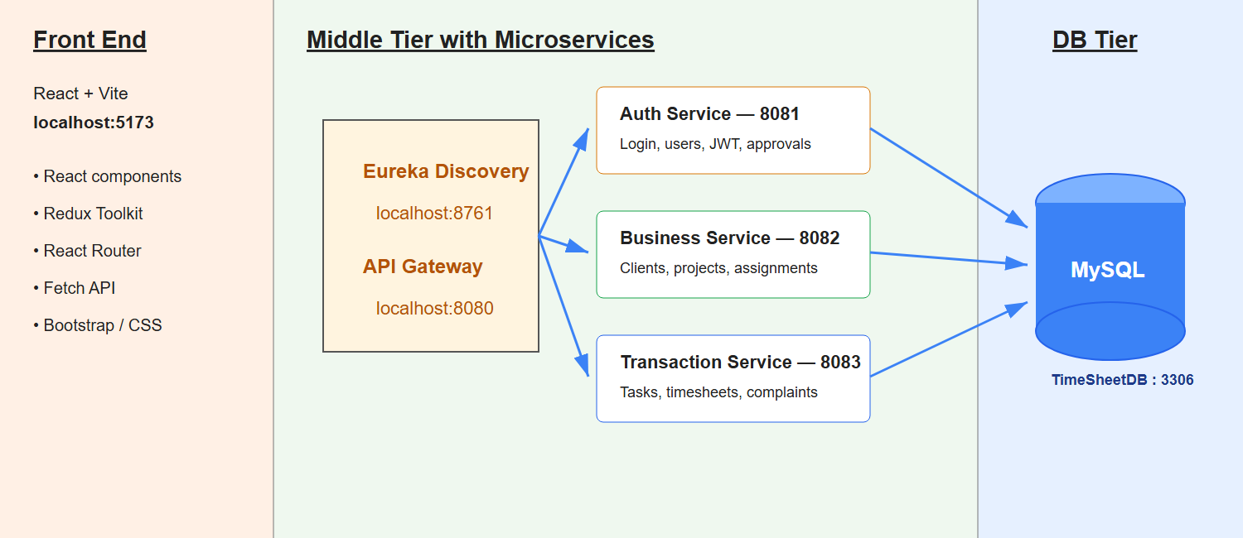
Project Architecture
AI Service - 8084
Employee Task Assistant

Slide 10
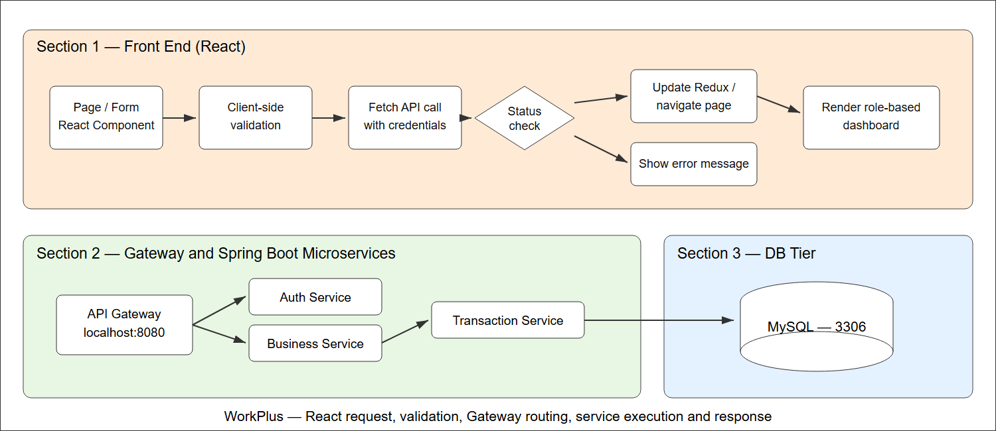
Front-end workflow
AI Service - 8084
Employee Task Assistant

Slide 11
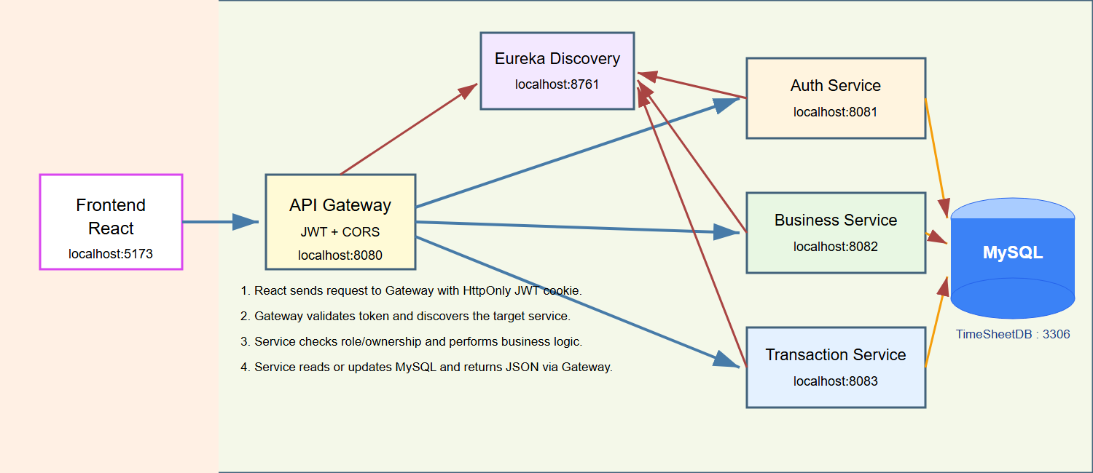
Microservices Architecture and Workflow
AI Service - 8084
Employee Task Assistant

Slide 12
My Role and Contribution
Designed Business Service modules for Clients, Projects and Employee-Project Assignments
Implemented role-based Controllers, Services, Repositories, DTOs and security
Built React pages, protected routes, sidebar navigation and API integration
Developed the Employee AI Assistant using Gemini and secure Task context
Tested APIs with Postman and resolved JWT, Eureka and integration issues

Slide 13
Testing & Tools
API Testing: Postman requests, response bodies and HTTP status codes Integration Testing: React to Gateway to service to MySQL verification Functional Testing: Login, Project, Task and Timesheet approval flows UI Testing: Forms, validation, navigation, loading and error messages Security Testing: JWT cookie, authentication and role-based authorization Manual Testing: Admin, HR Head, Manager and Employee scenarios Tools Used: Postman, Browser DevTools, MySQL Workbench, STS and VS Code

Slide 14
Future Scope
Voice-enabled AI and proactive Task recommendations Email and in-app notifications for deadlines and approvals Advanced analytics and downloadable reporting dashboards Docker deployment, centralized logging and monitoring Automated testing, performance optimization and CI/CD Mobile-friendly experience and optional mobile application

Slide 15
Conclusion and Lessons Learnt
Developed a secure Time Sheet Management System using microservices Implemented role-based workflows for four different user roles Connected React, API Gateway, Spring Boot services and MySQL Practised JWT security, Gemini integration, Postman testing and debugging Learnt layered architecture, module boundaries and team Git workflow

