Slide 1

CUDA Part 2:- Features, Memory, Graphics
From:
Balla Raviteza
Pritam Patel
Dev Kumar

Slide 2
What is CUDA?
CUDA Architecture
Expose GPU parallelism for general-purpose computing
Retain performance
CUDA C/C++
Based on industry-standard C/C++
Small set of extensions to enable heterogeneous programming
Straightforward APIs to manage devices, memory etc.
This session introduces CUDA C/C++

Slide 3
Introduction to CUDA C/C++
What will you learn in this session?
Start from “Hello World!”
Write and launch CUDA C/C++ kernels
Manage GPU memory
Manage communication and synchronization

Slide 4
Tuning Instruction-Level Primitives

Slide 5
Not all the instruction as created equally.
It does not matter how fast your application runs if you do not converge on the correct answer or obtain the expected results.
Understanding the strengths and weaknesses of different low-level primitives in terms of performance, numerical accuracy, and thread-safety is important when optimizing your application for throughput and correctness.

Slide 6
CUDA arithmetic instructions
Single and double precision floating point operations
CUDA intrinsic function
Atomic functions

Slide 7
MAD (Multiply-Add operations)
double value = in1 * in2 + in3;
Arithmetic pattern of a multiply followed by add is creatively called a multiply-add, or MAD, and is very common in a wide range of applications.
Any application that manipulates vectors and matrices likely contains many MAD operations as part of executing dot products, matrix multiplications, and other functions in linear algebra

Slide 8
MAD (Multiply-Add operations)
CUDA support a MAD instruction that fuses a multiply and an add operation.
But MAD instructions have less numerical accuracy.

Slide 9
Floating point operations

Slide 10
IEEE Standard 754
Sign
exponent
Fraction

Slide 11
1
8
23
float
1
11
52
double

Slide 12
Floating-point values that cannot be stored correctly are rounded to representable values using a configurable rounding mode.
There are four rounding modes. round-to-zero, round-up, round-down and round to-nearest. Round to nearest being default one.

Slide 13
Rounding modes
Round to the direction of zero
Round_to_zero
Round_up
Round_down
Round_to_nearest
Round to the direction of positive infinity
Round to the direction of negative infinity
Round to the direction of nearest representable float

Slide 14
Granularity of floating point values
FLOAT_MAX
0
FLOAT_MIN
INT_MAX
0
INT_MIN

Slide 15
X | NEXTAFTER(X) -X
3.14 | 2.384186e-07
314,159.28 | 0.03125
314,159,275,180,032.00 | 3.355443e+07

Slide 16
Standard vs intrinsic functions

Slide 17
Standard functions
Standard functions are used to support operations that are accessible from, and standardized across, the host and device
Intrinsic function
CUDA intrinsic functions can only be accessed from device code
In programming, a function being intrinsic, or built-in, implies that the compiler has special knowledge about its behavior, which enables more aggressive optimization and specialized instruction generation

Slide 18
In CUDA, many intrinsic functions are related to a standard function, meaning that a standard function exists that implements the same operation.
Intrinsic functions decompose into fewer instructions than their equivalent standard functions. As a result, intrinsic functions are faster than their equivalent standard functions but less numerically precise

Slide 19
So when Using CUDA for scientific simulations, financial algorithms, and other applications that demand a high level of accuracy and fidelity, generally requires two steps
Porting legacy applications from a CPU-only framework to CUDA
verifying the numerical accuracy of the port by comparing results from the legacy implementation and the CUDA version.

Slide 20
Manipulating instruction generation
Compiler flags provide a more automated and global way of manipulating instruction generation
ex : enabling MAD operations with --fmad flag to nvcc
nvcc --fmad=true
nvcc --fmad=false
Enable MAD instruction generation
Disable MAD instruction generation

Slide 21
Atomic operations

Slide 22
Atomic instructions
An atomic instruction performs a mathematical operation, but does so in a single uninterruptable operation with no interference from other threads.
When a thread successfully completes an atomic operation on a variable, it can be certain that the variable’s state change has completed no matter how many other threads are accessing that variable.

Slide 23
Atomic instructions contd…
Like standard and intrinsic functions, each atomic function implements a basic mathematical operation such as addition, multiplication, or subtraction
Unlike any other instruction type described so far, atomic instructions have a defined behavior when operating on a memory location shared by two competing threads.

Slide 24
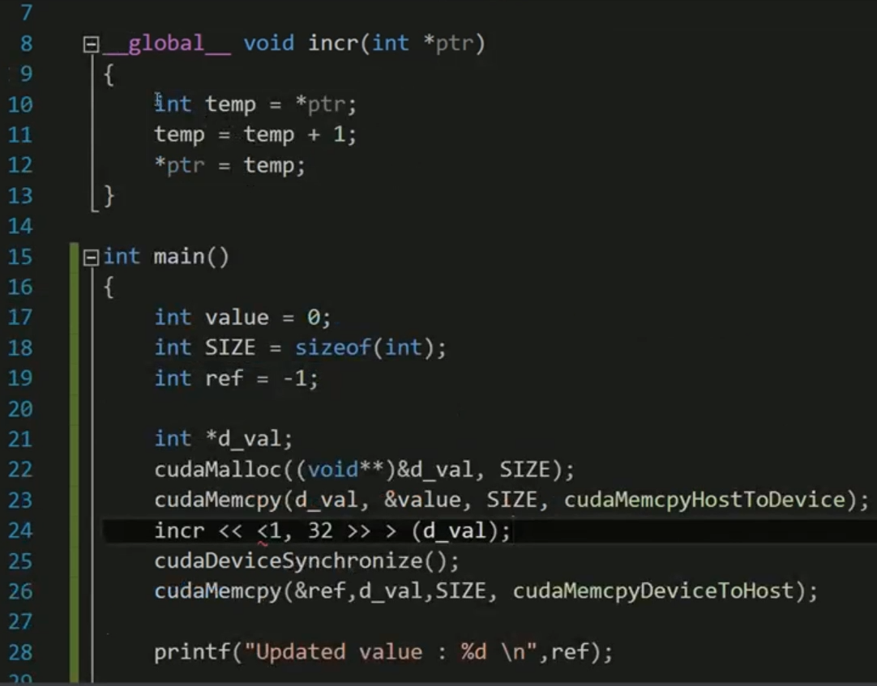

Slide 25
Atomic functions do not suffer from additional precision concerns as intrinsic functions do, but their use can severely degrade performance

Slide 26
CAS(Compare And Swap)
Memory location
int atomicCAS (
int * address,
int compare,
int val );
Expected value
New value

Slide 27
Read the target location and compare the value stored there to the expected value.
If the stored value equals the expected value, the target memory location is filled with the desired value.
If the stored value does not equal the expected value, then no change is made to the target location.
In either case, a CAS operation always returns the value that it found stored at the target location

Slide 28
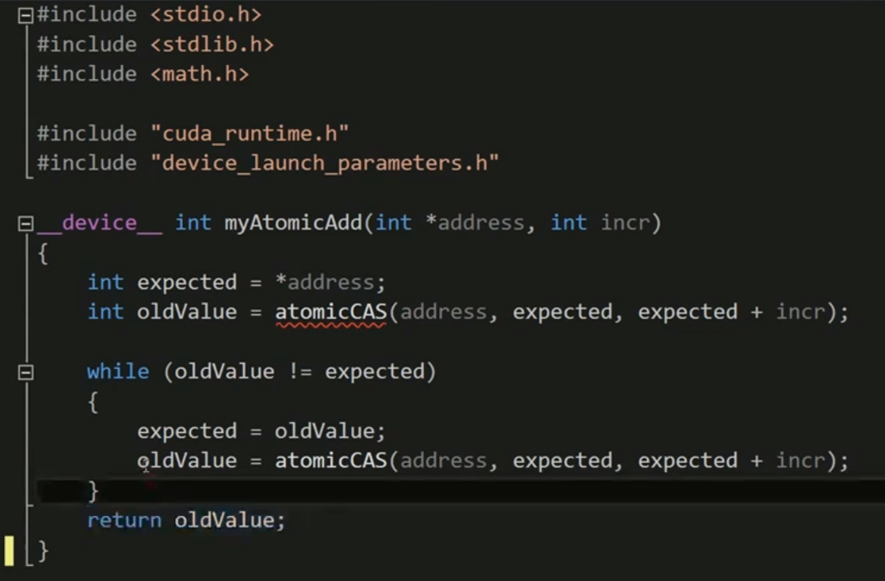
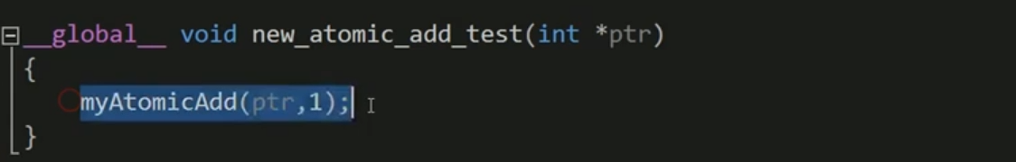

Slide 29
The Cost of Atomic Operations
an atomic instruction is going all the way to global or shared memory to read the current value stored there with no caching allowed
Conflicting atomic accesses to a shared location might require one or more retries by conflicting threads
When threads in the same warp must execute different instructions, warp execution is serialized. If multiple threads in a warp issue an atomic operation on the same location in memory, something similar will happen as they conflict with each other

Slide 30
Memory management

Slide 31
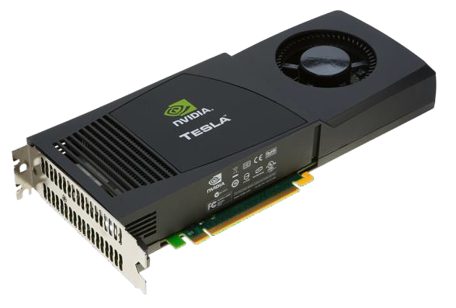
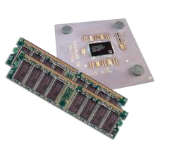
Memory Management
Host and device memory are separate entities
Device pointers point to GPU memory
May be passed to/from host code May not be dereferenced in host code
Host pointers point to CPU memory May be passed to/from device code May not be dereferenced in device code
Simple CUDA API for handling device memory
cudaMalloc(), cudaFree(), cudaMemcpy()
Similar to the C equivalents malloc(), free(), memcpy()

Slide 32
Host
Malloc
free
Device
cudaMalloc
cudaFree
cudaMemCpy

Slide 33
CPU
Main memory
15.75 GB/s
GPU
GPU memory
484 GB/s

Slide 34
Pinned memory
Allocated host memory is by default peggable.
The GPU cannot safely access data in pageable host memory

Slide 35
Pinned memory
Device
DRAM
Pageble memory
Pinned memory
Host

Slide 36
Pinned memory
cudaError_t cudaMallocHost ( void **devPtr, size_t count);
cudaFreeHost( void * ptr );

Slide 37
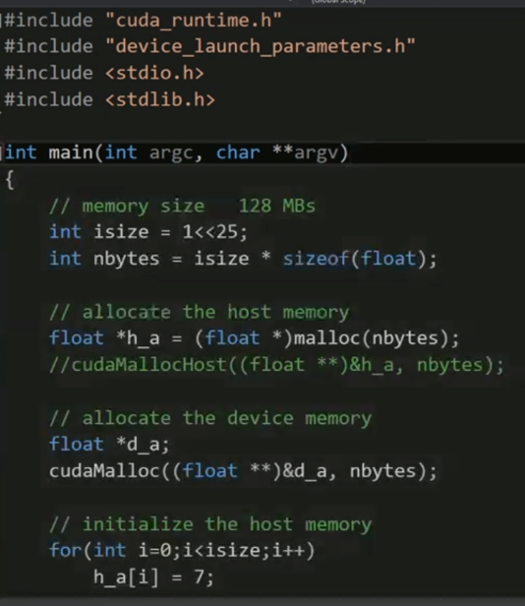
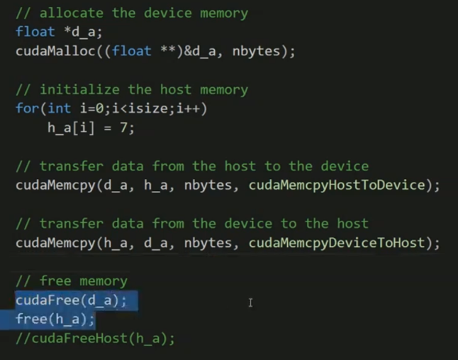

Slide 38
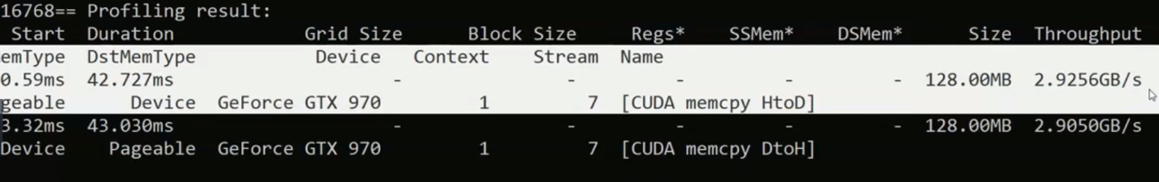

Slide 39
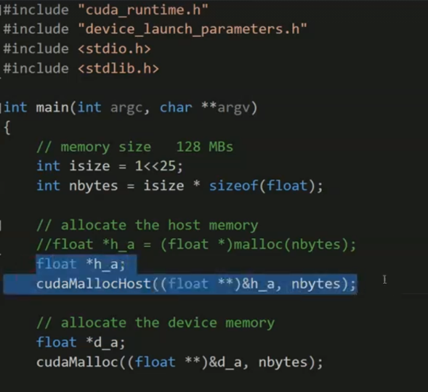
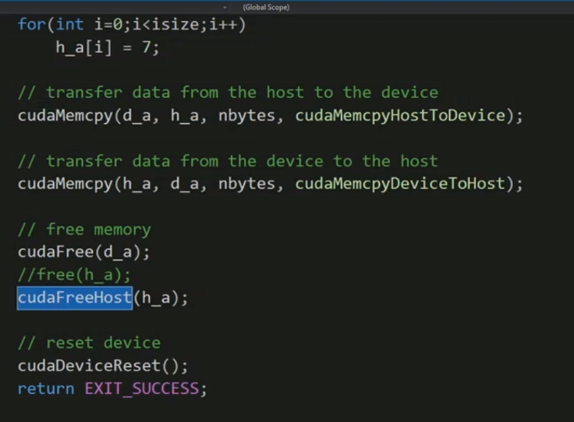

Slide 40
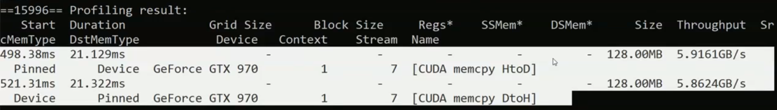

Slide 41
Cuda vector addition
Nsight Eclipse is Eclipse IDE for C/C++ bundled with the libraries of CUDA. The results are checked on a system which has GPU of compute capability of 1.2.
But we will get the same result on GPU of any compute capability for the following code.

Slide 42
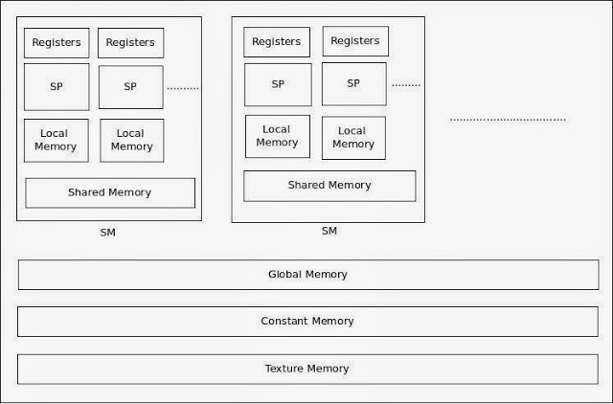

Slide 43
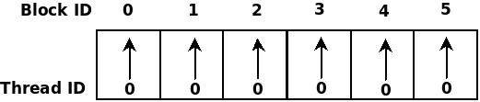
Cuda vector addition contd..
Here three cases are considered for addition of two arrays: 1. n blocks and one thread per block. 2. 1 block and n threads in that block. 3. m blocks and n threads per block.
n blocks and one thread per block (In this example n=6)

Slide 44
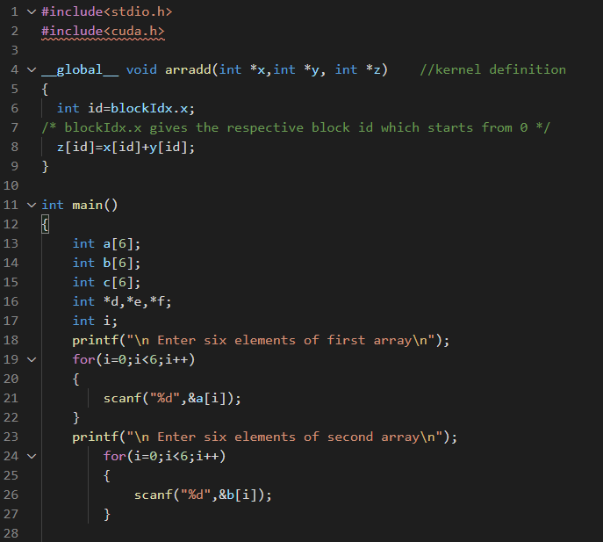
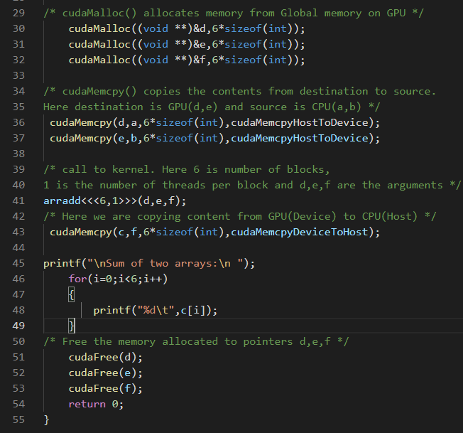

Slide 45
Output:
Enter six elements of first array 1 2 3 4 5 6 Enter six elements of second array 2 3 4 5 6 7 Sum of two arrays: 3 5 7 9 11 13

Slide 46
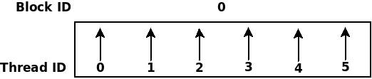
2. One block and n threads in that block (In this example n=6)

Slide 47
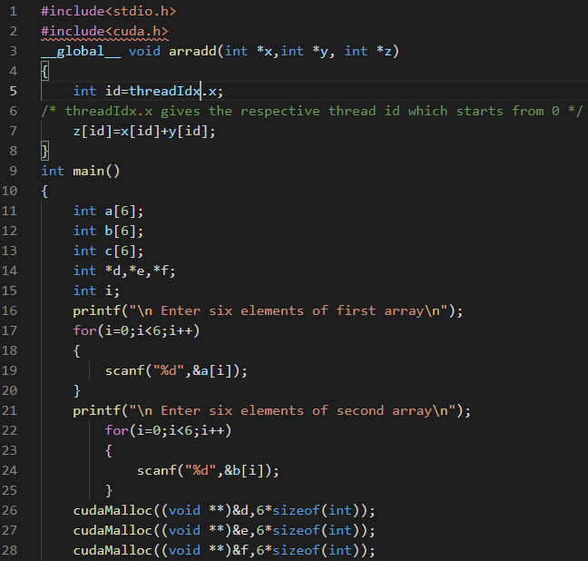
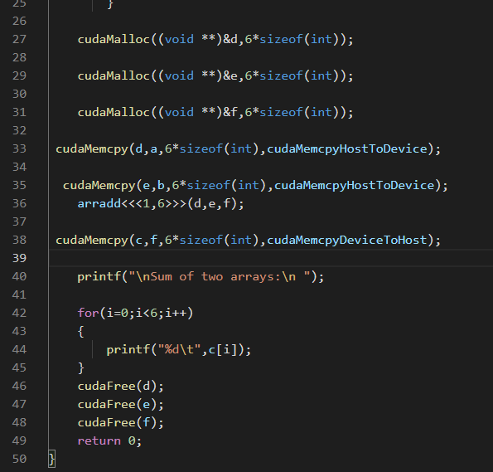

Slide 48
Output:
Enter six elements of first array 1 2 3 4 5 6 Enter six elements of second array 2 3 4 5 6 7 Sum of two arrays: 3 5 7 9 11 13

Slide 49
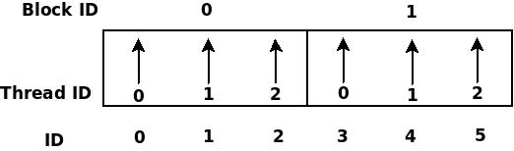
3. m blocks and n threads per block (In this example m=2 and n=3)

Slide 50
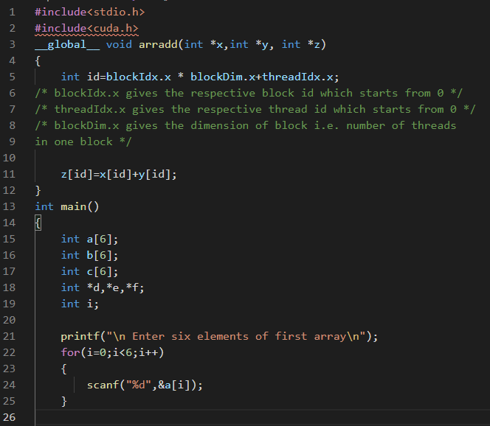
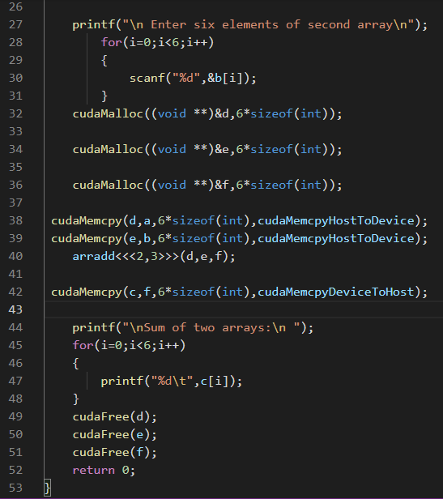

Slide 51
Output:
Enter six elements of first array 1 2 3 4 5 6 Enter six elements of second array 2 3 4 5 6 7 Sum of two arrays: 3 5 7 9 11 13

Slide 52


“Thank you sir !”

