Slide 1
Project Name : Portfolio
Silver Oak College Of Computer Application
SEMESTER : 2nd
Div : M1A3 & B
Subject Name : INTERNSHIP OJT
Name :Dev Tilwani
1

Slide 2
Description About Project
A portfolio website is a type of website that showcases a person's or a company's work and achievements in a visually appealing and interactive way. It serves as an online platform where individuals and businesses can showcase their projects, skills, and experience to potential clients or employers.
Portfolio websites typically include examples of past work, such as design projects, photography, writing samples, or coding projects. They may also feature testimonials from clients or colleagues, an "about" section that highlights the individual's or company's background and skills, and a contact page or form.

Slide 3
Objective
The main goal of a portfolio website is to showcase the individual's or company's unique skills and expertise in order to attract new clients or opportunities. A well-designed portfolio website can help to build a professional brand and establish credibility in a given field. It can also serve as a valuable tool for networking and expanding one's professional network.

Slide 4
Purpose
The purpose of a portfolio is to showcase an individual's or a company's skills, abilities, accomplishments, and experiences in a particular field. Portfolios can serve a variety of purposes, depending on the context in which they are used.
For individuals, a portfolio can be used to:
Demonstrate skills and abilities to potential employers or clients.
Showcase accomplishments and evidence of growth over time.
Reflect on personal learning and development.
Provide a platform for self-expression and creativity.
For businesses or organizations, a portfolio can be used to:
Showcase the company's work and expertise to potential clients.
Provide evidence of success and accomplishments to stakeholders.
Build a professional brand and establish credibility in a given field.
Highlight the company's unique skills and abilities.

Slide 5
Benefits
This is a small, reusable piece of code that can be easily inserted into larger programmes or projects. Here are some benefits:
Demonstrating skills and expertise: A portfolio provides a platform for showcasing one's skills and expertise in a given field. This can be helpful for individuals seeking employment or freelance work, as well as for businesses looking to attract new clients.
Building credibility: By highlighting past successes and accomplishments, a portfolio can help to establish credibility and build trust with potential employers or clients. This is especially important in competitive industries where standing out can be a challenge.
3. Showcasing a unique brand: A portfolio can help individuals and businesses to establish a unique brand and stand out in a crowded market. By showcasing a distinctive style or approach, a portfolio can help to differentiate one's work from that of competitors.

Slide 6

HTML
HTML (Hyper Text Markup Language) is the most basic building block of the Web. It defines the meaning and structure of web content. Other technologies besides HTML are generally used to describe a web page’s appearance/presentation (CSS) or functionality/behavior (JavaScript).
9

Slide 7
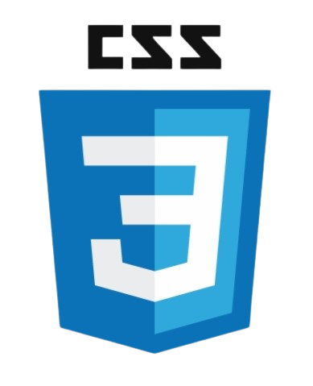
CSS
Cascading Style Sheets (CSS) is a stylesheet language used to describe the presentation of a document written in HTML or XML (including XML dialects such as SVG, MathML or XHTML). CSS describes how elements should be rendered on screen, on paper, in speech, or on other media.
10

Slide 8

JavaScript
JavaScript (JS) is a lightweight, interpreted, or just-in-time compiled programming language with first-class functions. While it is most well-known as the scripting language for Web pages, many non-browser environments also use it, such as Node.js, Adobe Acrobat. JavaScript is a prototype-based, multiparadigm, single-threaded, dynamic language, supporting object-oriented, imperative, and declarative (e.g. functional programming) styles.
11

Slide 9
THANK YOU!

