Slide 1
Parking Reservation Chatbot
Functions and screenshots

Slide 2
Stage 1 – RAG and basic user chat
RAG
Static information (like location, etc) about the parking lot is in a long .md file
During init it is splitted to chunks and saved to a local Chroma Vector database
Embeddings: OpenAI text-embedding-3-small
Chunking: RecursiveCharacterTextSplitter
Dynamic Data
SQLite

Slide 3
Stage 1 – RAG and basic user chat
UI
Streamlit
LLM
gpt-4o-mini
Guardrails
System prompt prohibits task, which are not connected to the task
In addition to it, there are filters for certain words, which are prohibited (like system, promt etc

Slide 4
Stage 1 – RAG and basic user chat
RAG
Static information (like location, etc) about the parking lot is in a long .md file
During init it is splitted to chunks and saved to a local Chroma Vector database
Embeddings: OpenAI text-embedding-3-small
Chunking: RecursiveCharacterTextSplitter
Dynamic Data
SQLite
UI
Streamlit

Slide 5
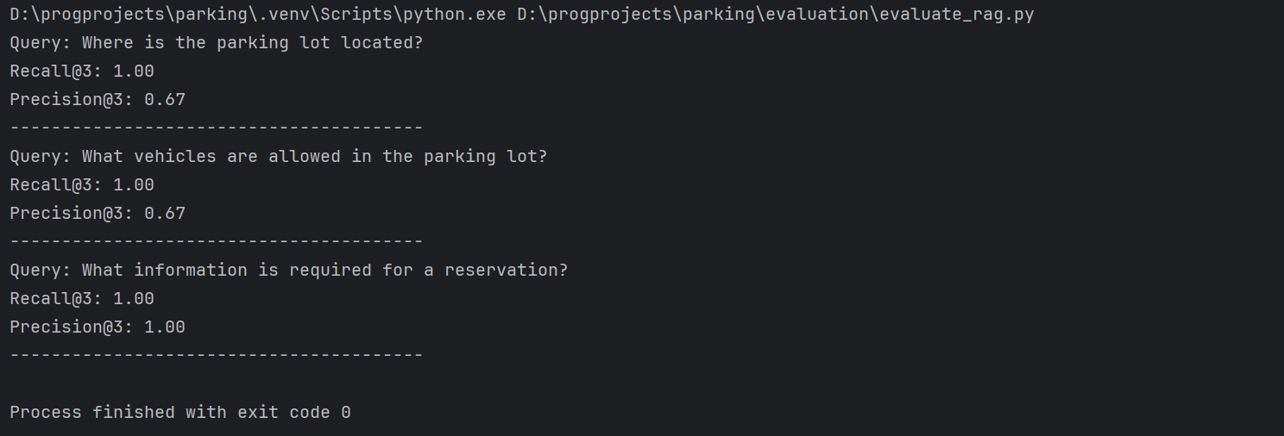
Stage 1 – RAG evaluation

Slide 6
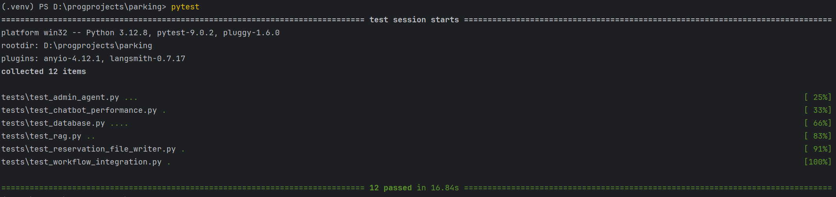
All stages – Tests

Slide 7
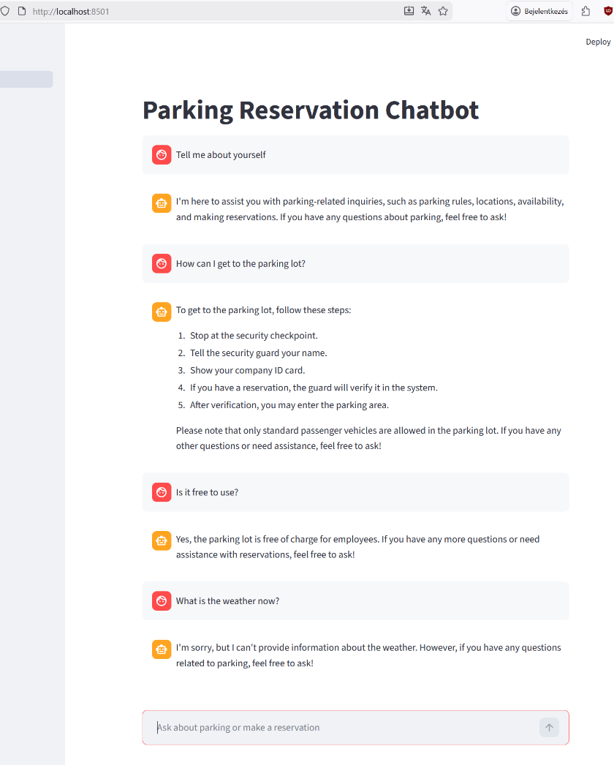
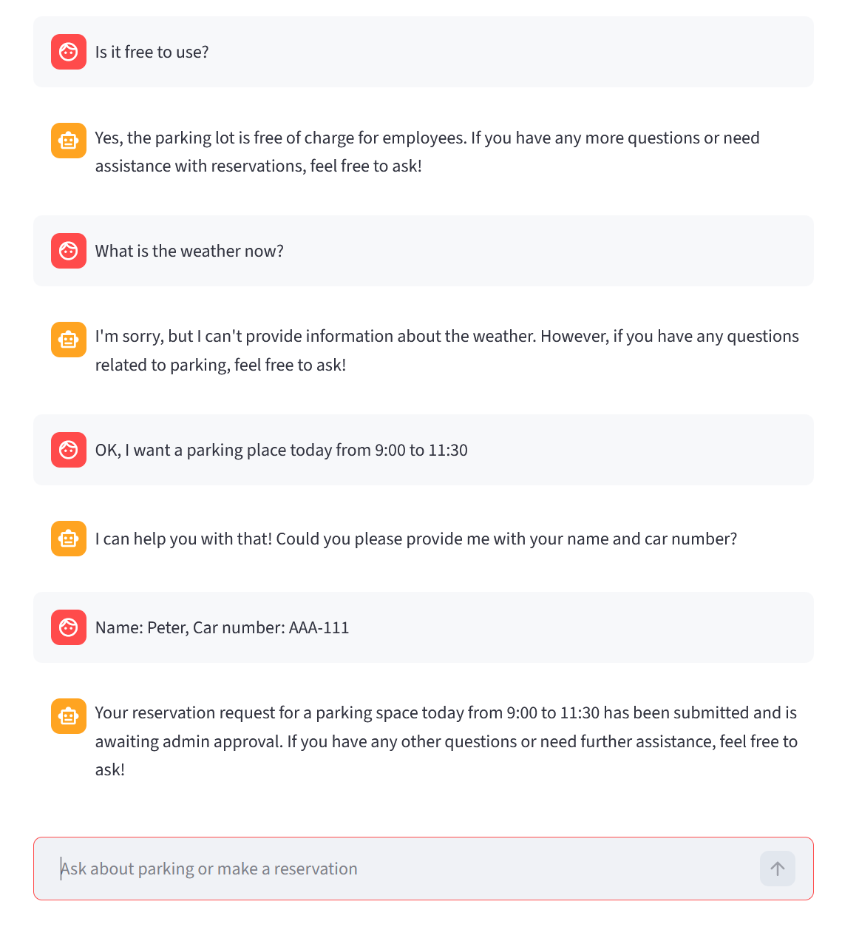
Stage 1 – User input handling

Slide 8
Stage 2
At stage 2, admin tasks are added.
Email notification to the admin
Opportonity to approve or reject a reservation

Slide 9
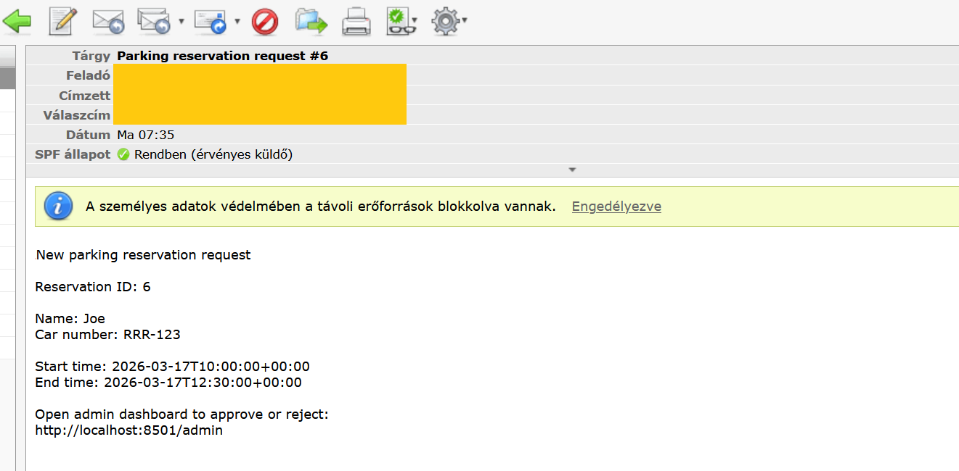
Stage 2 – Sending notification email for human

Slide 10
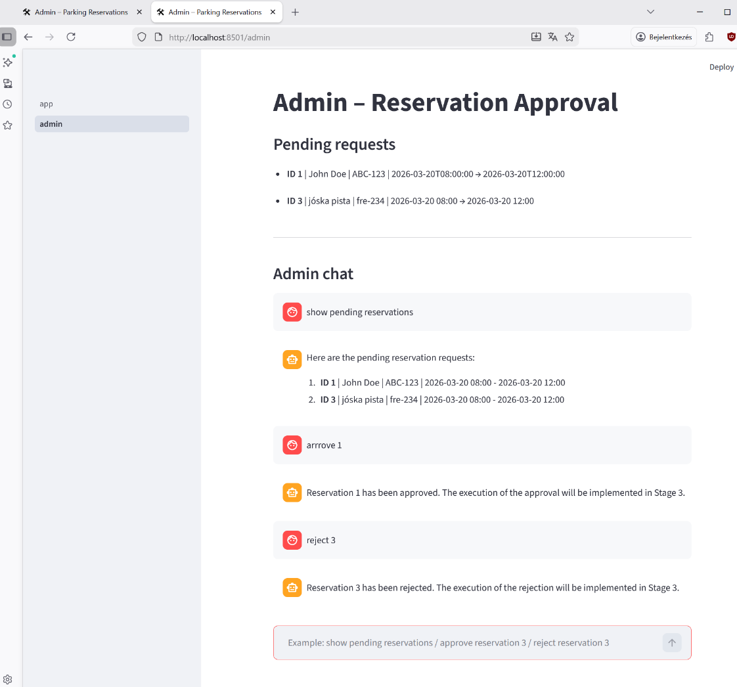
Stage 2 – Admin approval

Slide 11
Stage 3
Reservation through an MCP server
MCP server saves approved reservations to a text file
The security of the MCP server is handled by an API key

Slide 12
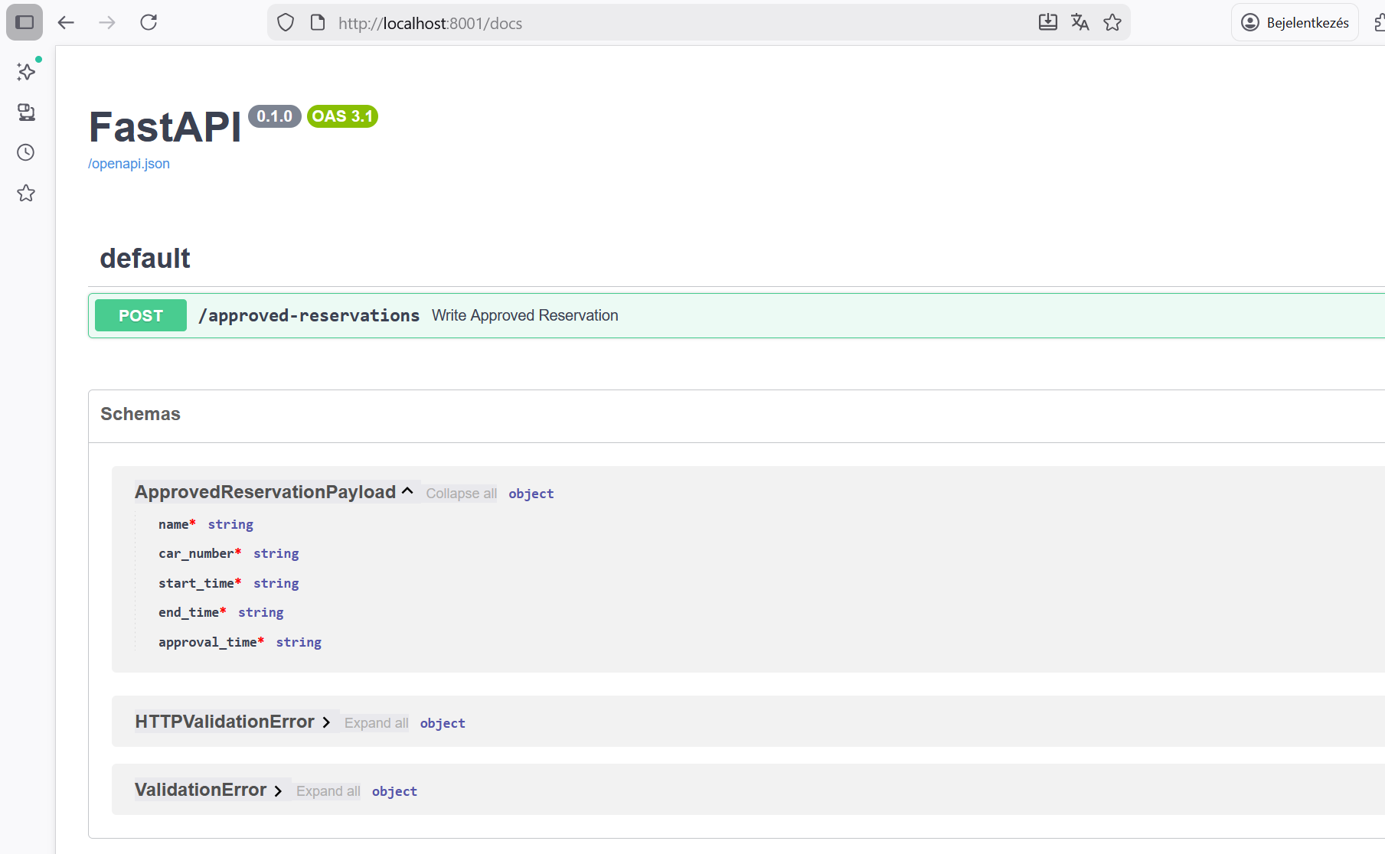
Stage 3 – MCP Server swagger

Slide 13
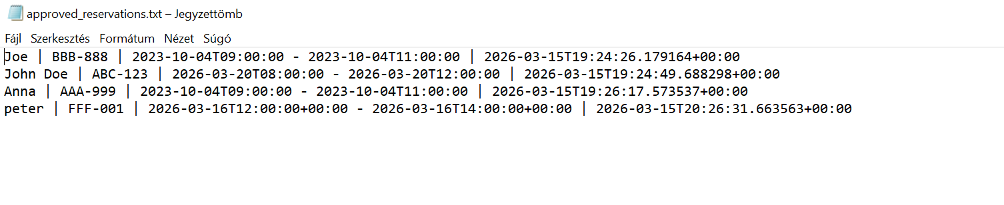
Stage 3 – recording to txt file

Slide 14
Stage 4
Orchestration is done by langgraph
There are 3 nodes
user_interaction_node
administrator_approval_node
data_recording_node
The orchestration layer coordinates:
reservation submission
administrator notification
reservation approval
external reservation recording

Slide 15
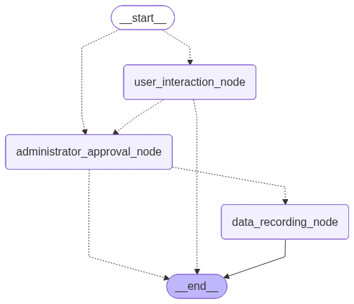
Stage 4 – Langgraph

