Slide 1
Identifying Regional and Age‑Group Patterns in Aadhaar Updates
Aadhaar Data Hackathon — Analytics

Slide 2
Objective
Identify regional (state/district) and age‑group patterns in Aadhaar updates
Provide insights and recommendations to improve service delivery

Slide 3
Dataset & Method
Demographic and Biometric aggregated CSVs (daily rows)
Aggregated by state/district; weekly resampling for forecasts
Holt–Winters forecasts (12-week horizon) for key series

Slide 4
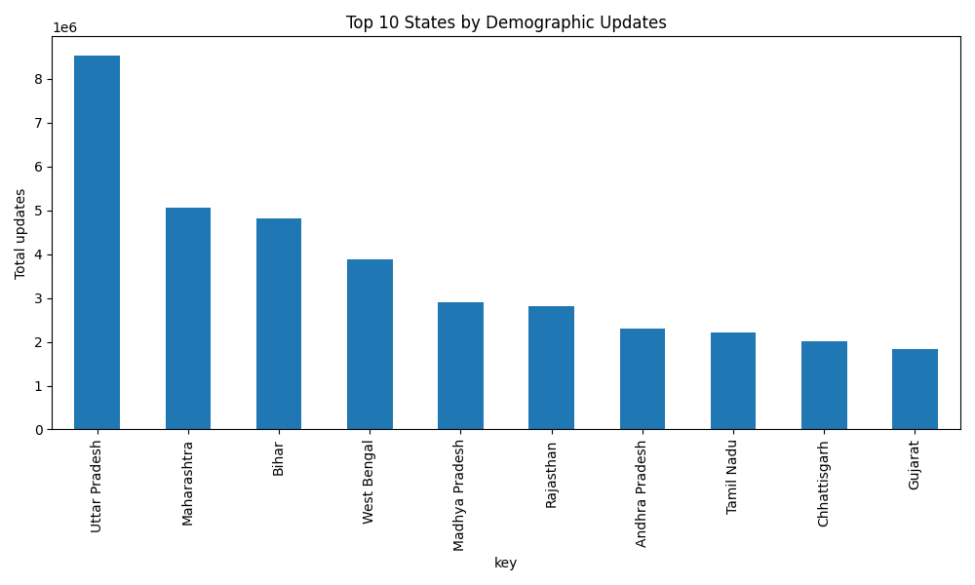
Top 10 States — Demographic

Slide 5
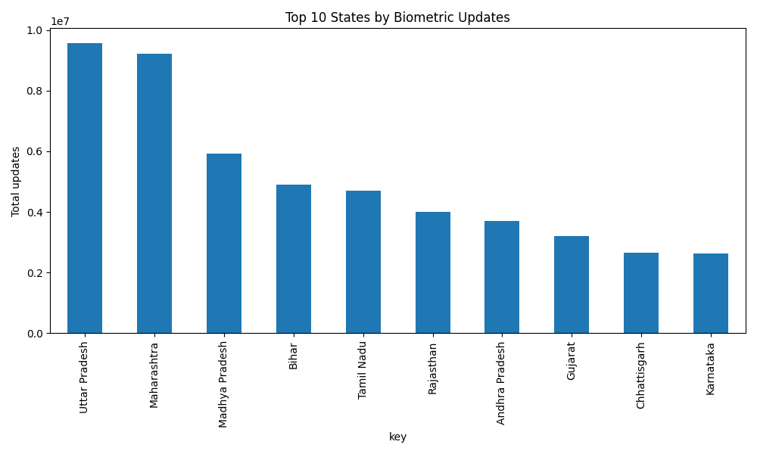
Top 10 States — Biometric

Slide 6
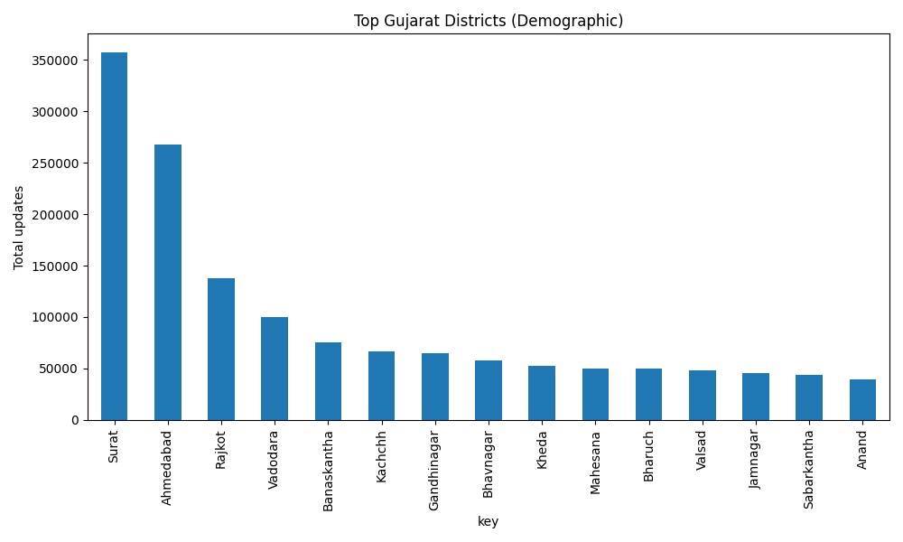
Gujarat — Districts (Demographic)

Slide 7
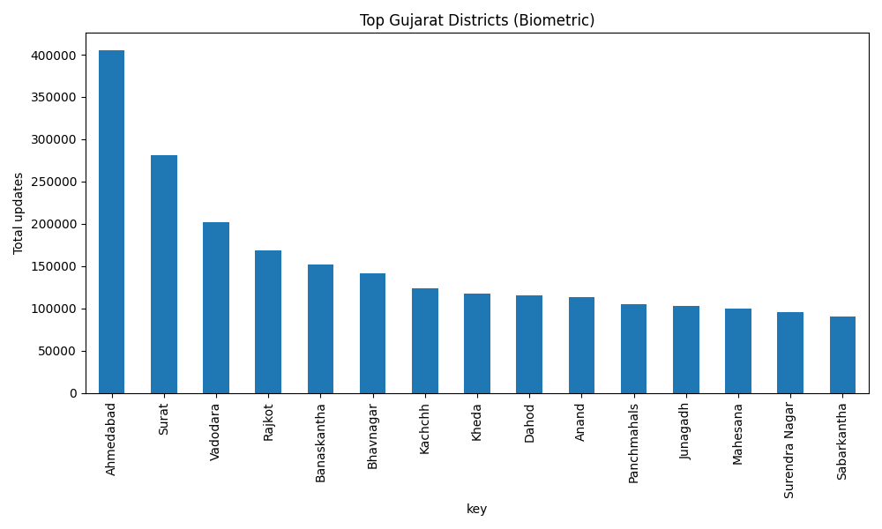
Gujarat — Districts (Biometric)

Slide 8
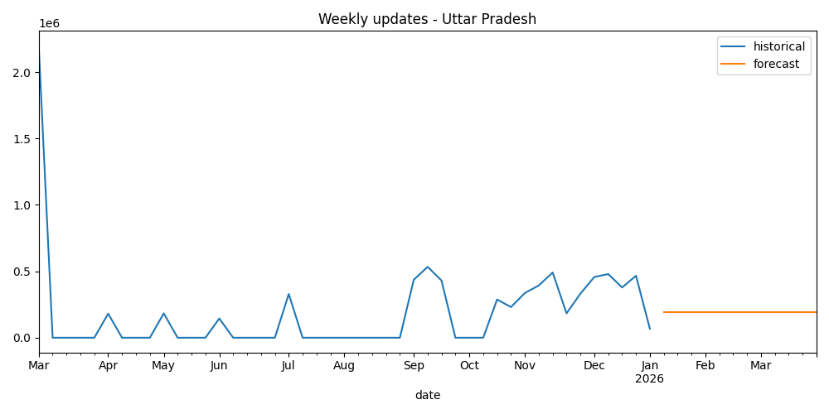
Forecast — Uttar Pradesh

Slide 9
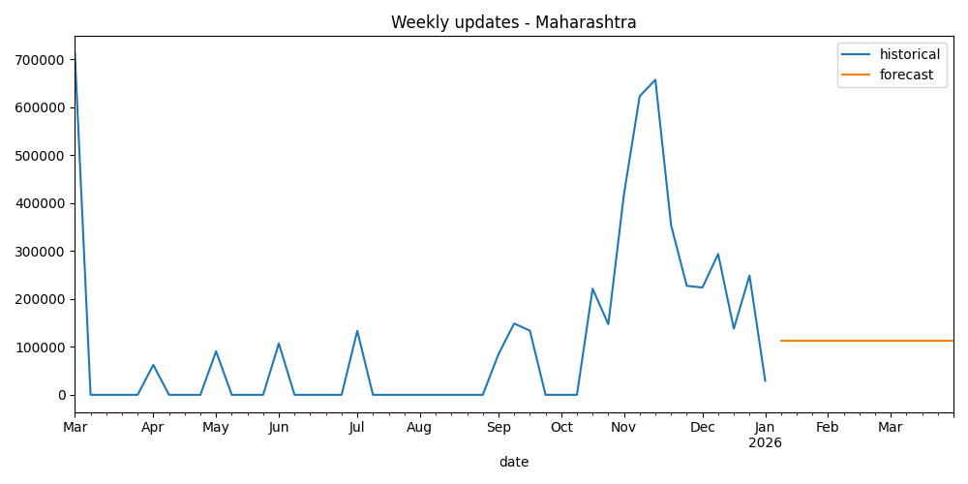
Forecast — Maharashtra

Slide 10
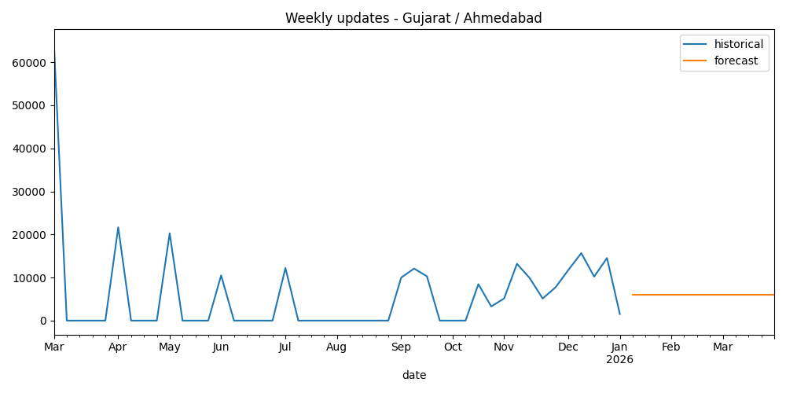
Forecast — Gujarat / Ahmedabad

Slide 11
Key Insights
Uttar Pradesh and Maharashtra show consistently high update volumes
Ahmedabad and Surat dominate Gujarat update requests — urban concentration
High biometric updates indicate revalidation/quality needs in populous areas

Slide 12
Recommendations
Scale temporary/mobile camps and staff during forecasted high weeks
Targeted outreach in high-update Gujarat districts for address/mobile updates
Implement biometric quality/revalidation programs to reduce repeat visits

Slide 13
Next Steps
Compare forecasts with ARIMA/Prophet models for accuracy
Incorporate event calendars as covariates (campaigns, policy changes)
Prepare PPT speaker notes and finalize slides for submission

Slide 14
Conclusion
Data-driven actions can significantly improve UIDAI service delivery efficiency.

