Slide 1
Image Analysis for Identifying Mosquito Breeding Grounds
Team name : Noobs
Team members: Ayush Shivani (20171100, B.tech. CSE)
Devansh Gupta (20171100, B.tech. CSE)
Shubhankar Bhagwat (20171147, B.tech. CSE)
Mentor TA : Aditya Aggarwal
Github link : https://github.com/ayushshivani/dip_project/

Slide 2
Motivation
Diseases carried by mosquitoes like dengue and malaria are on rise.
Mosquitoes breed in stagnant water puddles.
Abundant Water puddles even in cities.
Eliminate the root cause by identifying puddles.

Slide 3
Problem Statement
determine stagnant water in the images in the form of puddles .
Create pipeline, decide probability.
image processing problem involving feature extraction and processing raw data.

Slide 4
Challenges deep-dive
Challenge 1
Challenge 2
Challenge 3
The scope of the problem is small, there is no dataset available online for the purpose of our problem statement.
The problem becomes all the more complex because of the variety in the dataset as the images can be rotated as well.
The images collected in the dataset are from multiple environments which further add to the complexity of the solution.

Slide 5
Implementation

Slide 6
Collecting dataset
Various tags in google search to collect around 175 images which have water puddles in it.
160 images were collected which didn't have puddles in it.

Slide 7
Data pre-processing
As done in the concerned paper, the collected images have to be rotated to add to the directional variance in the dataset.
The image dataset (normal as well as rotated) goes through the image processing step where we use SIFT (Scale-Invariant Feature Transform) for feature extraction.

Slide 8
Training & Validation
The collected dataset is splitted in 80-20 distribution into training and testing data.
Training data is used for the training the classification model.
Testing data is later used to validate the classification model.

Slide 9
Classification model
Most optimal classifiers:
Support vector machine
Logistic regression
Bayesian classifier
Random forest classifier
Majority voting to compound the effect of all classifiers.

Slide 10
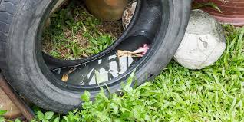

Results
Average Accuracy of the model: 76.9%
Average F1-score of the model: 76.2

Slide 11
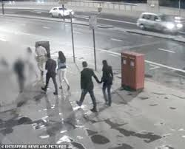

Results contd….

Slide 12
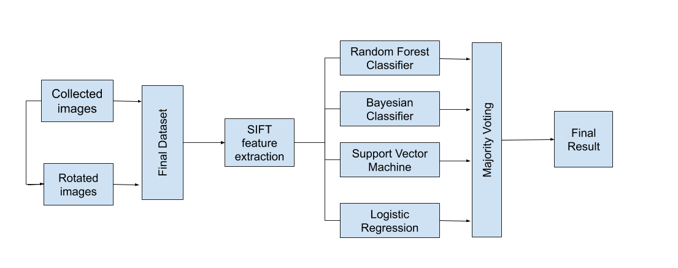
Project pipeline

Slide 13
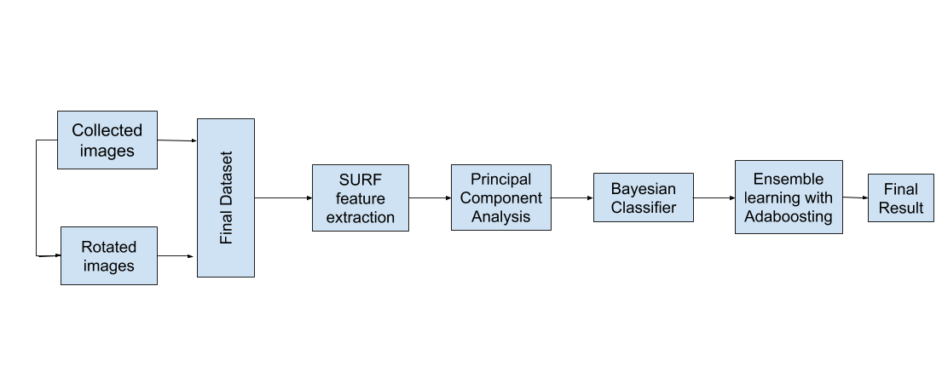
Pipeline as per the paper

Slide 14
Why the difference in pipeline?
Absence of the actual code and dataset.
Limited size of our own dataset.
Data specific techniques like PCA - not suitable.

Slide 15
Scope of improvement
Sophistication of dataset.
Parameter optimisation.

Slide 16
Work Distribution

Slide 17
Work distribution
Team member 1: Shubhankar bhagwat
Worked on the dataset collection.
Worked in the implementation of the pipeline.
Team member 2: Ayush Shivani
Worked on the demo of the project.
Worked in the implementation of the pipeline.
Team member 3: Devansh Gupta
Worked on the dataset collection.
Worked on the documentation and presentation slides.

