Slide 1
Align Test analysis and Forecasting

Slide 2
Exploring the data and its structure remains crucial before starting any analysis and I have explored and validated the data under the following two criteria:
1. Validation of data types, missing value analysis, data relationship , etc.
2. Business rule based discrepancies( eg. Orders, Doctors and Month details mappings, other features validations, etc )
Data Harmonization

Slide 3
Highest Sales in 2019
AccountNumber | ContactName | Percentage Share
64481 | Dr. Kailee Byrd | 2.02%
61039 | Dr. Charity Williams | 1.19%
212707 | Dr. Nathaly Case | 1.02%
74514 | Dr. Makayla Patel | 0.94%
59592 | Dr. Reilly Callahan | 0.76%
91524 | Dr. Rose Oconnor | 0.67%
74789 | Dr. Sage Frederick | 0.55%
111518 | Dr. Howard Stevens | 0.53%
184321 | Dr. Ramon Meza | 0.46%
59650 | Dr. Xander Rasmussen | 0.45%

Slide 4
Highest Sales in Dec 2019
AccountNumber | ContactName | 01-12-2020 Sales | % Sales
64481 | Dr. Kailee Byrd | 700 | 2.34%
212707 | Dr. Nathaly Case | 484 | 1.62%
74514 | Dr. Makayla Patel | 295 | 0.99%
61039 | Dr. Charity Williams | 253 | 0.85%
91524 | Dr. Rose Oconnor | 192 | 0.64%
64700 | Dr. Ishaan Wong | 184 | 0.62%
59592 | Dr. Reilly Callahan | 170 | 0.57%
238827 | Dr. Alexis Foley | 159 | 0.53%
74789 | Dr. Sage Frederick | 136 | 0.46%
184321 | Dr. Ramon Meza | 136 | 0.46%

Slide 5
Top 10 Highest Sales
Doc Name | Q1 | Q2 | Q3 | Q4 | Grand Total
Dr. Kailee Byrd | 4200 | 4670 | 4910 | 4270 | 18050
Dr. Charity Williams | 3266 | 3036 | 4071 | 3082 | 13455
Dr. Nathaly Case | 2740 | 2184 | 2672 | 2628 | 10224
Dr. Makayla Patel | 2115 | 2110 | 2450 | 1905 | 8580
Dr. Shyann Benjamin | 1719 | 2160 | 1728 | 981 | 6588
Dr. Isabela Anderson | 2438 | 1590 | 1802 | 742 | 6572
Dr. Reilly Callahan | 1445 | 1895 | 1755 | 1450 | 6545
Dr. Rose Oconnor | 858 | 1194 | 1248 | 1188 | 4488
Dr. Howard Stevens | 1008 | 1197 | 1106 | 1036 | 4347
Dr. Ramon Meza | 994 | 1124 | 1066 | 1062 | 4246

Slide 6
Professional Category Wise Sales
 | Year 2019 |  |  | Month Dec 2019
 | Professional Category | Sum of Order |  | Professional Category | Sum of Order
 | GP | 246889 |  | GP | 8413
 | Ortho | 650970 |  | Ortho | 21443

Slide 7
Category wise Dr. Segregation
Row Labels | Count of ContactName
GP | 6449
Ortho | 2609

Slide 8
Segment wise Doctors Distribution
Row Labels | Count of ContactName
A | 160
B | 1027
C | 4081
D | 3755
Other | 35

Slide 9
Sales distribution with respect Doctor’s Segments
 | 2019 Sales
Year | A | B | C | D | Other
2019 | 49782 | 133206 | 119125 | 26796 | 110
 | Dec 2019 Sales
Month | A | B | C | D | Other
Dec-19 | 4739 | 12627 | 10536 | 1954 | 0

Slide 10
State wise analysis

Slide 11
State Population wise Distribution (Top States)
State | % of Population | % of Orders | % of Doctors
California | 12.04% | 13.48% | 17.55%
Texas | 8.83% | 8.92% | 7.02%
Florida | 6.54% | 6.16% | 6.98%
New York | 5.93% | 6.75% | 8.45%
Pennsylvania | 3.90% | 3.91% | 3.08%
State | % of Population | % of Orders | % of Doctors
California | 12.04% | 13.48% | 17.55%
Texas | 8.83% | 8.92% | 7.02%
New York | 5.93% | 6.75% | 8.45%
Florida | 6.54% | 6.16% | 6.98%
Washington DC | 2.53% | 4.53% | 2.93%
State | % of Population | % of Orders | % of Doctors
California | 12.04% | 13.48% | 17.55%
New York | 5.93% | 6.75% | 8.45%
Texas | 8.83% | 8.92% | 7.02%
Florida | 6.54% | 6.16% | 6.98%
New Jersey | 2.71% | 4.33% | 4.51%

Slide 12
State Population wise Distribution (Bottom States)
State | % of Population | % of Orders | % of Doctors
Wyoming | 0.18% | 0.03% | 0.11%
Vermont | 0.19% | 0.03% | 0.08%
Alaska | 0.22% | 0.12% | 0.20%
North Dakota | 0.23% | 0.14% | 0.19%
South Dakota | 0.27% | 0.13% | 0.14%
State | % of Population | % of Orders | % of Doctors
Wyoming | 0.18% | 0.03% | 0.11%
Vermont | 0.19% | 0.03% | 0.08%
Mississippi | 0.91% | 0.07% | 0.18%
Alaska | 0.22% | 0.12% | 0.20%
South Dakota | 0.27% | 0.13% | 0.14%
State | % of Population | % of Orders | % of Doctors
Vermont | 0.19% | 0.03% | 0.08%
Wyoming | 0.18% | 0.03% | 0.11%
South Dakota | 0.27% | 0.13% | 0.14%
Montana | 0.33% | 0.15% | 0.16%
Mississippi | 0.91% | 0.07% | 0.18%

Slide 13
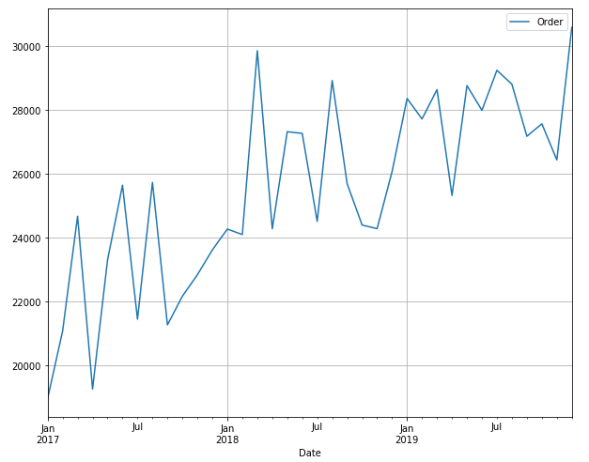
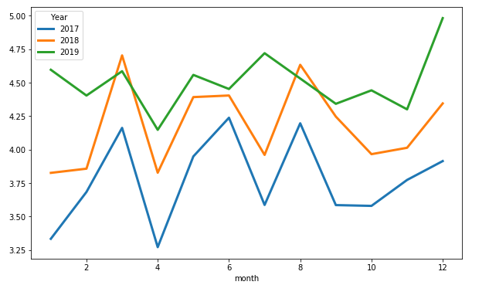
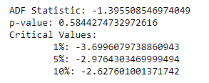
The total sales clearly shows UPWARDS trends as the total sales kept on increasing yearly.
Graph also depicts some SEASIONALITY trends, as we can see that:
- There is always a fall in total sales at the beginning of the year.
- Also the sales increases in Feb and again decreases
Trends and Seasonality in Data set

Slide 14
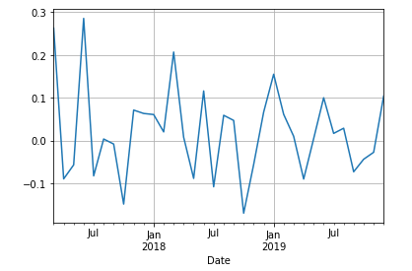
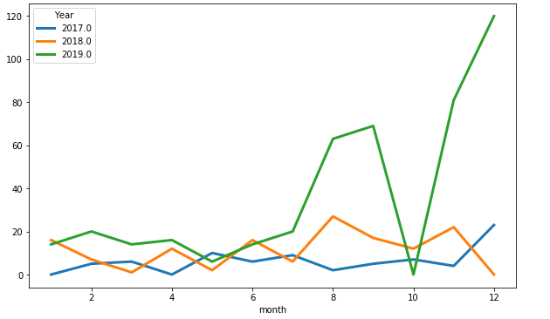
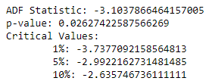
Stationary data in overall sales

Slide 15
Forecasting Steps
Preparing Data
EDA – Checking the NA values, data types of features and correcting them
Selecting features for our use
Selecting Algorithm and other values
Preparing data for algorithm use
Checking for seasonality and trends
Yes
No
Model Building and Forecasting
Correction to do
Move forward with next step

Slide 16
Preparing Data and EDA
Inserting Libraries
Importing data sets (both sheets)
Merging both the datasets
Removing Blank spaces doing other EDA
Checking the data types of features

Slide 17
Feature Selection and seasonality and trend test
Selection of Datetime feature and the dependent feature
Correcting the dataset if required.
Mean and variance method used for checking the seasonality.
Different graphs used for viewing the seasonality.

Slide 18
Correction of Seasonality
ADF and KPSS are used for checking if the data is stationary or not.
Converting non stationary data into Stationary data using log shift technique.

Slide 19
Selecting Algorithm, Model Building and Forecasting
Checking the autocorrelation and partial autocorrelation (value of p and q)
Building model with ARIMA and ARMA and checking the errors
Building the different models using different order values.
Selecting the model with the optimum errors
Doing forecasting using the selected model
Backtracking the actual value.

Slide 20
Strengths and Weakness of the Model
Strengths
Very less mean square error at 0.0053 for monthly forecasting, hence we get quite accurate error.
Simple to understand.
Weakness
Approximation is done in removing the seasonality and trends.
Approximation is done while converting the non stationary data into stationary.

Slide 21
Findings, Analysis and Insights
Dr. Kailee Byrd has the highest no. of orders in the year 2019, also he has the highest no. of orders for Dec 2019.
Dr. Charity Williams has the 2nd highest orders in 2019 but his order count decreases in Dec 2019.
Dr. Kailee Byrd and Dr. Charity Williams are very consistent in there order counts over different quarters.
As per the professional Category is concerned, Ortho has nearly 73% share in the orders in 2019 and 72% share in Dec 2019.
29% of Dr. are from Ortho and 71% are from GP.
4081 i.e. 45% of Dr. are in Segment C and this segment has the highest count where as only 35 Dr. are in other segment which is lowest.
California produces the highest no. of Orders and Wyoming has the least orders.
Kansas has the maximum average orders per Doctors, which is nearly 250 orders per Dr.
Population wise California has the highest population share at 12.04%, also California has 13.48% of orders and also it has the highest percentage of Doctors count.
Wyoming has the least population share at 0.15%, and also has the lease Order share where as Vermont has least Doctor share.

Slide 22
Possible Recommendations
We have opportunity in Mississippi as the Population vs Doctor ratio is very high by assigning more Doctors there.
Kansas, Maine, North Carolina are the states where Average Orders per Doctors is very High, So more Doctors can be assigned to these states to share the work loads and states like Wyoming, Vermont, Mississippi are the states with least average orders per Doctors hence few Doctors can be shifted to other states.

