Slide 1



COMPARATIVE CLUSTERING ANALYSIS
Human Activity Pattern
Discovery Using Smartphone
Sensor Data
Unsupervised learning on 561 inertial sensor features to recover human activity structure without labels
Algorithms Compared
K-Means
Hierarchical
Gaussian Mixture Model
DBSCAN

Slide 2






ROADMAP
What We'll Cover
1. Dataset & Problem
2. Data Quality & EDA
HAR sensor data, the unsupervised reframing
Integrity checks, activity distribution
3. Preprocessing Pipeline
4. Choosing K
Scaling, PCA, feature importance
Elbow method & silhouette analysis
5. Four Algorithms
6. Comparison & Verdict
K-Means, Hierarchical, GMM, DBSCAN
Metrics, ranking, best performer
Human Activity Pattern Discovery — A Comparative Clustering Analysis
2

Slide 3





THE PROBLEM
From Labeled Activities to
Unsupervised Discovery
SIX TARGET ACTIVITIES
The HAR dataset was originally built for supervised classification — each reading is labeled with one of six activities. This project deliberately ignores those labels during clustering, asking a harder question: can unsupervised algorithms rediscover natural activity structure purely from accelerometer and gyroscope signals?
Walking
Walking Upstairs
Walking Downstairs
10,299
561
30
6
Sitting
Sensor readings
Numerical features
Subjects (volunteers)
True activity classes
Standing
Source: UCI HAR Dataset — captured via waist-mounted smartphone accelerometer + gyroscope at 50Hz
Laying
Human Activity Pattern Discovery — A Comparative Clustering Analysis
3

Slide 4
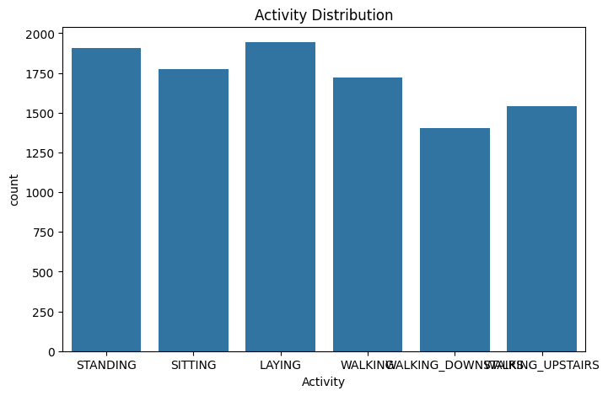

STEP 1
Data Quality Assessment
Before clustering, the dataset structure was verified to confirm it's ready for unsupervised analysis — missing values and duplicates can distort distance-based algorithms.
Missing Values
0
No nulls across all 563 columns
Duplicate Rows
0
Every record is unique
Train + Test Merged
10,299
7,352 train + 2,947 test rows combined
Activity distribution is well balanced — no class dominates, which keeps clustering bias low.
Human Activity Pattern Discovery — A Comparative Clustering Analysis
4

Slide 5



STEP 2
Preprocessing Pipeline
01
02
03
04
→
→
→
Drop Identifiers
Standardize
Reduce with PCA
Rank Features
Remove 'subject' & 'Activity' columns to isolate the 561 sensor features (X)
StandardScaler applied — zero mean, unit variance across all features
Project onto principal components that retain 95% of variance
Random Forest importance highlights the most discriminative sensors
561 → 104
82%
StandardScaler
Features after PCA (95% variance retained)
Dimensionality reduction achieved
Zero mean, unit variance normalization
Human Activity Pattern Discovery — A Comparative Clustering Analysis
5

Slide 6
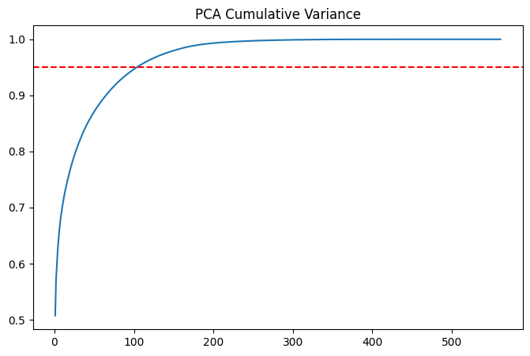
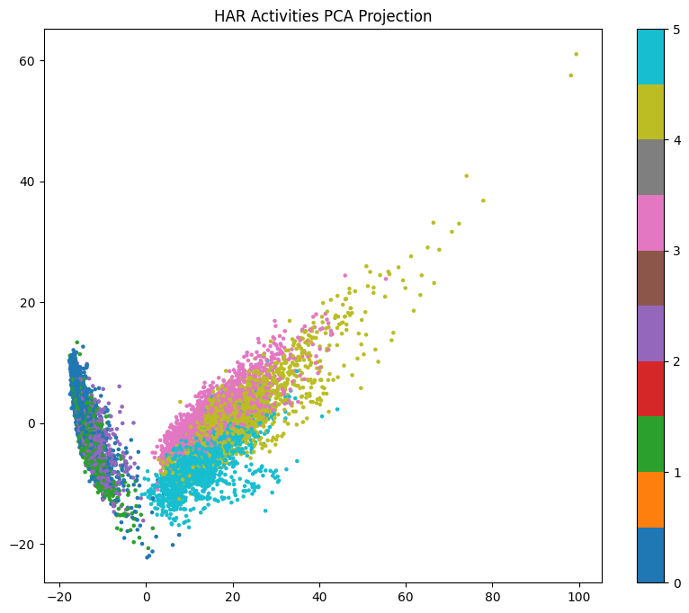
DIMENSIONALITY REDUCTION
PCA: Compressing 561 Features
Without Losing the Signal
Cumulative explained variance — the red line marks the 95% threshold
First 2 principal components, colored by true activity — natural groupings are already visible
Human Activity Pattern Discovery — A Comparative Clustering Analysis
6

Slide 7
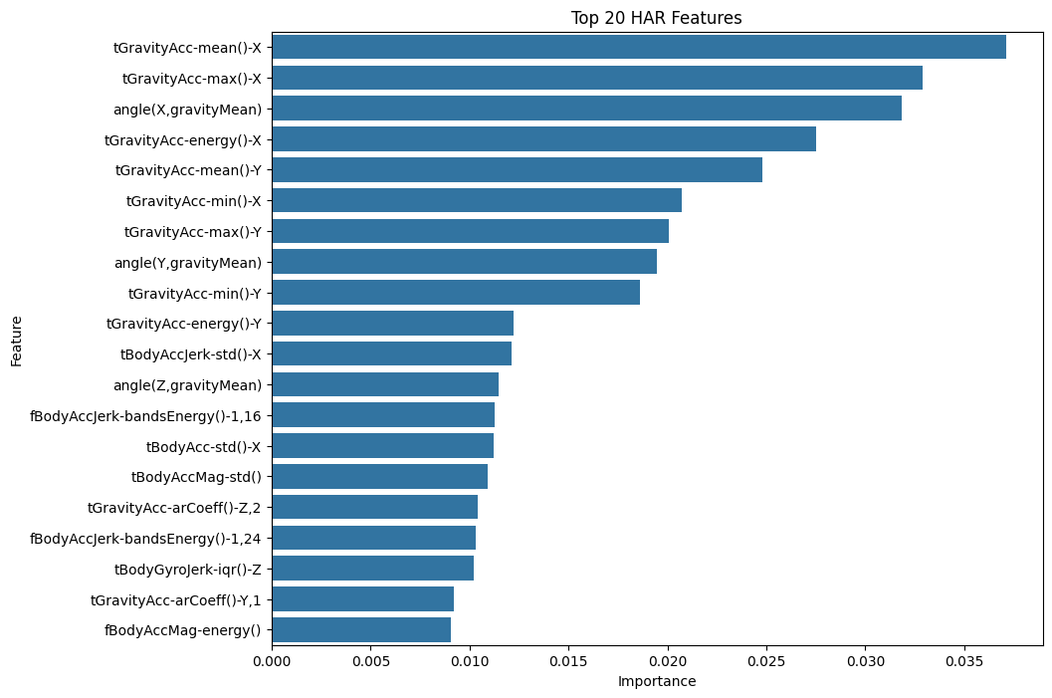
FEATURE INSIGHT
Which Sensor Signals Matter Most?
A Random Forest classifier (trained only to rank features, not for prediction) surfaces the top contributors. Gravity-axis acceleration dominates — it directly encodes phone orientation, which is highly diagnostic of posture (sitting vs. standing vs. laying) and motion.
#1
tGravityAcc-mean()-X
3.71%
#2
tGravityAcc-max()-X
3.29%
#3
angle(X, gravityMean)
3.18%
Top 50 ranked features were carried forward as a curated feature subset for downstream checks.
Human Activity Pattern Discovery — A Comparative Clustering Analysis
7

Slide 8
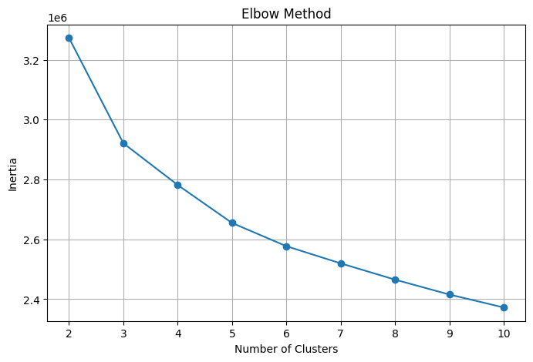
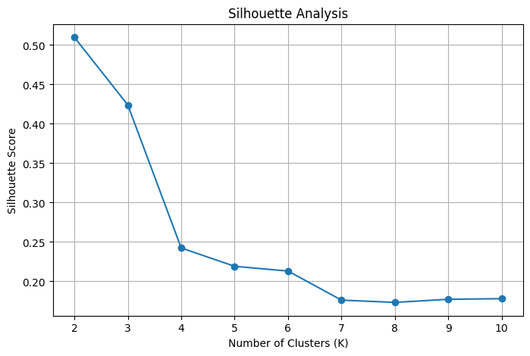
STEP 3
Choosing the Right Number of Clusters
Elbow Method — inertia flattens around K = 3
Silhouette Analysis — score peaks at K = 2, second-best at K = 3
Decision: K = 3 chosen — balances strong separation with capturing more than a trivial 2-group split (static vs. dynamic).
Human Activity Pattern Discovery — A Comparative Clustering Analysis
8

Slide 9




STEP 4
Four Clustering Algorithms,
One Dataset
Each algorithm makes different assumptions about cluster shape, density, and boundaries. Running all four on the same PCA-reduced space reveals which assumptions actually fit human activity signals.
K-Means
Hierarchical
GMM
DBSCAN
Centroid-based, assumes spherical clusters
Builds a tree via agglomerative merging
Probabilistic, soft elliptical clusters
Density-based, finds arbitrary shapes

Slide 10

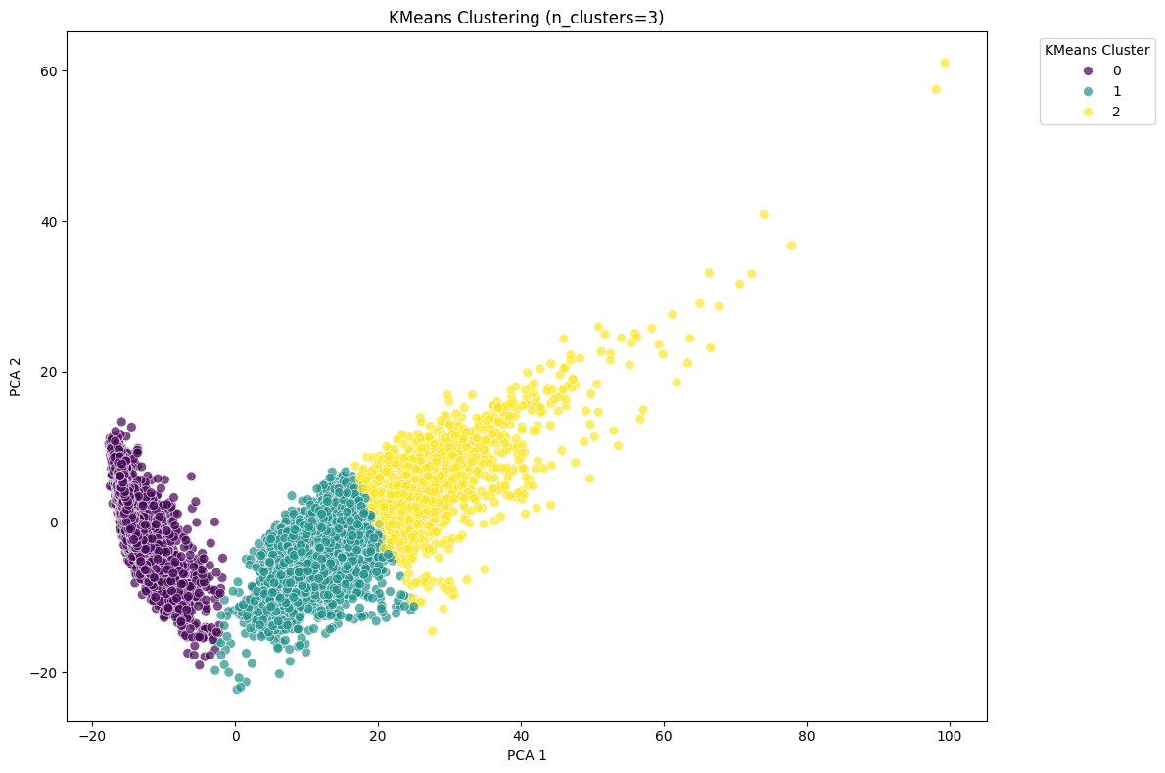
ALGORITHM 1 OF 4
K-Means Clustering
Partitions data into K=3 clusters by minimizing within-cluster variance around centroids — run on the PCA-reduced feature space.
Silhouette Score
0.4239
Highest of all 4 algorithms
Calinski-Harabasz
9,268.6
Highest of all 4 algorithms
Davies-Bouldin
1.2948
Lowest (best) of all 4 algorithms
Human Activity Pattern Discovery — A Comparative Clustering Analysis
10

Slide 11

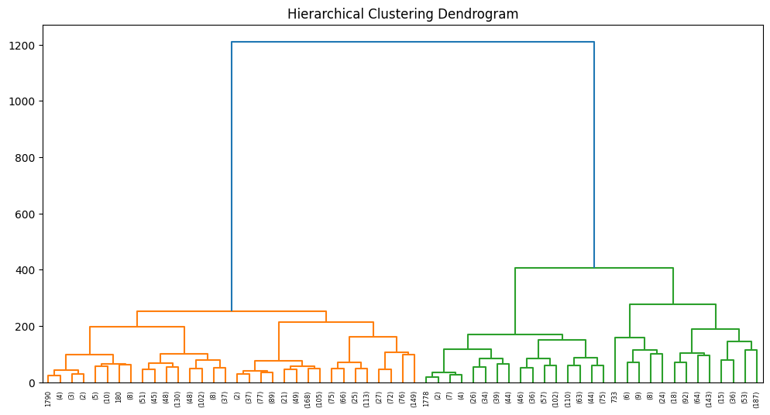
ALGORITHM 2 OF 4
Hierarchical (Agglomerative) Clustering
Ward-linkage clustering builds a tree of merges from the bottom up. Since the full dataset (10,299 rows) is too large for an efficient distance matrix, a random sample of 3,000 rows was used for the dendrogram.
Silhouette Score
0.2932
Calinski-Harabasz
1,556.1
Davies-Bouldin
1.8429
Dendrogram (Ward linkage, truncated to 5 levels) — branch heights show merge distance
Human Activity Pattern Discovery — A Comparative Clustering Analysis
11

Slide 12

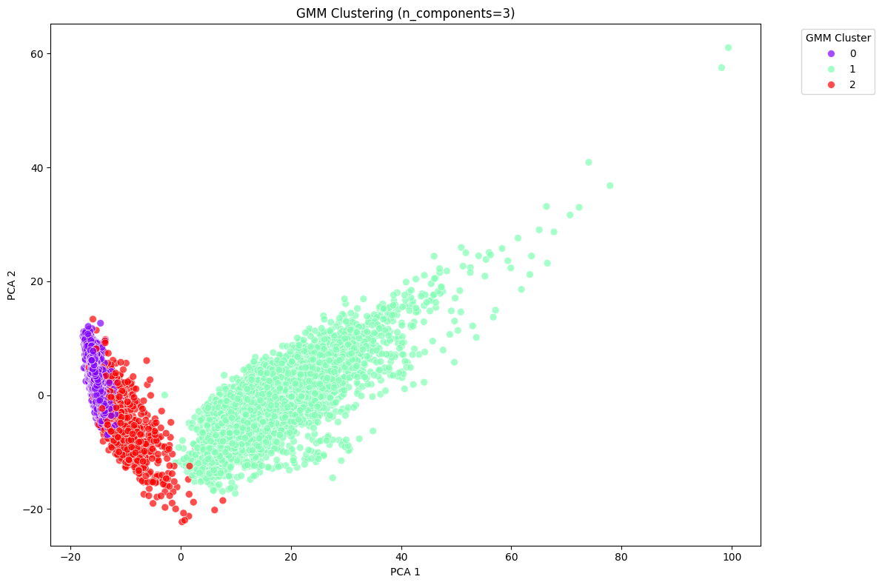
ALGORITHM 3 OF 4
Gaussian Mixture Model (GMM)
Models data as a mixture of 3 Gaussian distributions, assigning soft (probabilistic) cluster membership rather than hard boundaries.
Silhouette Score
0.3021
Calinski-Harabasz
7,307.9
Davies-Bouldin
1.5225
Second-best overall — strong Calinski-Harabasz score, but softer boundaries blur some activity transitions.
Human Activity Pattern Discovery — A Comparative Clustering Analysis
12

Slide 13

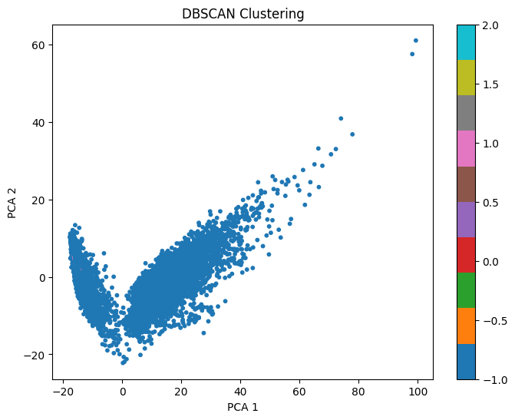
ALGORITHM 4 OF 4
DBSCAN
Density-based clustering that groups points by neighborhood density (eps=3, min_samples=10) and labels sparse points as noise — no need to pre-specify K.
Silhouette Score
-0.2224
Calinski-Harabasz
55.9
Davies-Bouldin
1.8039
In this high-dimensional PCA space, density is too uniform — DBSCAN collapses almost everything into a single cluster, producing weak, negative-leaning metrics.
Human Activity Pattern Discovery — A Comparative Clustering Analysis
13

Slide 14
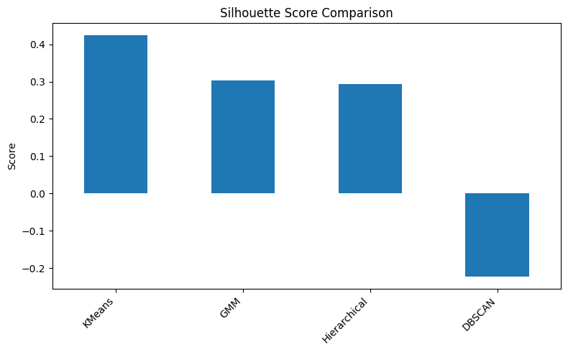
STEP 5
Head-to-Head Comparison
Algorithm | Silhouette ↑ | Calinski-Harabasz ↑ | Davies-Bouldin ↓ | Overall Rank
K-Means | 0.4239 | 9,268.59 | 1.2948 | 1st
GMM | 0.3021 | 7,307.91 | 1.5225 | 2nd
Hierarchical | 0.2932 | 1,556.11 | 1.8429 | 3rd
DBSCAN | -0.2224 | 55.93 | 1.8039 | 4th
Rank = sum of per-metric ranks (Silhouette desc + Calinski-Harabasz desc + Davies-Bouldin asc) — lower combined rank is better.
READING THE METRICS
Silhouette: higher (→1) = better-separated clusters
Calinski-Harabasz: higher = more compact & separated
Davies-Bouldin: lower (→0) = better separation
Human Activity Pattern Discovery — A Comparative Clustering Analysis
14

Slide 15
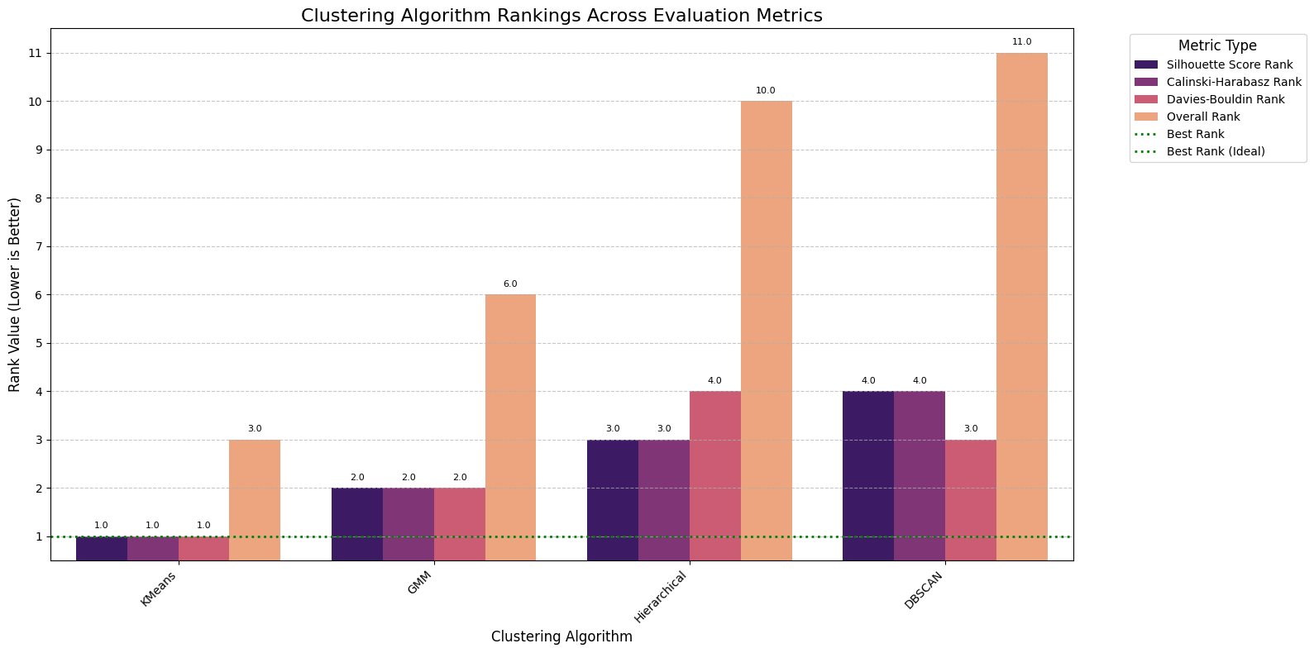
STEP 5 (CONT.)
Ranking Every Metric Side by Side
Per-metric rank (1 = best) for each algorithm — K-Means stays near the top across every dimension, while DBSCAN trails consistently.
Human Activity Pattern Discovery — A Comparative Clustering Analysis
15

Slide 16

FINAL VERDICT
K-Means Wins
BEST ALGORITHM
K-Means
Across all three evaluation metrics, K-Means delivered the most balanced, well-separated clustering of human activities from raw sensor signals.
n_clusters
3
Highest Silhouette Score (0.4239) — clusters are well-separated and internally tight
Silhouette
0.4239
Highest Calinski-Harabasz Index (9,268.6) — strong between-cluster vs. within-cluster variance ratio
Calinski-Harabasz
9,268.6
Lowest Davies-Bouldin Index (1.2948) — minimal cluster overlap
Davies-Bouldin
1.2948
Overall rank
#1 of 4
Activity signals form roughly spherical, evenly-sized groups in PCA space — exactly what K-Means assumes
Human Activity Pattern Discovery — A Comparative Clustering Analysis
16

Slide 17

WRAP-UP
Key Takeaways
Preprocessing drives results
Cluster geometry matters
Standardization + PCA (561 → 104 features) was essential before any algorithm could separate activities cleanly.
Activity signals cluster into roughly spherical, evenly-distributed groups — favoring centroid-based methods like K-Means.
Density methods underperform here
Multi-metric evaluation is essential
DBSCAN struggled because high-dimensional PCA space lacks the sharp density contrast it needs.
No single metric tells the full story — combining Silhouette, Calinski-Harabasz, and Davies-Bouldin gave a robust, balanced verdict.
Human Activity Pattern Discovery — A Comparative Clustering Analysis
17

Slide 18
Thank You
Human Activity Pattern Discovery Using Smartphone Sensor Data — A Comparative Clustering Analysis
Questions & Discussion

