Slide 1


U.S. Approach to Roadway Traffic Safety
National Highway Traffic Safety Administration
U.S. Department of Transportation
(USDOT / NHTSA)
Presented by Ronald E. Boenau, P.E.
Federal Transit Administration
(USDOT / FTA) at
U.S. – East Africa Workshop
August 26-27, 2009

Slide 2
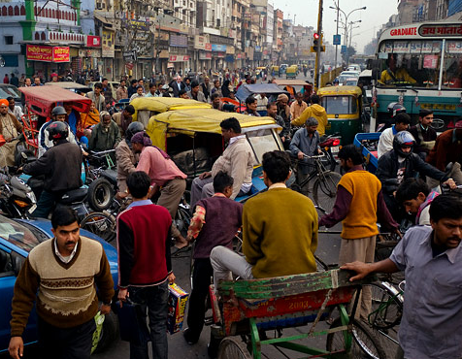
Road Traffic Crashes: Global Impact
Annually, road traffic crashes cause:
  1.2 million deaths
  20 – 50 million injuries
  $500 billion in economic costs
By 2020, traffic crashes will be the 6th largest cause of death worldwide.
Crashes in Africa, for example, account for more than 10 per cent of global road fatalities
Crashes in low- and middle-income countries increasing while crashes in high-income countries are decreasing
Source: WHO World Report on Traffic Injury Prevention 2004

Slide 3
Road Traffic Crashes: U.S. Impact
U.S. traffic fatalities and injuries continue to decrease, with 2008 posting the lowest fatality rate and injury numbers on record.
  37,261 fatalities / 1.27 per 100 million VMT
    This rate has improved over time -- from 1.41 in 2006 and 1.69 in 1996
  2.35 million people injured
  $150 billion in economic costs
NHTSA is committed to further reducing the losses due to traffic crashes, and is focusing several specific challenge areas:
Motorcycle crashes
Seatbelt use
Drunk Driving Mitigation
Source: National Center for Statistics and Analysis

Slide 4
NHTSA Overview
~$800M annual budget
Key Divisions:
  Vehicle Safety
    Rulemaking
    Enforcement
    Vehicle Safety Research
    National Center for Statistics and Analysis
~600 employees
  Traffic Injury Control (Behavioral)
    Research & Program Development
    10 Regional Program Offices

Slide 5
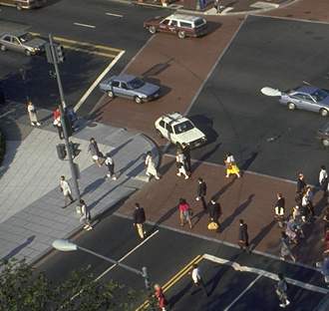
NHTSA Mission & Strategy
NHTSA is the lead agency responsible for vehicle and traffic safety in the United States.
Mission:
Traffic safety is a multi-sector issue:
Save Lives, Prevent Injuries, and Reduce Economic Costs due to Road Traffic Crashes
Transportation
Law Enforcement
Public Health

Slide 6
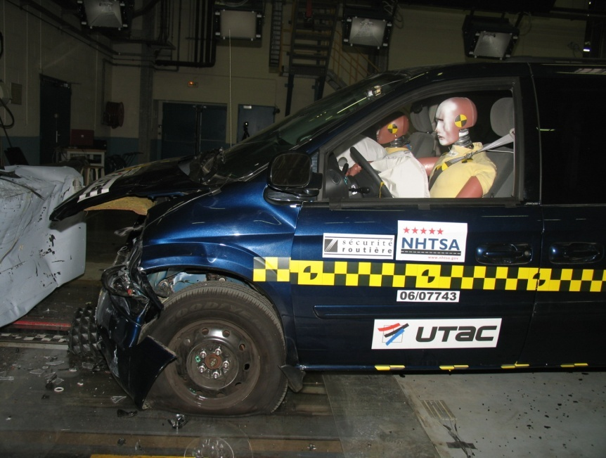
The NHTSA Approach
NHTSA realizes its goals of increasing road and traffic safety by establishing and enforcing rules informed by a rigorous policy approach.
This approach is:
COMPREHENSIVE
  Human, Vehicle, Environment
  All contributing factors are examined
PERFORMANCE-BASED
  Regulating the performance rather than the design of vehicles and their components
SCIENCE-BASED and DATA-DRIVEN
  Pre-crash, crash, post-crash
  Rulemakings are undertaken only when grounded in theory and backed by sound, empirical evidence.

Slide 7
Rulemaking
NHTSA is responsible for developing Federal Motor Vehicle Safety Standards (FMVSS), regulations establishing minimum standards for vehicle safety, fuel economy, and theft prevention. These standards and processes used to establish them must be Transparent, Open, Reasoned and Fair
Notes:
Administrative Procedures Act:
Transparent & Open—notice and opportunity for comment, timely availability of info, written response to comments
Reasoned and Fair Decision-Making
Regulatory Flexibility Act:
Examines rules’ impacts on small businesses
Executive Order:
Detailed examination of costly or controversial rules’ impacts

Slide 8
Rulemaking: Harmonization
The economic and safety benefits of harmonized vehicle regulations are significant. As such, NHTSA’s harmonization efforts are centered on the 1998 Agreement on Global Technical Regulations administered by the UNECE’s World Forum for Harmonization of Vehicle Regulations (WP.29).
South Africa is a contracting party and actively participates in WP.29.
Completed Vehicle Safety GTRs:
  Door Locks and Latches, Motorcycle Brakes, Head Restraints, Glazing, Electronic Stability Control (ESC), Pedestrian Safety
In-Process GTRs:
  Hydrogen Vehicles, Tires, Motorcycles Controls & Displays
New Program of Work
http://www.unece.org/trans/main/welcwp29.htm

Slide 9
Rulemaking: Fuel Economy
NHTSA’s Corporate Average Fuel Economy program (CAFE) is the cornerstone of fuel economy efforts in the U.S. The program’s current focus is meeting mandates for significant increases in U.S. fleet fuel economy over the next ten years. Specific priorities include:
Passenger Cars and Light Trucks, MY 2011-2015
  Proposes substantial increases to current standards
New Responsibilities
  Medium and heavy duty truck fuel efficiency
  Tire fuel efficiency
  Consumer information

Slide 10
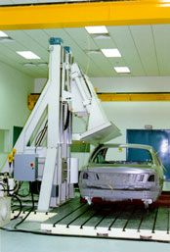
Vehicle Safety Research
The Vehicle Safety Research division supports NHTSA’s programs through the collection and analysis of crash data to identify safety issues. The resulting research is used to develop solutions to problems and assess the costs, benefits, and effectiveness of countermeasures.
Research activities focus on improving vehicle crashworthiness and crash avoidance. Current priorities include:
  Increasing seat belt use
  Decreasing alcohol and drug involvement in crashes
  Decreasing the number of rollover crashes
  Improving vehicle-to-vehicle crash compatibility
  Improving data systems
Notes:
Applied Vehicle Safety Research
Human-Vehicle Performance Research
VRTC

Slide 11
Crashworthiness & Crash Avoidance
The Vehicle Safety Research division’s works to foster promising new technologies and to improve the performance of existing systems.
Crashworthiness strives to reduce the severity and increase the survivability of a crash. Areas of study include:
Crash Avoidance technologies are designed to increase vehicle’s ability to avoid crashes. Areas of study include:
Roof Crush
Vehicle Compatibility
Rollover Mitigation
Advanced Restraints
Ejection Mitigation
Motorcoach / School Bus Safety
Electronic Stability Control
Lane Departure Warning
Adaptive Cruise Control
Blind Spot Detection
Night Vision
Active Braking

Slide 12
National Center for Statistics and Analysis
The collection and analysis of quality data is critical to NHTSA’s mission. The National Center for Statistics and Analysis (NCSA) provides an objective basis to analyses of motor vehicle safety standards and highway safety programs. NCSA collects data, evaluates the extent of problems, and identifies potential countermeasures.
Key Data Acquisition Programs:
  Fatality Analysis Reporting System
  National Automotive Sampling System
  Special Crash Investigation
  Crash Outcome Data Evaluation System
  National Occupant Protection Survey
Traffic Records Analysis
  Collection and analysis of State driver records
Regulatory Analysis and Evaluation
  Examines effectiveness of existing NHTSA regulations and programs
Data, fact sheets, and reports are accessible online at: www.nhtsa.dot.gov

Slide 13

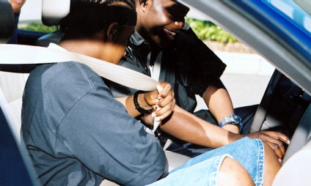
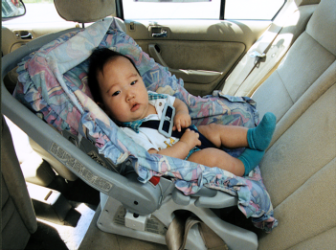
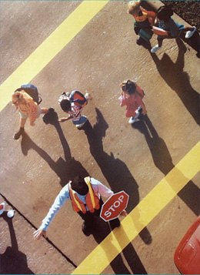

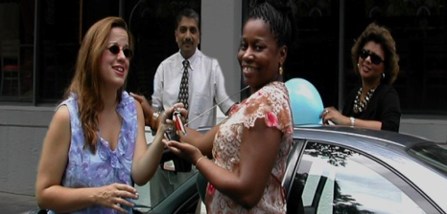


Traffic Injury Control
NHTSA’s Traffic Injury Control programs address the human behavioral factors of road safety. The Research and Program Development division develops countermeasures targeting the following key areas:
Impaired Driving and Occupant Protection
Safety Programs
    Enforcement and Criminal Justice Systems
    Speed Management
    Young Novice Drivers
    Older Drivers
    Pedestrians
    Motorcycles
Behavioral Safety Research
Emergency Medical Services
www.photos.com
Notes:
93 percent of all motor vehicle crashes are the result of human error. To reduce crashes, it is essential to engage drivers and other road users in understanding the problem and developing solutions.

Slide 14
Thank you very much!
Martin Koubek
National Highway Traffic Safety Administration
Martin.Koubek@dot.gov

