Slide 1
CA NURSING and ALLIED HEALTH EDUCATION INITATIVE
INTRODUCTION TO
Workforce Investment Act
Participant Forms
Prepared by
E.D.D./W.I.D.s’
Capacity Building Unit
Revised by CCCCO 11/09
December 2009

Slide 2
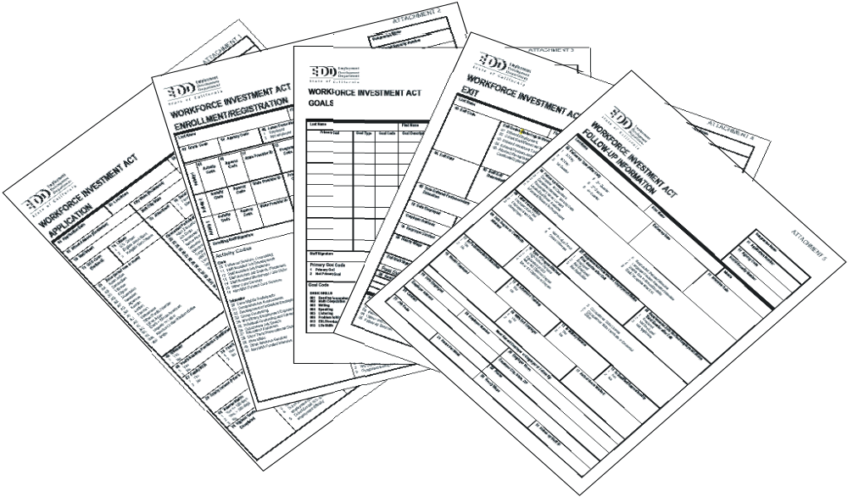
Four Participant Forms
Application
Enrollment/Registration
Exit
Follow-up

Slide 3
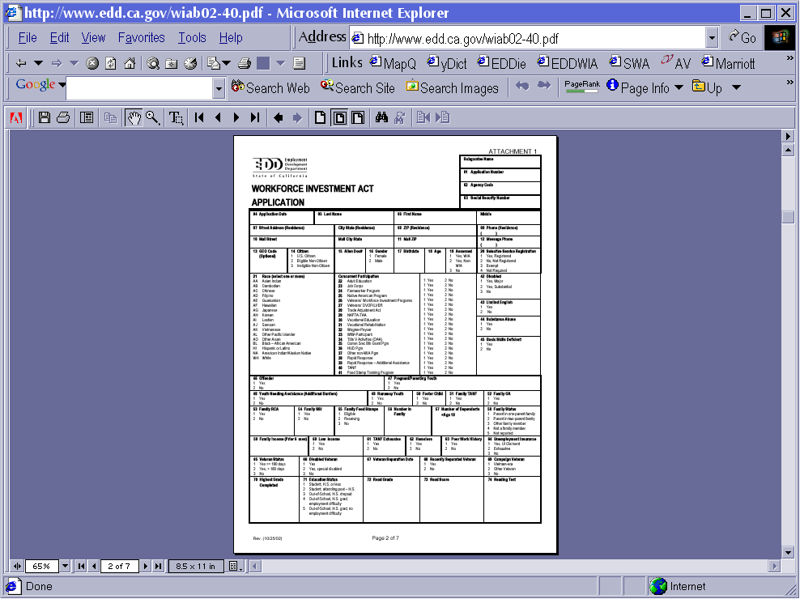
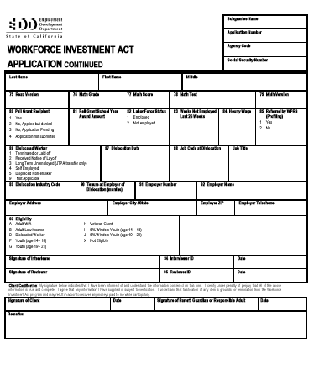
Application Form
Collect data & determine eligibility
Ensures you get credit
No legally defined timeline
Info must be current (no more than
6 months from data collection
to actual enrollment)
Can update this form as needed
One App to a customer

Slide 4

Participant Eligibility
Basic eligibility criteria
Legal right to work in USA
Selective Service –
  Males
  Age 18 – 26
Help Wanted

Slide 5
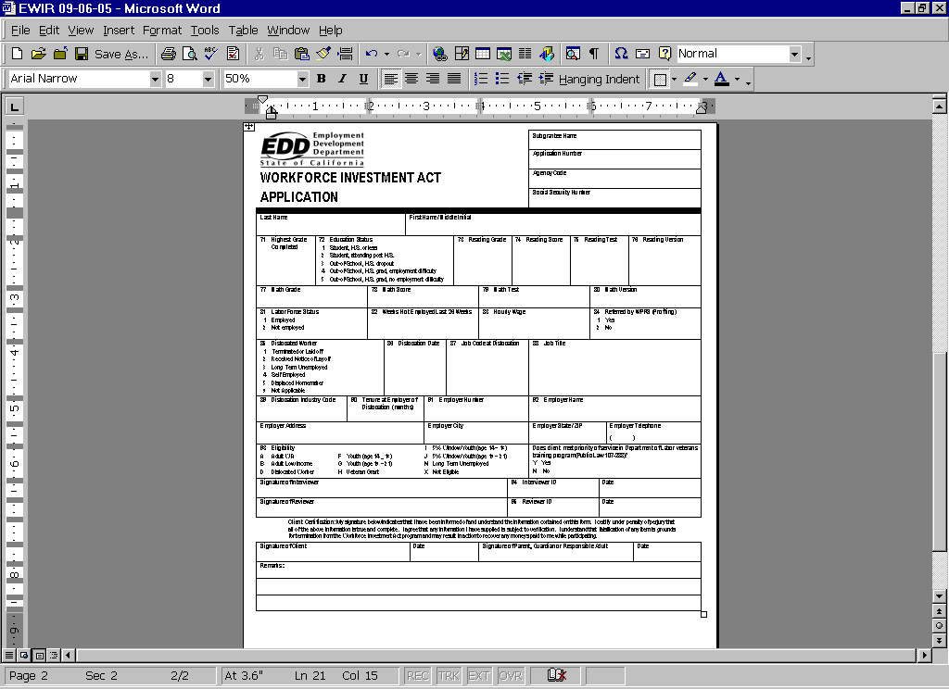

Slide 6
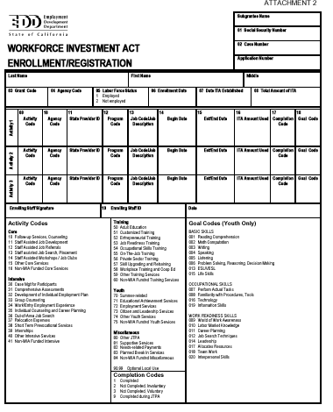
Enrollment/Registration
Puts the individual into the program
Means this person counts in performance
stats
Complete when determined eligible & you
are ready to start spending $$ on this
individual
Because individuals can be
concurrently enrolled, you
need one per Fund Source or Grant Code

Slide 7
Veterans’ Priority
Extends to DOL funded employment and training programs for veterans meeting programs’ eligibility requirements
What is priority?
  Definition: a veteran shall be given priority over a non-veteran for receipt of employment, training, and placement services in job training programs if the veteran meets the program’s eligibility requirements

Slide 8
Who counts as a Veteran?
Veterans (180 days active duty with other than D.of D.)
Certain spouses of service member/veteran who:
  Died of service-connected disability
  MIA
  Captured or forcibly detained

Slide 9
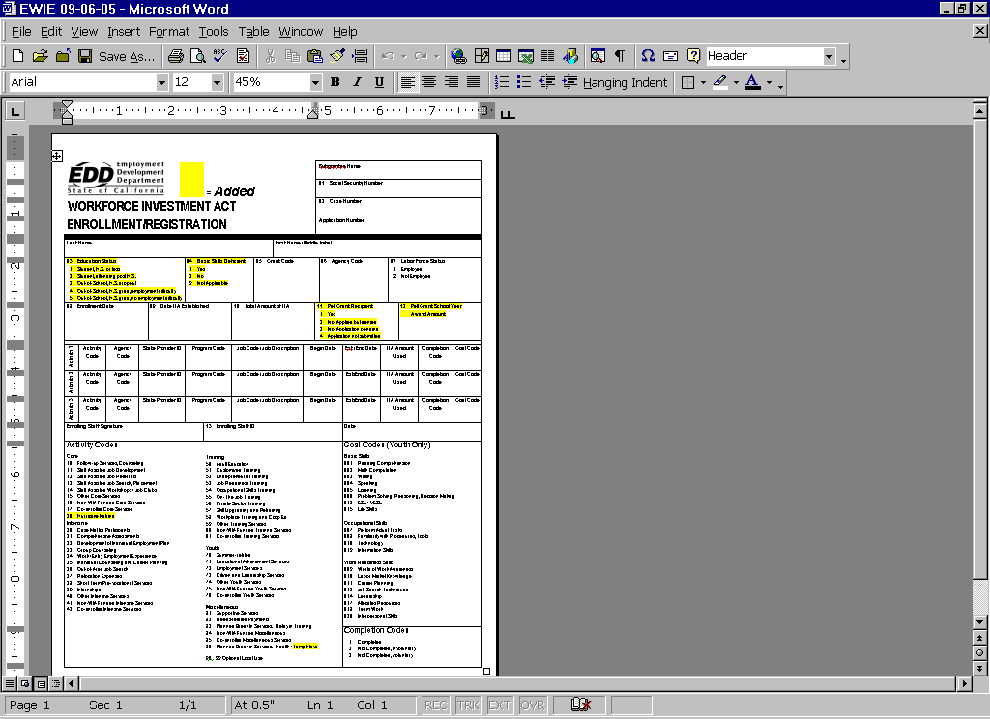

Slide 10
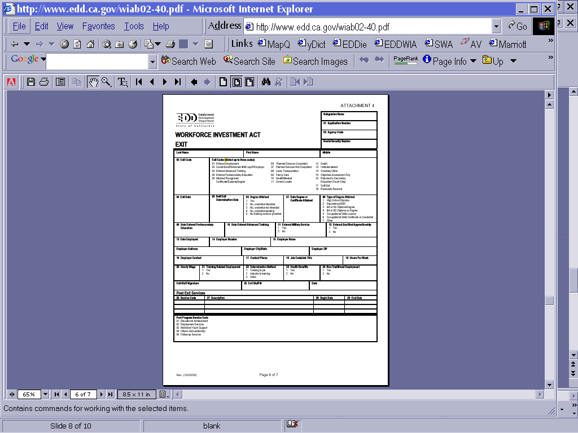
Exit
When participant has completed ALL services, including partner services (except FU)
anything afterward goes on FU form
One EXIT per Application
Exit feeds from app =
ALL grant codes must be closed
Can’t exit until all activities
have a completion code

Slide 11
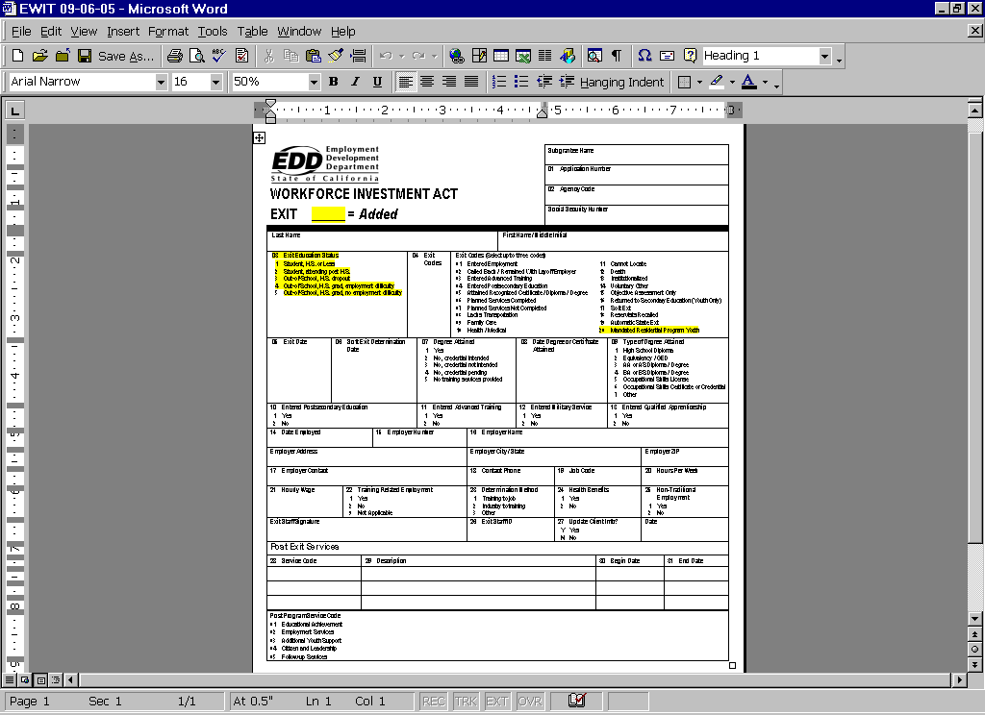

Slide 12
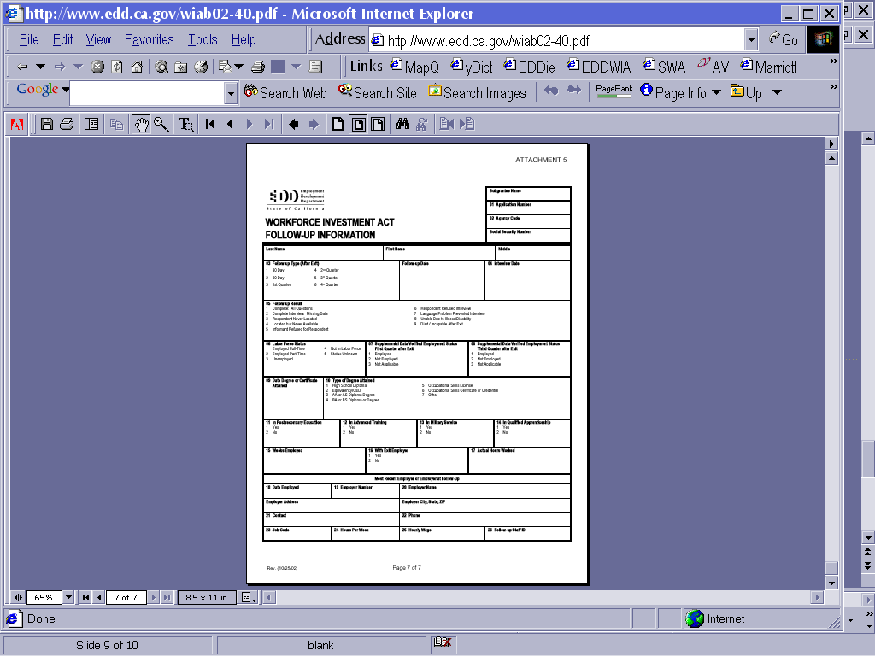
Follow-Up
Why? Required!
Who? Everyone!
When? Every Quarter
JTA roster IDs those not in
Base Wage File so you can
supply supplemental data
Begins at EXIT one report
a quarter for 1 yr

Slide 13
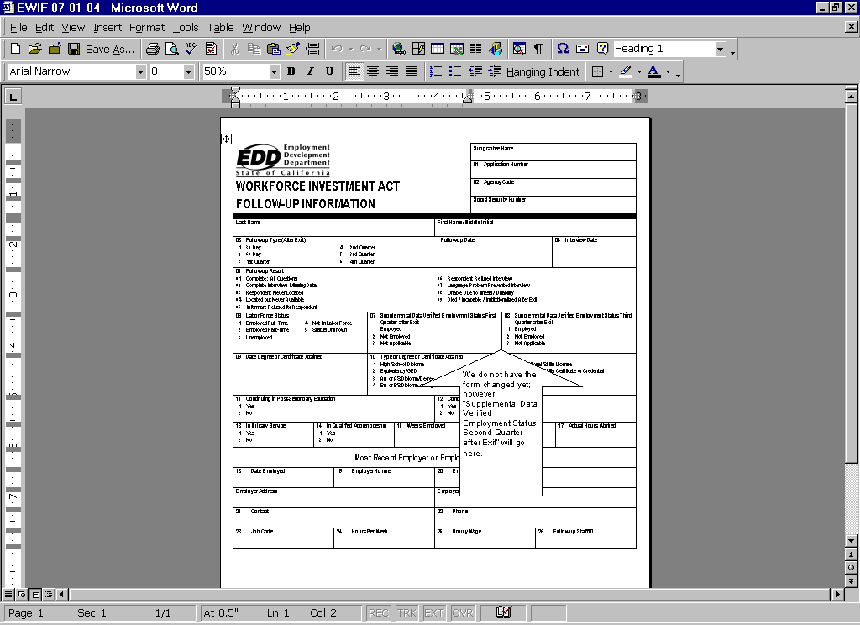

Slide 14
Housekeeping
Equipment Approval
Quarterly Report Narrative
  Discuss objectives and activities of the grant conducted during the quarter
  Increased enrollment numbers
  Student success/attrition
  Equipment purchase

Slide 15
Housekeeping continued
  Instruction
  Clinical facilities
Remember increased enrollments must occur by January 2010 and no later

Slide 16
Housekeeping continued
Barbara retiring
Staff
  Kathy Pulse – kpulse@cccco.edu
  Helga Martin – hmartin@cccco.edu
  Brenda Fong – bfong@cccco.edu
  Vera Weise – vweise@cccco.edu
  Suzanne Louie – slouie@cccco.edu

