Slide 1
Environmental Law
Exploring the Influence on Engineering Design
Institute for Environmental Sciences, Engineering and Technology
Prepared By: Sanne Knudsen, July 2001
Faculty Guidance Provided By: Dr. Gregory Keoleian

Slide 2
Presentation Roadmap
Part I: Structural Overview of Environmental Law. . . slides 4-11
  Sources of Environmental Law. . . . . . . . . . . . . . . . . . . . . . . . . . . slide 5
  The Importance of State Laws. . . . . . . . . . . . . . . . . . . . . . . . . . . . slide 6
  Targets of Environmental Laws. . . . . . . . . . . . . . . . . . . . . . . . . . . slide 7
  Regulatory Objectives. . . . . . . . . . . . . . . . . . . . . . . . . . . . . . . . . . slide 8
  Regulatory Obligations. . . . . . . . . . . . . . . . . . . . . . . . . . . . . . . . . . slide 9
  Translating Statutes into Regulations. . . . . . . . . . . . . . . . . . . . . .slide 10
  Sources for Identifying Regulatory Obligations. . . . . . . . . . . . . . slide 11
Part II: Environmental Laws. . . . . . . . . . . . . . . . . . . slides 12-44
  Federal Environmental Statutes. . . . . . . . . . . . . . . . . . . . . . . slides 13-33
  Common Law Liabilities. . . . . . . . . . . . . . . . . . . . . . . . . . . . slides 34-39
  International Treaties. . . . . . . . . . . . . . . . . . . . . . . . . . . . . . . slides 40-44

Slide 3
Presentation Roadmap (contin…)
Part III: The Influence of Environmental Laws on Engineering Design. . . . . . . . . . . . . . . . . . . . . . . . . . . . . . . . . . . . . . slides 45-54
  The Life Cycle Framework. . . . . . . . . . . . . . . . . . . . . . . . . . . . . . . slide 46
  Case Example: Using the Life Cycle Framework to Track the Environmental Laws Governing Petroleum-Based Fuel. . . . . .slides 47-51
  Performance Standards. . . . . . . . . . . . . . . . . . . . . . . . . . . . . . . slides 52-54
Part IV: Designing Beyond Compliance. . . . . . . . . . . .slides 55-62
  Risks in Settling for Compliance. . . . . . . . . . . . . . . . . . . . . . . . . . .slide 56
  Benefits of Proactive Design. . . . . . . . . . . . . . . . . . . . . . . . . . .slides 57-59
  Environmental Necessity and Ethical Responsibility. . . . . . . .slides 60-62

Slide 4
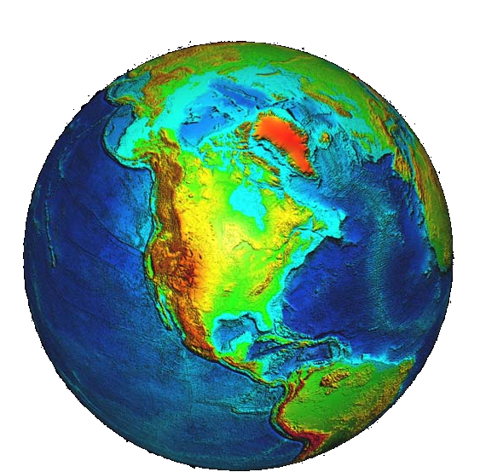
Part I:
Structural Overview of Environmental Law

Slide 5
Sources of Environmental Law
Legislation (federal, state, local)
Regulations (federal, state, local)
Court decisions (interpreting statutes and regulations)
Common law
Constitutions (United States, state)
International treaties
Foreign regulations
Notes:
Legislation: relevant environmental statutes are passed on the federal, state, and local levels
Regulations: federal, state, and local agencies pass regulations in order to implement the mandates of federal, state, and local statutes
Court decisions: environmental law can be developed by the way that courts interpret the meaning of various environmental statutes and regulations
Common law: common law is the creation of general principles and rules relating to persons and property from court decisions that have recognized customs and usages over time -- not derived from express legislative authority.
Constitutions: another example of the dual influence of federal and state law
International treaties: international treaties can effect United States regulations by committing the United States to reduce pollutant emissions (e.g. the Kyoto Protocol, if ratified, would commit the U.S. to reduce carbon dioxide emissions by 7% below 1990 levels)
Foreign regulations: regulations in other countries can influence engineering in the United States if American products are produced in foreign countries or exported to foreign countries with more stringent environmental regulations than the United States.

Slide 6
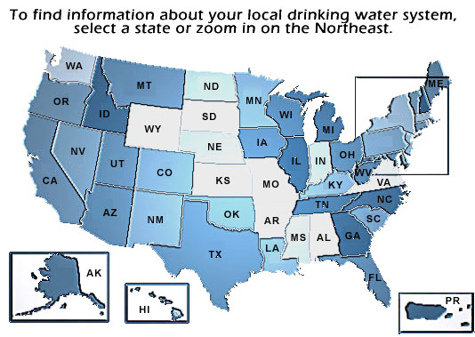
The Importance of State Laws
Some state laws implement federal programs
  Clean Water Act programs
  Clean Air Act programs
Some state laws are independent from federal programs
  Massachusetts: Toxic Waste Minimization Law
  California: Proposition 65
  New Jersey: Property Transfer Environmental Law
Notes:
Some state law implement existing federal programs:
a state may implement federal programs established under the Clean Air Act or Clean Water Act if the state:
designates a lead state environmental agency
adequately staffs, funds, and designs the program to meet minimum federal standards
the state may set standards that are more stringent than federal standards
if the state program undermines the success of the federal program, the EPA may regain exclusive control over the program and administer the program itself
Some state laws are independent from federal programs:
Massachusetts Toxic Waste Minimization Law: imposes mandatory waste reduction objectives on companies that use or generate toxic or hazardous wastes
California Proposition 65: an environmental full disclosure law that requires companies to undergo significant efforts to make the public aware of health risks associated with products or environments to which they are exposed
New Jersey Property Transfer Environmental Law: requires extensive investigation and cleanup of contaminated sites before they are sold or transferred

Slide 7
Targets of Environmental Laws:
Who or what gets regulated?
Products
Pollutants
Industrial Facilities
Government Agencies
Individuals
Land uses
Notes:
Products. Legislation targeted at products can be broad like the Toxic Substances Control Act (TSCA), which regulates any chemical substance or mixture. Or, legislation can be more specific like the Federal Insecticide, Fungicide, and Rodenticide Act (FIFRA), which only governs pesticide chemicals.
Pollutants. Virtually every pollutant resulting from industrial, commercial, or domestic activities fall within the scope of a federal environmental statute.
Industrial Facilities. Federal regulation targeted at industrial facilities is the most popular and perhaps the easiest form of regulation to enforce because facilities are fewer in number than individuals. For example, the EPA can more easily impose requirements for emissions reductions against car manufacturers rather than individual car owners.
Government Agencies. Governmental entities may be regulated if they own certain kinds of facilities that are part of the pollution problem, e.g. public water supply systems.
Individuals. Regulation of individual conduct is less popular than regulation of facilities for both political and practical reasons.
Land Uses. While most private land use decisions are regulated only at the local level, some of the federal environmental laws contain provisions that effect land use decisions. The Clean Water Act, for example, requires individuals to obtain permits before dredge and fill operations are conducted on wetlands.

Slide 8
Regulatory Objectives:
What is the desirable level of protection?
Health or Environmental Based Standards
  E.g., under the Clean Air Act, ambient air quality standards must protect human health
Technology or Feasibility Based Standards
  E.g., under the Clean Air Act, emission limits for new sources is determined by the limits achievable using the best control technology demonstrated by that industry
Balancing Standards
  E.g., the Toxic Substances Control Act requires the EPA to balance the environmental and health effects of chemicals with the economic consequences of regulation

Slide 9
Regulatory Obligations
How will regulations achieve their objectives?
Design Standards
Performance Standards
Ambient or Harm Based Standards
Product Bans or Use Limitations
Planning or Analysis Requirements
Information Disclosure Requirements
Notes:
Design Standards or Technology Specifications These specify how a certain plant piece of machinery, or pollution control apparatus should be designed.
Performance Standards or Emissions Limits. These set an objective standard for the regulatory target to meet without specifying the method for obtaining these standards, e.g. emissions limits that set a rate of pollutant that can be emitted from a given source.
Ambient or Harm Based Standards. These establish a level of environmental quality to be achieved or maintained in a particular environment, e.g. lake or stream. For example, pursuant to the Clean Air Act, the EPA sets National Ambient Air Quality Standards for criteria pollutants such as ozone and lead, which set a maximum acceptable concentration of lead of ozone in the air.
Product Bans or Use Limitations. These prohibit a product or limit its use. They typically involve products such as chemicals, pesticides, or food additives. For example, the Federal Insecticide, Fungicide, and Rodenticide Act prohibits the sale of any pesticide that is not registered with the EPA.
Planning or Analysis Requirements. The National Environmental Policy Act, for example, requires federal agencies to analyze the environmental impacts and alternative courses of action of any major federal action before commencing the project.
Information Disclosure Requirements. These require the regulatory target to disseminate information. The Emergency Planning and Community Right to Know Act (EPCRA), for example, requires facilities to report annual release of toxic substances. Such reports are made available to the public and generate public pressure to reduce emissions.

Slide 10
Translating Statutes into Regulations
Federal Environmental Statutes:
Enacted through the legislative process.
Provide the regulatory framework.
Authorize the agencies to adopt regulations.
Reported in the United States Code.
Federal Environmental Regulations:
Adopted by federal agencies.
Set forth implementation details, such as emission standards
or procedures for submitting permit applications.
Reported in the Code of Federal Regulations (CFR)
Notes:
Drafting, debating, and passing a bill is a time consuming process that results in confusing language in order to embody all the compromises necessary for its passage. Given the long and difficult process, most congressional statutes do not include enough detail to implement the statute without further regulations.
The specific environmental regulatory requirements that are imposed on industry are rarely articulated in the federal environmental statute itself. In federal environmental statutes, Congress typically outlines the objectives of the legislation and provides a regulatory framework. The details, such as setting emissions standards or articulating the format of permit applications, are left to the federal agency that has been authorized by Congress to implement the statute. Leaving the details for the agencies to develop makes use of the agency’s expertise in a given area, e.g. environmental protection and risk analysis. In addition, by making an agency determine what level of emissions is adequate to protect human health and the environment, Congress does not have to weigh environmental benefits against costs to industry and therefore avoids having to agree on controversial policy decisions.
In order for the regulations promulgated by the agency to be valid, the agency must follow procedures articulated either in the Administrative Procedure Act (APA) or the federal statute from which the regulations are derived.

Slide 11
Sources of information to help identify regulatory obligations
Federal or State Agencies
  e.g., USEPA or Michigan Department of Quality
Internal Corporate Resources
  e.g., environmental health and safety department or “in-house” legal counsel
Federal Register
  contains proposed and adopted regulations, available at http://www.nara.gov/fedreg
Notes:
There are several sources of information that can help individuals and companies decipher their obligations:
Federal or state agencies: agencies can be useful contacts to determine what statutes or regulations may be applicable.
Corporate resources: Individuals that work for corporations can discuss environmental obligations with the corporate environmental health and safety department or the legal counsel. Corporations may even have an environmental compliance manual to assist in identifying obligations.
Federal Register: Anyone can access regulations that are proposed and adopted by federal agencies through the Federal Register. The Federal Register can be accessed on-line at: www.nara.gov/fedreg. Proposed regulations contain information on where to send public comments and the deadline for submitting those comments. Public comments and background documentation for agency actions are also typically kept in dockets that are referenced in the Federal Register notices.

Slide 12
Part II:
Environmental Laws
Federal Statutes
International Treaties
Common Law

Slide 13

Federal Environmental Statutes
Clean Air Act
Clean Water Act
Pollution Prevention Act
Toxic Substances Control Act
National Environmental Policy Act
Occupational Safety and Health Act
Resource Conservation and Recovery Act
Federal Insecticide, Fungicide, and Rodenticide Act
Emergency Planning and Community-Right-to-Know Act
Comprehensive Environmental Response, Compensation, and Liability Act

Slide 14

Clean Air Act
What is the purpose?
  To control air pollution by instituting point source controls and establishing maximum pollutant levels for the ambient air.
What is the scope?
  The main focus is stationary sources of air pollution but the Act also provides some regulation for mobile sources.
Who implements the program?
  The EPA must establish national ambient air quality standards (NAAQS) for criteria pollutants: total suspended particulates, sulfur dioxide, nitrogen oxides, carbon monoxide, ozone, and lead.
  Each state is required to determine how to attain and maintain NAAQS by developing a State Implementation Plan (SIP).
  For state areas that exceed the NAAQS, the states must implement a program to prevent the significant deterioration of air quality in those areas that exceed the NAAQS.
Notes:
For more details on the Clean Air Act, see Section II of the reference text.

Slide 15
CAA. . .
What are the major provisions?
  Stationary source permits (Title V): Different standards are imposed on existing verses new or modified facilities. New or modified sources are subject to new source performance standards (NSPSs) and must obtain preconstruction permits. If the new or modified source is located in a nonattainment area, the source must obtain a non-attainment area permit and offset emissions so that the nonattainment can further its progress toward becoming an attainment area.
  Hazardous air pollutants: The 1990 amendments list 189 hazardous air pollutants for which the EPA requires the installation of technology that will result in the maximum achievable reductions.
  Title VI Phase-outs: With the enactment of the 1990 Amendments, Title VI implements the Montreal Protocol by phasing out substances like CFCs, halons, carbon tetrachloride, methyl chloroform.
Notes:
For more details on the Clean Air Act, see Section II of the reference text.

Slide 16
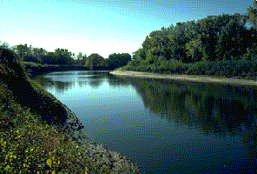
Clean Water Act
What is the purpose?
  The stated objective of the Clean Water Act is to restore and maintain the chemical, physical, and biological integrity of the Nation’s waters.
What is the scope?
  All point sources that discharge any pollutants into the waters of the United States must first obtain a permit under the Act.
Who implements the program?
  the EPA
  With EPA approval, states can issue NPDES permits within the state. The EPA can revoke a state’s permitting authority if the program is not as stringent as the federal program.
Notes:
For more details on the Clean Water Act, see Section II of the reference text.

Slide 17
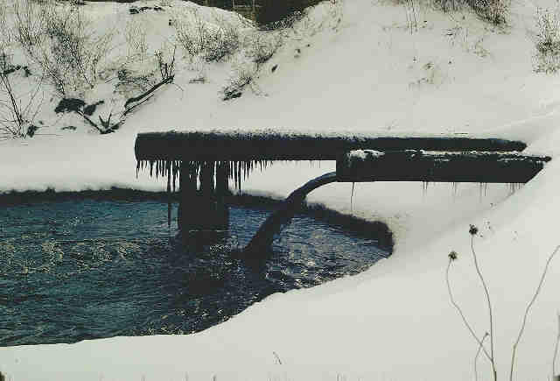
CWA
What are the major provisions?
  National Pollution Discharge Elimination System Permit: End-of-pipe pollution from point source dischargers is controlled through permits that specify effluent limitations for each discharger.
  Water Quality Standards: Each water body of every state must meet certain ambient water quality standards consisting of numerical and narrative criteria. Water quality standards vary depending on the state’s designated use of the water body.
  TMDLs: When point source effluent limitations are not stringent enough to meet water quality standards, states must develop total maximum daily load (TMDL) calculations for that water body to help identify and reduce pollution inputs from both point and nonpoint sources.
Notes:
For more details on the Clean Water Act, see Section II of the reference text.

Slide 18

Resource Conservation and Recovery Act
What is the purpose?
  to provide a “cradle to grave” framework for managing solid and hazardous waste from generation to final disposal
Who must comply?
  Any party that generates, transports, stores or disposes of solid and hazardous waste.
Who implements the program?
  the EPA
  States: with EPA approval, some states implement and manage solid and hazardous waste management programs in lieu of the federal RCRA program
Notes:
For more details on RCRA, see Section II of the reference text.

Slide 19
RCRA ….
What are the Major Provisions?
  Permits (Subtitle C): Requires generators, transporters, and treatment/storage/disposal facilities to obtain permits before handling solid or hazardous waste.
  Uniform Hazardous Waste Manifest (Subtitle C): Requires preparation and maintenance of Waste Manifest to track origin of waste, who is transporting the waste, and destination of waste.
  Sanitary Landfills (Subtitle D): Addresses the management of nonhazardous waste and exempt hazardous solid waste. This title mainly pertains to the design and monitoring of wastes that are disposed of in sanitary landfills.
  Leaking Underground Storage Tanks (Subtitle I): Addresses problems associated with regulated substances entering the soil and groundwater due to leaking underground storage tanks.
Notes:
For more details on RCRA, see Section II of the reference text.

Slide 20
Comprehensive Environmental Response, Compensation, and Liability Act
What is the purpose?
  To provide a mechanism to clean up contaminated sites and hold potentially responsible parties accountable for clean up costs.
What is the scope?
  Parties may be liable for cleanup costs if they contributed any amount of hazardous substance to a contaminated site, e.g. anyone who disposed of hazardous substances found at the site.
How is the Act enforced?
  The EPA can conduct a short-term removal action at any site requiring emergency action or conduct a long-term remedial action at any site on the National Priorities List.
  The EPA can compel private parties to cleanup a site when release or threatened release of hazardous substances present an imminent endangerment to the public health or welfare of the environment.
Notes:
For more details on the CERCLA, see Section II of the reference text.

Slide 21
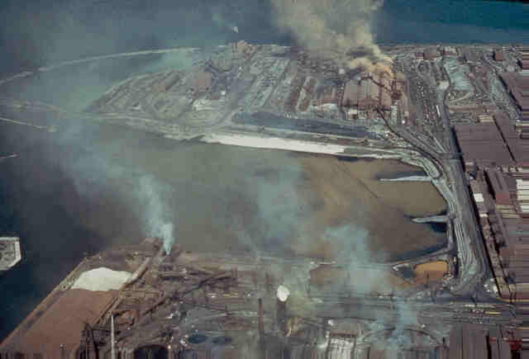
CERCLA. . .
What are the major provisions?
  Contaminated Site Cleanup: CERLCA authorizes the EPA to force parties that were responsible for the release of hazardous substances to finance cleanups on the contaminated site.
  Superfund: Where the responsible party cannot be identified or has gone bankrupt, CERCLA established a $1.6 billion Trust Fund, known as Superfund. The Superfund Amendments and Reauthorization Act of 1986 (SARA) appropriated another $8.5 billion.
  National Priorities List: The EPA can only conduct long term remediation actions at sites that are on the National Priorities List, which ranks the sites eligible for Superfund clean up.
Notes:
For more details on the CERCLA, see Section II of the reference text.

Slide 22
Toxic Substances Control Act
What is the purpose?
  To regulate toxic chemicals and mixtures that present an “unreasonable risk of injury to health or the environment”
What is the scope?
  TSCA places the burden on manufacturers to supply the EPA with information on environmental and health effects of chemical substances and mixtures. The EPA then has broad power to regulate the manufacture, use, distribution, and disposal of chemical substances and mixtures. However, the EPA must balance the economic and social benefits of a chemical against the risks when setting forth regulations.
Who implements the program?
  the EPA
  Unlike other programs, states do not implement TSCA
Notes:
For more details on the TSCA, see Section II of the reference text.

Slide 23
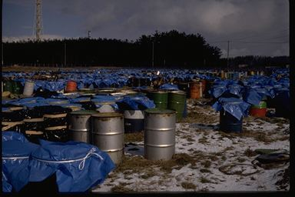
TSCA . . .
What are the major provisions?
  Premanufacture Notice (Section 5): Any person who manufactures or processes new chemicals for commercial purposes must submit a premanufacture notice (PMN) to the EPA at least 90 days before they begin manufacturing or processing. The PMN lists the intended uses of the substance, the information required to develop test data, and the nature of the test data that was developed.
  Existing Chemicals (Section 4): TSCA requires manufacturers, importers, and processors of TSCA-related chemical substances to submit data to the EPA on existing chemicals when they may present an unreasonable risk to health and environment or when they are produced in such quantities that there is a potential for a substantial release into the environment or human exposure.
Notes:
For more details on the TSCA, see Section II of the reference text.

Slide 24

Federal Insecticide, Fungicide, and
Rodenticide Act
What is the purpose?
  To protect the public health and environment against the misuse of pesticides.
What is the scope?
  All pesticide manufacturers must submit data regarding the safety and efficacy of their pesticides.
Who implements the program?
  The EPA
  Where a state has a federally approved pesticide program, the state is the primary enforcement authority.
Notes:
For more details on the FIFRA, see Section II of the reference text.

Slide 25
FIFRA . . .
What are the major provisions?
  Registration requirements (Section 3): Based on the data submitted by the manufacturer on its registration application, the EPA decides whether the pesticide poses unreasonable adverse effects to the environment. The EPA takes into account the economic, social, and environmental costs and benefits of the pesticide’s use.
  Suspension or cancellation of pesticides (Section 6): The EPA may suspend, cancel, or restrict the use of a pesticide that poses unreasonable adverse effects or imminent hazards to the environment.
  Labeling requirements: All registered pesticides must be properly labeled for lawful sale. The label must specify the pesticide’s active ingredients, how to use the pesticide on particular crops, and limitations on how or when it may be used.
Notes:
For more details on the FIFRA, see Section II of the reference text.

Slide 26

National Environmental
Policy Act
What is the purpose?
  Section 2 of NEPA declares that the purpose of the Act is to promote efforts which will prevent or eliminate damage to the environment and biosphere and stimulate the health and welfare of man; and to enrich the understanding of the ecological systems and natural resources important to the Nation.
What is the scope?
  NEPA applies to all major federal actions -- therefore it affects all federal agencies.
Who implements the Act?
  The Council on Environmental Quality, established under Title II, as an Executive Office of the President to implement NEPA
  States do not implement NEPA
Notes:
For more details on the NEPA, see Section II of the reference text.

Slide 27
NEPA. . .
Substantive NEPA (Section 101): Pronounces national environmental policy goals.
Procedural NEPA (Section 102):
  Purpose to guarantee that no federal agency will undertake projects without first considering the adverse environmental consequences of its action
  Requires an environmental impact statement (EIS) to be prepared for all major Federal actions that significantly impact the environment.
    Agency prepares environmental assessment (EA) to determine whether a full-blown EIS is necessary (whether the project will significantly affect the environment), posted on the Federal Register
    If no EIS is necessary, the agency issues a finding of no significant impact statement (FONSI), posted on the Federal Register
    If EIS is necessary, the agency issues a notice of intent, posted on the Federal Register
  Once the first version of the EIS (the Draft EIS) is available on the Federal Register, there is a public comment period; the agency will respond to the public comments in the Final EIS.
Notes:
For more details on the NEPA, see Section II of the reference text.

Slide 28
Emergency Planning and Community Right-to-Know Act
What is the purpose?
  To create emergency response plans to prepare for accidental chemical releases.
  To create an information database so that the public can know what types of chemical are being released by manufacturing facilities in their communities.
What is the scope?
  Any facility that produces, uses, or stores any of the substances listed on the EPA’s List of Extremely Hazardous Substances.
Who implements the Act?
  The State Emergency Response Commission, which are created in each state under the Act, implement the emergency planning requirements.
  The EPA receives submissions of the Toxic Release Inventory (TRI) reports with the authority to inspect and verify the reports.
Notes:
For more details on the EPCRA, see Section II of the reference text.

Slide 29

EPCRA
What are the major provisions?
  Planning Provisions (Section 301, 302, 303):
    Require states to create local emergency units that must establish plans for responding to chemical release emergencies
    Requires facilities to report any release of a chemical substance that exceeds the reportable quantity established for that substance to the state and local emergency planning commissions
  Community Right to Know Provisions (Sections 311, 312, 313):
    Toxic Release Inventory – requires the facilities producing more than a threshold amount of listed chemicals to report the maximum amount of the chemicals at the facility and released from the facility to the EPA
    Toxic Release Inventory – data submitted to the EPA is compiled in a computerized database that is available to the people to view chemical releases from facilities in their communities
Notes:
For more details on the EPCRA, see Section II of the reference text.

Slide 30
Occupational Safety and Health Act
What is the purpose?
  To ensure that “no employee will suffer material impairment of health or functional capacity” from a lifetime of occupational exposure.
What is the scope of the Act?
  The Act extends to all employers and their employees in all fifty states, except workplaces with fewer than ten workers and federal or state employees.
Who implements the Act?
  The Occupational Safety and Health Administration (OSHA)
Notes:
For more details on the OSHA, see Section II of the reference text.

Slide 31

OSHA
What are the major provisions?
  General Duty Clause
    Imposes a generic duty on employers to keep their workplaces safe. Even where specific standards do exist, the general duty clause is triggered if those standards are outdated or otherwise not sufficient to ensure worker safety.
  Refusal to Work/ Whistle blowing Provisions
    If a worker refuses to work because of unsafe working conditions, the OSHA regulations protect workers from discrimination
    If a worker reports an OSHA violation, the Act also protects the employee from being fired because of the whistle blowing
  Hazard Communication Regulations
    Requires employers to provide employees with information concerning hazardous chemicals through labels, material safety data sheets, training and education, and lists of hazardous chemicals in each work area.
Notes:
For more details on the OSHA, see Section II of the reference text.

Slide 32
Pollution Prevention Act
What is the purpose?
  Establishes Pollution Prevention as the nation’s preferred pollution control strategy, as opposed to end of pipe pollution control.
  Pollution Prevention is the attempt to reduce the amount of generated waste through more efficient use of resources at the input and production levels.
What is the scope of the Act?
  Moves facilities beyond compliance on a voluntary basis
Who implements the Act?
  The EPA
Notes:
For more details on the Pollution Prevention Act, see Section II of the reference text.

Slide 33
Pollution Prevention Act
What are the major provisions?
  Amendment to the TRI reporting requirement under EPCRA:
    Facilities subject to EPCRA’s reporting requirements must also report information on the pollution prevention and recycling activities at the facility for each chemical
  Voluntary Programs to Implement Pollution Prevention Strategies:
    Environmental Leadership Program: Participating companies develop and implement pollution prevention management practices and set environmental goals beyond regulatory compliance.
    Common Sense Initiative: The EPA takes an industry-by-industry approach to environmental protection by giving facilities more opportunity to reduce waste streams generally instead of targeting particular pollutants
    Excellence in Leadership (XL) Program: Participating companies have the flexibility to meet regulatory requirements in exchange for an enforceable commitment to moving beyond compliance.
Notes:
For more details on the Pollution Prevention Act, see Section II of the reference text.

Slide 34
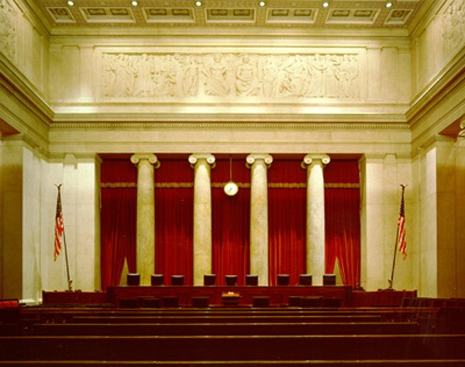
Common Law Liabilities
Notes:
For more details on Common Law Liabilities, see Section II of the reference text.

Slide 35
Common Law v. Statutory Law
Common Law
Rules are created by judges through court decisions.
Because common law is continuously shaped by court decisions, common law can vary between different jurisdictions.
Liabilities stem from personal injuries or property damage caused by environmental conditions.
Statutory Law
Rules are created through legislative procedures.
Statutes provide uniform, national frameworks for pollution control, e.g. Clean Water Act.
Liabilities stem from national pollution control policies.

Slide 36

Common Law:
Trespass
Definition: unauthorized invasion of a person’s land
Application in environmental law: a defendant was held liable for trespass when defendant’s sludge seeped on to plaintiff’s land and yet defendant did nothing to stop it.

Slide 37
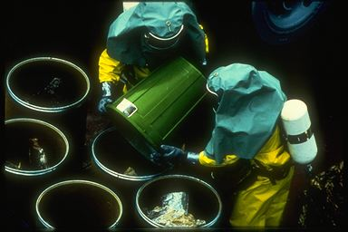
Common Law:
Strict Liability for Ultra Hazardous Activities
Definition of Strict Liability: the defendant can be liable if he was engaged in the activity that caused injury, without proof that defendant actually did anything wrong.
Application in environmental law: the owners of a toxic waste dump were held strictly liable for harm caused to others even though the situation looked like a CERCLA issue.

Slide 38
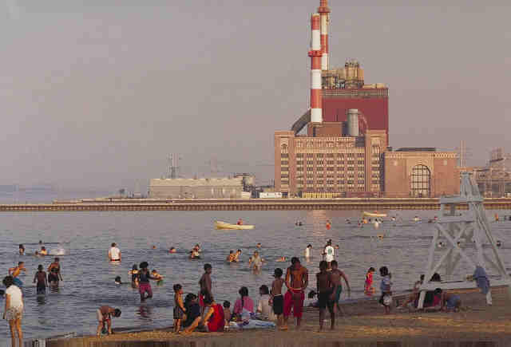
Common Law:
Nuisance
Definition: An action brought against somebody for interfering with one’s use and enjoyment of property
Application in environmental law: In Florida, a court ruled that an oil company unreasonably interfered with the ability of neighboring land owners to peacefully occupy their land because of noise, vibrations, and emissions from the plant.

Slide 39
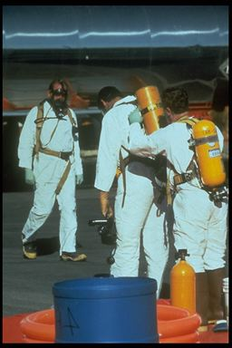
Common Law:
Toxic Torts
Definition: A claim for damages arising from exposure to a harmful chemical or substance.
Application in environmental law: Environmental torts are increasingly related to injuries caused by exposure to pesticides, PCBs, benzene, heavy metals, and other contaminants.

Slide 40
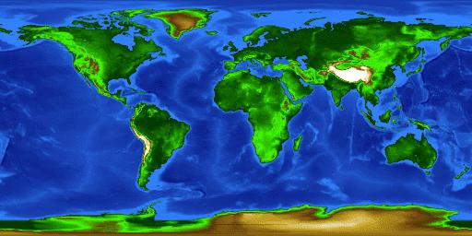
International Treaties
Notes:
For more details on International Treaties, see Section II of the reference text.

Slide 41
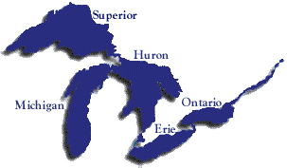
International Treaties:
Great Lakes Water Quality Agreement of 1978
Agreement between the U.S. and Canada
Created an international joint commission to draft regulations and make recommendations on all actions affecting the Great Lakes, their tributaries, and adjacent riparian areas

Slide 42
International Treaties:
The Kyoto Protocol
Addresses greenhouse gas emissions
Signed by the former President Clinton in 1998, but not yet submitted to the Senate for ratification
If ratified, the U.S. would have to:
  Reduce greenhouse gas emissions (CO₂, NO_{x}, and CH₄) 7% below 1990 levels
  Reduce HCFC, CFC, and HFC 7% below 1995 levels over the period from 2008 to 2012
The Protocol also contains provisions whereby credits for greenhouse gas emissions can be earned by carbon reducing activities, e.g. reforestation.

Slide 43
International Treaties:
The Montreal Protocol
Addresses ozone depletion
1987 Protocol Requirements:
  50% reduction in the 1986 CFC productions levels by 1999
  Freeze on the 1986 halon production and consumption levels
London Amendment of 1990:
  Phase out CFCs entirely by 2000
Amendments of 1992:
  Accelerated timetable for reducing ozone depleting substances
Implementation in the U.S. through Title VI of the Clean Air Act Amendments of 1990:
  Production of all Class I substances (CFCs, halons, carbon tetrachloride, and methyl chloroform) phased out by 2000
  Production of Class II substances (HCFCs) phased out by 2030

Slide 44
International Treaties:
International Organization for Standards
International Organization for Standards (ISO) is a private sector non-governmental organization founded in Switzerland in 1947.
Promotes international harmonization and development of manufacturing, product, and communications standards.
ISO 14000 series – environmental management standards:
  Voluntary
  Standards and guidance documents on environmental management, eco-labeling, auditing, life-cycle assessment, and environmental performance evaluation.
  Calls for environmental policies that represent a commitment to environmental compliance and pollution prevention

Slide 45

Part III:
The Influence of
Environmental Laws on Design

Slide 46
Organizing Environmental Laws with a Life Cycle Framework
laws that govern
how and where resources
can be extracted
e.g.
Clean Water
Act
Resource
Extraction
laws that regulate
information about a
product
e.g.
EPCRA
Production
e.g.
Clean Air
Act
laws that govern
the manufacturing
process
e.g.
TSCA or
FIFRA
laws that govern
how the product
can be used
Use
e.g.
CERCLA or
RCRA
laws that govern
disposal and damage
to the environment
Disposal
Notes:
For more details on a Life Cycle Analysis of Environmental Laws, see Section III.A.1 of the reference text.

Slide 47
Case Example: Using the Life Cycle Framework to Track the Many Environmental Statutes that Govern Petroleum-Based Fuel
Extraction
Offshore petroleum extraction
Onshore petroleum extraction
Refining
Use
Notes:
For more details on a Life Cycle Analysis of the Petroleum Industry, see Section III.A.2 of the reference text.

Slide 48
Petroleum Case Example:
Onshore Petroleum Extraction
Rules that govern where to extract
(1) National Park System Mining Regulation Act (5) Clean Water Act
(2) Federal Land Policy and Management Act (6) Wild and Scenic Rivers Act
(3) National Forest Management Act (7) National Wildlife Refuge System Act
(4) Federal Onshore Oil and Gas Leasing Reform Act
Rules that govern how to extract
(1) Clean Water Act (4) Endangered Species Act
(2) Federal Onshore Oil and Gas Leasing Reform Act (5) Safe Drinking Water Act
(3) Resource Conservation Recovery Act (6) National Environmental Policy Act
Rules that govern transportation of petroleum
(1) Federal Onshore Oil and Gas Leasing Reform Act (4) CERCLA
(2) Federal Land Planning and Management Act (5) RCRA
(3) Department of Transportation Regulations
Notes:
For more details on a Life Cycle Analysis of the Petroleum Industry, see Section III.A.2 of the reference text.

Slide 49
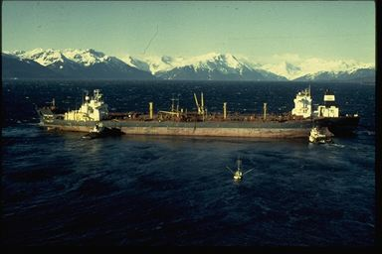
Offshore Petroleum Extraction
Rules that govern where to extract
(1) Marine Mammal Protection Act (5) Fishery Conservation and Management Act
(2) Endangered Species Act (6) Outer Continental Shelf Land Act
(3) Marine Protection, Research, and Sanctuaries Act (7) National Environmental Policy Act
(4) Coastal Zone Management Act (8) International Law
Rules that govern how to extract
(1) Mineral Management Service regulations (5) Shore Protection Act
(2) National Environmental Policy Act (6) Mineral Management Service air quality standards
(3) Clean Water Act (7) Clean Air Act Amendments of 1990
(4) Marine Protection, Research and Sanctuaries Act
Rules that govern transportation and storage of petroleum
(1) Mineral Management Service regulations (4) 1990 Oil Pollution Act
(2) International Convention for the Prevention of Pollution from Ships (5) Deepwater Port Act
(3) National Environmental Policy Act (6) Shore Protection Act
Notes:
For more details on a Life Cycle Analysis of the Petroleum Industry, see Section III.A.2 of the reference text.

Slide 50
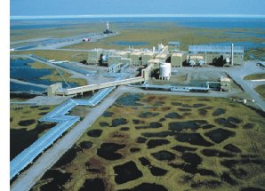
Refining
Rules that may govern where to locate the refinery
(1) Deepwater Port Act (5) Migratory Bird Treaty Act
(2) National Environmental Policy Act (6) Historic Preservation Act
(3) Endangered Species Act (7) Clean Air Act
(4) Wild and Scenic Rivers Act
Rules that govern refining process emissions
(1) Clean Air Act
(2) Clean Water Act
(3) Occupational Safety and Health Act
Rules that govern information related to the refining process
(1) Toxic Substances Control Act (4) Petroleum Marketing Practices Act
(2) Emergency Planning and Community Right-to-Know Act (5) Occupational Safety and Health Act
(3) CERCLA
Notes:
For more details on a Life Cycle Analysis of the Petroleum Industry, see Section III.A.2 of the reference text.

Slide 51

Use
Rules that govern the Use of Gasoline
(1) Clean Air Act
(2) Powerplant and Industrial Fuel Use Act
(3) Environmental taxes
(4) Transportation controls
Notes:
For more details on a Life Cycle Analysis of the Petroleum Industry, see Section III.A.2 of the reference text.

Slide 52
Performance Standards Derived From Environmental Laws
Corporate Average Fuel Economy (CAFE)
  Established through the Energy Policy and Conservation Act of 1975.
  Requires manufacturers to produce and sell enough fuel efficient cars to compensate for producing and selling cars or trucks with poor gas mileages in order to reach a targeted fuel efficiency of the manufacturer’s product line overall
  The National Highway Traffic Safety Administration has been trying to pass more stringent CAFE standards, but has met with opposition from the Department of Transportation Appropriations Committee.
Notes:
For more details on CAFE, see Section III.B.1 of the reference text.

Slide 53
Performance Standards Derived From Environmental Laws (cont…)
Appliance Energy Standards
  Established by the National Appliance Energy Conservation Act of 1987
  Requires minimum energy efficiency standards for a dozen appliances
  Initial, uniform support from appliance manufacturers broke down in 1995
  In spite of a one year moratorium on setting new standards in 1995, the Department of Energy has since successfully upgraded two standards
    New standard for refrigerators and freezers (effective July 1, 2001)
    New standard for one room air conditioners (effective October 1, 2000)
Notes:
For more details on Appliance Standards, see Section III.B.2 of the reference text.

Slide 54
Performance Standards Derived From Environmental Laws (cont…)
Vehicle Emissions Standards and Fuel Sulfur Content Regulations
  New standards require passenger vehicles to be 77 to 95% cleaner than those on the road today
    Promulgated to implement the goals of the Clean Air Act
    In February 2000, the EPA announced more protective tailpipe emissions standards for all passenger vehicles, including SUVs, minivans, vans, and pickup trucks.
  New standards reduce sulfur content by up to 90%
    At the same time, the EPA announced lower standards for sulfur content in gasoline, which reduces air pollution and ensures the effectiveness of low emission-control technology
Notes:
For more details on Vehicle Emissions, see Section III.B.3 of the reference text.

Slide 55
Part IV:
Designing Beyond Compliance
Resting on regulatory minimums is risky
Designing beyond compliance generates corporate benefits
Environmental and ethical necessity may demand beyond compliance

Slide 56
Resting is Risky
When regulations become more stringent, companies must react to the new requirements in a relatively short time frame.
Retrofits to reduce emissions or comply with new design criteria are costly.
If companies voluntarily design beyond compliance are not forced to accommodate costly retrofits in their budgets on short notice.
Notes:
For more details, see Section IV.A of the reference text.

Slide 57
Benefits of Proactive Design
Save money in materials and in end-of-pipe remediation
Increase consumer appeal and open up new business opportunities with “green” design
Improve recruitment, employee morale, investor support, host community acceptance, and management’s self-respect by earning a reputation for being environmentally progressive
Notes:
For more details, see Section IV.B of the reference text.

Slide 58


Benefits of Proactive Design:
Dow – NRDC Pollution Prevention Case
The people:
  The Natural Resources Defense Council, Dow Chemical, and five community activists initiated the Michigan Source Reduction Initiative (MSRI)
The goal:
  To reduce the waste and emissions or 26 priority chemicals at Dow’s Midland Site in Michigan by 35% by April 30, 1999 using only pollution prevention techniques
Notes:
For more details, see Section IV.C of the reference text.

Slide 59
Benefits of Proactive Design:
Dow – NRDC Pollution Prevention Case
The results:
  7 million pounds of pollution eliminated
    Emissions from 1 million to 593,000 pounds
    Wastes from 17.5 million to 11 million pounds
    2/3 of the waste reduction were chlorinated → significant reduction given the ability of chlorinated substances to produce carcinogens such as dioxins when they are incinerated
  5 million dollars saved annually
  In just 2 years!

Slide 60
Environmental Necessity and Ethical Responsibility
“ When we set aside the obvious benefits of being an environmentally responsible company, we are left with the simple truth that we cannot lead lives of dignity and worth when the natural resources that sustain use are threatened or destroyed. We must act responsibly and we must act now.”
Samuel C. Johnson, former Chairman of S.C. Johnson Wax
Notes:
For more details, see Section IV.D of the reference text.

Slide 61

Environmental Necessity and Ethical Responsibility:
The Pineapples and Pesticide Problem
      The rule:
        In 1978, the EPA cancelled all use of the pesticide heptachlor except on pineapples in Hawaii to control pineapple mealybugs
      The injury:
        Heptachlor was used on pineapples in Hawaii, pineapple tops were fed to dairy cattle, heptachlor residues were concentrated in milk as a more toxic and persistent carcinogen, mother’s milk was contaminated with heptachlor epoxide, and infants were ingesting carcinogenic milk through breast feeding
The lesson:
  Sometimes environmental compliance does not protect human health…
Notes:
For more details, see Section IV.D of the reference text.

Slide 62
Environmental Necessity and Ethical Responsibility:
The MTBE Case Example
The Use of MTBE to Achieve Compliance:
  Methyl tertiary-butyl ether (MTBE) is a fuel additive in motor gasoline that helps gasoline burn more completely by raising the oxygen content. Used to fulfill requirements of the 1990 Clean Air Act Amendments, MTBE has resulted in the annual emission reduction of smog-forming pollutants and toxics.
The Un-foreseen Consequences:
  MTBE contaminates surface and ground water through leaks and overflows in underground petroleum storage tank systems, emissions from motorized watercraft, and atmospheric deposition.
  MTBE contamination has recently raised concerns about health risks associated with its inhalation and ingestion.
The Lesson:
  The challenge facing design engineers is to anticipate impacts of a chemical, product, or process in areas outside of the area for which the chemical, product, or process is designed.

