Slide 1
Understanding
Employment Laws for
Federal Contractors
Meet the higher standards of working for the federal government
  Disclaimer: This Module Is Not Intended To Give Advice Regarding Business, Federal, or Other Laws. This module Is For Informational Purposes Only With Knowledge Derived From Study, Experience, or Instruction.

Slide 2
Learning Objectives
At the end of this module, you will be able to:
  List the various laws that govern all federal contractors and subcontractors.
  Understand the impacts that federal government contracts might have on your business.
  Identify six recommended compliance steps.
  Disclaimer: This Module Is Not Intended To Give Advice Regarding Business, Federal, or Other Laws. This module Is For Informational Purposes Only With Knowledge Derived From Study, Experience, or Instruction.
FDIC OMWI Education Module: Understanding Employment Laws for Federal Contractors

Slide 3
About FDIC Small Business Resource Effort
The Federal Deposit Insurance Corporation (FDIC) recognizes the important contributions made by small, veteran, and minority and women-owned businesses to our economy. For that reason, we strive to provide small businesses with opportunities to contract with the FDIC. In furtherance of this goal, the FDIC has initiated the FDIC Small Business Resource Effort to assist the small vendors that provide products, services, and solutions to the FDIC.
The objective of the Small Business Resource Effort is to provide information and the tools small vendors need to become better positioned to compete for contracts and subcontracts at the FDIC. To achieve this objective, the Small Business Resource Effort references outside resources critical for qualified vendors, leverages technology to provide education according to perceived needs, and offers connectivity through resourcing, accessibility, counseling, coaching, and guidance where applicable.
This product was developed by the FDIC Office of Minority and Women Inclusion (OMWI). OMWI has responsibility for oversight of the Small Business Resource Effort.
FDIC OMWI Education Module: Understanding Employment Laws for Federal Contractors

Slide 4
Executive Summary
Doing business with the government can be rewarding and profitable as long as you are aware of employment laws that you must adhere to.
Several types of laws—which govern federal contractors and subcontractors—can significantly impact your work.
A working knowledge of employment laws will help you avoid potential legal pitfalls.
FDIC OMWI Education Module: Understanding Employment Laws for Federal Contractors

Slide 5
Employment Law Basics
The U.S. has numerous federal and state laws and regulations regarding employee rights and employer responsibilities. These laws cover four broad categories:
  Discrimination
  Fair pay
  Employee privacy
  Safety in the workplace
Various government agencies enforce these laws including the Equal Employment Opportunity Commission (EEOC), the Department of Justice (DOJ), and the Department of Labor (DOL).
Small businesses are exempt from some of these federal laws (see the following page), but as a federal contractor or subcontractor, you must adhere to certain specific laws.
FDIC OMWI Education Module: Understanding Employment Laws for Federal Contractors

Slide 6
Key Federal Employment Laws
 | Law | Brief Description | Exemption Criteria
1 | Title VII of the Civil Rights Act of 1964 | Prohibits discrimination in the hiring process (race, color, religion, sex, or national origin) | Businesses with fewer than 15 employees
2 | Americans with Disabilities Act (ADA) | Prohibits discrimination against a person with a qualified disability | No exemptions
3 | Age Discrimination in Employment Act (ADEA) | Prohibits discrimination against workers aged 40 or older | Businesses with fewer than 20 employees
4 | Fair Labor Standards Act (FLSA) | Governs the following: Duration of work hours, breaks, minimum salary, and overtime | Businesses with less than $500,000 in annual sales
5 | Family and Medical Leave Act (FMLA) | Employers must allow employees (who have worked there more than 12 months) up to 12 weeks off for certain medical conditions | Businesses with fewer than 50 employees
(State laws might be more stringent)
FDIC OMWI Education Module: Understanding Employment Laws for Federal Contractors

Slide 7
Unique Laws for Federal Contractors and Subcontractors
These laws apply to all businesses:
  Executive Order 11246
  Americans with Disabilities Act, Section 503 of the Rehabilitation Act
  Vietnam Era Veterans' Readjustment Assistance Act of 1974
These laws apply only to construction contractors/subcontractors:
  Davis-Beacon and Related Acts
  McNamara-O'Hara Service Contract Act
FDIC OMWI Education Module: Understanding Employment Laws for Federal Contractors

Slide 8
Executive Order 11246
Executive Order 11246 is similar to Title VII in that it addresses discrimination, but is geared specifically toward federal contractors.
The Order “prohibits federal contractors and federally assisted construction contractors and subcontractors, who do over $10,000 in Government business in one year from discriminating in employment decisions on the basis of race, color, religion, sex, or national origin.”
The Order also requires “supply and service contractors—generally those with 50 or more employees and a contract of $50,000 or more—to develop and maintain a written affirmative action program (AAP).”
FDIC OMWI Education Module: Understanding Employment Laws for Federal Contractors

Slide 9
Administration of
Executive Order 11246
Executive Order 11246 is administered by the U.S. Department of Labor’s Office of Federal Contract Compliance Programs (OFCCP).
The OFCCP’s mission is “to enforce, for the benefit of job seekers and wage earners, the contractual promise of affirmative action and equal employment opportunity required of those who do business with the federal government.”
The OFCCP proactively audits federal contractors and subcontractors to ensure compliance.
The OFCCP also enforces Section 503 of the Rehabilitation Act of 1973, which prohibits discrimination against qualified individuals with disabilities; and the affirmative action provisions of the Vietnam Era Veterans’ Readjustment Assistance Act of 1974, which prohibits discrimination against qualified protected veterans.
FDIC OMWI Education Module: Understanding Employment Laws for Federal Contractors

Slide 10
A Comparison of Governing Bodies Regarding Discrimination
 |  | Equal Employment Opportunity Commission | Office of Federal Contract Compliance Programs
1 | Agency Acronym | EEOC | OFCCP
2 | Agency Status | Independent Government Agency | Office within the Department of Labor
3 | Employment Law Focus | Discrimination | Discrimination, Fair Pay
4 | Business Focus | Private and public companies (covered by the laws) as well as the federal agency sector | All federal contractors and subcontractors
5 | Functions: Responds to complaints? Performs audits? Education and training? | Yes No Yes | Yes Yes Yes
6 | Enforcement Authority | Lawsuits | Disbarment
FDIC OMWI Education Module: Understanding Employment Laws for Federal Contractors

Slide 11
What This Means for Small Business Owners
If you are awarded a sizeable contract with a federal government agency, you must make your books and records available if audited by the OFCCP.
For very small firms who are not currently subject to the federal laws, you may have to make changes, including, but not limited to, the following:
  Create/upgrade employee policies, procedures, and practices.
  Create and administer an Affirmative Action Program.
  Create/update employee training programs.
  Become more knowledgeable about employment law and/or hire an attorney or human resources firm to help you become compliant.
FDIC OMWI Education Module: Understanding Employment Laws for Federal Contractors

Slide 12
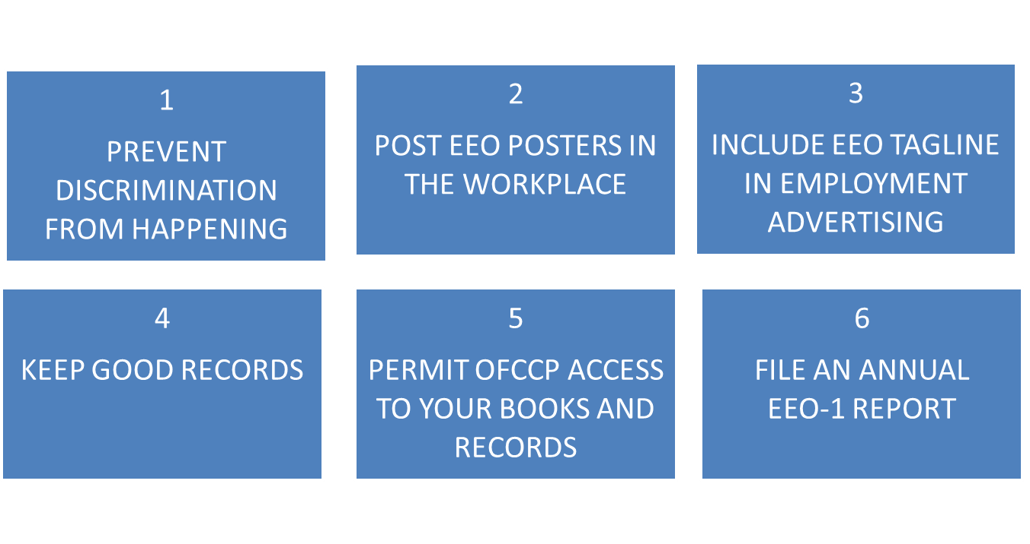
6 Major Guidelines from the OFCCP
FDIC OMWI Education Module: Understanding Employment Laws for Federal Contractors

Slide 13
Self-Audits
The OFCCP recommends conducting self-audits to ensure that you provide equal opportunities to applicants and employees.
Audit suggestions include:
  Assess your hiring or promotion decisions: How have they impacted your numbers?
  Review job families and geography within your business: Where are there women and minorities? Where are women and minorities missing?
  Review your hiring practices: How have they affected women and minorities over longer time periods (quarters, years)?
FDIC OMWI Education Module: Understanding Employment Laws for Federal Contractors

Slide 14
Next Steps
If you are a small business that is already doing business with a federal agency ($10,000 or more per year) or plans to in the future:
  Visit the Office of Federal Contract Compliance Program pages on the Department of Labor's web site (dol.gov/ofccp/).
  Review the guidelines.
  Document any actions you need to take to be fully compliant.
  Perform a self-audit to see how your business is doing (use the how-to guide on the web site).
FDIC OMWI Education Module: Understanding Employment Laws for Federal Contractors

Slide 15
Excellent Employment Law Resources for Small Businesses
Finding legal resources on the web, including Find Law: smallbusiness.findlaw.com
Global Legal Resources from companies like HG: HG.org
HR Hero: HRHero.com
The U.S. Department of Labor’s Office of Federal Contract Compliance Program: DOL.gov/ofccp/
FDIC OMWI Education Module: Understanding Employment Laws for Federal Contractors

Slide 16
Key Takeaways from This Module
Before you pursue a federal contract, it is important to understand how the employment laws impact doing business with the federal government.
Following the six steps outlined by the OFCCP will help your business stay compliant.
Self-audits of your hiring and promotion practices will help you proactively find and address problem areas.
FDIC OMWI Education Module: Understanding Employment Laws for Federal Contractors

Slide 17
Sources and Citations
Business.gov, Employment Laws for Federal Contractors
DOL.gov, Office of Federal Contract Compliance's Guide for Small Businesses with Federal Contracts
Ginny Schlosser, ProSidian Consulting, LLC, Employment Laws for Federal Contractors
HRHero.com, Employment Laws and Regulations for Federal Contractors
Smallbusiness.findlaw.com, Employment Law 101
Smallbusiness.findlaw.com, Employment and Anti-Discrimination Laws: An Introduction
FDIC OMWI Education Module: Understanding Employment Laws for Federal Contractors

