Slide 1
Successes and Failures in
E-Commerce in the United States: Lessons to be Learned
Kenneth H. Slade
Hale and Dorr LLP
PRAC Conference
Singapore April 26, 1999

Slide 2
Preface
I am not a securities analyst or investment advisor
I am commenting on the current state of e-commerce as I see it, from my perspective as an attorney working with clients in the area. These comments do not reflect the opinions of Hale and Dorr LLP.
As this presentation is a summary and has been prepared in order to highlight only a few selected issues or factors, and as those issues and factors are subject to change, it should be not be relied upon without independent investigation of the issues or factors referred to herein or other factors which you may consider relevant

Slide 3
Overview
Definition of E-Commerce
Current Status of E-Commerce in the United States
Some Successes
Some Failures
Future Developments
Seven Lessons to be Learned

Slide 4
Definition of E-Commerce
Electronic Commerce refers to the conduct of business transactions (whether with consumers or between businesses) using the Internet or other computer networks.
Examples:
  Retail transactions
  Business-to-business transactions
  Electronic cash (beyond scope of this talk)

Slide 5
Growth of E-Commerce in the United States
Growth of Internet Population
User Demographics
Retail Products Purchased by U.S. Internet Users
Internet Use by U.S. Businesses

Slide 6
Estimated Geographic Distribution of 153.5 Million Online Users
Latin America 4.5 mil
Africa 1.14 mil
Asia-Pacific 26.55 mil
Europe 33.71 mil
U.S. and Canada 87 mil
Middle East 0.78 mil
Source: Nua Internet Services, 2/99

Slide 7
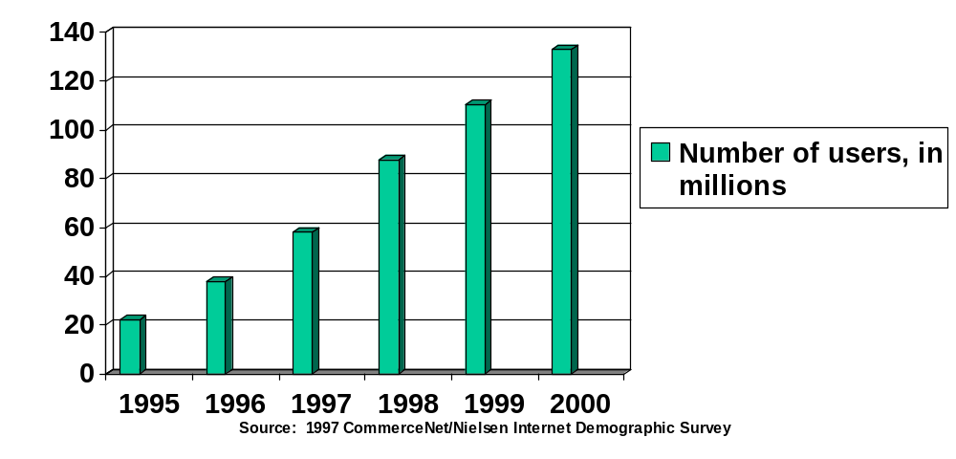
Growth of Internet Population in the United States and Canada

Slide 8
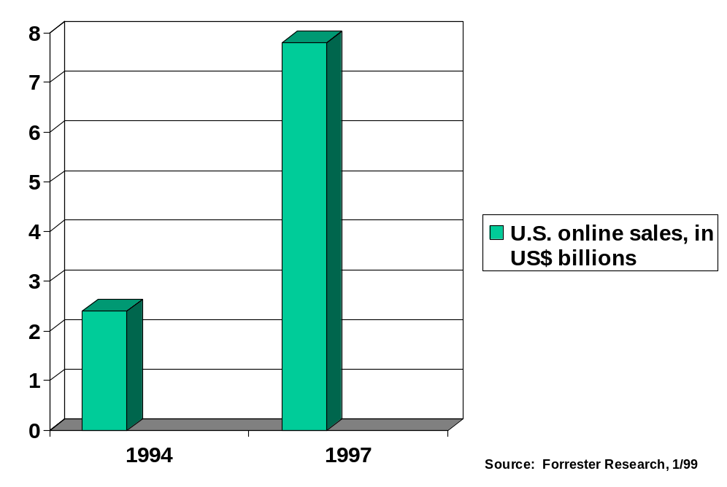
Volume of U.S. Online Sales
1994: US$2.4 billion
1997: US$7.8 billion
2003(est): $US103 billion

Slide 9
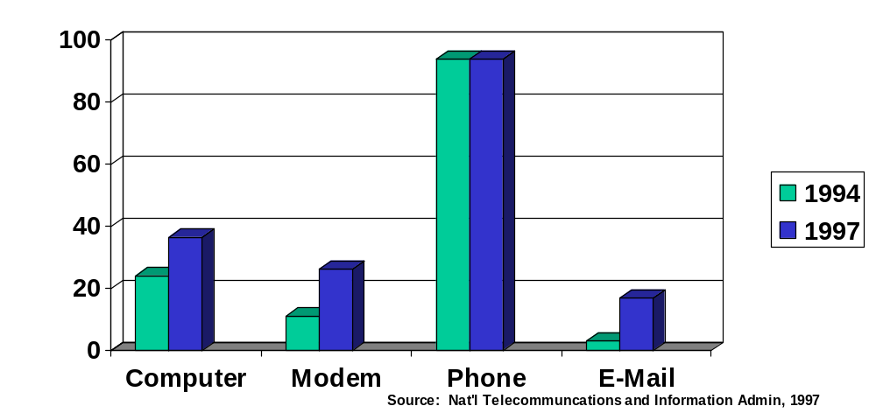
Percent of U.S. Households with Computer, Modem, Telephone and E-Mail

Slide 10
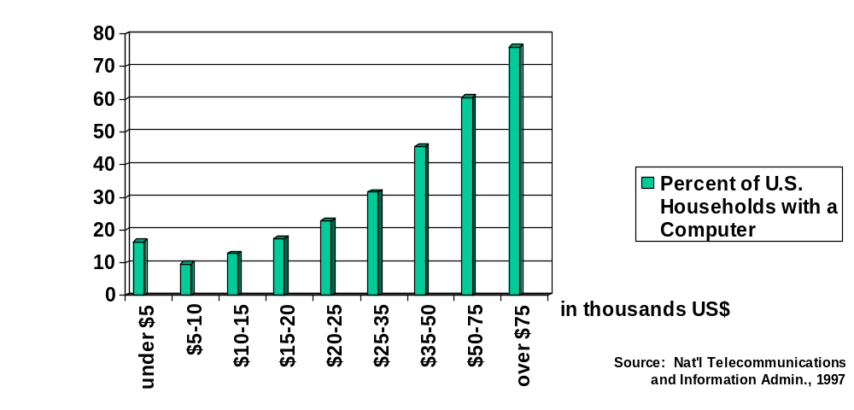
Percent of U.S Households with a Computer, by Income

Slide 11
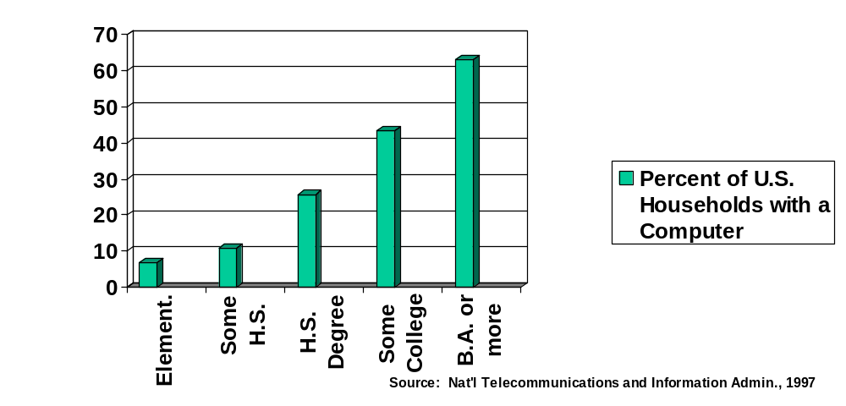
Percent of U.S Households with a Computer, by Education

Slide 12
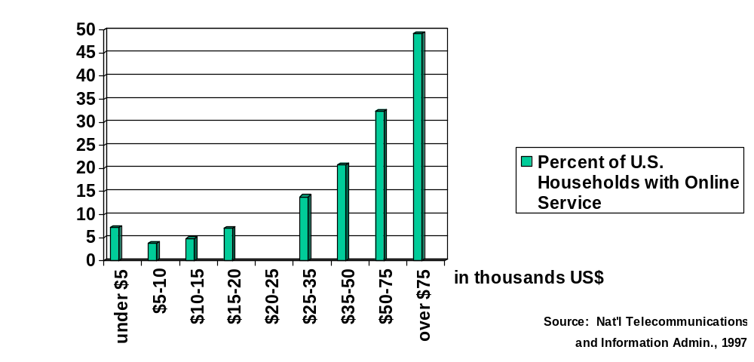
Percent of U.S Households with Online Service, by Income

Slide 13
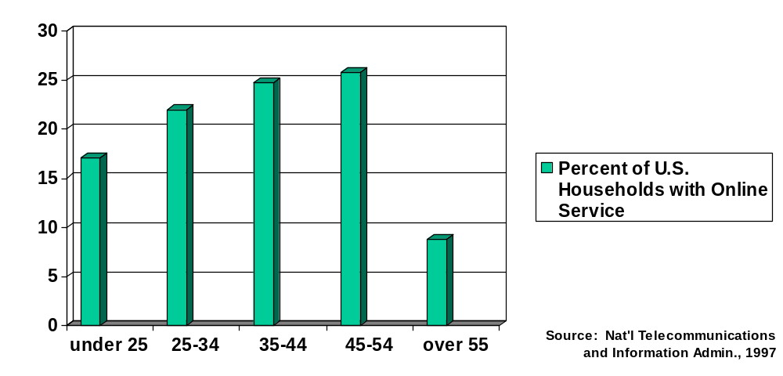
Percent of U.S Households with Online Service, by Age

Slide 14
Types of Retail Products Purchased by U.S. Internet Users
Clothing 12%
Books 25%
Travel 12%
CD's/cassettes/
Computer Hardware 19%
videos 15%
Computer Software 17%
Source: CommerceNet, June 1998

Slide 15
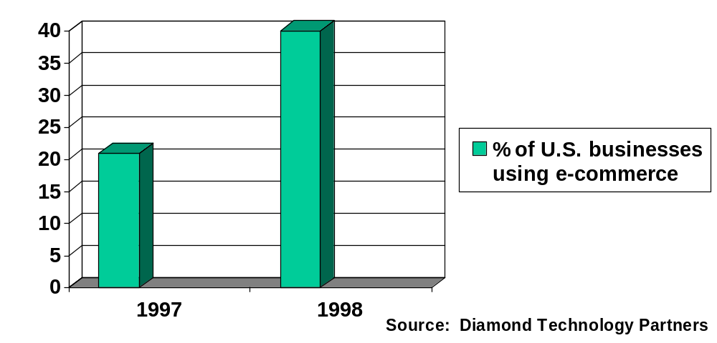
Percentage of U.S. Businesses Using e-Commerce

Slide 16
Some Factors Driving e-commerce
Retail
  Customer convenience: compare products and buy from home
  Retailer savings: cheaper than maintaining retail stores; centralized distribution
Business-to-business
  lower sales costs
  centralized order processing and billing
  centralized distribution

Slide 17
Some Successes
RETAIL
  amazon.com
  eBay
  E*Trade
BUSINESS-TO-BUSINESS
  Cisco

Slide 18
amazon.com
On-line revenues increased 51% from US$1,429 million for FY 97 to US$2,161 million for FY 98 (ending 6-30-98)
Advertising and electronic commerce fees increased 159% from US$98 million for FY 1997 to US$254 for FY 98
amazon.com is an online book, CD and video retailer and soon . . . prescription drugs
offers more than 4.7 million books, music CD, video, DVD and computer games.

Slide 19
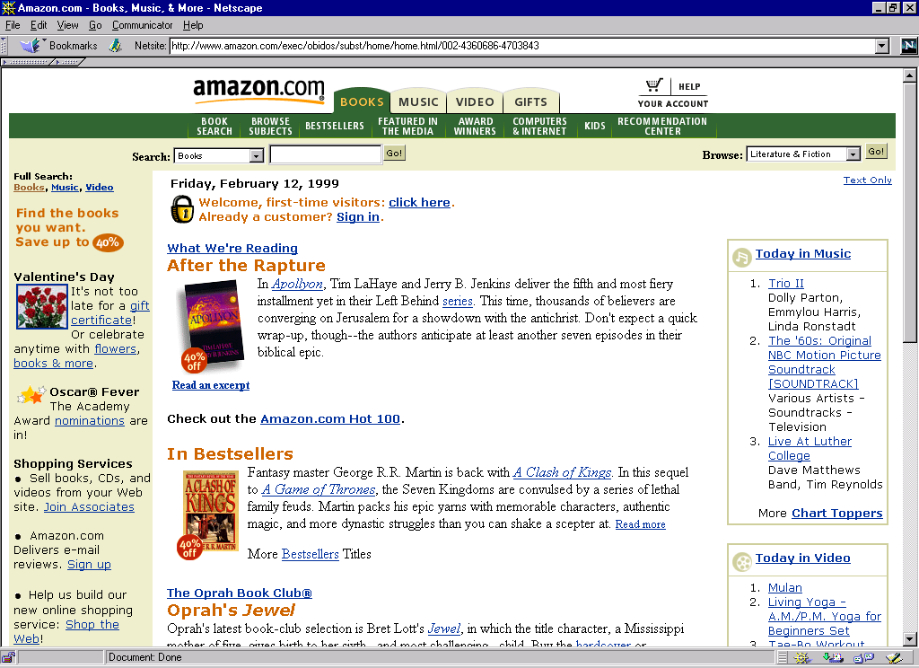

Slide 20
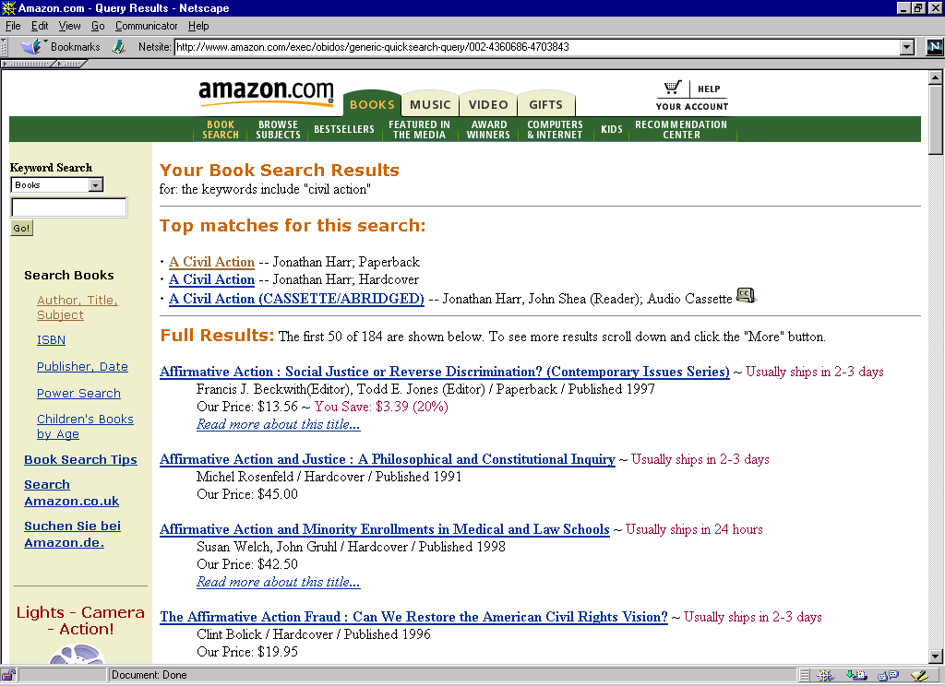

Slide 21
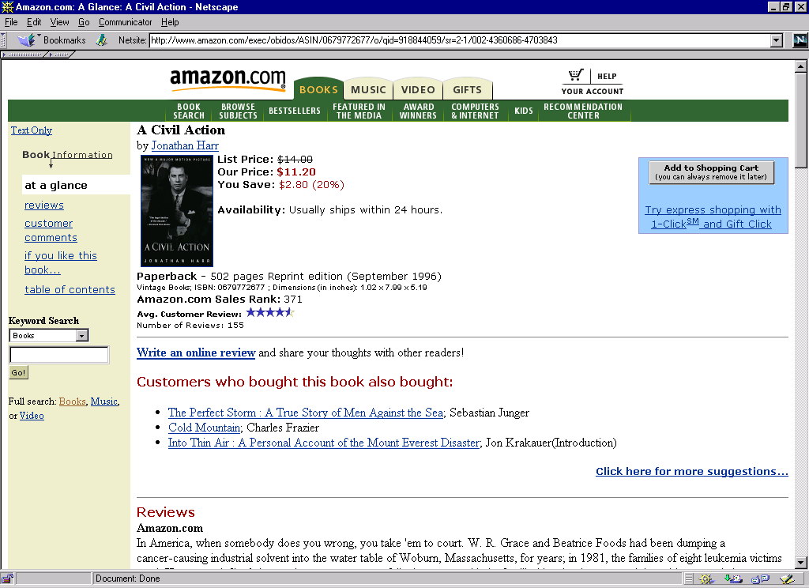

Slide 22
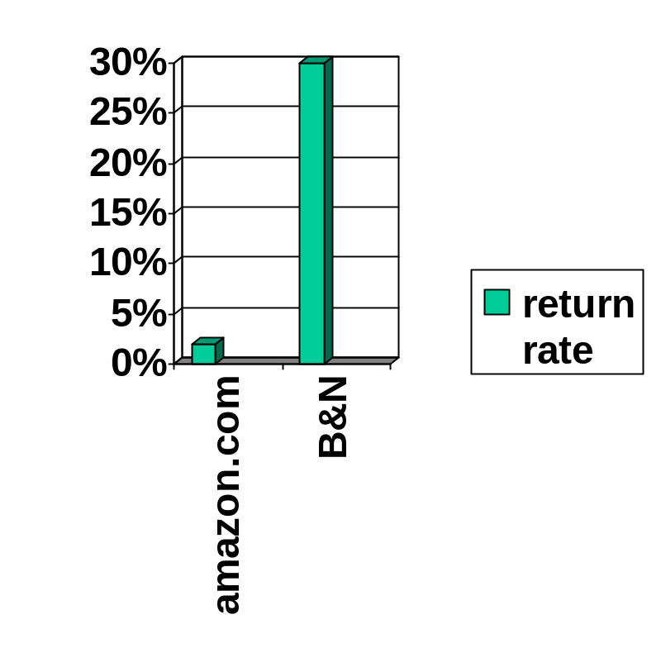
amazon.com vs. Barnes & Noble:
Book Return Rate
amazon.com has a 2% book return rate
Barnes & Noble has a 30% book return rate

Slide 23
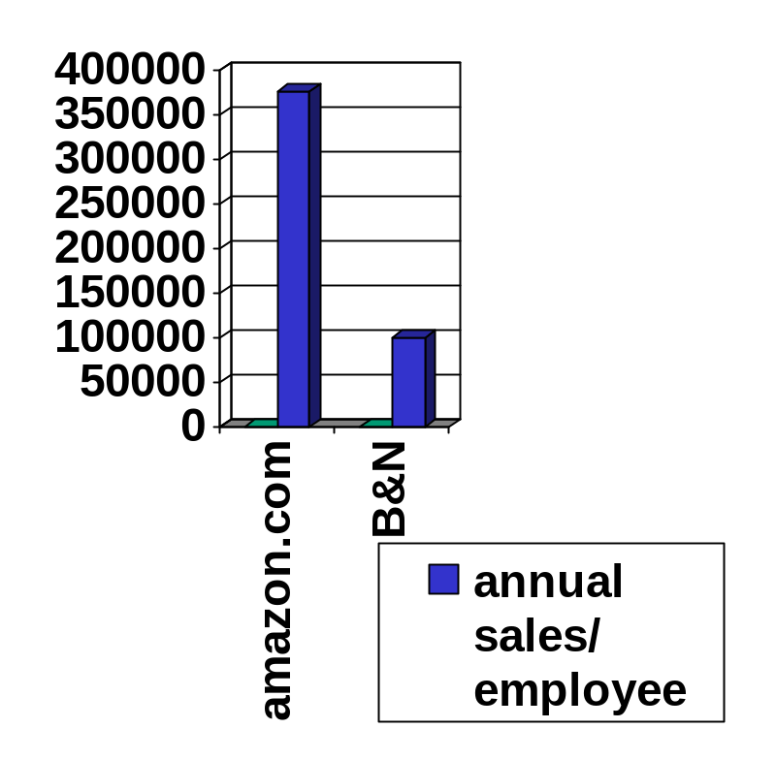
Amazon.com vs. Barnes & Noble:
Annual Sales per Employee
Amazon.com has US$375,000 annual sales per employee
Barnes & Noble has US$100,000 annual sales per employee

Slide 24
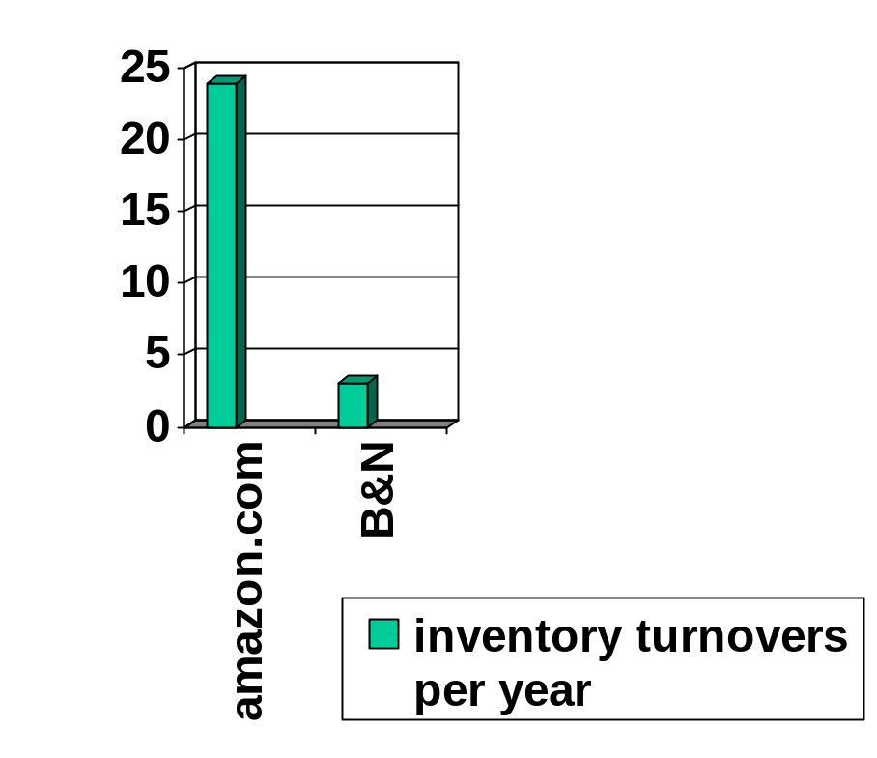
Amazon.com vs. Barnes & Noble
Inventory Turnover per Year
amazon.com turns over its inventory 24 times each year
Barnes & Noble turns over its inventory only 3 times each year

Slide 25
eBay
Operates an online person-to-person exchange in an auction format to trade personal items such as antiques, coins, collectibles, computers, dolls, jewelry and other items.
Hosts live, on-line bidding for high-exposure items
  January 1999 -- hosted auction with Guernseys to sell Mark McGwire home run balls

Slide 26
eBay
2.1 million registered users
over 800,000 online auctions per day, over 140 million hits per week (Source: Wired)
72% increase in registered users from September 1998 to December 1998
stock rose from initial offering price of US$18 in September 23, 1998 to US$231 as of February 16, 1999
market capitalization was US$9.5 billion as of February 16, 1999

Slide 27
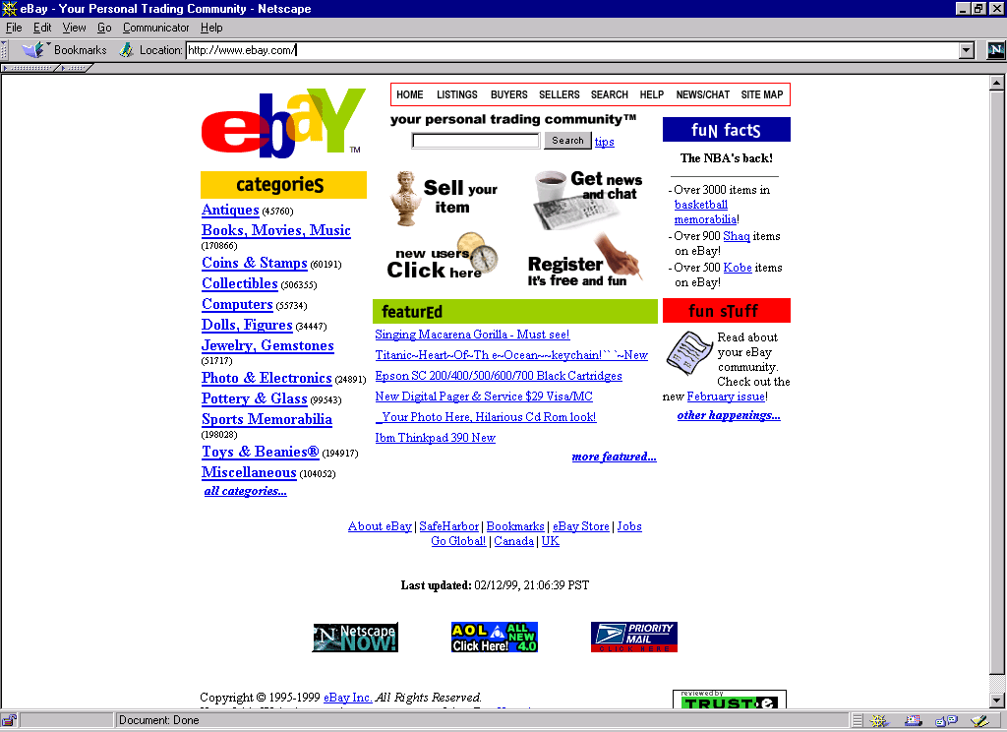

Slide 28
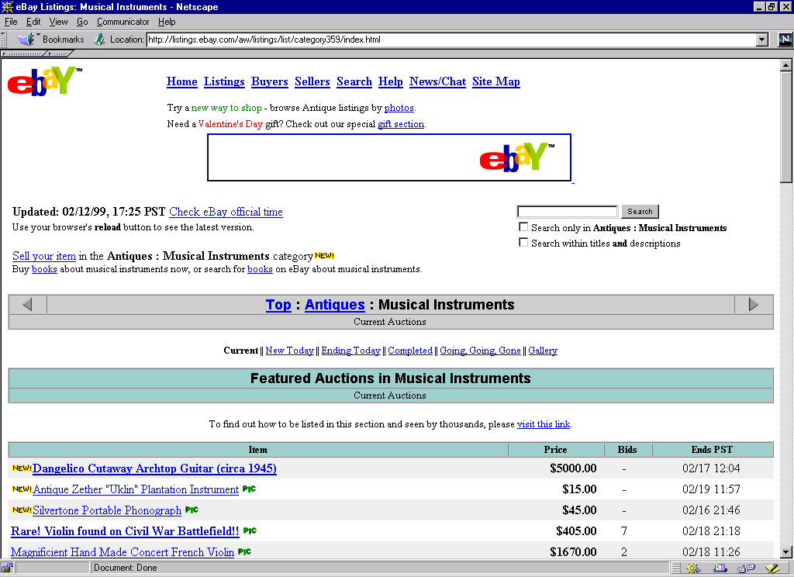

Slide 29
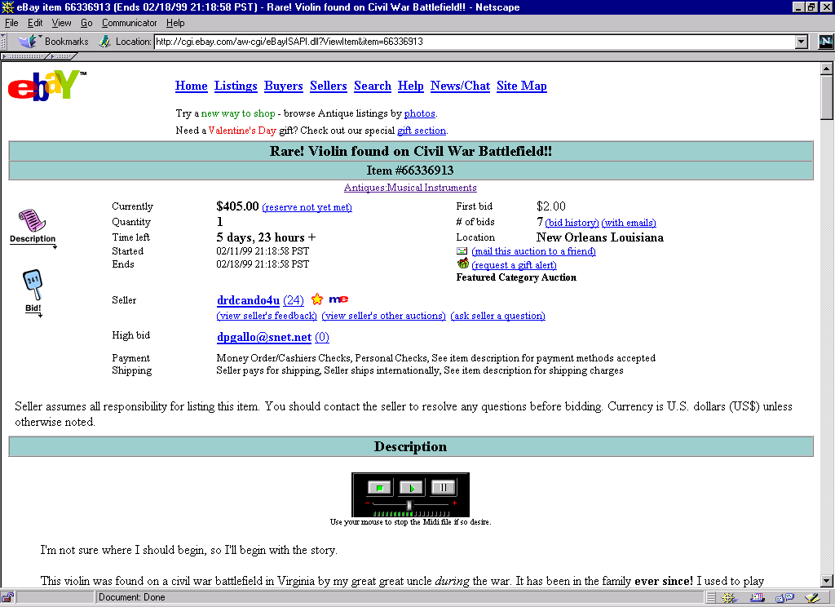

Slide 30
eBay’s competition
Yahoo! Auctions, working with Butterfield & Butterfield
  movie memorabilia and O.J. Simpson possessions
  free to users (vs. eBay’s charge of 25¢ to US$2.00, plus percentage of sales price to sellers)
Sotheby’s
Others: Millionaire.com, 2TheMarket.com, Onsale, Auction Universe, First Auction

Slide 31
eBay’s response
Improving user’s experience
  offer additional services: payments, shipping and customs clearance
Investing in infrastructure
  add icon from Equifax to verify the identity of users
  insure products worth US$25 to US$200 through Lloyd’s of London
  offer access to escrow services
expanding internationally
  launched country-specific auctions in the United Kingdom and Canada

Slide 32
eBay’s response (continued)
Boosting “fun factor”
  publishing on-line newsltr; adding 18 chat rooms
addressing concerns about fraud
  tougher rules for deadbeats; clarify policies on auctioning illegal items; closer coordination with law enforcement
  NYC Dept. of Consumer Affairs investigation for fraud (multiple sales of one-of-a-kind items)
Spend more on promotion -- through AOL and Netscape’s Netcenter portal (offer most popular Internet resources through a single site)

Slide 33
E*Trade
Provides on-line investing services: automated stock, bond and mutual fund order placement at low commission rates; portfolio tracking; real-time market commentary and analysis 7x24
Revenues for FY 1998 (ending 9/30/98) were US$245.3 million, up 57%
market capitalization increased from US$2.7 billion as of 12/31/98 to US$5.43 billion as of 3/3/99

Slide 34
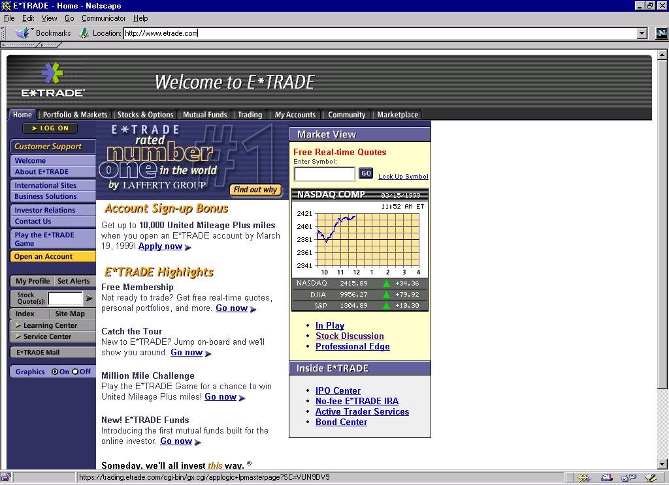

Slide 35
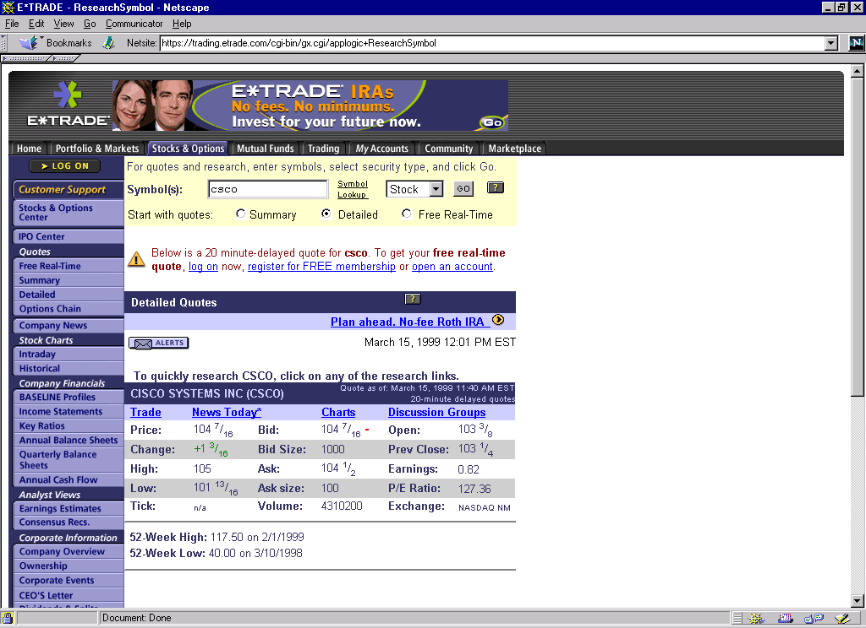

Slide 36
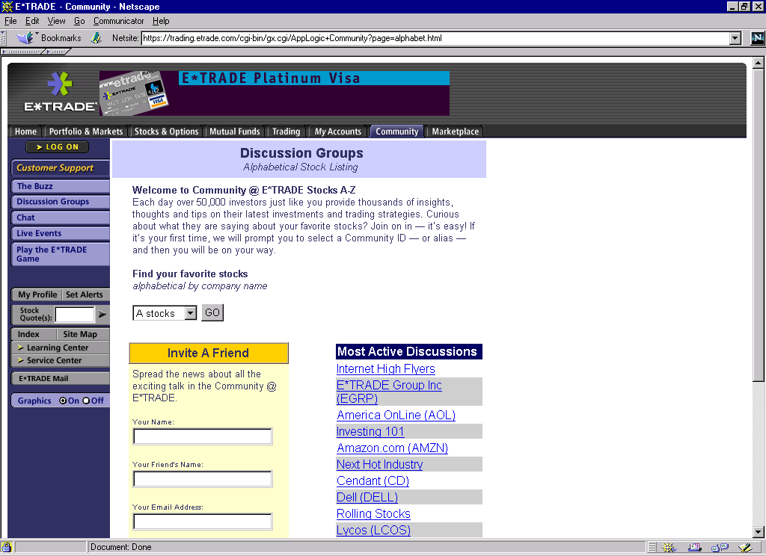

Slide 37
E*Trade’s Alliances
America Online -- part of AOL’s Personal Financial Channel
BancBoston Robertson Stephens -- users have access to proprietary research and recommendations available only to large investors and institutions
CNNfn -- significant branded presence
Scudder Kemper Investments-- offers more than 30 no-load Scudder Funds online
E*Trade is the exclusive retail broker for a number of high profile Internet IPO’s, including Priceline.com

Slide 38
BUSINESS-TO-BUSINESS: Cisco
1998 revenues of US$8.5 billion; market capitalization of US$165 billion (3/99)
Sells Internet routers and network switches; software that resides on customer’s Intranet and provide ordering tracking and other functions
By providing Internet based technical support, the company is resolving 200,000 calls per day without human intervention

Slide 39
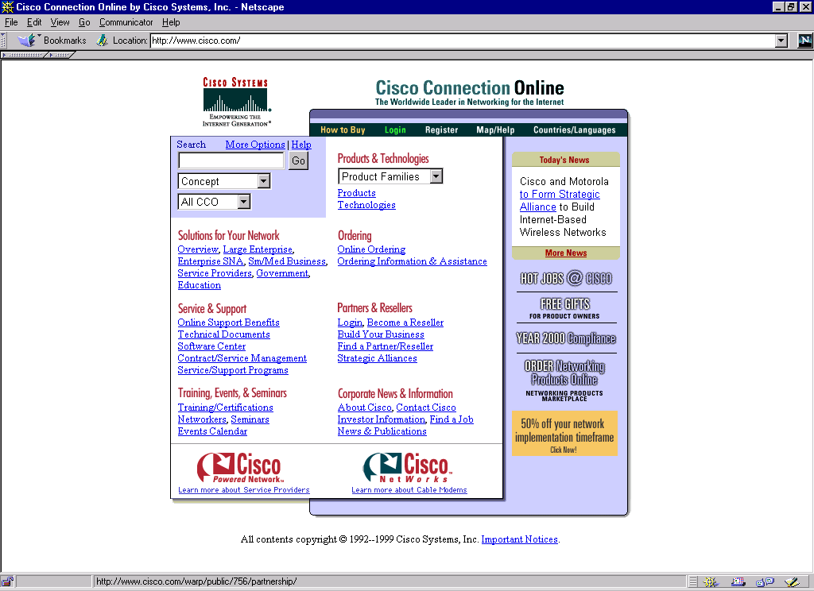

Slide 40
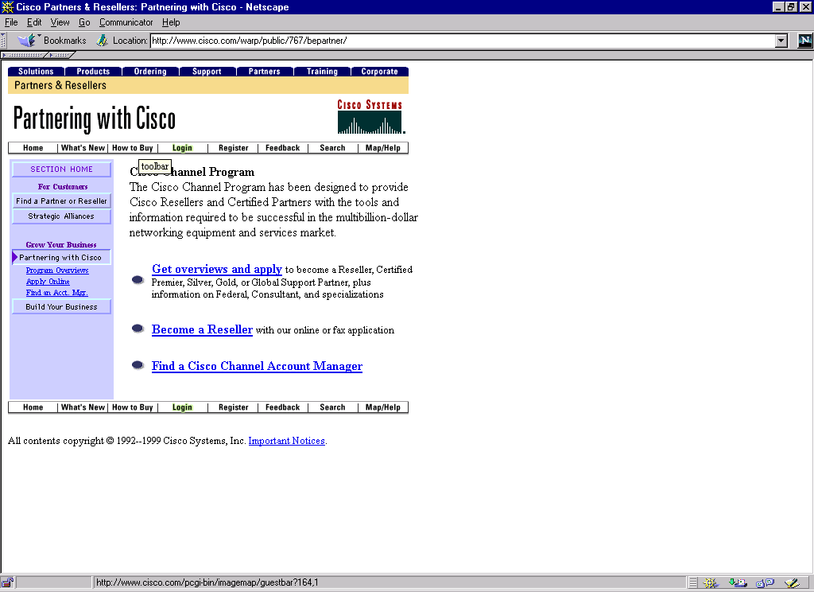

Slide 41
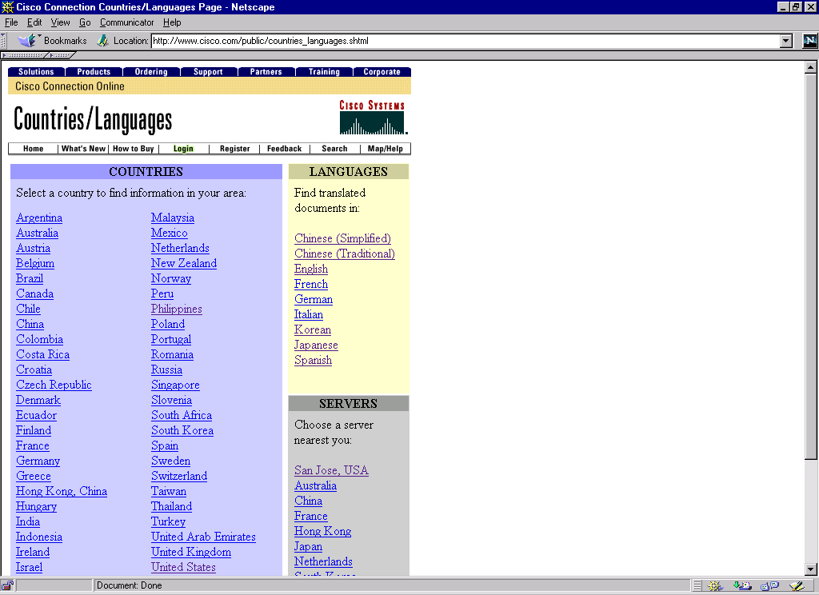

Slide 42
Some Failures
IBM’s World Avenue Mall
MCI’s 1-800 Music Now

Slide 43
IBM’s World Avenue Mall
on-line mall offering a variety of consumer products
July 1997: shut down after a year of sub-par revenue
according to CNNfn, merchants criticized IBM for lack of promotions relating to World Avenue
IBM will not be a “traffic-generator”
  conceded that on-line mall requires major retailer or consumer packaged-goods company to generate necessary traffic

Slide 44
MCI’s 1-800 Music Now
MCI Communications abandoned in December 1996 its 1-800 Music Now service, just one year after launching the venture to sell CD’s over both phone lines and its on-line shopping mall
MCI spent US$10 million developing and promoting the service on TV, radio and print media.
According to the Washington Post, 1-800 Music Now failed due to three major obstacles:
  wrong product at wrong time-- 1995-96 music sales overall had a slow year; other retailers offered deep discounts
  did not offer an easy-to-use site for consumers; easier to buy from traditional record store
  prices were relatively high (vs. retail stores)

Slide 45
Future Developments
Technological breakthroughs will make e-commerce easier and more accessible to larger audiences
Problems ahead -- bumps in the road

Slide 46
Technological Breakthroughs
increased use of digital certificates
development of higher capacity media for video and audio recordings
use of new technologies to provide single-use or limited-use copies
increasing consumer demand for faster Internet access (service through cable TV box)
  as of 1/99, 67% of US households subscribe to cable; 96.56% of U.S. homes passed by cable

Slide 47
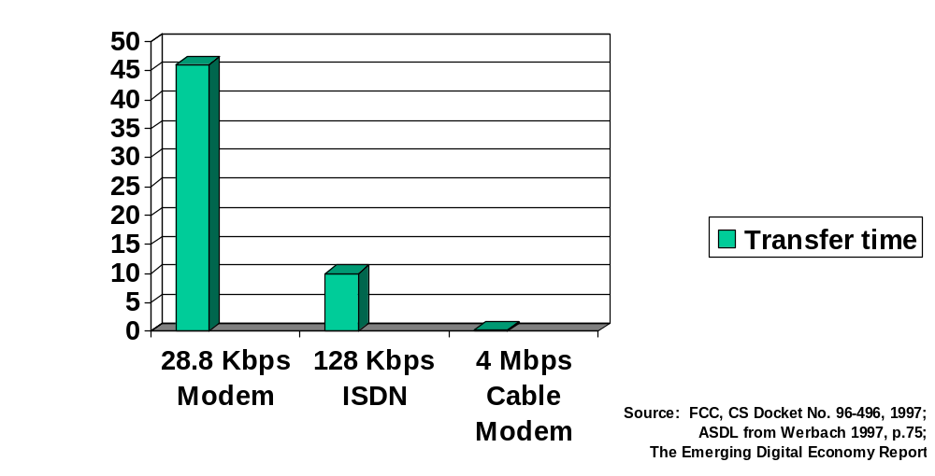
Internet Access Speeds: Time to Download 3.5 Min. Video Clip

Slide 48
Bumps in the Road
Possible governmental charges for Internet access
Government efforts to collect sales and use taxes
Internet patents: threat to fluid structures of WWW
  Microsoft’s patent covering aspects of cascading style sheets
  conflict between innovation and collaboration
Resistance from traditional “brick-and-mortar” retailers
  Compaq announced on 2/23/99 that it had revoked the ability of Internet-only retailers to sell its computers for a 90-day evaluation period
  response to growing sale by both on-line retailers and traditional retailers opening cyber outlets, although ban does not affect the latter
Efforts to increase security meeting resistance
  computers with specific serial numbers (Pentium® III processor)

Slide 49
Perhaps Biggest Bump in Road:
Privacy
European Union’s Data Privacy Directive
receiving increasing attention from U.S. Federal Trade Commission
  as of 3/98, of 1,400 websites reviewed by FTC, only 14% informed visitors of their information-collection practices
  only 28 of those sites posted “comprehensive” privacy statements
cookies or Cookie Monster?
  remembers account information
  remembers where user left off in site
  potential of tracking usage of site and developing user profile in order to direct other information

Slide 50
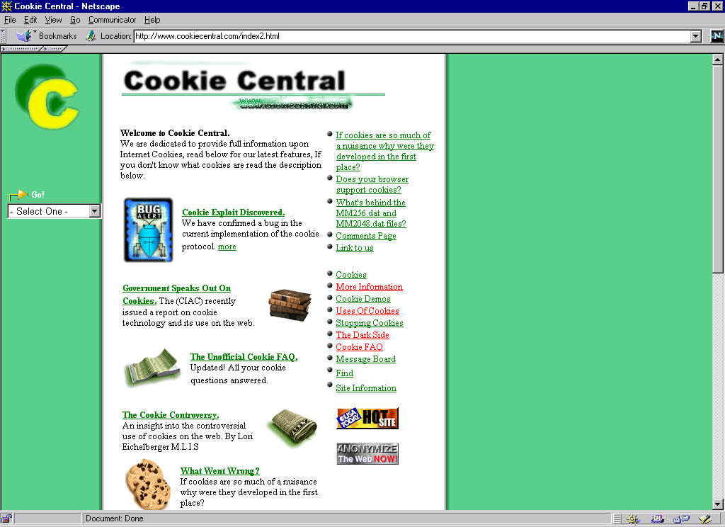

Slide 51
Bump or Launching Ramp?
Consumers seem not to be concerned by loss of privacy
Free-PC gives away 10,000 free computers, in exchange for permission to target advertising messages directly to customer’s desktop
  marketing companies pay US$1,000 per user for such information
  cost of state-of-the-art Compaq Presario has dropped to US$800
  received 1,200,000 visits on web site on morning of announcement

Slide 52
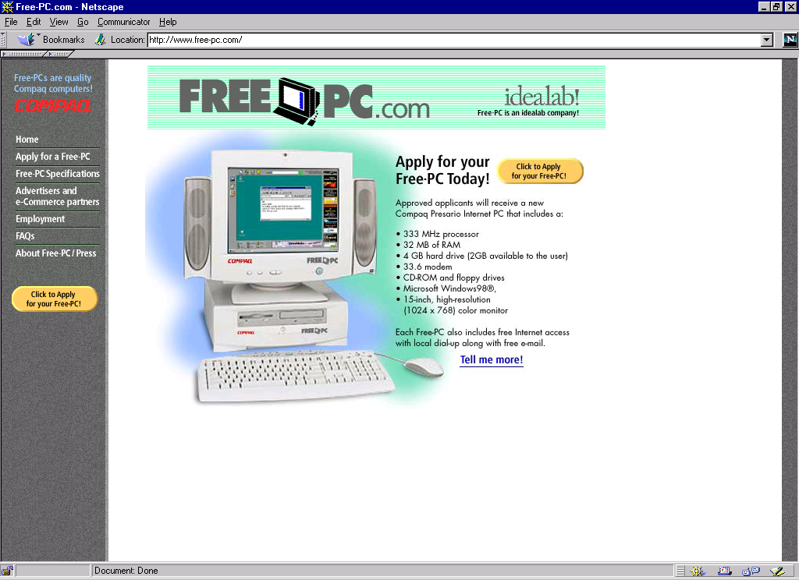

Slide 53
Free-PC
messages sent based on detailed information provided by customer
  age, income, family status, personal tastes and interests
Advertisements will appear in frame surrounding working area -- and cannot be removed
  agreement with Cybergold, which represents Disney, ESPN, credit-card issuer MBNA and AOL

Slide 54
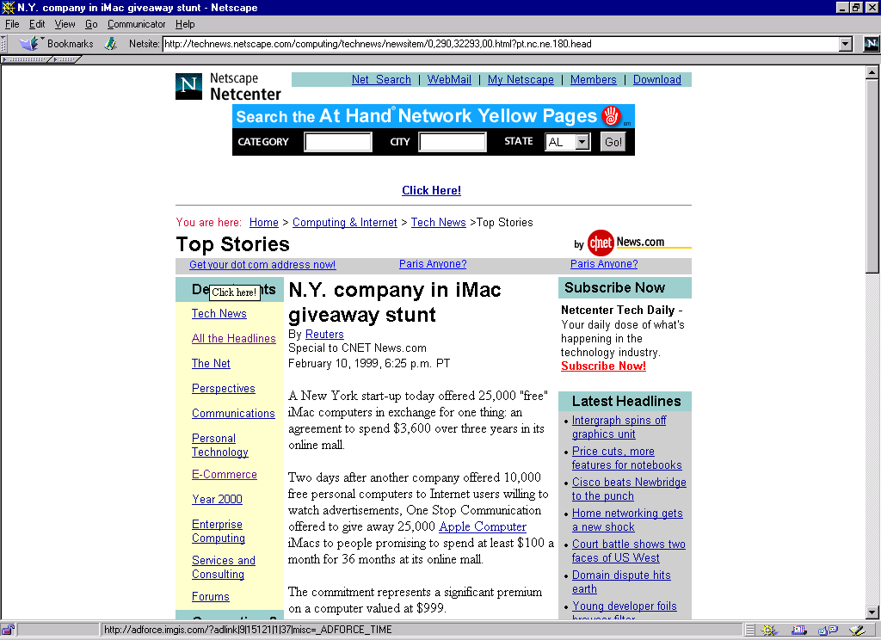

Slide 55
Seven Lessons to be Learned
#1 - Copying is the highest form of flattery … so expect to be flattered
#2 - Ease of access: establish a close, hopefully unique, relationship with a portal to increase traffic through your website
#3 - Ease of use: make the site easy, fast and perhaps even fun
  successes: amazon.com, eBay, E*Trade, Cisco
  failures: 1-800 Music Now

Slide 56
Seven Lessons to be Learned
#4 - Convenience is not enough; offer competitive prices as well
#5 - Multi-industry on-line malls will probably be controlled by a few major companies with patience and deep pockets
    IBM was not patient and was not willing to dig deep enough into its pockets
#6 - Follow Cisco’s lead: do business for the Internet and through the Internet
#7 - Future = next month

