Slide 1

R. GLENN
HUBBARD
ANTHONY PATRICK
O’BRIEN
Money,
Banking, and
the Financial System

Slide 2

Money and the Payments System
2
C H A P T E R
LEARNING OBJECTIVES
After studying this chapter, you should be able to:
2.1
Analyze the inefficiencies of a barter system
2.2
Discuss the four key functions of money
2.3
Explain the role of the payments system
2.4
Explain how the U.S. money supply is measured
2.5
Use the quantity theory of money to analyze the relationship between money and prices in the long run

Slide 3
Money and the Payments System
2
C H A P T E R
THE FEDERAL RESERVE FIGHTS TO PRESERVE ITS INDEPENDENCE
Facing criticism from Congress about the Fed’s actions during the crisis, Fed Chairman Ben Bernanke insisted on the need for the Fed to remain independent from the rest of the federal government.
An example of a country without central bank independence is Zimbabwe, where the inflation rate during 2008 was an almost unimaginable 15 billion percent!
Most economists believe that there is a connection between how independent a country’s central bank is and how much inflation the country experiences.
An Inside Look at Policy on page 44 discusses the Fed’s new role as the key regulator of the financial sector.

Slide 4

Key Issue and Question
Issue: The Federal Reserve’s actions during the financial crisis led to concerns about whether it could maintain its independence.
Question: Should a central bank be independent of the rest of the government?

Slide 5
2.1
Learning Objective
Analyze the inefficiencies of a barter system.

Slide 6
Do We Need Money?
Economists define money very broadly as anything that is generally accepted as payment for goods and services or in the settlement of debts.

Slide 7
Barter
Economies can function without money.
Barter A system of exchange in which individuals trade goods and services directly for other goods and services.
Do We Need Money?

Slide 8
Barter
There are four main sources of inefficiency in a barter economy:
1. There must be a double coincidence of wants. The time and effort spent searching for trading partners in a barter economy increases the transactions costs.
2. Each good has many prices.
When there are N items: Number of prices = N(N – 1)/2.
3. There is a lack of standardization.
4. It is difficult to accumulate wealth.
Transactions costs The costs in time or other resources that parties incur in the process of agreeing and carrying out an exchange of goods and services.
Do We Need Money?

Slide 9
The Invention of Money
In growing an economy, there is an incentive to identify a specific product that most people will generally accept in an exchange.
A good used as money that also has value independent of its use as money is called commodity money.
Making the Connection
What’s Money? Ask a Taxi Driver!
During a visit to Russia in 1989, one of the authors of this book navigated with difficulty through the streets of Moscow because Russian merchants and taxi drivers discouraged payments in rubles.
Taxi drivers quoted fares in dollars, marks, and yen.
For taxi drivers, Marlboro cigarettes were the commodity money of choice.
Do We Need Money?

Slide 10
The Invention of Money
Specialization A system in which individuals produce the goods or services for which they have relatively the best ability.
Once money is invented, people can specialize, become far more productive, and earn higher incomes.
Do We Need Money?

Slide 11
2.2
Learning Objective
Discuss the four key functions of money.

Slide 12
The Key Functions of Money
Money serves four key functions in the economy:
It acts as a medium of exchange.
It is a unit of account.
It is a store of value.
4. It offers a standard of deferred payment.
Medium of Exchange
Medium of exchange Something that is generally accepted as payment for goods and services; a function of money.
Unit of Account
Unit of account A way of measuring value in an economy in terms of money; a function of money.

Slide 13
Store of Value
Store of value The accumulation of wealth by holding dollars or other assets that can be used to buy goods and services in the future; a function of money.
While you incur transactions costs when you exchange other assets for money, money is, of course, perfectly liquid. People hold money to avoid transactions costs, even though other assets offer a greater return as a store of value.
Standard of Deferred Payment
Money can facilitate exchange not only at a point in time, but also over time, as a standard of deferred payment.
The Key Functions of Money

Slide 14
Distinguishing Among Money, Income, and Wealth
Money, like other assets, is a component of wealth, which is the sum of the value of a person’s assets minus the value of the person’s liabilities.
However, only if an asset serves as a medium of exchange can we call it money.
A person’s income is equal to his or her earnings over a period of time.
So, a person typically has considerably less money than income or wealth.
The Key Functions of Money

Slide 15
What Can Serve as Money?
An asset is suitable to use as a medium of exchange if it is:
Acceptable to (that is, usable by) most people.
Standardized in terms of quality, so that any two units are identical.
Durable, so that it does not quickly become too worn out to be usable.
Valuable relative to its weight, so that amounts large enough to be useful in trade can be easily transported.
Divisible, because prices of goods and services vary.
U.S. paper currency—Federal Reserve Notes—meet all these criteria.
The Key Functions of Money

Slide 16
The Mystery of Fiat Money
Fiat money Money, such as paper currency, that has no value apart from its use as money.
The federal government has designated paper currency to be legal tender, which means the government accepts paper currency in payment of taxes and requires that individuals and firms accept it in payment of debts.
Our society’s willingness to use green pieces of paper issued as money makes them an acceptable medium of exchange.
The Key Functions of Money

Slide 17
Making the Connection
Apple Didn’t Want My Cash!
To prevent the resale of new iPads, any customer wanting to buy an iPad had to pay either with a credit card or a debit card. This would make it easier for Apple to keep track of anyone attempting to buy more than the limit of two per customer.
Firms do not have to accept cash as payment for goods and services. For example, a bus line may prohibit payment of fares in pennies or dollar bills.
The woman who tried to buy an iPad for cash was disabled, and the case drew bad publicity, so Apple gave her a free iPad and rescinded ban on paying for iPads with cash.
The Key Functions of Money

Slide 18
2.3
Learning Objective
Explain the role of the payments system.

Slide 19
Payments system The mechanism for conducting transactions in the economy.
The Transition from Commodity Money to Fiat Money
An economy’s reliance on gold and silver coins alone makes for a cumbersome payments system.
To get around this problem, early banks began to store gold coins in safe places and issue paper certificates. In effect, paper currency had been invented.
In modern economies, the central bank issues paper currency but does not exchange it for gold or any other commodity money.
The Payments System

Slide 20
The Importance of Checks
Checks are promises to pay on demand money deposited with a bank or other financial institution.
The use of checks avoids the drawbacks of paper money, but also requires more trust on the part of the seller.
The Payments System

Slide 21
Electronic Funds and Electronic Cash
Electronic funds transfer systems have greatly improved the efficiency in settling and clearing transactions. Here is how:
  Cash registers are linked to bank computers, so when a customer uses a debit card, his bank instantly credits the store’s account. In this way, debit cards eliminate the problem of trust.
  ACH transactions include direct deposits of payroll checks and electronic transfers, which help to reduce transactions costs, the likelihood of missed payments, and the costs of notifying borrowers of missed payments.
  ATMs add the convenience of withdrawing funds from your bank anytime, away from your bank.
  E-money, or electronic money, is digital cash people use to buy goods and services over the Internet.
The Payments System

Slide 22
2.4
Learning Objective
Explain how the U.S. money supply is measured.

Slide 23
Measuring the Money Supply
Measuring Monetary Aggregates
Monetary aggregates Measures of the quantity of money that are broader than currency; M1 and M2.
M1 A narrower definition of the money supply: The sum of currency in circulation, checking account deposits, and holdings of traveler’s checks.
M2 A broader definition of the money supply: all the assets that are included in M1, as well as time deposits with a value of less than $100,000, savings accounts, money market deposit accounts, and noninstitutional money market mutual fund shares.

Slide 24
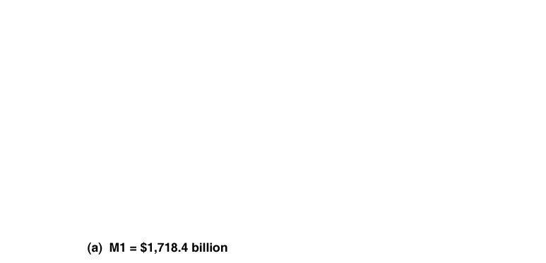
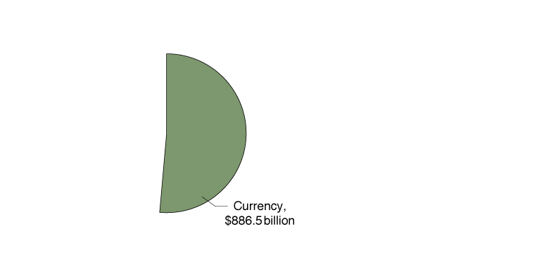
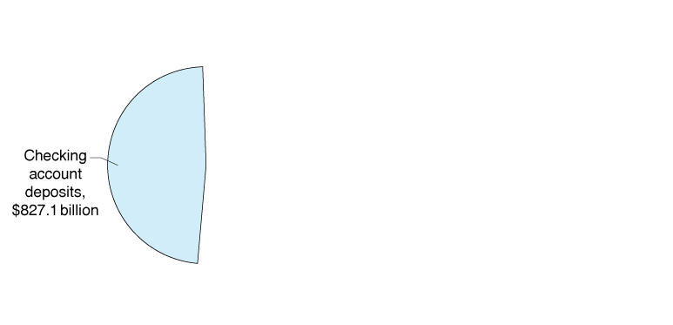
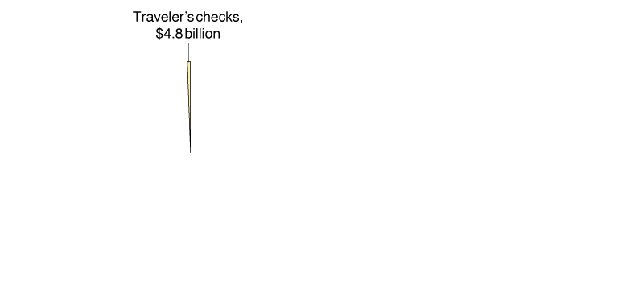
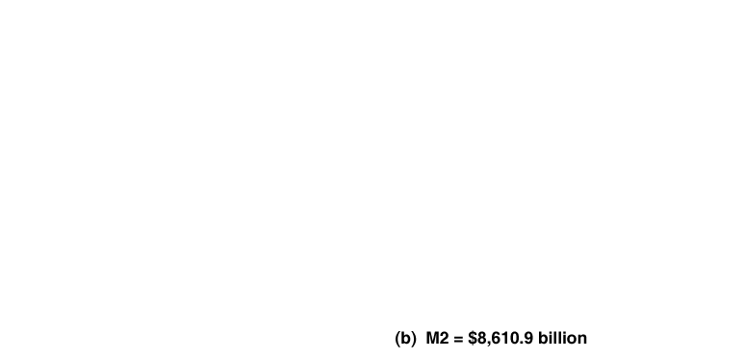
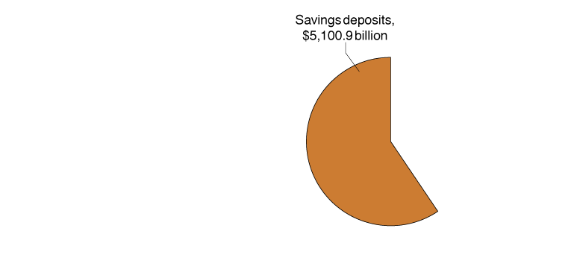
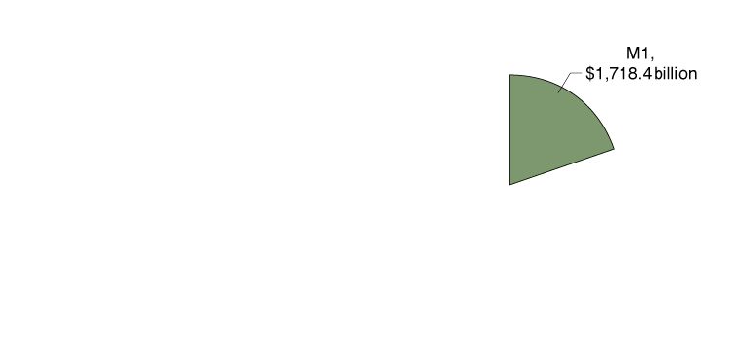
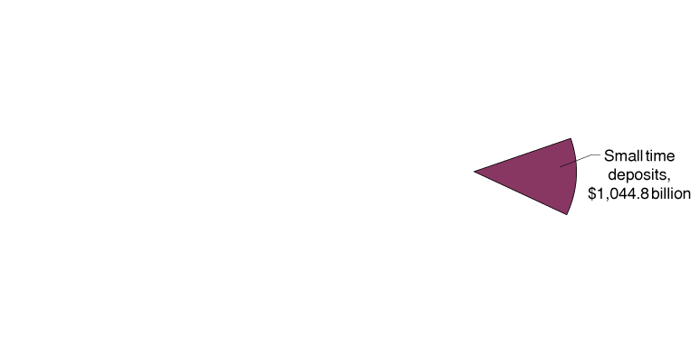
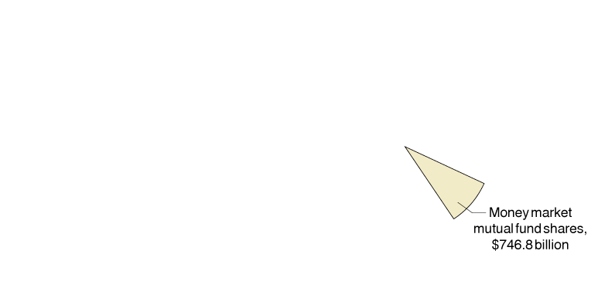
Measuring the Money Supply
Figure 2.1
Measuring the Money Supply, July 2010
Notes:
In panel (b), savings deposits include money market deposit accounts.
Checking account deposits are also called demand deposits.

Slide 25
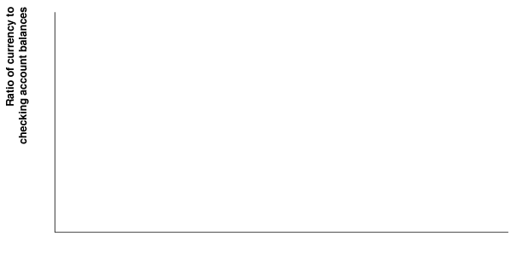

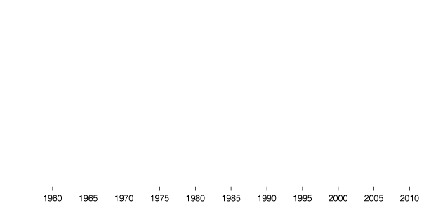
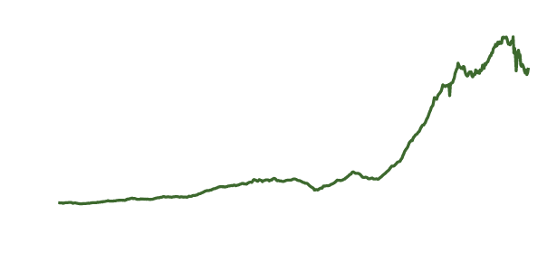
Making the Connection
Show Me the Money!
As more U.S. currency is held outside the United States, the ratio of currency to checking deposits increases.
As much as two-thirds of the $886.5 billion in currency outstanding in July 2010 was held outside the United States. People in other countries see the dollar as a safe haven when their own currencies are unstable.
Measuring the Money Supply

Slide 26
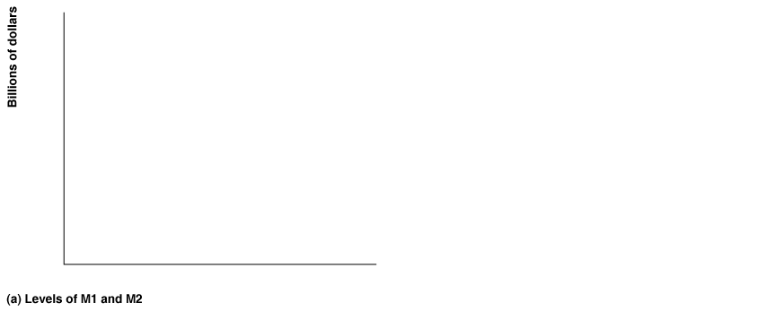

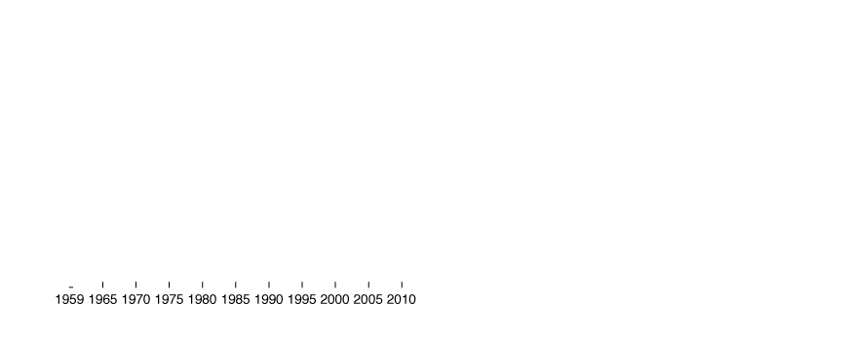
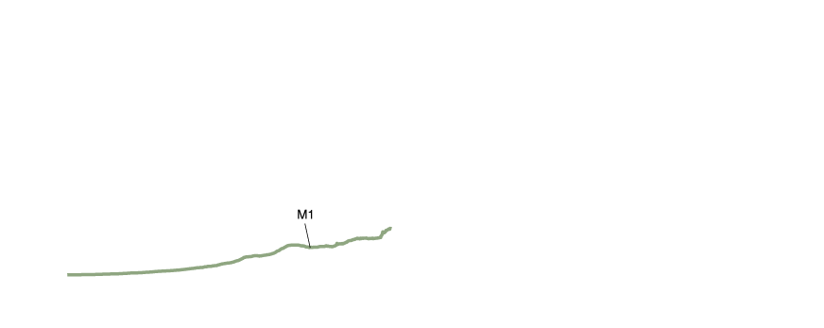
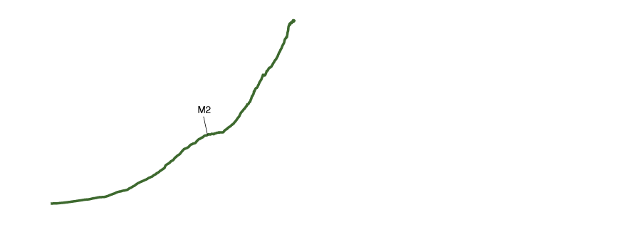


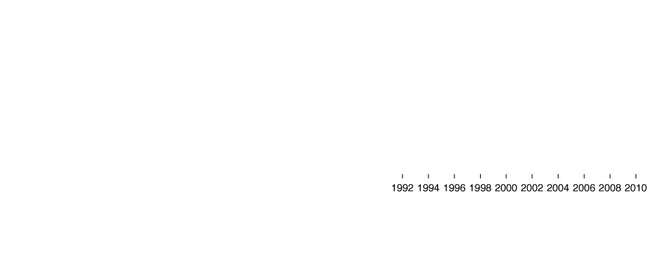
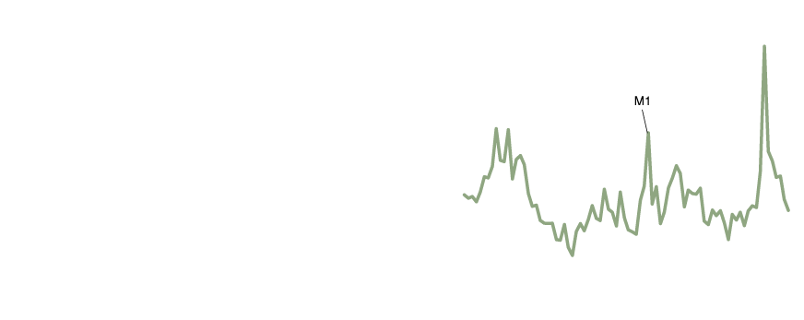
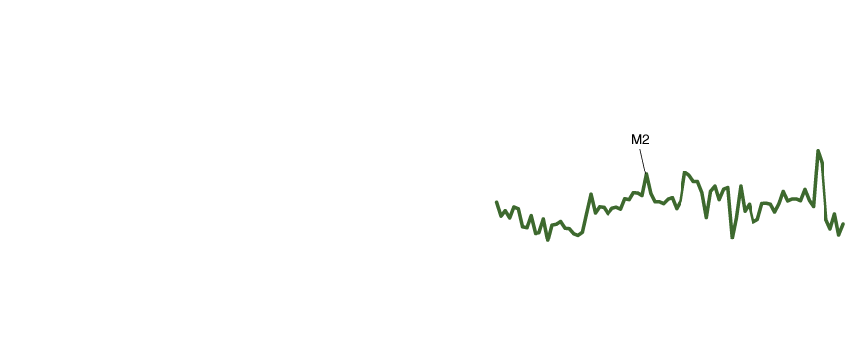
Does It Matter Which Definition of the Money Supply We Use?
Figure 2.2
Measuring the Money Supply, July 2010
Panel (a) shows that since 1959, M2 has increased much more rapidly than has M1.
Panel (b) shows that M1 has experienced much more instability than has M2.•
Measuring the Money Supply
Notes:
Note: In panel (b), percentage changes are measured as the compound annual rate of change using quarterly data.
Given the difference in growth rates of M1 and M2, can forecasters decide which measures to use to explain changes in other economic variables, such as the economy’s total output, the price level, and interest rates? The measure of the money supply that is best for forecasting remains an open question.

Slide 27
2.5
Learning Objective
Use the quantity theory of money to analyze the relationship between money and prices in the long run.

Slide 28
Irving Fisher and the Equation of Exchange
The equation of exchange, MV = PY, states that the quantity of money, M, multiplied by the velocity of money, V, equals the price level (or GDP deflator), P, multiplied by the level of real GDP, Y.
Note that PY equals nominal GDP, and that velocity, V = PY/M.
Irving Fisher turned the equation of exchange (an identity) into the quantity theory of money by asserting that velocity is constant.
Quantity theory of money A theory about the connection between money and prices that assumes that the velocity of money is constant.
The Quantity Theory of Money: A First Look at the Link between Money and Prices

Slide 29
The Quantity Theory of Money: A First Look at the Link between Money and Prices
The Quantity Theory Explanation of Inflation
We use the quantity equation expressed in percentage changes:
% Change in M + % Change in V = % Change in P + % Change in Y.
Since the percentage change in the price level is inflation, then:
Inflation rate = % Change in M – % Change in Y

Slide 30
Solved Problem
2.5
The Relationship between Money and Income
Do you agree or disagree with the following statement: “It is not possible for the total value of production to increase unless the money supply also increases. After all, how can the value of the goods and services being bought and sold increase unless there is more money available?”
The Quantity Theory of Money: A First Look at the Link between Money and Prices

Slide 31
Solved Problem
2.5
The Relationship between Money and Income
Solving the Problem
Step 1 Review the chapter material.
Step 2 Explain whether output in an economy can grow without the money supply also growing.
The value of total production is measured by nominal GDP, or in symbols PY. PY is the right side of the equation of exchange, so for it to increase, the left side—MV—must also increase.
Nominal GDP could increase with the money supply remaining constant, provided that V increases.
The Quantity Theory of Money: A First Look at the Link between Money and Prices

Slide 32
How Accurate Are Forecasts of Inflation Based on
the Quantity Theory?
Since velocity is more erratic in the short run than in the long run, the quantity theory can make better predictions of inflation in the long run.
Indeed, most of the variation in inflation rates across decades in the United States comes from variation in the rates of growth of the money supply.
When looking across countries, it is also true that countries where the money supply grew rapidly tended to have high inflation rates.
Zimbabwe's inflation rate of 15 billion percent during 2008 is an example of hyperinflation.
Hyperinflation A rate of inflation that exceeds 100% per year.
The Quantity Theory of Money: A First Look at the Link between Money and Prices

Slide 33
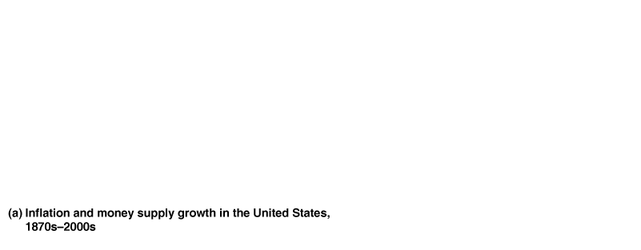

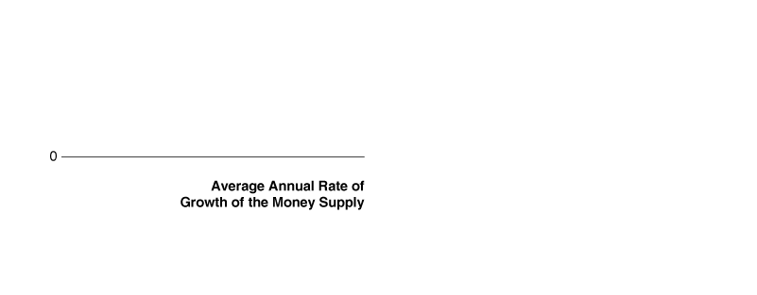

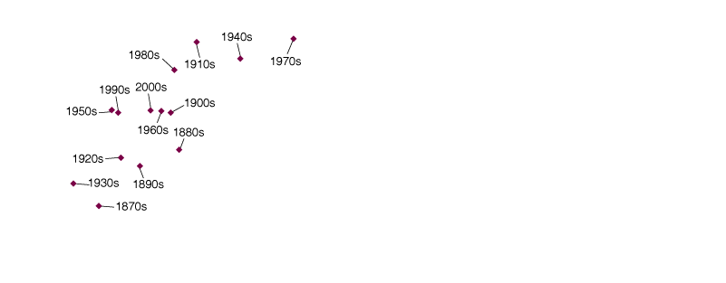
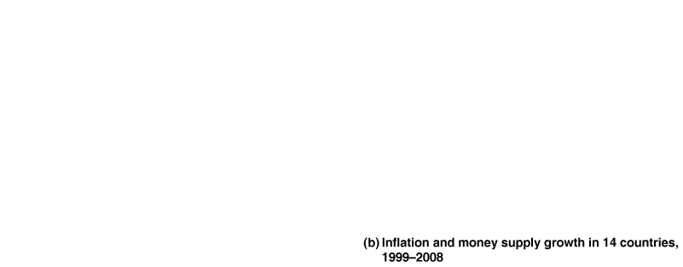


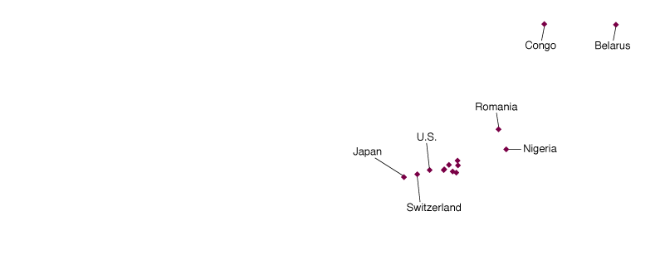

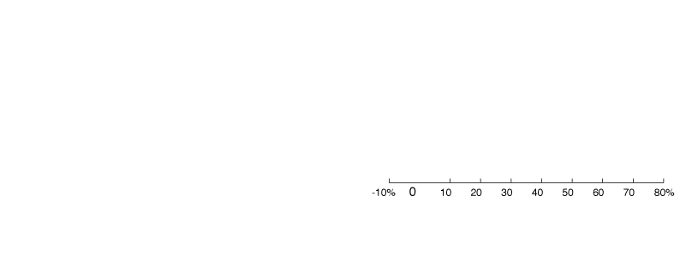
The Relationship between Money Growth and Inflation over Time
and around the World
Figure 2.3
Panel (a) shows that, by and large, in the United States the rate of inflation has been highest during the decades in which the money supply has increased most rapidly.
Panel (b) shows that in countries where the growth rate of the money supply was low, the rate of inflation was low, while in countries with high rates of growth of the money supply had high rates of inflation.•
The Quantity Theory of Money: A First Look at the Link between Money and Prices

Slide 34
What Causes Hyperinflation?
The equation of exchange explains how hyperinflation occurs. When both M and V increase more rapidly than Y, the inflation rate must soar.
Why does it occur? Because central banks are not always free to act independently of the rest of the government.
Governments that run budget deficits but can’t sell bonds to private investors will often sell them to their central banks.
In paying for the bonds, the central bank increases the country’s money supply. This process is called monetizing the government’s debt, or, more casually, funding government spending by printing money.
The Quantity Theory of Money: A First Look at the Link between Money and Prices

Slide 35
Making the Connection
Deutsche Bank during the German Hyperinflation
During a hyperinflation, loans will be repaid in money that will have lost most of its value.
One of the most famous hyperinflations occurred in Germany during the early 1920s.
The total number of marks—the German currency—in circulation rose from 115 million in January 1922 to 1.3 billion in January 1923 and then to 497 billion billion, or 497,000,000,000,000,000,000, in December 1923.
The German price index rose to 126,160,000,000,000 in December 1923. The German mark became worthless.
Deutsche Bank would make loans only to borrowers who would repay them in either foreign currencies or commodities.
The Quantity Theory of Money: A First Look at the Link between Money and Prices

Slide 36
Should Central Banks Be Independent?
The more independent a central bank is of the rest of the government, the more it can resist political pressures to increase the money supply, and the lower the country’s inflation rate is likely to be.
This result was proven in a study of 16 high-income countries (Figure 2.4).
Critics of the Fed in Congress argue that the Fed’s independence violates democratic principles, and that its actions exceed the authority granted under federal law.
But in 2010, the financial reform bill passed by Congress actually granted the Fed even more authority.
The Fed now regulates financial firms, and was also charged with ensuring that there would not be another financial crisis of the magnitude of 2007–2009.
The Quantity Theory of Money: A First Look at the Link between Money and Prices

Slide 37
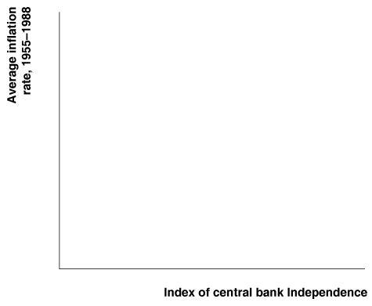

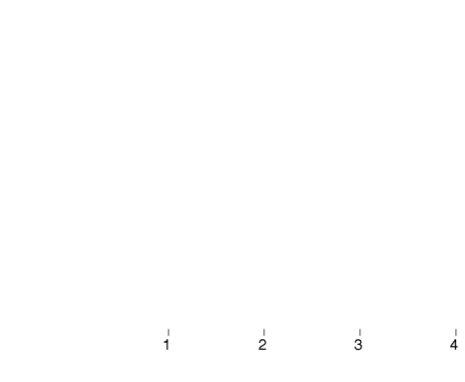
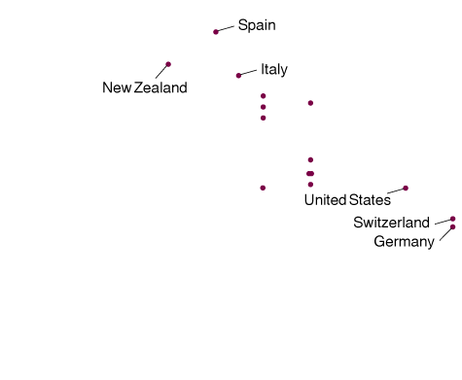
Figure 2.4
The Relationship between Central Bank Independence and the Inflation Rate
For 16 high-income countries, the greater the degree of central bank independence, the lower the inflation rate. Central bank independence is measured by an index ranging from 1 (minimum independence) to 4 (maximum independence).•
The Quantity Theory of Money: A First Look at the Link between Money and Prices

Slide 38

Answering the Key Question
At the beginning of this chapter, we asked the question:
“Should a central bank be independent of the rest of the government?”
We have seen that policymakers disagree on the answer to this question. The degree of independence that a country grants to its central bank is ultimately a political question. We have also seen, though, that most economists believe that an independent central bank provides a check on inflation.

Slide 39

AN INSIDE LOOK AT POLICY
Its Independence Was Threatened, but New Law Grants the Fed New Powers
Wall Street Journal, Fed Gets More Power, Responsibility
Key Points in the Article
Despite Congressional challenges to its independence following the financial crisis and recession of 2007–2009, the Federal Reserve emerged from the debate with new powers and responsibilities.
The Federal Reserve will now decide whether the Financial Stability Council should vote to break up companies that threaten the stability of the financial system, force companies to increase their capital and liquidity, and scrutinize large hedge funds.
Congress also granted the Fed responsibility for setting fees firms pay banks when customers use their debit cards.

Slide 40
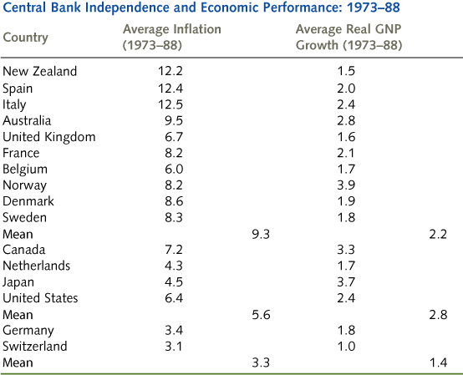
AN INSIDE LOOK AT POLICY
Its Independence Was Threatened, but New Law Grants the Fed New Powers
The two countries with greatest degree of independence, Germany and
Switzerland, had the lowest average rates of inflation over the 1973–88 period.

