Slide 1

SHRI VAISHNAV VIDYAPEETH VISHWAVIDYLAYA
Department of Computer Science Engineering
Minor Project
Batch- 2018-2022
Topic- Exam Analyzer
Guided By-
Proff. Shubham Kothari
Proposed By-
Mr. Chaitanya Mishra
Mr. Divyanshu Shrivastava
Ms. Nayanpreet Chhabra

Slide 2
EXAR- THE COMPETITIVE EXAM ANALYZER
-Work Smart

Slide 3
Team Members
Chaitanya Mishra (18100BTCSAII02836)
Divyanshu Shrivastava (18100BTCSAII02839)
Nayanpreet Chhabra (18100BTCSAII02848)

Slide 4
Contents
Introduction
Abstract
Problem Statement
Brief introduction
Main Idea
Conceptual Idea
Problem Statement
Functional Requirements
Non-functional Requirements

Slide 5
Contents
Literature Review
System Requirements
Comparative chart
Hardware Specifications
Software Specifications

Slide 6
Contents
Technologies Used
Methodologies
Back end
Database Management
Front end
Agile Model

Slide 7
Contents
UML Diagrams
UML Diagrams
Conclusion
Use Case Diagram
Level 0 DFD
Level 1 DFD
Level 2 DFD
ER Diagram
Class Diagram
Sequence Diagram
Activity Diagram
Summary of the project created.

Slide 8
Contents
References
Limitations
Future Enhancement
Drawbacks in this project.
Bibliography
References

Slide 9
Contents
Snapshots
Snapshots
Main page
About us
Registration Page
Login Page
Forgot Password Page
Selection Page
Analyzer Page
Previous Year Page
Prediction Page
Detailed Report Page
Feedback Page

Slide 10
Introduction
We are a part of a competitive world.
Competition is such an excessively powerful stimulus that it leads to over-work and the ruin the physical health of too ambitious students.
To survive and to perform exceptionally well in a competition one has to focus more on smart work rather than hard work.
So, for the people who wish to do so, we are proposing this project which will analyze the previous year exam questions and will conclude a pattern to cover the complete syllabus efficiently.
Also this project will predict the weightage of a particular topic that you are currently preparing.

Slide 11
Abstract
Life today has become so complex that examinations have come to play an important part in one’s educational career. The importance of examination is so high that most students are afraid of them. The examinations are hated by many and Loved by many.
We are a part of a competitive world. Competition is such an excessively powerful stimulus that it leads to over-work and the ruin the physical health of too ambitious students. To survive and to perform exceptionally well in a competition one has to focus more on smart work rather than hard work. Competitive traits during Examinations sometimes leads to Peer Problems like ruined friendships, bonds etc.
Our analysis and prediction based project focuses on the people who wish to do so, we are proposing this project which will analyze the previous year exam questions and will conclude a pattern to cover the complete syllabus efficiently. Our project will also cover each subject in the competitive exam to prepare in an efficient way which will allow the student to prepare smartly rather than doing blunt hard work.

Slide 12
Problem Statement
New users can register to the system through an online process. By registering a user agrees to abide by different pre-defined terms and conditions as specified by the system. Any registered user can access the different features of the system authorized to him / her, after he authenticates himself through the login screen.
An authenticated user can then select the subject to work on and the application will show the weightage of the subject.
Also it will analyze the previous year exam questions and will conclude a pattern to cover the complete syllabus efficiently.

Slide 13
Functional Requirements
Registration: New users have to register themselves online with the site and accept its terms & conditions
User Login: A user has to login into the site using his correct user ID & password
Admin: Admin can change and edit the data set and use resources
Normal user: Normal user can login and access the facilities
Input Data: User will be entering data to work upon.
Analyze Data set: Data set will then be analyzed for questions and weightage of the subject.
User logout: Once the result is displayed the user will have to logout.

Slide 14
Non-Functional Requirements
The system provides option for registration of new authorized users.
The system should remain up & running throughout it's working hours
Sessions of different users must not affect each other
Customer care for the website should provide 24x7 help over phone
System should maintain privacy of their users and should not leak their information to third parties
System could remain unavailable for up to 2 hours for maintenance once in a quarter with 36 hour prior notice

Slide 15
Literature Review
Criteria | Examify | Gradeup | Exar
Free | Yes | No | Yes
Internet Connection | Yes | Yes | Yes
Open for all | Yes | No | Yes
Secure | Yes | Yes | Yes
Prediction | No | No | Yes
Login required | Yes | Yes | Yes
User Rating | Yes | Yes | Yes
Strategies Provided | No | No | Yes

Slide 16
Literature Review
Criteria | Examify | Gradeup | Exar
User Feedback | Yes | No | Yes
Ease of access | Yes | Yes | Yes
Ad-Banner | Yes | Yes | No
Previous Year question papers | No | No | Yes
Compatibility | Yes | Yes | Yes
Android Support | Yes | No | No
IOS support | Yes | No | No
Web application | No | Yes | Yes

Slide 17
Literature Review
Criteria | Examify | Gradeup | Exar
Open source | Yes | No | Yes
Visualization | No | No | Yes
Analyzer | No | No | Yes

Slide 18
System Requirements
System specifications help to define the operational and performance guidelines for a system. It may outline how the system is expected to perform, and what that may include. Key specifications may include interface definitions, document design rules and functional areas.
When purchasing software or a computer, system specifications may be outlined during the evaluation process and agreed upon during the payment process. The specifications may determine security access. Many organizations will offer templates and resources to help facilitate the adherence of system specifications. In some cases, system specifications can be quite specific and difficult to follow without these guidelines.

Slide 19
Hardware Requirements
Processor: Minimum 1.8 GHz*2;
Recommended 2 GHz*2 or more
Ethernet connection (LAN) OR a wireless adapter (Wi-Fi)
Hard Drive: Minimum 4 GB;
Recommended 32 GB or more
Memory (RAM): Minimum 4 GB;
Recommended 8 GB or above

Slide 20
Software Requirements
Windows: 7 or newer
MAC: OS X v10.7 or higher
Linux: Ubuntu
Anaconda/spyder/pycharm platform
Python3 or latest version
Tkinter GUI

Slide 21
Technologies Used
Back end : Python- Pandas, Matplotlib, Numpy, Pandas Profiling, Scikit-learn, Ghostscript, Datetime, tkdocviewer, PIL
Front end : Tkinter (Python GUI), Webbrowser
(Tkinter is a Python binding to the Tk GUI toolkit.)

Slide 22
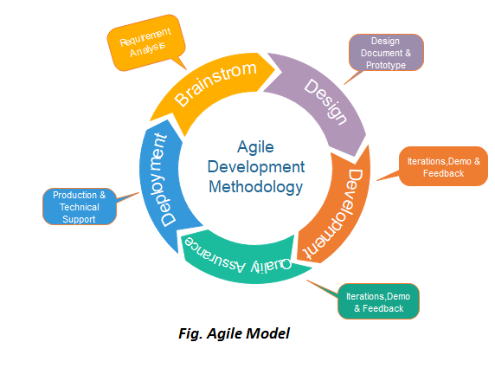
Methodology
"Agile process model" refers to a software development approach based on iterative development. Agile methods break tasks into smaller iterations, or parts do not directly involve long term planning. The project scope and requirements are laid down at the beginning of the development process. Plans regarding the number of iterations, the duration and the scope of each iteration are clearly defined in advance.
Following are the phases in the Agile model are as follows:
Requirements gathering
Design the requirements
Construction/ iteration
Testing/ Quality assurance
Deployment
Feedback

Slide 23
UML DIAGRAMS

Slide 24
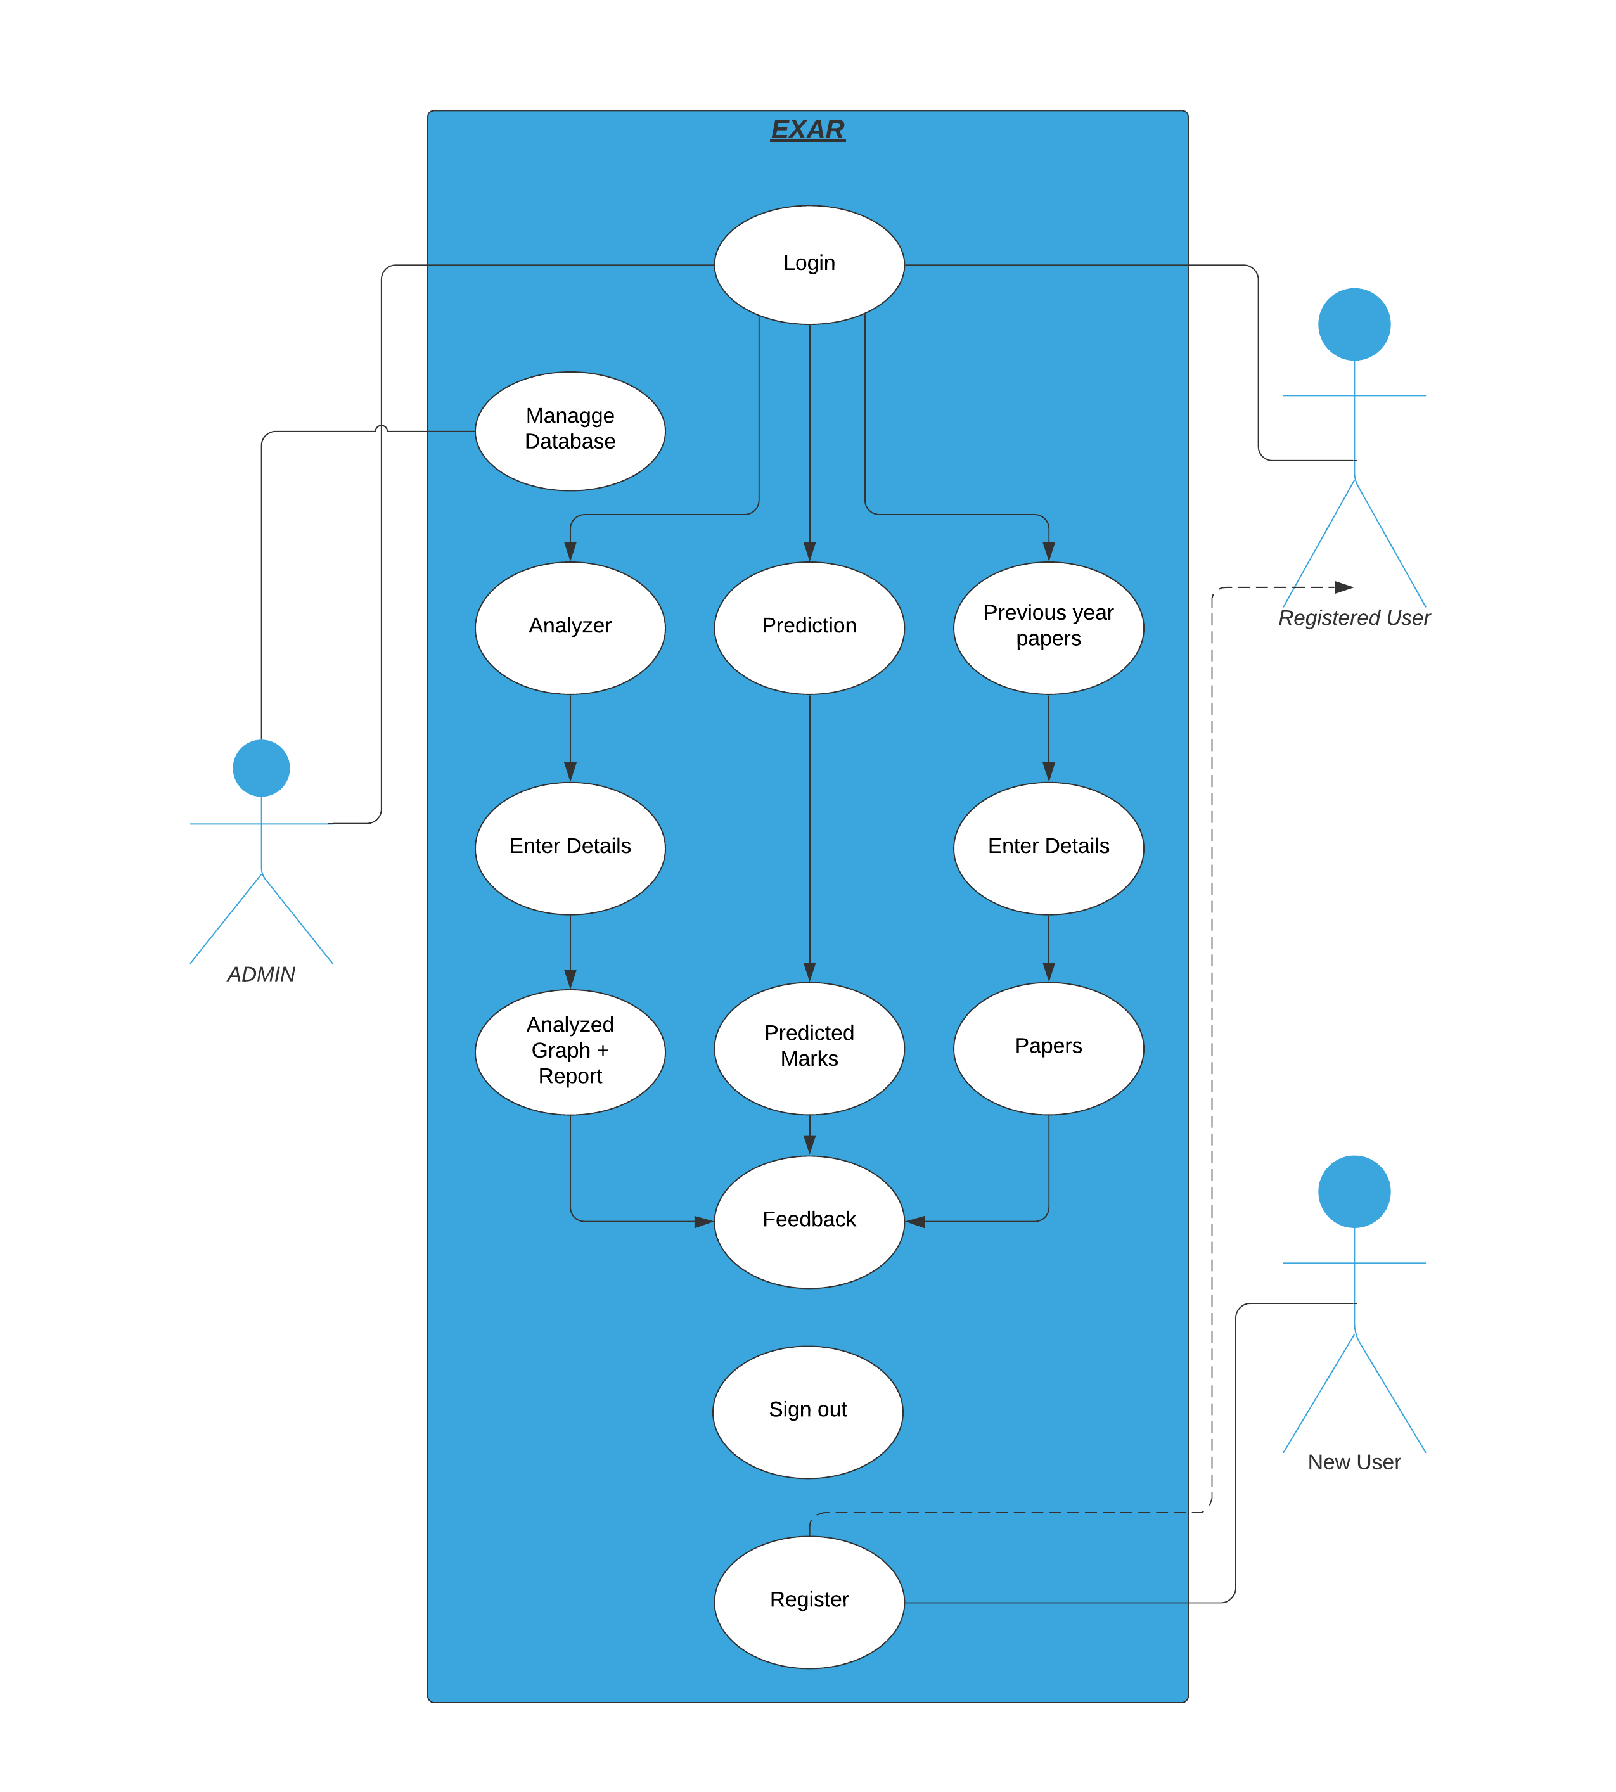
Use Case Diagram
A Use Case consists of use cases, persons, or various things that are invoking the features called as actors and the elements that are responsible for implementing the use cases.
Use case diagrams capture the dynamic behavior of a live system.

Slide 25
Data Flow Diagram
A Data Flow Diagram (DFD) is a traditional visual representation of the information flows within a system. A neat and clear DFD can depict the right amount of the system requirement graphically. It can be manual, automated, or a combination of both.

Slide 26
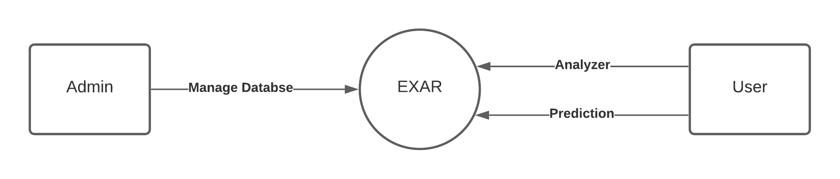
DFD Level-0
It is also known as context diagram. It’s designed to be an abstraction view, showing the system as a single process with its relationship to external entities. It represent the entire system as single bubble with input and output data indicated by incoming/outgoing arrows.

Slide 27
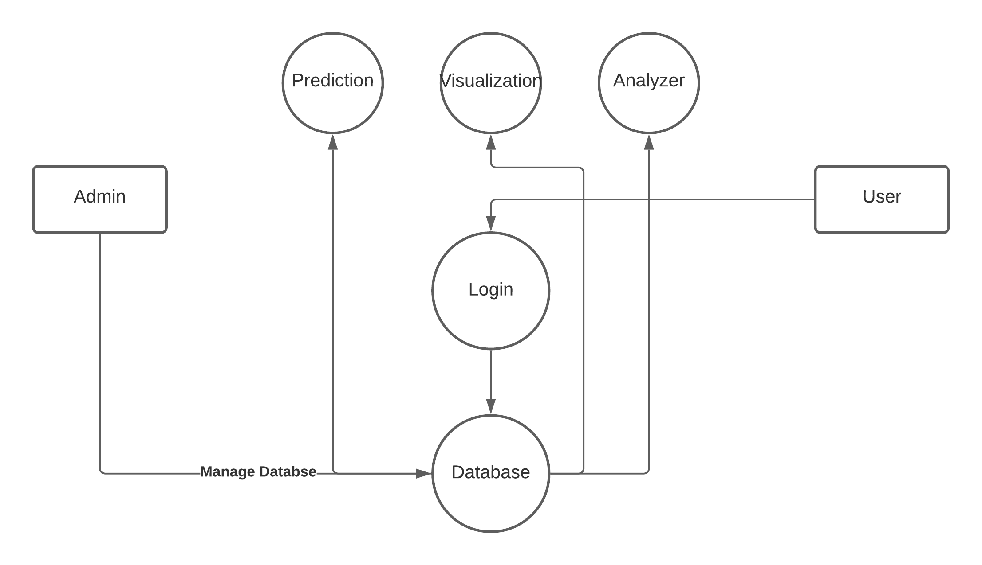
DFD Level-1
In 1-level DFD, a context diagram is decomposed into multiple bubbles/ processes. In this level, we highlight the main objectives of the system and breakdown the high- level process of 0-level DFD into sub processes.

Slide 28
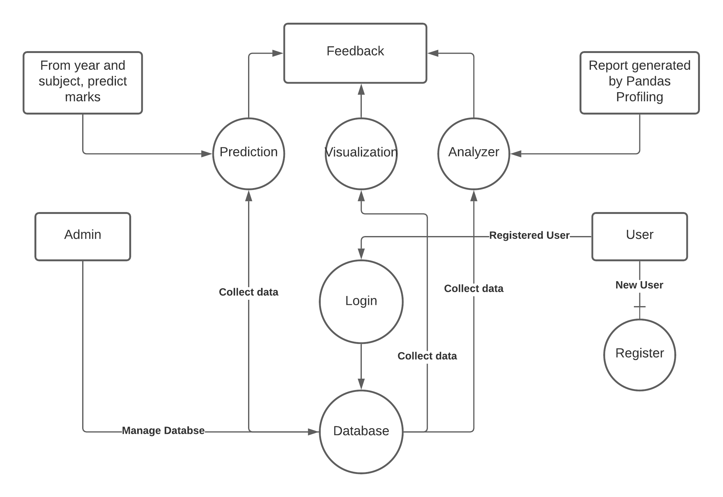
DFD Level-2
2-level DFD goes one process deeper into parts of 1-level DFD. It can be used to project or record the specific/necessary detail about the system's functioning.

Slide 29
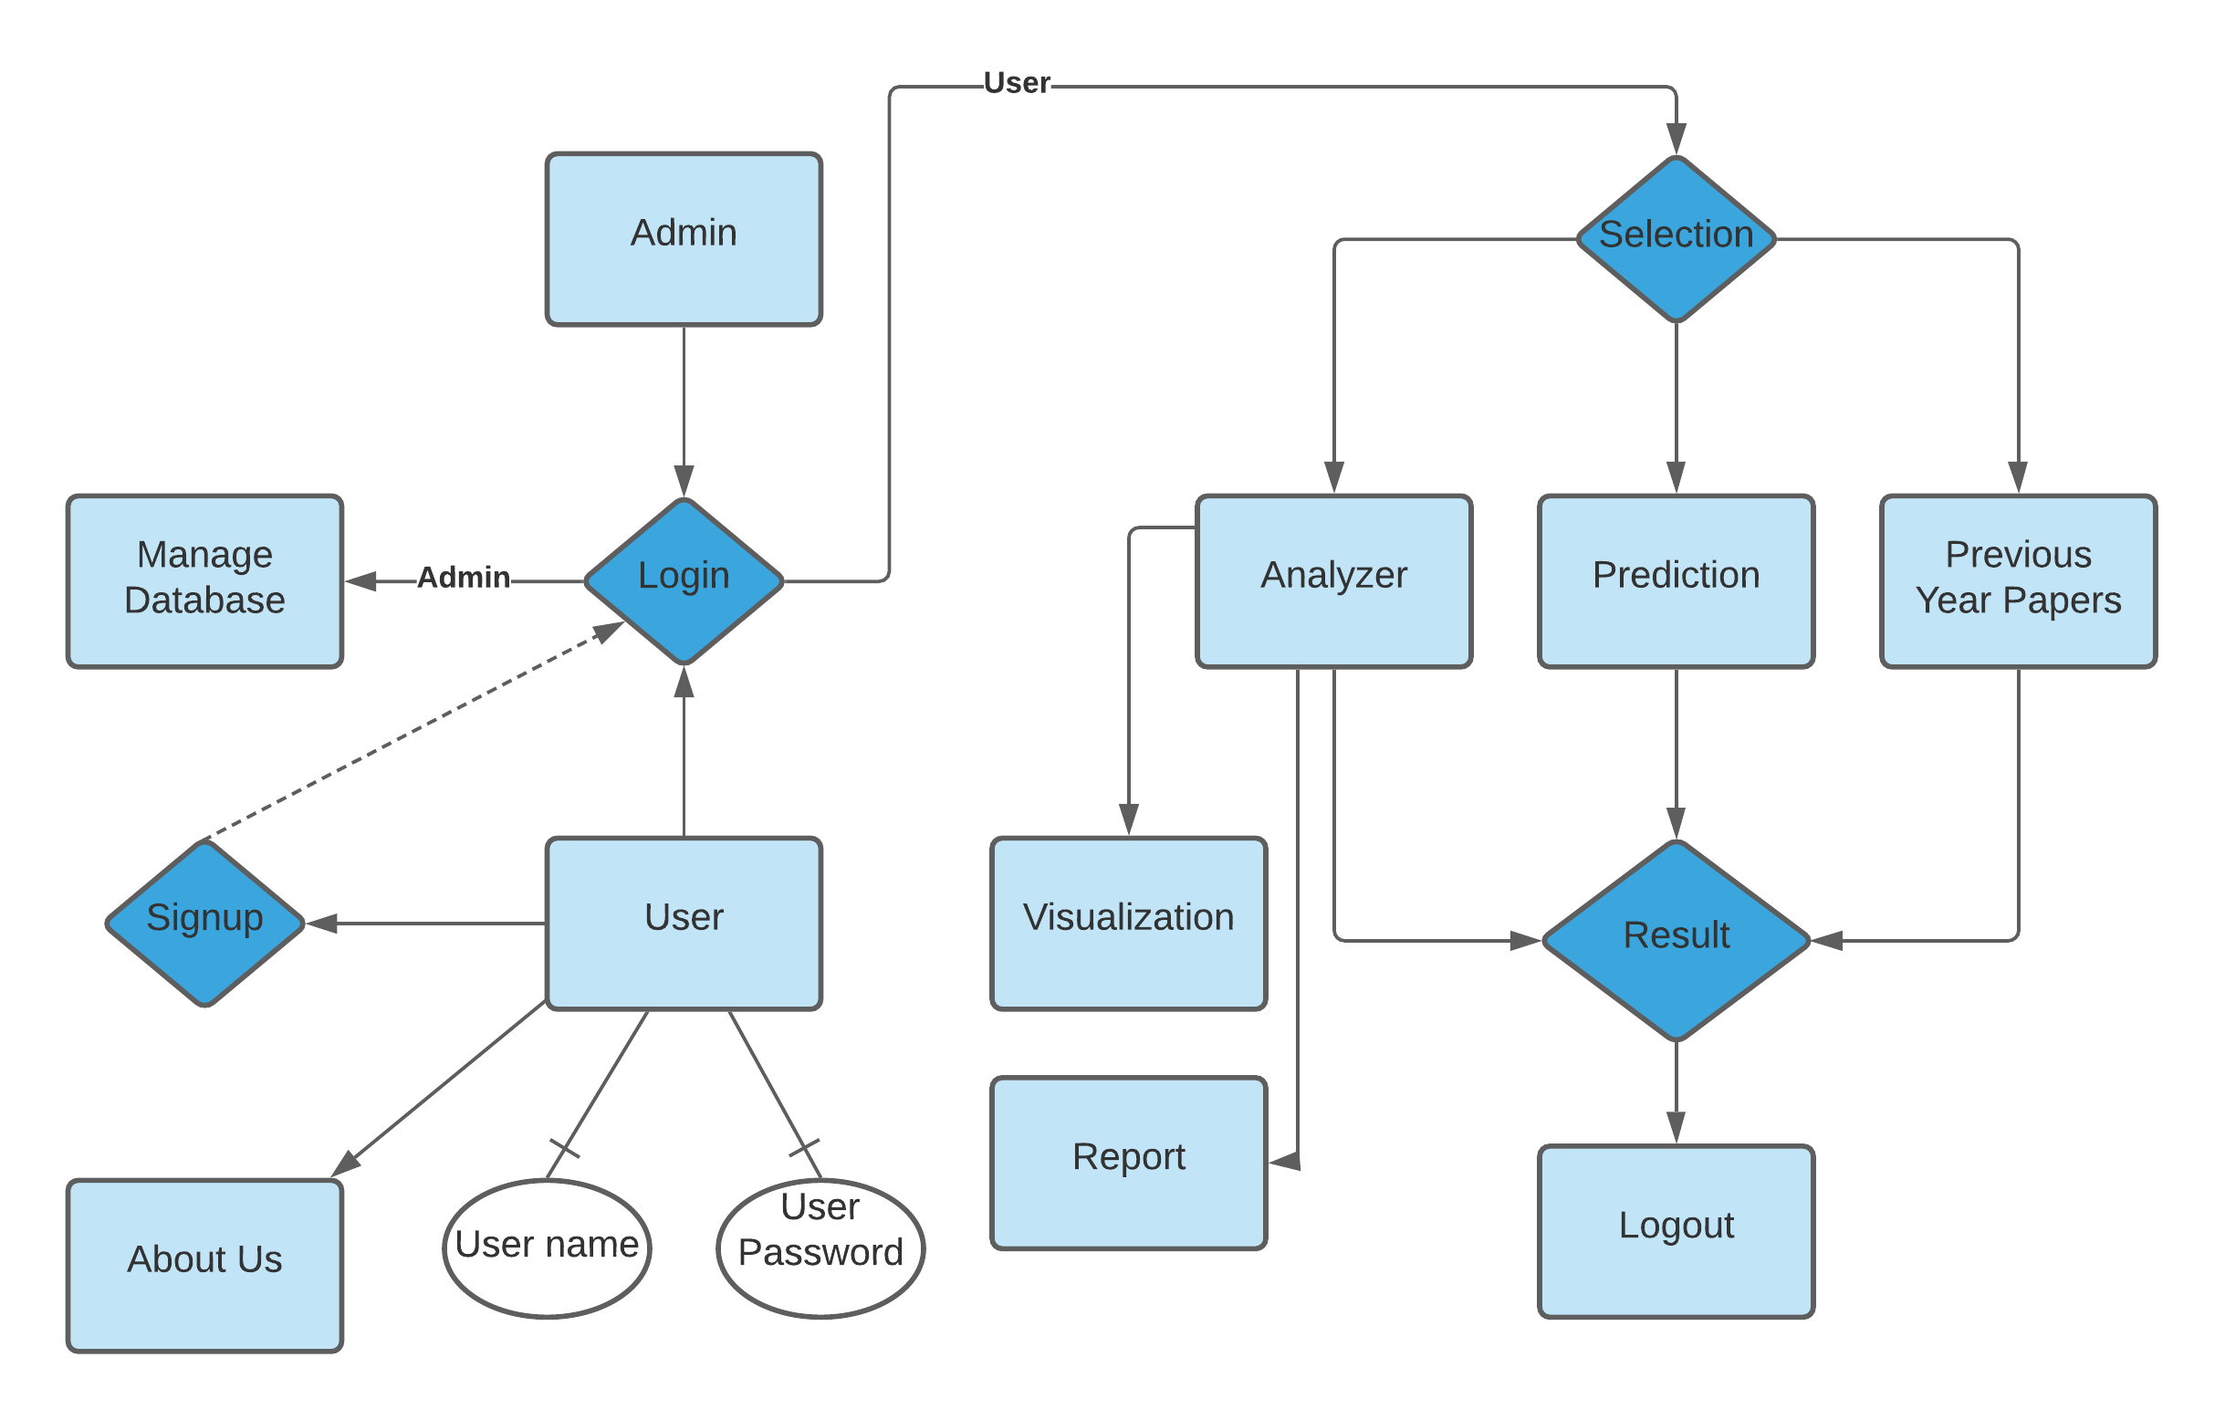
ER Diagram
ER diagram displays the relationships of entity set stored in a database. In other words, we can say that ER diagrams help you to explain the logical structure of databases.

Slide 30
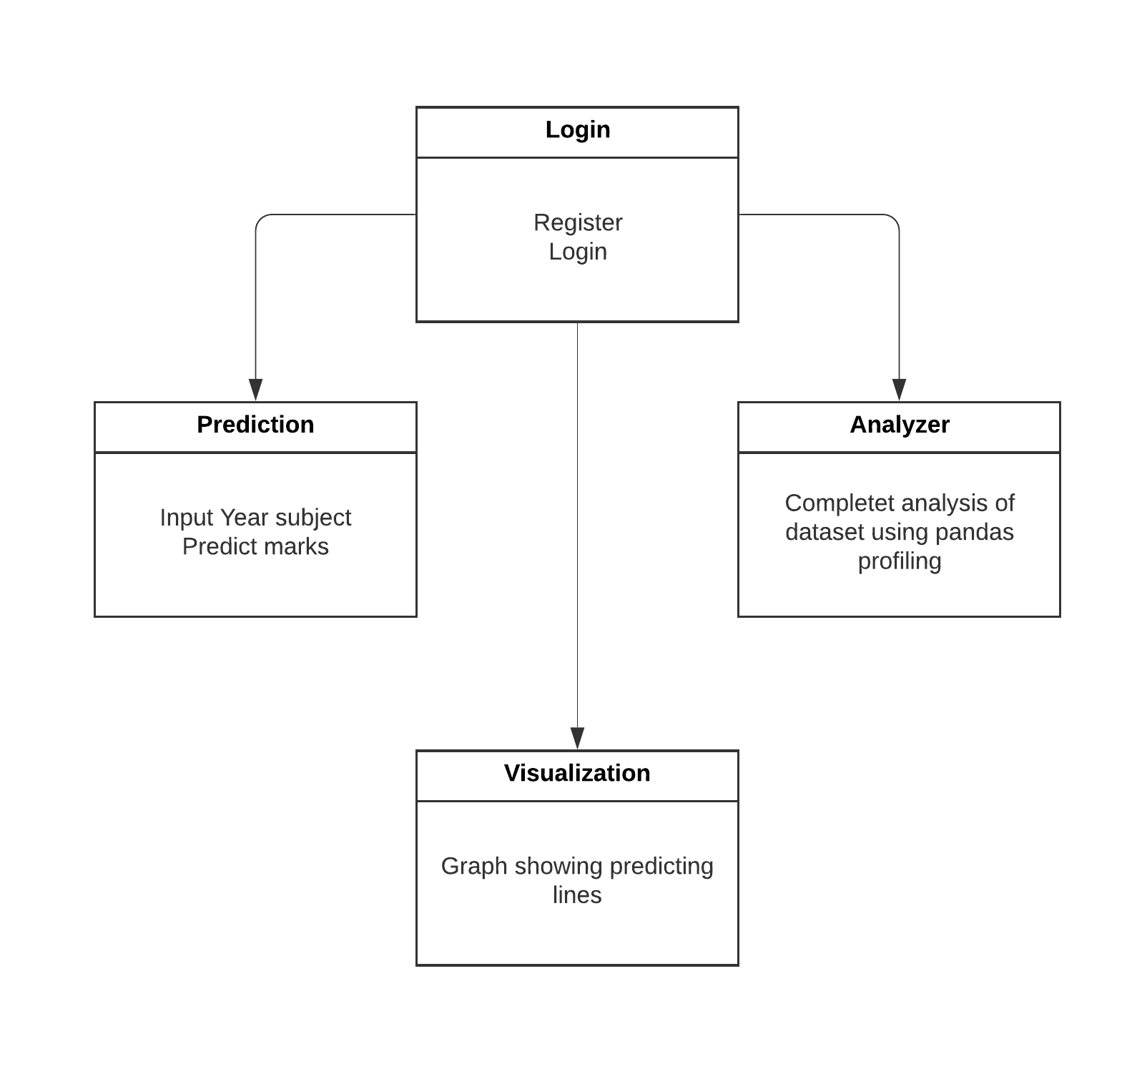
Class Diagram
Class diagram is a static diagram. It represents the static view of an application. Class diagram is not only used for visualizing, describing, and documenting different aspects of a system but also for constructing executable code of the software application.
Class diagram describes the attributes and operations of a class and also the constraints imposed on the system.

Slide 31
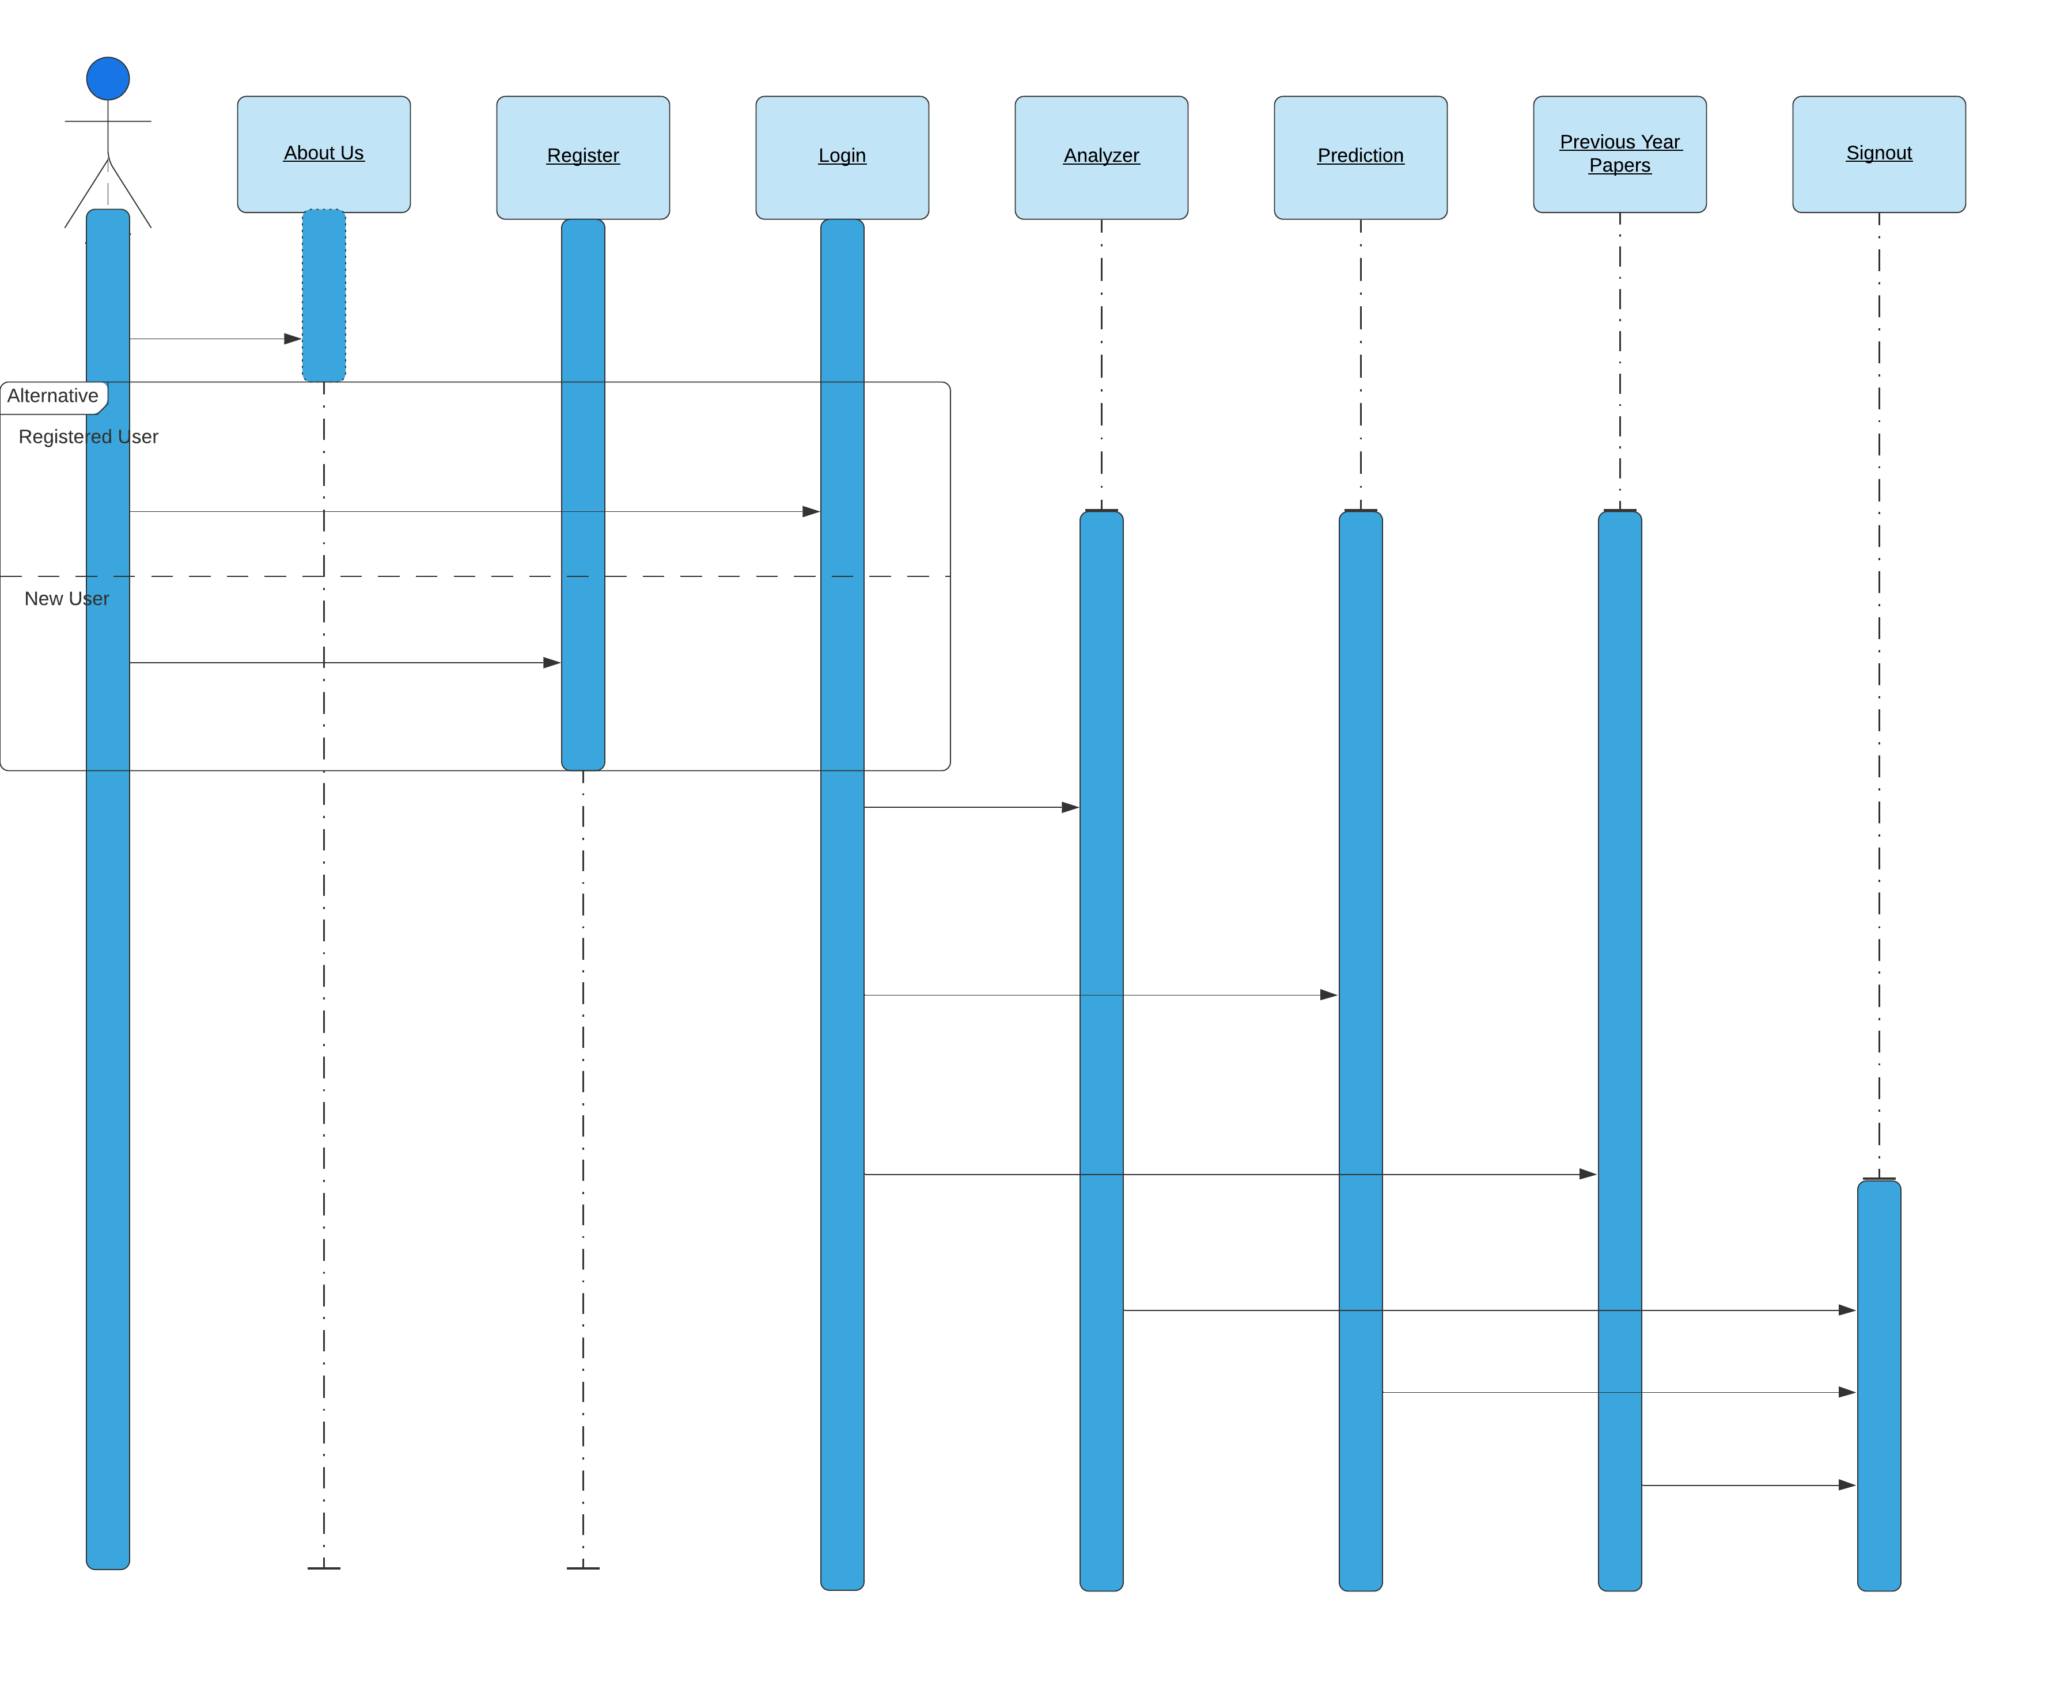
Sequence Diagram
The sequence diagram represents the flow of messages in the system and is also termed as an event diagram.

Slide 32
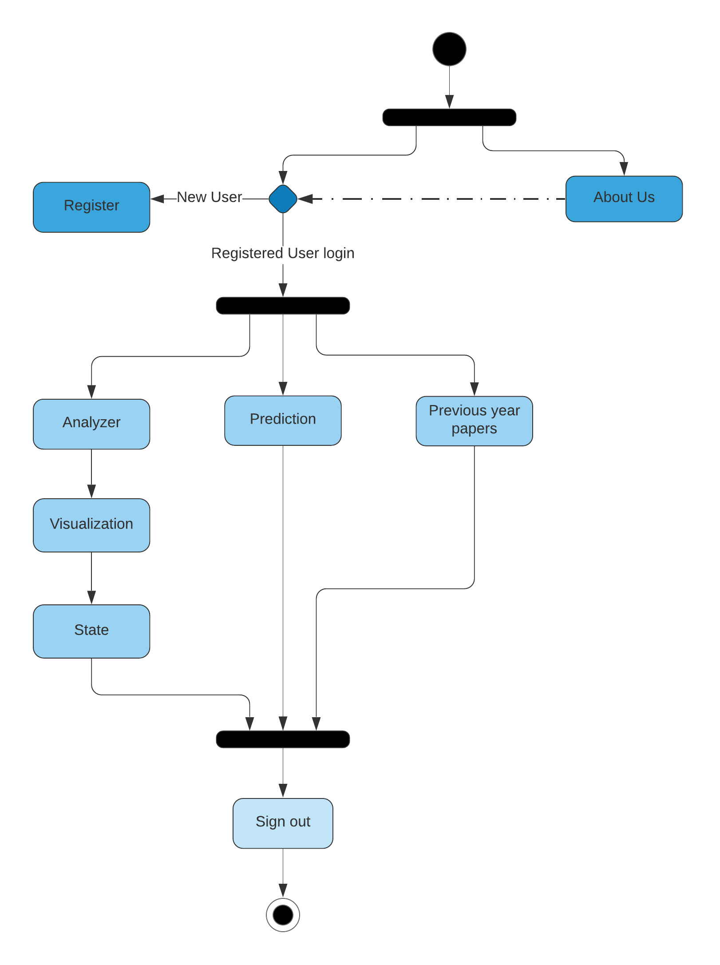
Activity Diagram
Activity diagram is basically a flowchart to represent the flow from one activity to another activity. The activity can be described as an operation of the system.
The control flow is drawn from one operation to another. This flow can be sequential, branched, or concurrent. Activity diagrams deal with all type of flow control by using different elements such as fork, join, etc

Slide 33
Conclusion
Our main idea was to grow the traditional system for exam preparation and bring forward the smart way of preparation rather than the blunt hard work. So with this project we generated a project that not only provides you previous year papers to practice but also gives you the complete analyzed report for previous years for GATE (The Graduate Aptitude Test in Engineering) competitive exam. We also added he feature of prediction for individual subject so that the user can easily get an estimation for the upcoming examination and give the preparation time to the particular subject accordingly.

Slide 34
Limitations of the Project
The drawbacks which are faced by this project currently are:
We have only one type of exam.
The dataset has to be updated manually (as our team generated the whole dataset manually, because there was no dataset available)
The GUI is not extraordinary, as generated by Tkinter which does not provide a lot of features to make it attractive.

Slide 35
Future Enhancement
The scope of improvement lies everywhere, so has this project. The features that can be added in future are as follows:
We can add different exams on the same platform.
Various other subjects can be added, as currently we have 5 subjects as this is the prototype.
The GUI can be made more creative and attractive.
The dataset can be made dynamic.

Slide 36
REFERENCES

Slide 37
Bibliography
www.tutorialspoint.com
www.javatpoint.com
www.geeksforgeeks.org
www.gradeup.co
www.stackoverflow.com
www.github.com
www.gate2016.info
www.gate-exam.in
www.gate.iitd.ac.in
www.gate.iitg.ac.in
www.lucidchart.com

Slide 38
References
[1]Gulden Kaya Uyanik and Nese Guler, "A Study on Multiple Linear Regression Analysis," 2013 4th International Conference on New Horizons in Education, Sakarya University, Turkey 2013.

Slide 39
SNAPSHOTS

Slide 40
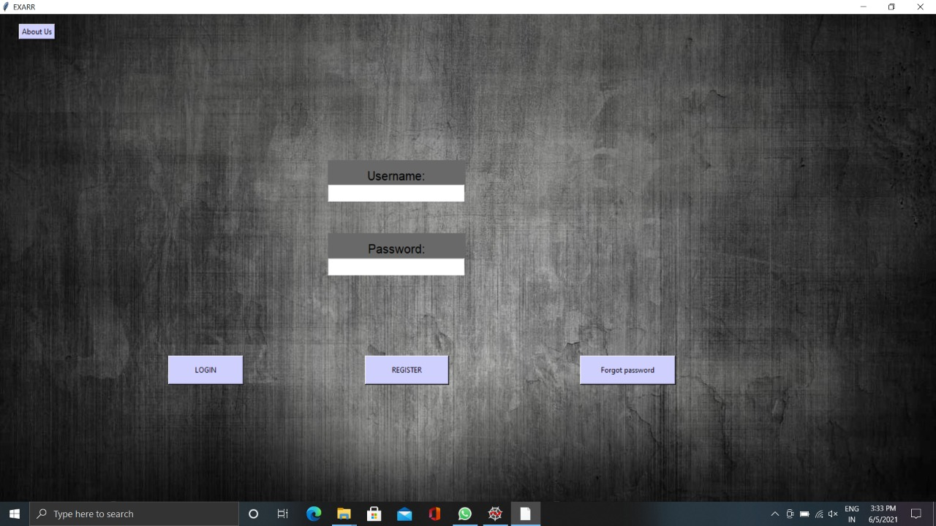
Main Page
This is the front page user will see when the program is run. This page consists the options to “Login”/ “Register” / “Forgot Password” or “About Us”.

Slide 41
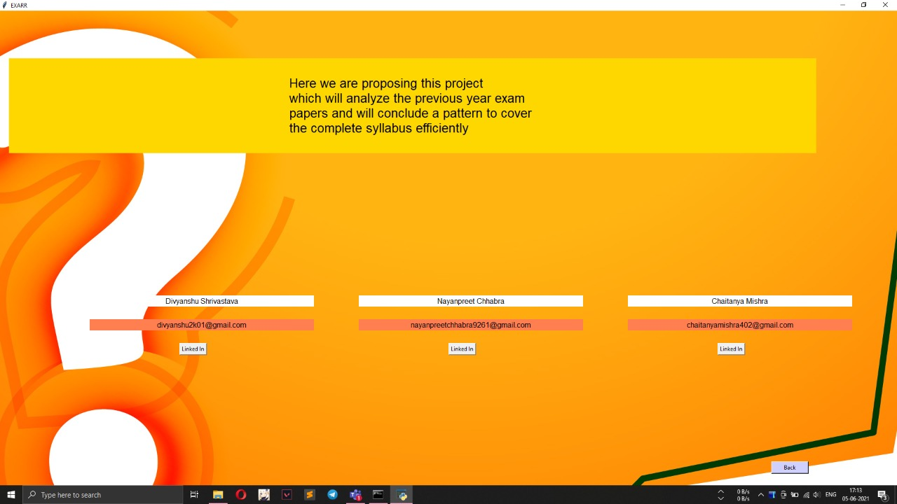
About Us Page
This page consists of the information about this project and the information about the creators with a button that directly directs user to the creator’s LinkedIn page.

Slide 42
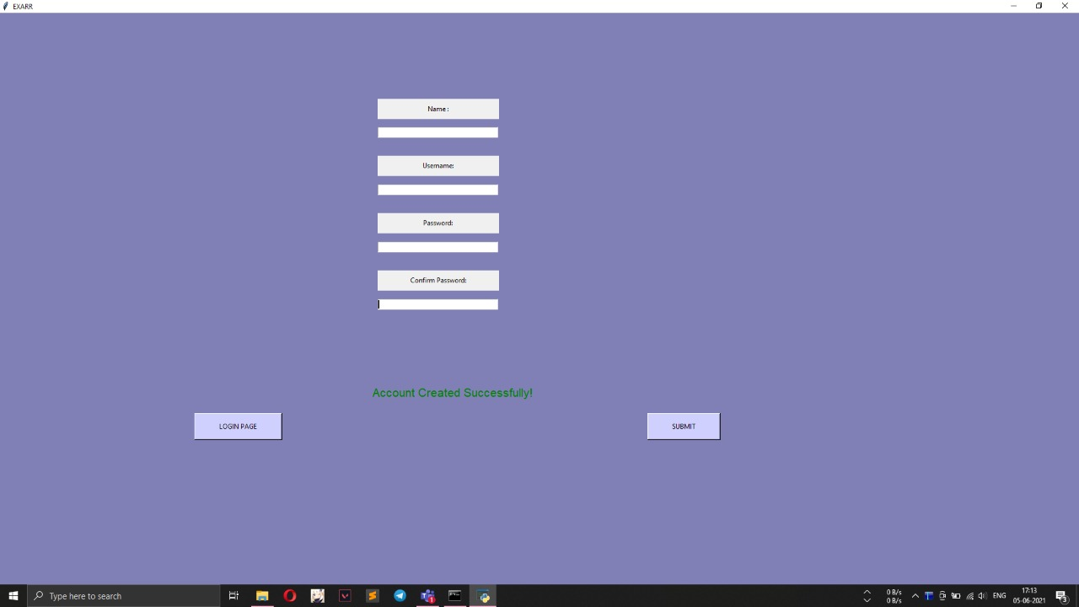
Registration Page
The registration page asks you to enter your name and choose a unique username, also you need to enter your password and confirm it, then submit. After registration you need to go to the login page.

Slide 43

Login Page
To login you need to enter your unique username and password.

Slide 44
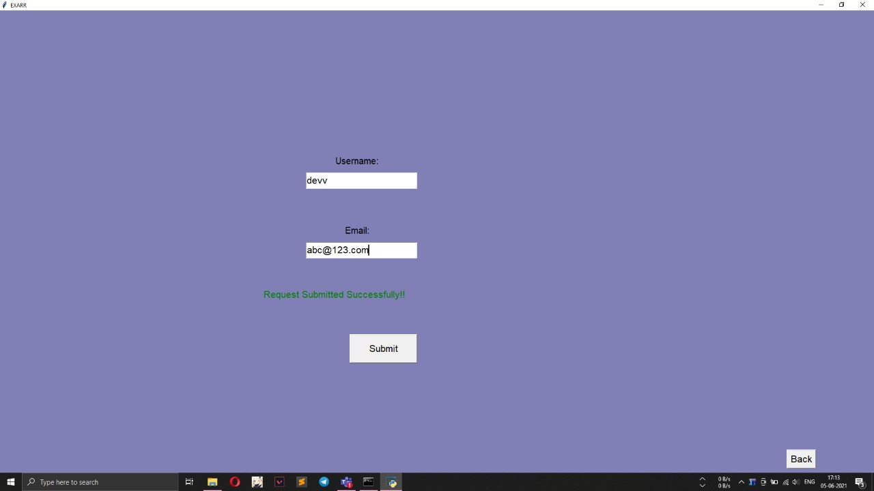
Forgot Password Page
In case the user forgets the password he/she has to enter the username and email then he admin will send you the new password on your mail id.

Slide 45
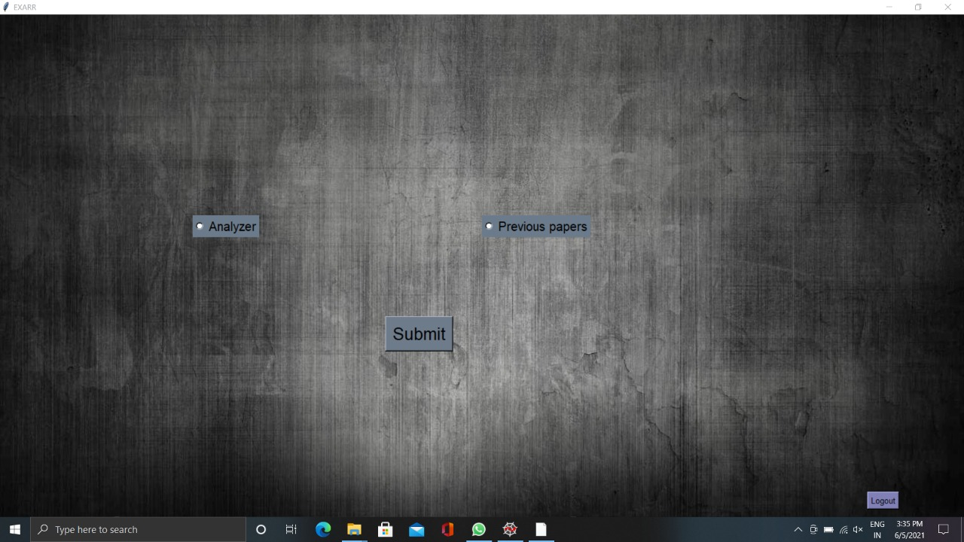
Selection Page
After successful login you need to select the operation you want to perform between “Analyzer” and “Previous papers”.

Slide 46
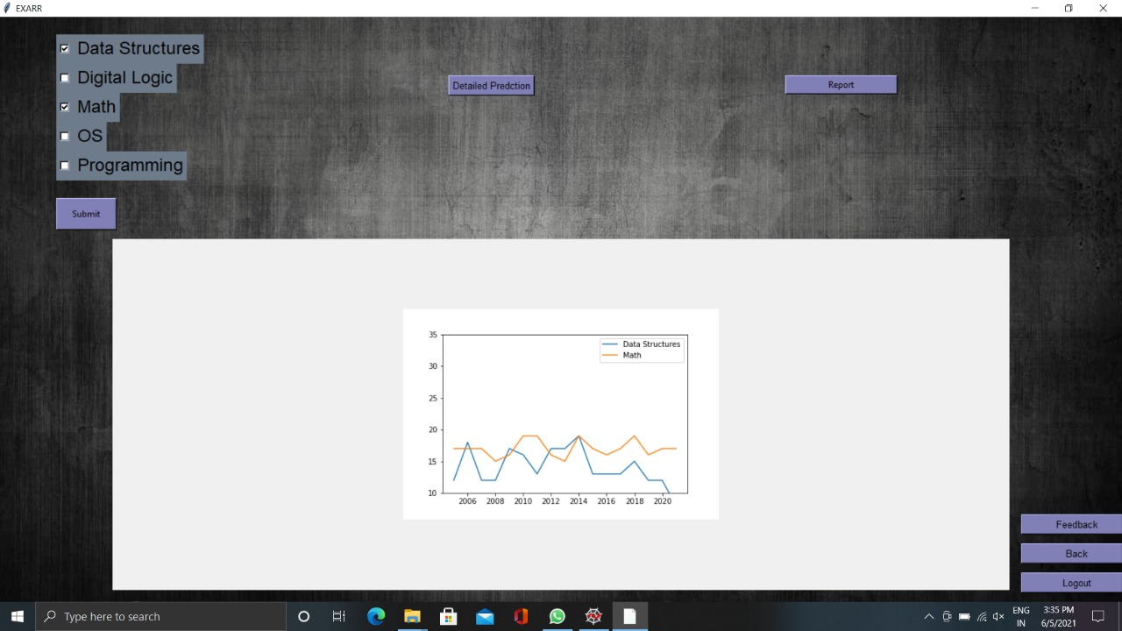
Analyzer Page
This page allows you to select the subjects from multiple checkboxes and then shows you the visualized graph of the years on y axis and marks on the x axis on the same graph.

Slide 47
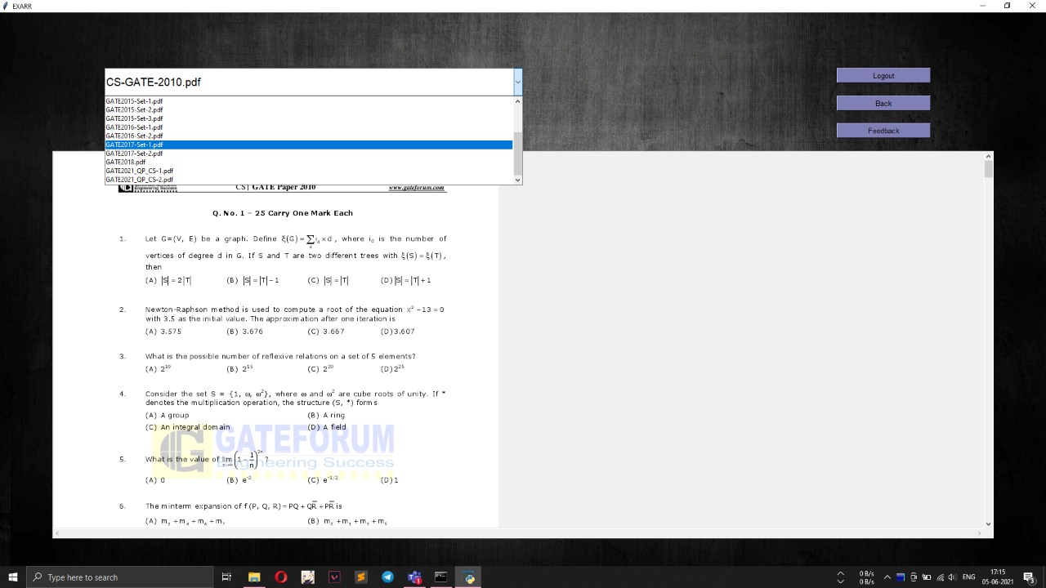
Previous Year Paper Page
This page gives you a scrolling list to select from various previous year papers and display it in the frame below.

Slide 48
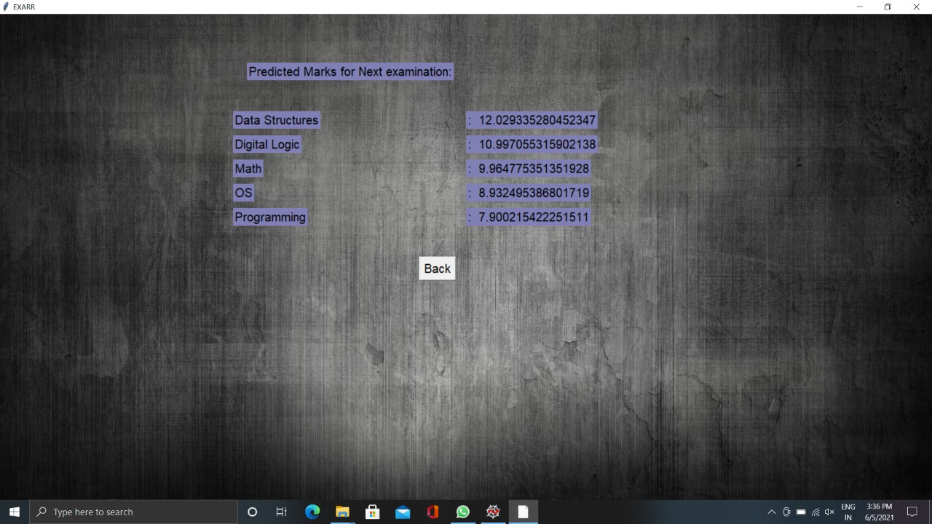
Prediction Page
This particular page displays the subject wise predicted marks for the coming examination.

Slide 49
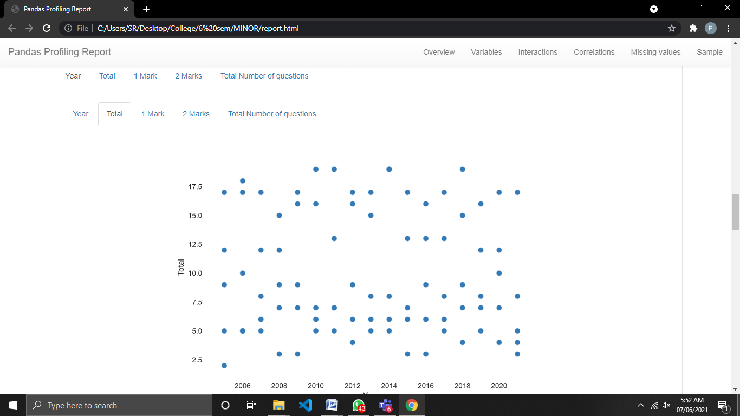
Detailed Report Page
This button redirects us to the html report generated by pandas profiling which gives the detailed description of the dataset with visualization.

Slide 50
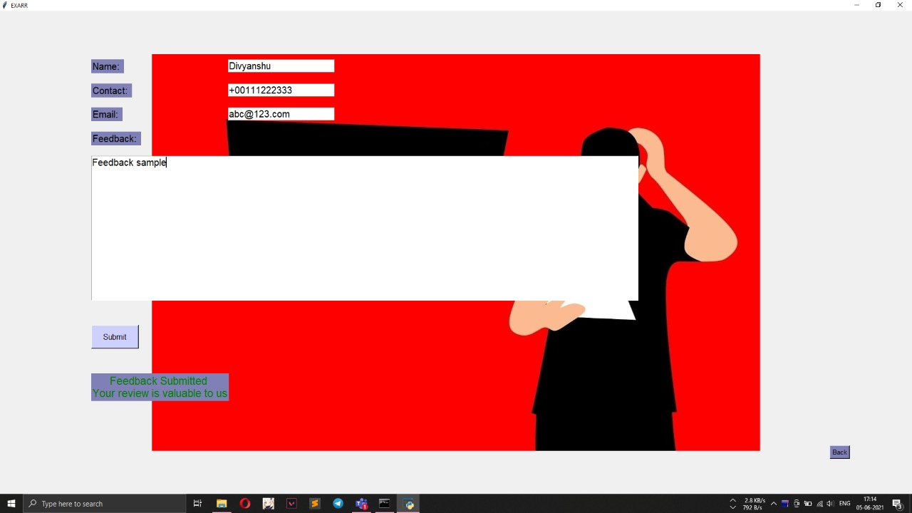
Feedback Page
This page allows the user to give their valuable feedback about the project.

Slide 51


