Slide 1
End Semester Project Project Design Group Members Muhammad Amjad (455527) Muhammad (467684) Class: BE-SE-14B

Slide 2
SECRET AGENT SAGA
GAME CONCEPT:
You are “Agent 47”, a special forces spy on a mission is to reveal secret intel from a notorious organization, neutralize key targets and eliminate the final boss of the organization. You must surpass every trial that comes in your way while staying hidden and return back successfully.

Slide 3
Game Architecture:
Game Loop:
The central control structure that repeats continuously, taking player input, updating game state and displays appropriate ouput accordingly.
User Interface:
The game has been prepared with a user interface in which intially a menu is displayed, and on top player stats and objectives are displayed. A dialog box is also shown in case of a certain scenario which takes input from the user and progresses the game

Slide 4
Real Time Changes:
The spy acting as a character moves in real time upon arrow keystrokes while the guards move infinitely in their bounds. These changes are shown simultaneously.
Input Handling:
User input such as keyboard keys will be used to control the movement of the character and to make game decisions that will influence the progress of the game.

Slide 5
Resource Management:
The user game progress will be saved upon each objective completion. The game may loaded in future and a new game can also be started.
Scene Managment:
Transition Text will be provided in the game upon completion of certain level.
Combat System:
Properly enforced turn-based combat system for the fight with the final boss of the notorious organization. This will include four moves: light attack, heavy attack, block and shoot (based on ammo)

Slide 6
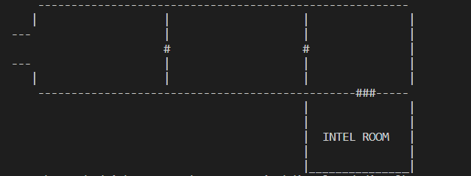
Maps Overview:

Slide 7
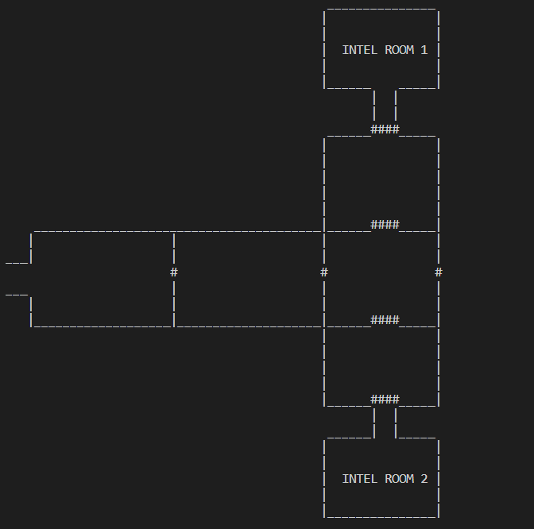

Slide 8
TECHNICAL REQUIREMENTS:
An appropriate IDE is necessary for running the code for example Visual Studio Code.
<stdlib> library to randomly display a code of certain difficulty and in combat with the final boss.
Extensive use of <windows.h> library to display real time cursor movement of spy.

Slide 9
A game loop has been included to keep the game continued.
File handling has been implemented to store the game progress and load it for future
User is guided throughout the game and the input is handled.
Appropriate data structures such as arrays and structs to store user stats, game progress and user choices.

Slide 10
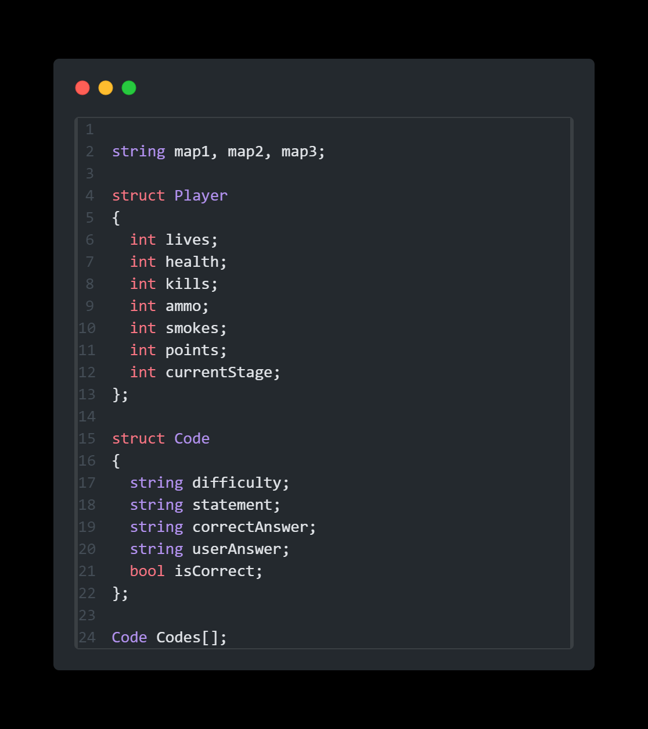
Data Structures:

Slide 11
Algorithms:
Game Initialization.
Create player.
Define equipment, scenarios, and intel rooms.
Set initial player attributes.
Game Loop:
Display current scenario or intel room description.
Display player's equipment and decoded secrets.
Accept and process user input.
Update player and scenario/intel room based on user actions.

Slide 12
Player Movement:
Update X and Y coordinates while keeping the boundaries of the map and collision with the guard in check.
Player Choice:
Display a dialog box for fetching user choice in case of encouterment with guard or being caught by a camera and progress the game accordingly.
Intel Room Interaction:
Allow the player to enter intel rooms.
Generate a code for the player to decode.
Update player's decoded secrets based on the success of decoding.

Slide 13
Character Development:
Award experience points for successfully completing scenarios or decoding intel.
Award ammo points or smokes upon correct choices.
Winning Condition:
Check if the player has revealed the required number of secrets or neutralized the targets based on the stage
Losing Condition:
Check if the player has lost all lives or failed to reveal the required secrets.
Game Over

Slide 14
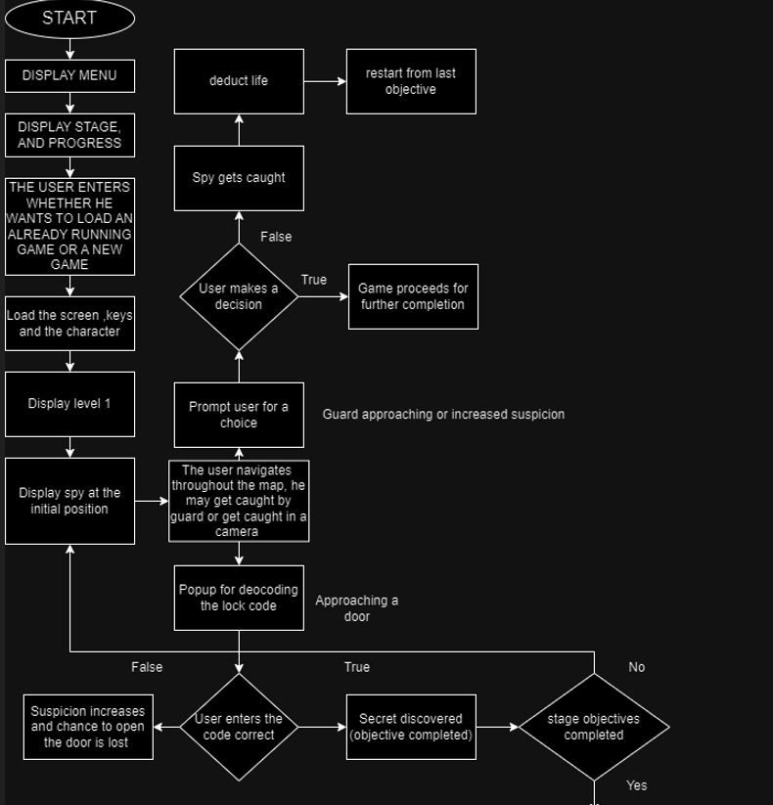
Game Flow:

Slide 15
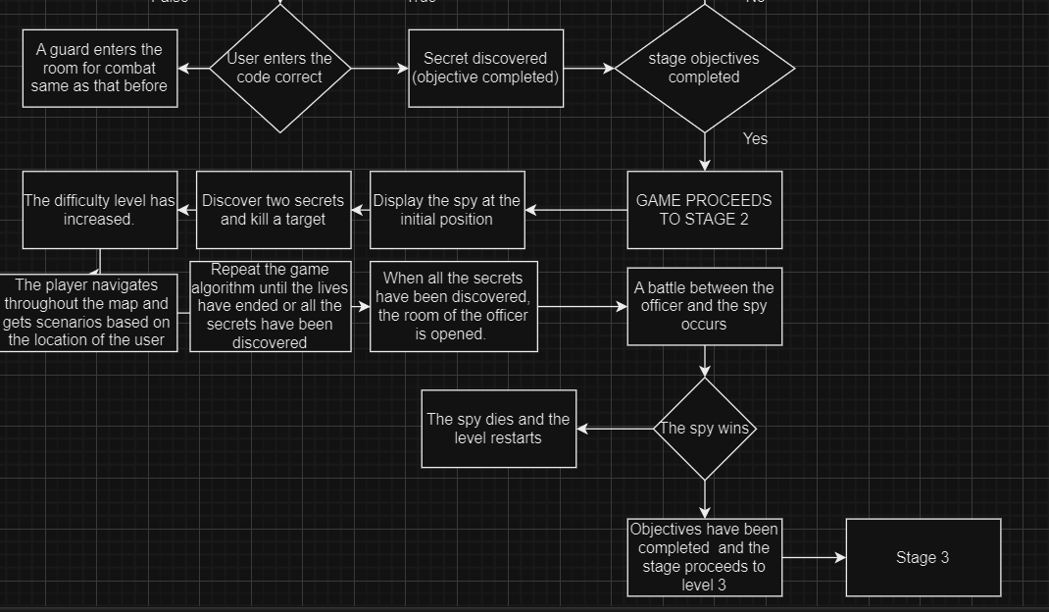

Slide 16
