Slide 1

Performance Comparison of Different Sampling, Smoothing and Path Planning Algorithms for a 2 Link 4 DOF Robotic Manipulator
CS 5335: Robotics Science and Systems
Siddharth Maheshwari
Dev Vaibhav
Notes:
We want to compare algorithms and try to get some insight about the best method for this environment

Slide 2
Report Overview
Problem Statement
Environment/ Simulator
Literature Review
Sampling Algorithms
Uniform Sampling
Gaussian Sampling
Bridge Sampling
Path Planning Algorithms
Dijkstra
Probabilistic Roadmap (PRM)
A*
Rapidly exploring Random Tree (RRT)
RRT*
Path Smoothing/ Interpolation Algorithms
Polynomial Interpolation
Bézier Curve
Cubic Splines
B-Spline
Piecewise Cubic Hermite Interpolating Polynomial (PCHIP)
Results
Conclusion
Concluding remarks
Improvements
Challenges
References

Slide 3
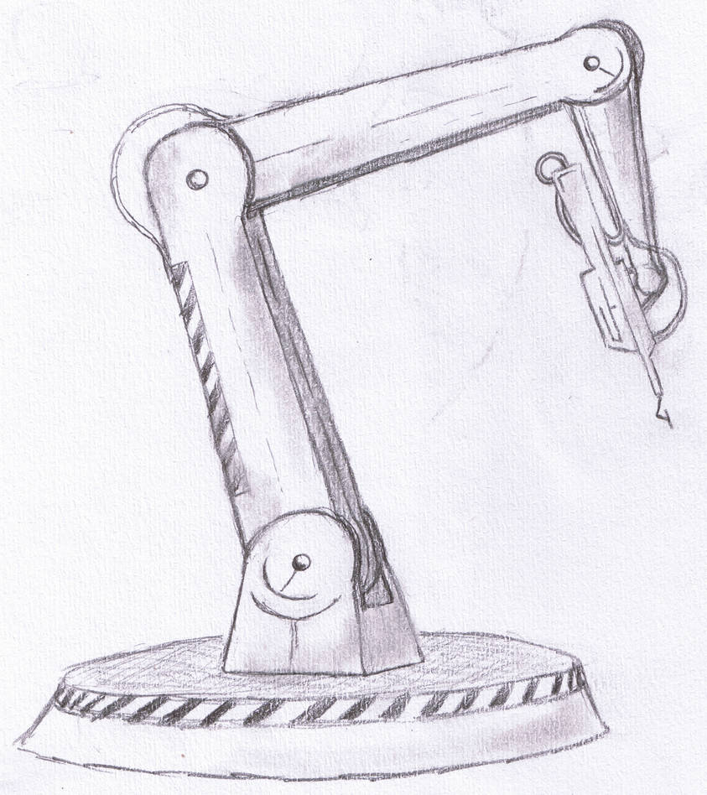
Problem Statement
The aim of this project is to evaluate and compare the performance of different sampling, smoothing, and path planning algorithms to identify the most effective approach for achieving optimal path planning for the 4 DOF robotic manipulator in a 3D environment.
Notes:
Serena

Slide 4
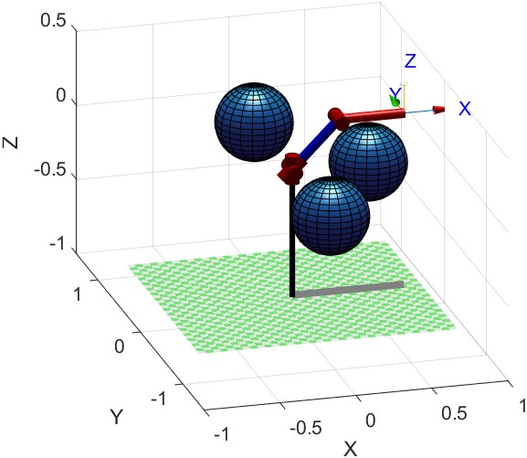
Environment
Software Used: MATLAB
2 Link 4 DOF Robotic Manipulator
Environment from HW3. Obstacle locations changed

Slide 5

Literature Review -
Ravankar A, Ravankar AA, Kobayashi Y, Hoshino Y, Peng CC. Path Smoothing Techniques in Robot Navigation: State-of-the-Art, Current and Future Challenges. Sensors (Basel). 2018 Sep 19;18(9):3170. doi: 10.3390/s18093170. PMID: 30235894; PM- CID: PMC616541
Lecture Notes (Motion Planning)
MATLAB documentation
Notes:
Zhu

Slide 6
Path Planning Algorithm Analysis
Time taken to find 100 samples and calculate the adjacency matrix.
Uniform Sampling: 22.73 sec
Gaussian/ Normal Sampling (Increasing standard deviation results in faster processing): 65.00 sec
Bridge Sampling: 989.46 sec (~ 16.49 mins)
 | Uniform Sampling |  | Gaussian/ Normal Sampling |  | Bridge Sampling
Path Planning Algorithm | Runtime | Path Length | Runtime | Path Length | Runtime | Path Length
PRM | 3.546567 | 3 | 9.434046 | 5 | 10.26381 | 3
RRT | 1.015241 | [22,28] | 7.841516 | [23,29] | CANCELLED
Dijkstra | 0.003367 | 3 | 0.00317 | 3 | 0.004106 | 3
RRT* | 7.192849 | [22,28] | 26.55914 | [21,25] | CANCELLED
A* | 0.002449 | 7 | 0.00256 | 8 | 0.002878 | 6
NOTE: Data captured for 10 iterations for each combination : 5*3*10 = 150 iterations total. For Runtime, mean result is reported.
CANCELLED: Took a lot of time to find samples (waited easily >5 mins)
Takeaway:
Use Bridge/ Gaussian Sampling for offline calculation while Uniform for online
Dijkstra is fast and provides shortest path
A* is fastest but path length is a bit more
RRT is fast but path length is more

Slide 7
Path Smoothing/ Interpolation Algorithms Analysis
Path Smoothing/ Interpolation Algorithm | Run Time | % Points in collision
Linear Interpolation | 0.000178 | 0
Polynomial Interpolation | 0.007155 | 0
Spline | 0.028115 | 0
Bezier Curve | 0.009217 | 45.54
B-Spline | 0.138516 | 0
Piecewise Cubic Hermite Interpolating Polynomial (PCHIP) | 0.008928 | 0
Takeaway: For the path, Linear Interpolation turns out to be the most efficient in terms of run time.
Bezier Curves tends to have ~ 45% of collision with the obstacle after smoothing the path.
Apart from Linear Interpolation we should consider checking for obstacles for all other algorithms as the new path made by them might have some points intersecting with obstacles.
RRT* path from uniform sampling is taken to compare the performance as it was the one which had most zig-zags
Original Path length from RRT* with uniform sampling: 28
Path length after shortening: 4 (It is fed to the interpolation algorithms)

Slide 8
Path Smoothing/ Interpolation Algorithms Comment
Path Smoothing/ Interpolation Algorithm | Comments
Linear Interpolation | Requires at least 2 points
Polynomial Interpolation | Higher degree polynomial required if the waypoints increase and are in a very zig-zag fashion which is computationally more expensive
Spline | Requires at least 4 points Requires more memory and computation time than 'pchip' but the path is C² continuous
Bezier Curve | The curve passes through a convex hull of control points. Hence, does not pass through the waypoints
B-Spline | As seen from the graph, closer to the shortened path but more computationally expensive
Piecewise Cubic Hermite Interpolating Polynomial (PCHIP) | Requires at least 4 points Requires more memory and computation time than 'linear'

Slide 9
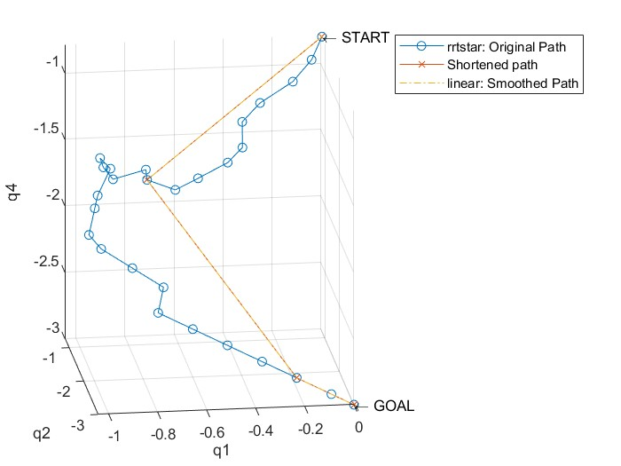
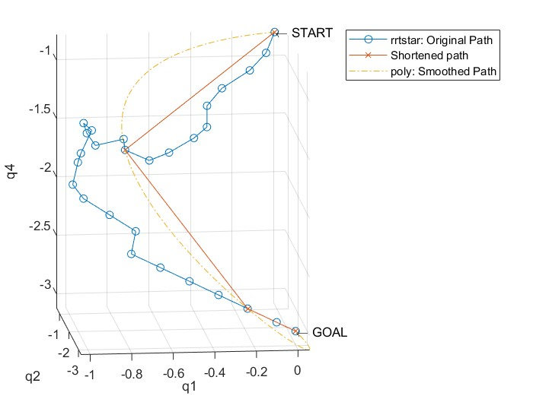
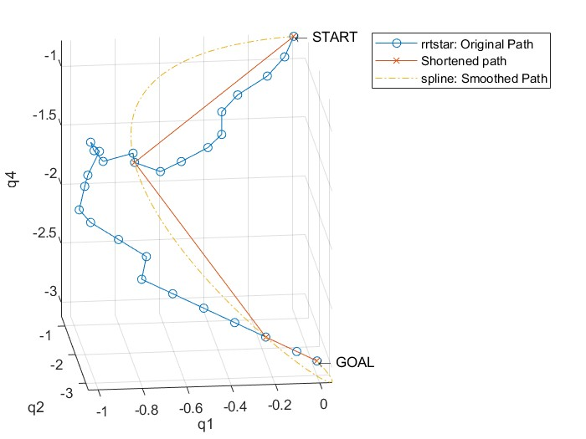
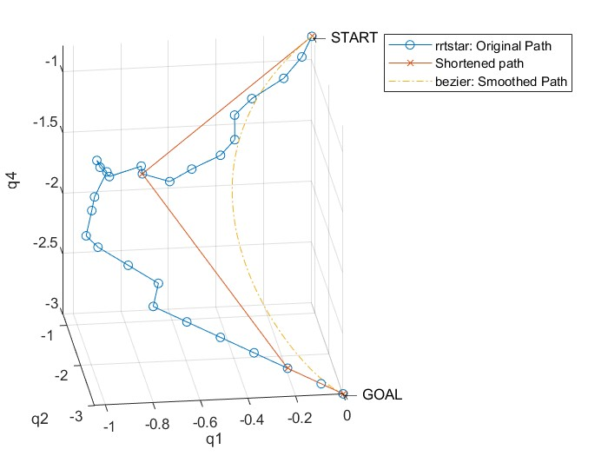
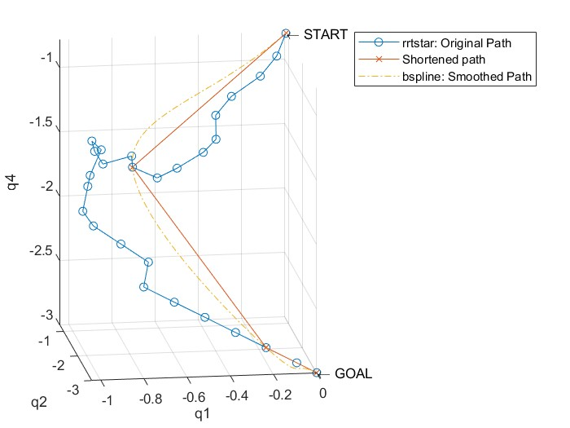
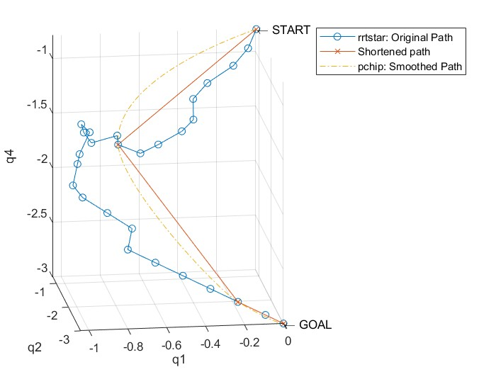
Path Smoothing Results

Slide 10
Conclusion
For this particular (static) environment, for online computation use uniform sampling with Dijkstra or A*.
For Dynamic environment, gaussian or bridge sampling will consume a lot of time. Therefore, we recommend to use uniform sampling with RRT or RRT*.
For path smoothing/ interpolation: Spline produces C² continuous curve, meaning that its first and second derivatives are also continuous. This characteristic guarantees the curve's smoothness and natural-looking shape, which makes it a prime option for path smoothing. But it requires at least 4 points.

Slide 11
Challenges
Future Improvement Areas
RRT* tree was expanding away from the goal because one of the function's argument was overwritten inside the function (duplicate variable name)
Finding functions to do different types of interpolation and if could not find, make one by checking the tutorials.
Trying all combinations which are left
Use much more sophisticated obstacles

Slide 12
Thank You!

