Slide 1

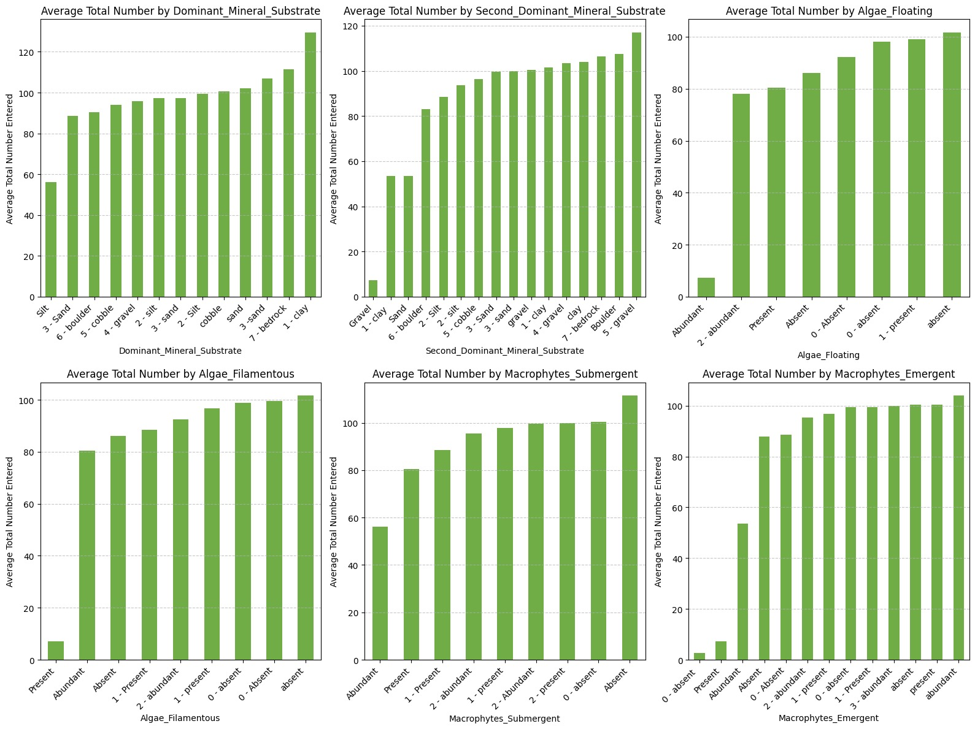
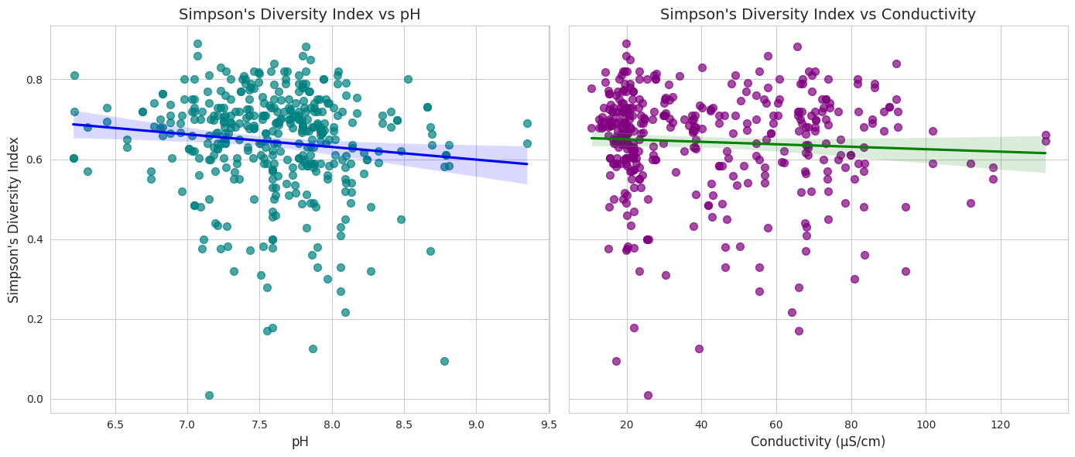
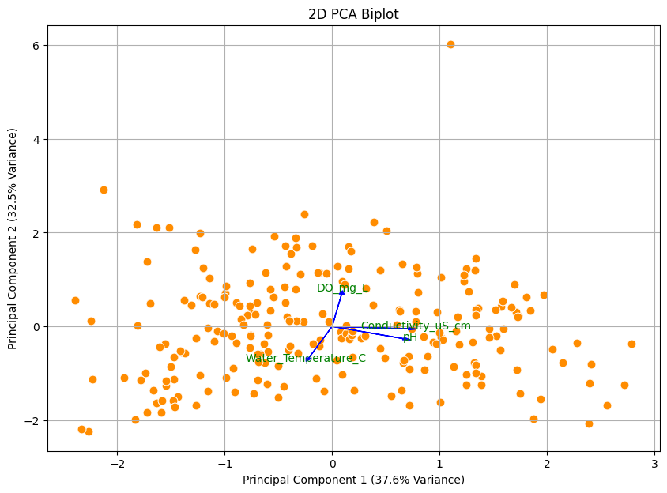
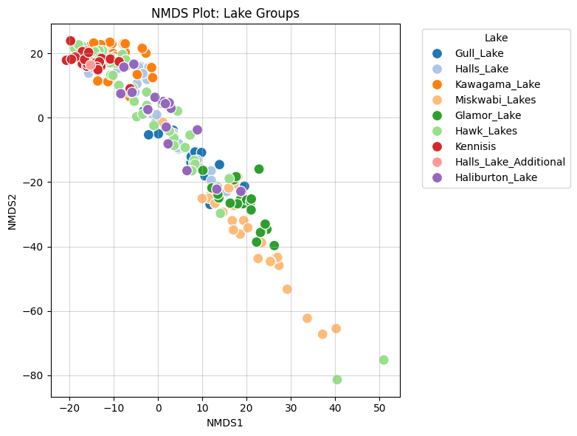
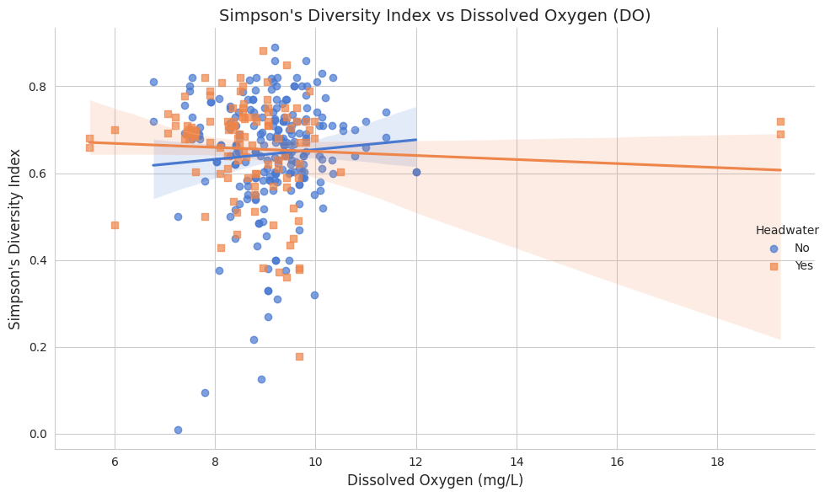
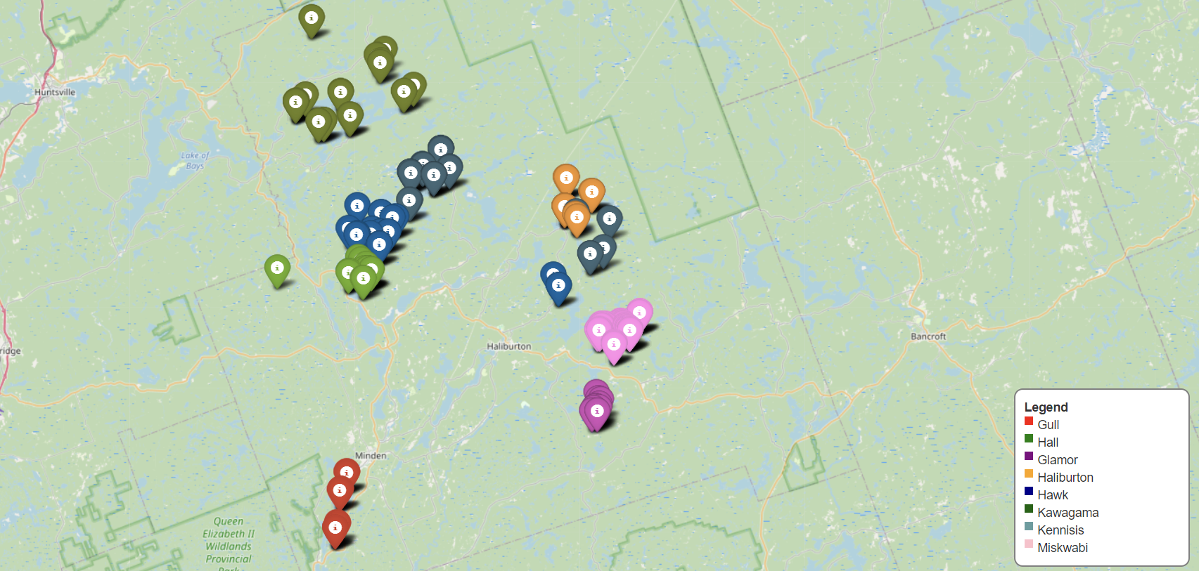
Grp no: 9
Woodlands and Waterways EcoWatch (WWEW)
Investigating Benthic Macroinvertebrate Communities in Haliburton County Lakes
Project Report
Results
Introduction
This study investigates the relationship between benthic macroinvertebrate communities and environmental factors in Haliburton County's freshwater lakes over five years. By analyzing changes in community composition and key environmental drivers, the research aims to support data-driven conservation strategies, enhancing the ecological health and sustainability of local aquatic ecosystems.
Benthic communities thrive in areas with coarser sediments (gravel/sand) and abundant algae or macrophytes, benefiting from better oxygen levels, water movement, and essential resources. Vegetation, including algae and submergent macrophytes, provides crucial habitats and food sources, positively correlating with larger and more diverse benthic populations. These findings highlight the importance of sediment type and vegetation in supporting benthic community size and ecological health.
Left Panel: Simpson's Diversity Index decreases slightly with increasing pH, indicating a weak negative trend. Diversity appears higher near-neutral pH (7.0–7.5), with points widely scattered, showing high variability. . Right Panel: Conductivity shows an even weaker negative trend with diversity, suggesting minimal correlation. Insights: Riparian zone conditions mildly influence diversity, with extreme pH or conductivity reducing species adapted to such conditions. Headwater lakes may exhibit more diversity resilience.
Conclusion
Q1: Riparian vegetation, sediment type, and aquatic plants significantly influence benthic diversity. Forested zones, coarse substrates, and submergent macrophytes support higher diversity, while pH and conductivity show strong positive correlations.
Q2: PCA reveals pH, conductivity, and DO drive benthic patterns.
Q3: PERMANOVA confirms significant lake-specific environmental variation.
Q4: pH is key to diversity, with chemical parameters outweighing lake type effects.
Objective
Investigating relationships between benthic community numbers and environmental factors.
PCA analyses to identify the key environmental drivers of benthic diversity, and should incorporate elevation, water chemistry.
Assess how the benthic diversity varies across different riparian zones, chem conditions, and if these patterns might differ in headwater lakes?
Reference
Bonada, N., Prat, N., Resh, V. H., & Statzner, B. (2005b). DEVELOPMENTS IN AQUATIC INSECT BIOMONITORING, 51(1), 495–523. https://doi.org/10.1146/annurev.ento.51.110104.151124
Larsen, S., Pace, G., & Ormerod, S. J. (2010). Experimental effects and River Research and Applications, 27(2), 257–267. https://doi.org/10.1002/rra.1361
Hering, D., Feld, C. K., Moog, O., & Ofenböck, T. (2006). Cook book for the development of a Multimetric Index for biological condition of aquatic ecosystems. Hydrobiologia, 566(1), 311–324. https://doi.org/10.1007/s10750-006-0087-2
Explained Variance Ratio for each Principal Component:
PC1: 0.38, PC2: 0.32, PC3: 0.18. PC4: 0.12
The first two PCA components (PC1 and PC2) capture ~70% of dataset variation, highlighting key environmental variables like water temperature, pH, dissolved oxygen, and conductivity. Closely aligned variables in the biplot indicate correlations, reflecting shared influences on benthic diversity. PCA simplifies the dataset, focusing on influential factors and visualizing relationships between environmental conditions across lake sites, aiding understanding of their impact on benthic communities..
The analysis highlights benthic macroinvertebrate patterns in Haliburton County lakes. Grouped lakes, like Kennisis and Halls, share ecological traits, while distinct groupings, such as Kawagama and Hawk, indicate unique conditions. Transition zones in Halls and Haliburton suggest gradual shifts, while moderately spaced lakes like Glamor and Miskwabi show partial uniqueness. Clustering reveals ecological similarities, while outliers highlight distinct environments, guiding effective conservation and management strategies.
Non-Headwater Lakes (Blue): A slight positive trend suggests benthic diversity increases with dissolved oxygen (DO), supporting more aerobic species in oxygen-rich environments.
Headwater Lakes (Orange): A slight negative trend shows diversity decreases with rising DO, likely due to stable conditions favoring specific species.
Variability: High scatter, especially at mid-range DO (~8–12 mg/L), indicates other factors influence diversity. Riparian zones and land use significantly affect DO and benthic dynamics as observed in this plot.
Methodology
We employed multivariate techniques, including PCA and PERMANOVA, to analyze relationships between environmental variables and benthic communities. Statistical methods (correlation, regression), visual tools (scatter/box plots, heatmaps), and machine learning (Random Forest) identified key drivers like pH, conductivity, and substrate types. Diversity indices further assessed ecological health and taxa responses across lakes. Also, we used regression analysis and random forest for detailed analysis.
Locations
Teammates: Dakshkumar(0792827), Devkumar(0792519)

