Slide 1
Amazon Sales Data Analysis
BY DEV VORA

Slide 2
Objectives
Total Sales and Total Profit by Region
Yearly Total Sales
Total Sales, Total Profit, Average Profit Margin, and Average Unit Price
Bestseller Item Type
Mode of Channel Generating Maximum Sales
Order Priority with Highest Sales
Number of Units Sold of a Particular Item Type

Slide 3
The Procedure to be followed
Data Collection
Data Cleaning
Data Analysis
Insights
Summary

Slide 4
Data Collection
The Data has been collected in the form CSV file.
The CSV file has the data of sales of products during the span of 2010 - 2017.

Slide 5
Data Cleaning
There were no Null values or blank fields
There were some values in ‘Order Date’ and ‘Ship Date’ having String datatype. So we converted them to datetime.
the values in ‘Total Revenue’, ‘Total Cost’ and ‘Total Profit’ columns are written with two decimal places, so checked that each value in these columns have two decimal places.

Slide 6
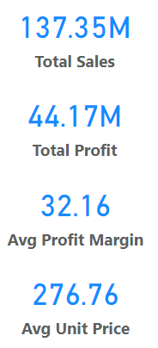
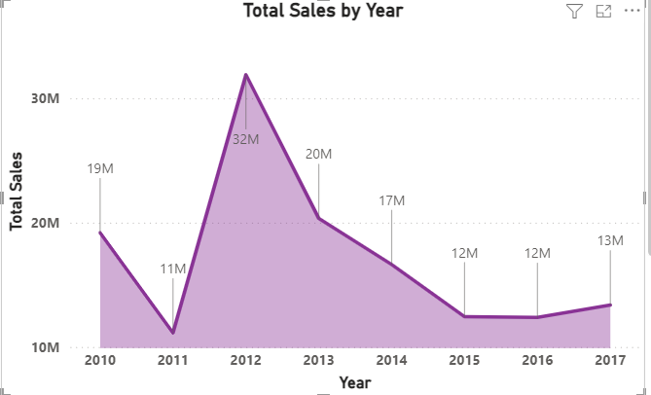
Data Analysis
Total Sales by Year

Slide 7
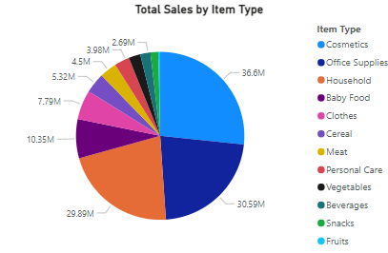
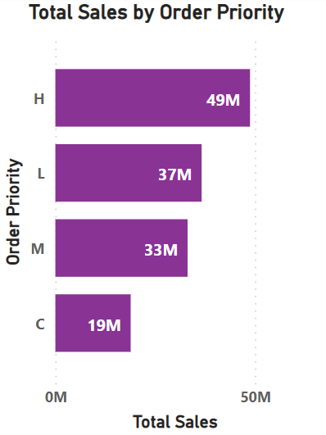
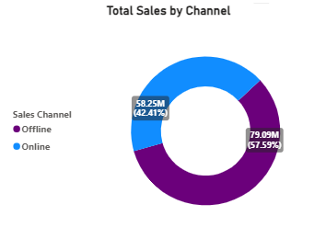






Data Analysis

Slide 8
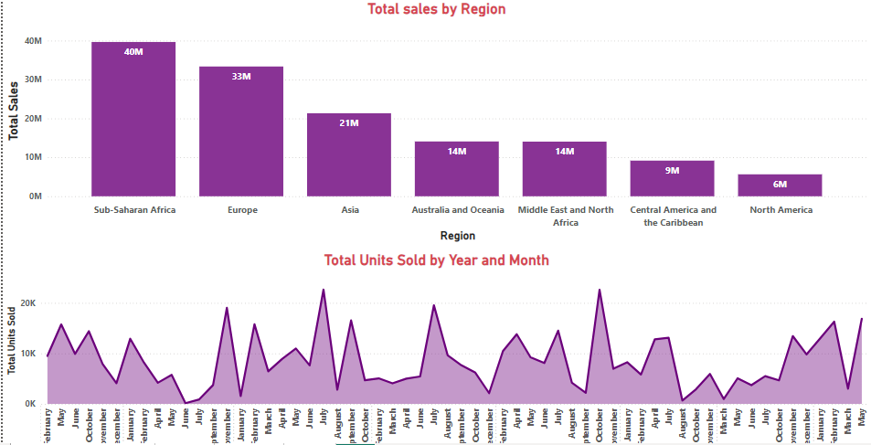
Data Analysis

Slide 9
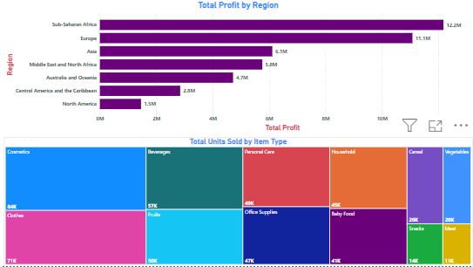
Data Analysis

Slide 10
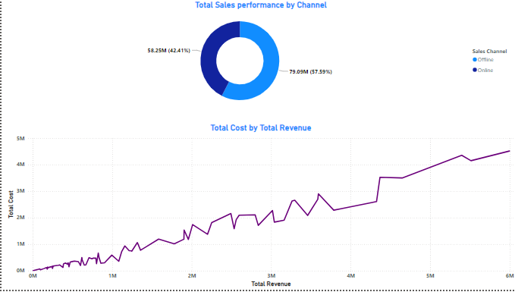
Data Analysis

Slide 11
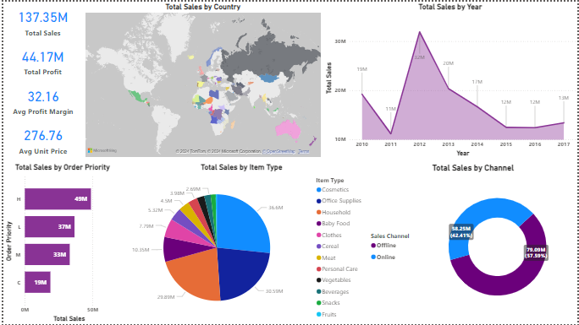
Dashboard (whole)

Slide 12
Insights
The year 2012 has seen the highest sales.
The Sub-Saharan Africa region has seen the highest sales.
"H" order priority gave the highest sales, indicating a demand for fast product delivery.
Majority of people still prefer "Offline Channel" for buying products.
"Cosmetics" products gave the highest sales.
The total sales is $137.35 million out of which total profit is $44.17 million.
The average profit margin and unit price is $32.16 and $276.76 respectively.

Slide 13
Summary
"Cosmetic" products are particularly popular in Europe, generating the highest profit of $14.56 million. It's recommended to focus marketing campaigns on promoting these products further.
Although the total population of North America prefers offline shopping, the majority of profits come from the online channel. Therefore, it's advisable to prioritize online promotion strategies to capitalize on this trend.
Sub-Saharan Africa emerges as the region with the highest profit, primarily driven by the sale of fruits, with approximately 31 thousand units sold. Campaigns should emphasize the health benefits of fruits and align marketing with local preferences.
Following cosmetics, the second most purchased item in Europe is baby food. This suggests a significant portion of the European population consists of newlywed couples. Thus, promoting products related to newborns could effectively target this demographic.

Slide 14
Summary
North America Region has generated the least profit by selling only Personal Care and Household Items through Offline Channel. It's advisable to promote products other than both these item types through the Online Channel by offering discounts. Conduct surveys to understand local preferences better.
"Fruits" have generated the least profit of all item types, totaling only $120.50 thousand. It's recommended to analyze customer needs, adjust prices, and tailor offerings to local preferences.
Household Items and Cosmetic Products are sold the most through Offline and Online Channels respectively. To capitalize on this trend, enhance physical stores with attractive displays and promotions for Household Items. Additionally, run targeted ads and improve website usability for Cosmetic products.
Meat is the least sold item type with 11 thousand units sold in Australia and Oceania and Sub-Saharan Africa Region using only the Online Channel. Consider diversifying meat product offerings and adjusting prices to stimulate sales.

Slide 15
Thank you

