Slide 1
NES Disassembler
Presented by
Devin Wingfield
Company Name
Quarter Month
Year

Slide 2
Content
1
Parser
2
Mapper
3
Output Creation
4
Advanced Features
Company Name
Quarter Month
Year

Slide 3
Parser
The Parser includes parsing the header, PRG ROM, and CHR ROM then storing them for later use.

Slide 4
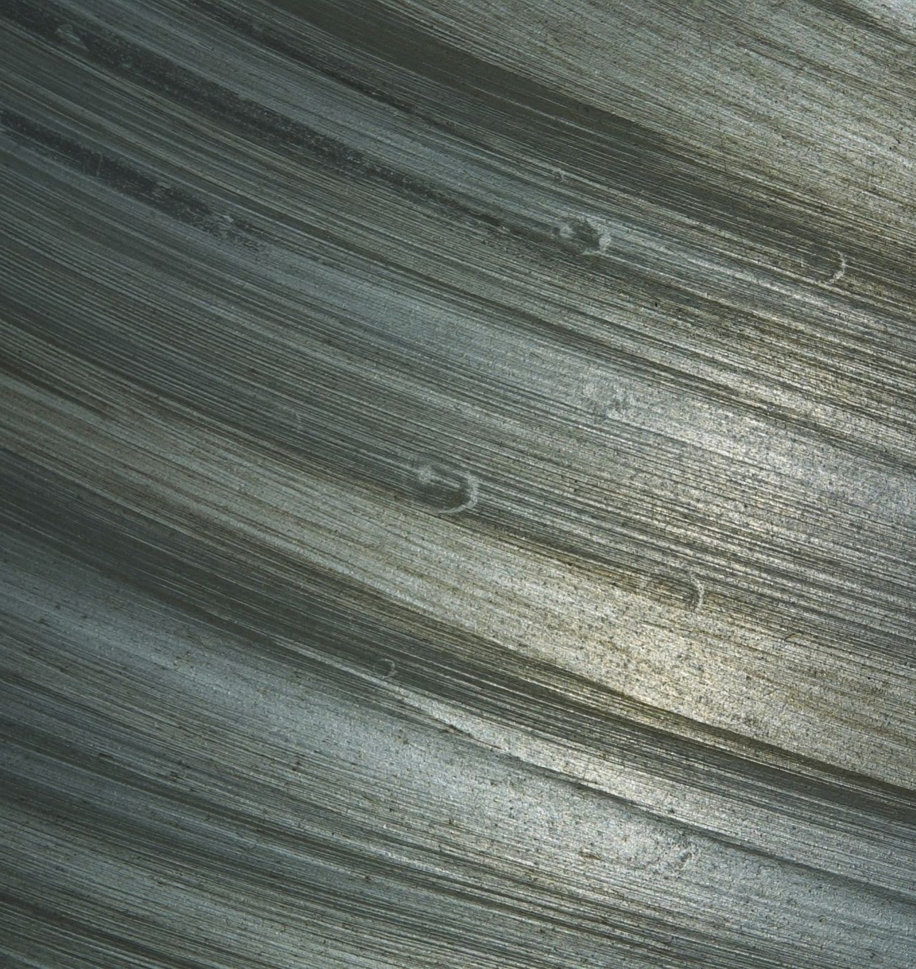
Parser: Learning the File Format
Challenges
In order to parse a file, you must know the format of it. Did not know where to find this format
Inexperience with parsing files + interacting with low
level elements
Creating new and unique techniques to find solutions to problems

Slide 5
Parser: Solutions
1
2
Inexperience dealing with ines files
Inexperience parsing files + low level opcodes
For simple file structure, most solutions could be found on the ines wiki dev
For complex parsing, structs and new code had to be made.
While a simple process, I needed to search how to correctly parse an iNES file. Taking a lot of time with experimenting and finding a good method
First time with interacting with opcodes, but learned they could be abstracted from me (for now).

Slide 6
Parser: Solutions
Header Struct:
typedef struct {
char *file_type; // 3 chars + MS-DOS EOF
uint8_t prg_rom_bytes, // rom chunks
chr_rom_bytes;
uint8_t *flags, // flags for mapper and others
*buffer; // buffer between header and
prg-rom
} header ;
3
Creating New Techniques
Reasoning: structs were needed to save read opcodes and later give meaning to them
Cartridge Struct:
typedef struct {
header *headers ; // Allow for later use
char *PRG_ROM, *CHR_ROM; // Save parsed data
int8_t mapper, mirror; // easier access to
Frequently used data
} cartridge ;

Slide 7
Mapper
Mapper includes how memory is read and whether bank switching is implemented based on specified mapper

Slide 8
Mapper: What is it???
Challenges
Difficult implementation
  How do I implement CPU address ranges?
  How can I make it scalable?

Slide 9
Mapper: Solutions
CPU Emulation:
The main code (disassembler.c) would use virtual address ranges starting from 0x8000, but in the mapper, use the physical address.
E.g. If disassembler.c called for 0xA013, the mapper would look for physical address 0x2013
1
Difficult Implementation
The difficulty was trying to implement how to read from the cpu address ranges even though I am not interacting with the cpu in that way.
Scalability was also a problem. How can I create a single interface in a non-OOP language.
Mapper Struct:
I learned you could create typedef function structs e.g. (typedef int (*func_name)(int, char *) )
Allowing me to create any mapper func I wanted as long as it followed that structure

Slide 10
Output Generation
Output generation includes creating the assembly file and tiles.

Slide 11
Output Generation
Challenges
Creating correct assembly output
How to organize the output

Slide 12
Output Generation: Solutions
Assembly Commands:
Created an array of all valid opcodes (yes it was tedious)
Allows me to point to null if not a valid command and point to the corresponding command if it is valid
1
Correct assembly output
How do I get the assembly commands
How do I verify they’re valid “gracefully”
How do I deal with the uniqueness of 256 commands?
Valid Opcodes:
Since non-valid opcodes had null values in my opcode array, I just had to check if the resulting value was null in my main code.

Slide 13
Output Generation: Solutions
Unique Commands:
Commands have 4 unique values.
  The actual command
  Their address mode
  The size of the command
The only way to uniquely identify these three is through a new struct that holds each of these values.
typedef struct {
const char *mnemonic, *comment;
addr_mode_t mode;
uint8_t size;
} opcode_entry;
1
Correct assembly output
How do I get the assembly commands
How do I verify they’re valid “gracefully”
How do I deal with the uniqueness of 256 commands?
[0x01] =
{"ORA", "OR Memory with Accumulator", INDEXED_INDIRECT, 3}

Slide 14
Output Generation: Solutions
PRG ROM Organization:
As a simple solution, each output file follows some format with the unique attribute being the name of the disassembled file.
CHR ROM Organization:
Since there are some many tiles, they have their own directory to be stored following the naming convention tiles_<filename>
Each file is given an id based on the order it was created (e.g. tile_0001.jpeg)
Both:
All generated files go into the “output_files/” directory as to not clutter the home directory
2
Organizing Output
If one tile has 8x8 pixels = 64 pixels then there are 16 bytes per pixel
If the minimum size of CHR ROM is 8KB that means there is a minimum of 512 tiles for a file

Slide 15
Advanced Features
This includes the main points not required in the core components of the project.

Slide 16
Output Generation
Challenges
HTML output implementation
Call Graph implementation

Slide 17
Advanced Features: Solutions
First Iteration:
At first I tried inserting tags at a manually counted index
  Pros: simple to implement
  Cons: did not solve edge cases
Second Iteration:
Find the index of ‘$’ and insert tag there
  Pros: used first iterations code
  Cons: used more processing power
1
HTML file generation
How to correctly insert anchor tags into already created strings

Slide 18
Advanced Features: Solutions
Finding start of Subroutine
No indicators when an SR starts
Only way to know where an SR is by the commands that call it
Creating Call Graph:
How deep do I make the graph?
  Anything more than a single layer may cause a loop
  Rudimentary but solves many edge cases
How to convey the call graph since it can’t be too in-depth
  Simple: this SR calls this SR
  E.g.
Subroutine at $8F97 calls:
$5B85
2
Call Graph Implementation
How do I know when a subroutine starts?
How can I create a call graph?

Slide 19
Thank you
Company Name
Quarter Month
Year

