Slide 1
Dev
[WEEKENDS]
Dev Weekends
Summer Fellowship 2025
Kick-Off
Zeeshan Adil
Qurban ali

Slide 2

What is Dev Weekends
Dev Weekends is a community-driven initiative.
Provides a platform for learning.
It encourages collaboration among developers.
Offers resources and opportunities to expand knowledge.
Designed to foster growth and collaboration.
Sharing knowledge and building projects together.
Aims to create a supportive environment for learning.
Facilitates teamwork and idea exchange among participants.

Slide 3
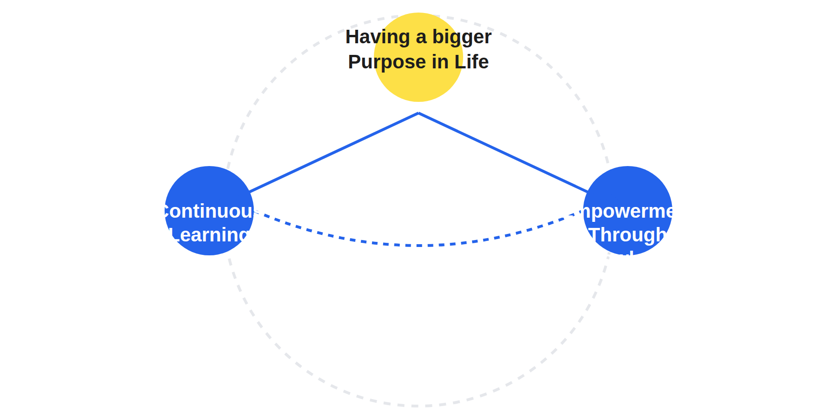
Our Ideology
Having a bigger Purpose in Life
Fostering a community where sharing ideas and resources is prioritized over rivalry.
Continuous Learning
Encouraging a culture where every member seeks to expand their knowledge and skills.
Empowerment Through Knowledge Sharing
Creating opportunities for individuals to share insights and experiences to uplift the community.

Slide 4


Purpose & Plan of the Fellowship
Real-world experience
Mentorship opportunities
Skill development
Participants gain hands-on experience in the tech industry, preparing them for future careers.
Access to industry professionals who provide guidance and support throughout the fellowship.
Fellows will enhance their technical skills, making them more competitive in the job market.

Slide 5
Plan for the Summer
Engage in workshops focused on key technologies.
Learn about the latest technologies that are shaping the industry.
Participate in mentorship sessions.
Gain insights and guidance from experienced professionals in your field.
Collaborate on team projects with real clients.
Apply your skills in practical scenarios and work with actual clients to build real-world solutions.

Slide 6
How to Plan your 4 years
Tech
SDDC, Open Source
EGA
IELTS, Leadership, Hacker Cup
Theory
Encourages individuals from diverse backgrounds to pursue careers in technology.

Slide 7
Developer vs Engineer Mindset
Developer: Focused on coding and building solutions.
Engineer: Emphasizes design and architecture of systems.
Developers are primarily concerned with the practical aspects of creating software and applications.
Engineers take a broader view, focusing on how different components fit together to create a cohesive system.

Slide 8


A Day at Dev Weekends & your journey with Mentors
Hands-on Coding Sessions
Engage in practical coding exercises that enhance your skills.
Collaboration on Projects
Work alongside peers to develop innovative projects.
Networking Opportunities
Connect with mentors and fellow participants for future opportunities.

Slide 9

Reflection and Talks
15-Minute Reflection Time - Write Your Thoughts
Take a moment to introspect and jot down your feelings about the fellowship experience.
Mindset Talk
Engage in discussions that foster a growth mindset among participants.
Tech Love Talk
Share your passion for technology and its impact on our lives.
Spiritual Time Talk
Explore spiritual aspects and connect with your inner self during this session.

Slide 10
Dev
[WEEKENDS]
Let's Build Something
Together
Saturday, 29 Nov | Online 6:05PM SLT | 13:35PM CST

