Slide 1
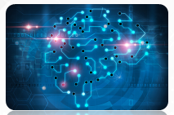
Artificial Intelligence
A Presentation by: Aryan Vala

Slide 2
OUTLINE
Introduction to Artificial Intelligence
Application of AI
History of AI
Application Domains of AI

Slide 3
Introduction to AI

Slide 4
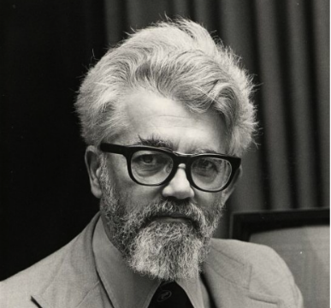
What is Artificial Intelligence (AI)?
AI is the science and engineering of making intelligent machines, especially intelligent computer programs (1956).
John McCarthy
(the father of Artificial Intelligence)
AI is a branch of computer science dealing with the simulation of intelligent behavior in computers.
AI is the study of how to make computers do things which, at the moment, people do better.
AI is, the study and design of intelligent agents where an intelligent agent is a system that perceives its environment and takes actions.

Slide 5
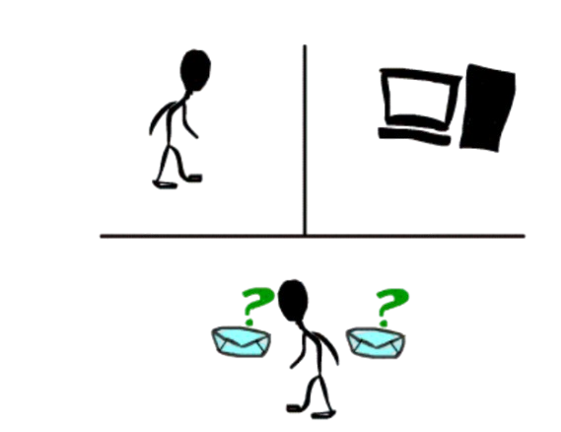
Turing Test
Acting Humanly: The Turing Test proposed by Alan Turing (1950)
A Turing Test is a method of inquiry for determining whether or not a computer is capable of thinking like a human being.
The interrogator job is to try and figure out which one is human and which one is computer by asking questions to both of them.
The computer would try to remain indistinguishable from human as much as possible

Slide 6
AI Techniques
There are three important AI techniques:
Search –
Provides a way of solving problems for which no direct approach is available.
It also provides a framework into which any direct techniques that are available can be embedded.
Use of knowledge –
Provides a way of solving complex problems by exploiting the structure of the objects that are involved.
Abstraction –
Provides a way of separating important features and variations from many unimportant ones that would otherwise overwhelm any process.

Slide 7
Task Domains of AI
Mundane tasks | Formal tasks | Expert tasks
Perception Computer Vision Speech, Voice | Games Go Chess (Deep Blue) Ckeckers | Engineering Design Fault Finding Manufacturing Monitoring
Natural Language Processing Understanding Language Generation Language Translation | Mathematics Geometry Logic Integration and Differentiation | Scientific Analysis
Common Sense Reasoning | Theorem Proving | Financial Analysis
Planning |  | Medical Diagnosis
Robot Control

Slide 8
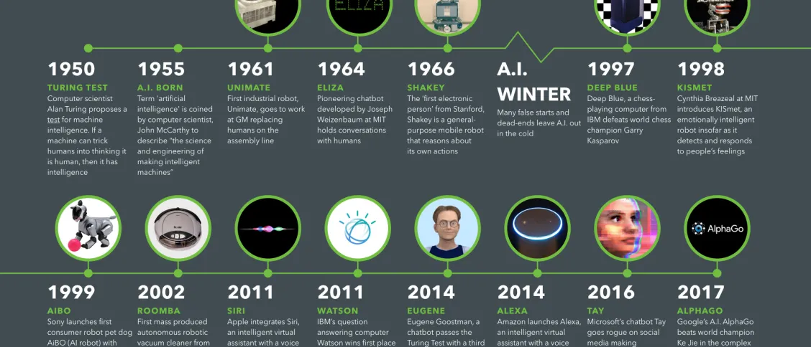
History of AI

Slide 9
Application Domains of AI

Slide 10
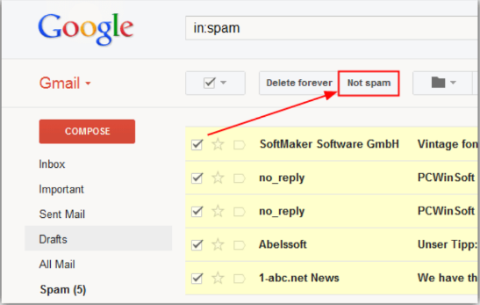
Natural Language Processing
Email Spam Filter in Gmail
Neural Network

Slide 11
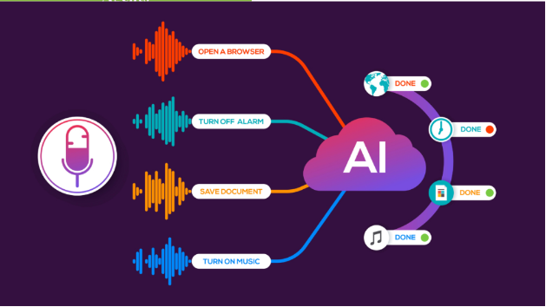
Speech Recognition
Voice Technology in Virtual Agents
Deep Learning

Slide 12

Expert System
IBM Watson
Reinforcement Learning

Slide 13
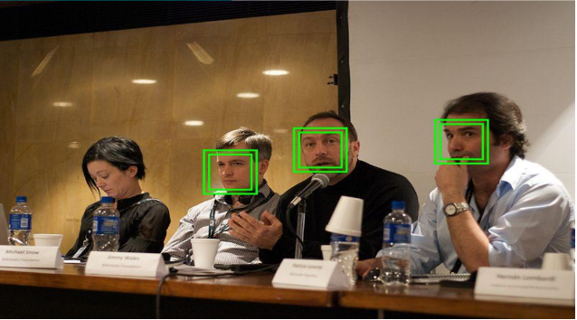
Image Processing
Face Detection in Camera
Deep Learning

Slide 14
AI – ML – DL and Data Science
Technique that enables
machines to mimic human behavior
AI
Subset of AI which uses
statistical methods to enable machine to learn and improve with time
Machine
Learning
Data
Science
Subset of ML that includes algorithms and enables system to train itself
Deep
Learning

Slide 15
Analyzation of result

Slide 16
AI
Data Science
Business Intelligence
AI Hierarchy
Data pipeline
Data storage

Slide 17
NAME | Python | PHP | OS | Averge
Aryan | 29 | 22 | 25 | 25.33
Dhrumil | 23 | 27 | 21 | 23.66
Prashil | 29 | 28 | 22 | 26.33

Slide 18
THANK-YOU!

