Slide 1
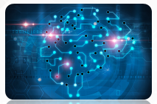
Artificial Intelligence
A Presentation by: Aryan Vala

Slide 2
OUTLINE
Introduction to Artificial Intelligence
Application of AI

Slide 3
Introduction to AI

Slide 4
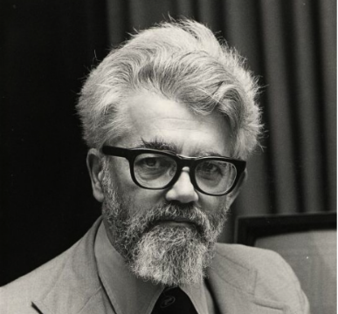
What is Artificial Intelligence (AI)?
AI is the science and engineering of making intelligent machines, especially intelligent computer programs (1956).
John McCarthy
(the father of Artificial Intelligence)
AI is a branch of computer science dealing with the simulation of intelligent behavior in computers.
AI is the study of how to make computers do things which, at the moment, people do better.
AI is, the study and design of intelligent agents where an intelligent agent is a system that perceives its environment and takes actions.

Slide 5
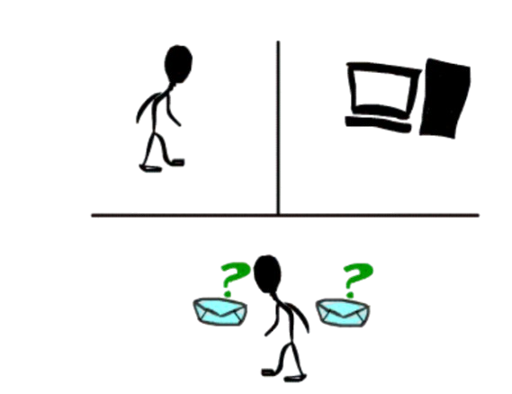
Turing Test
Acting Humanly: The Turing Test proposed by Alan Turing (1950)
A Turing Test is a method of inquiry for determining whether or not a computer is capable of thinking like a human being.
The interrogator job is to try and figure out which one is human and which one is computer by asking questions to both of them.
The computer would try to remain indistinguishable from human as much as possible

Slide 6
AI Techniques
There are three important AI techniques:
Search –
Provides a way of solving problems for which no direct approach is available.
It also provides a framework into which any direct techniques that are available can be embedded.
Use of knowledge –
Provides a way of solving complex problems by exploiting the structure of the objects that are involved.
Abstraction –
Provides a way of separating important features and variations from many unimportant ones that would otherwise overwhelm any process.

