Slide 1
PROLOGUE
목표 : 모범이 되는 좋은 논문의 학습 -> 학위논문작성에 도움
검색 : 구글 학술검색 (https://scholar.google.co.kr)
배재 대학교 전자도서관 학술 DB (http://library.pcu.ac.kr)
(Full Text Finder 제공 서비스 학술정보의 원문 및 초록, SCI(SSCI) 등재여부)
검색어 : Machine Learning , SVM 등
랩실에서의 추천

Slide 2


Distributed Denial of Service (DDoS) Attacks
Detection Using Machine Learning
13th International Conference on Distributed Computing and Artificial Intelligence (DCAI'16) - Seville (Spain), June, 2016
관련자료 : https://github.com/devwithu
원문, 소스코드
Machine Learning의 실제적용
- DDoS Detection
- Machine Learning and Feature Selection
for Videogame Beta Testing

Slide 3
Abstract
The Distributed Denial of Service (DDoS) attacks affect the availability
of Web services for an indeterminate period of time, flooding the company’s servers
with fraudulent requests and denying requests from legitimate users, generating
economic losses by unavailable rendered services. Therefore, the aim of this paper is
to show the process of detection prototype DDoS attacks using a supervised learning
model by Support Vector Machines (SVM), which captures network traffic, filters
HTTP headers, normalizes the data on the basis of the operational variables: rate of
false positives, rate of false negatives, rate of classification and then sends the information to corresponding SVM’s training and testing sets. The results show that
the proposed DDoS SVM prototype has high detection accuracy (99 %) decrease
of the false positives and false negatives rates compared to conventional detection
models
26年 11月 8日

Slide 4
Introduction
DDoS attacks are a critical issue, ex) North Korea internet communications offline
DDoS 의 방식에 대한 요약, infected machines(zombies), botnets, SYN Flood, Smurf attacks
therefore it’s necessary
the development of new techniques and prototypes to detect attacks ~.
Machine learning using
SVM have been used with great success in the field of information security and
pattern recognition research in different processes of classification, prediction and
regression.
The paper describes: The contextual
reference and some relevant work in section 2. The Section 3 shows the proposed
model of the development and application of machine learning prototype. In section 4
some results are evident and in the end, finally in Section 5 the conclusions are
presented.
북한 인터넷 다운에 대한 뉴욕타임즈의 기사
http://www.nytimes.com/2014/12/23/world/asia/attack-is-suspected-as-north-korean-internet-collapses.html?_r=0
26年 11月 8日

Slide 5
Context and Recent Literature
배경 , 최근 학문
Since 1998 and 1999, DARPA has collected and distributed the first standard
dataset for evaluation of intrusion detection systems for computer networks.
intrusion detection systems (IDS):
- Rules: set of rules is applied to compare traffic patterns,
a rules engine based on XML
- Neural Networks: Artificial neural networks (ANN),
Support Vector Machine
(SVM) is a technique based on machine learning, where data is classified by
determining a group of support vectors and characteristics to be quantified are described.
- hybrid system
* DARPA (Defense Advanced Research Projects Agency)은 미국 국방성의 연구, 개발 부문을 담당하고 있으며 인터넷의 원형인 ARPANET을 개발한 것으로 잘 알려져 있다. 최초의 이름은 ARPA 또는 ARP (Advanced Research Projects Agency)에서 개칭되었다.
* Artificial neural networks (ANN) are inspired by the behavior
of neurons in the biological world, seeking to emulate in technology.
26年 11月 8日

Slide 6
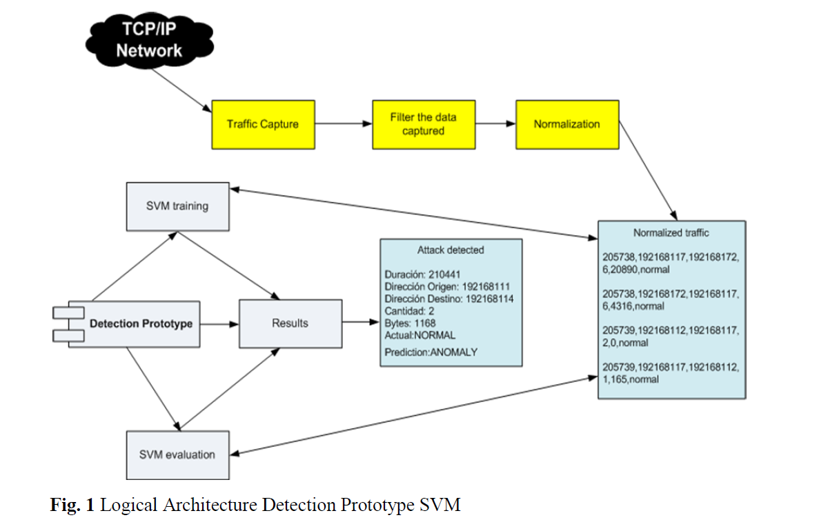
Materials and Method
- Design
26年 11月 8日

Slide 7
Materials and Method
- Implementation and Training
The collection, filtering and traffic normalication -> shell and python from performance~
Trainning and evaluation -> Java with SVM library,
libsvm 1 library in JAVA, which allows training,
evaluating and generating a statistical model, based on standardized information.
The evaluation phase is to receive the standard traffic and
send it to the SVM to perform the process of detecting the attack based on the
model that was generated in the training stage.
. The evaluation process has
as its starting point the traffic sent by users and it’s standardized at the initial
stage, the prototype loads the generated model and discusses each record
individually, in order to compare the statistical model generated in step training
and identify indeed if it is generating an attack.
https://www.csie.ntu.edu.tw/~cjlin/libsvm/
26年 11月 8日

Slide 8
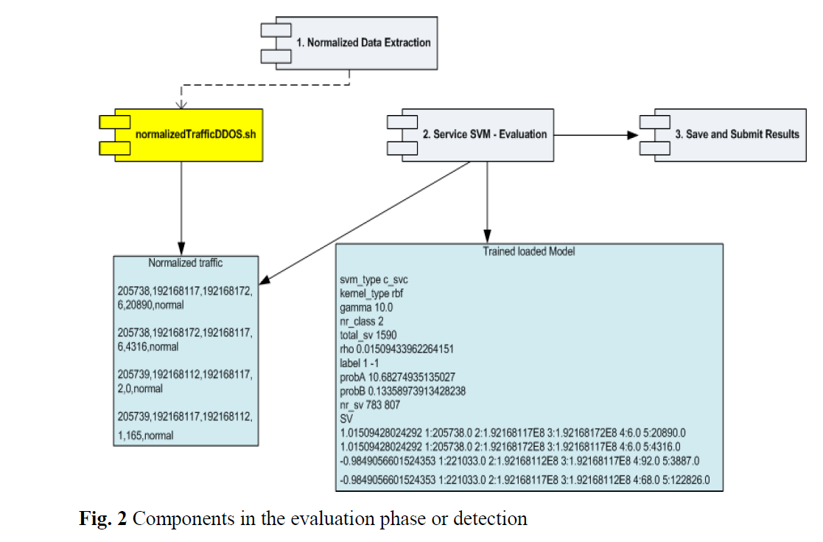
Materials and Method
- Implementation and Training
26年 11月 8日

Slide 9
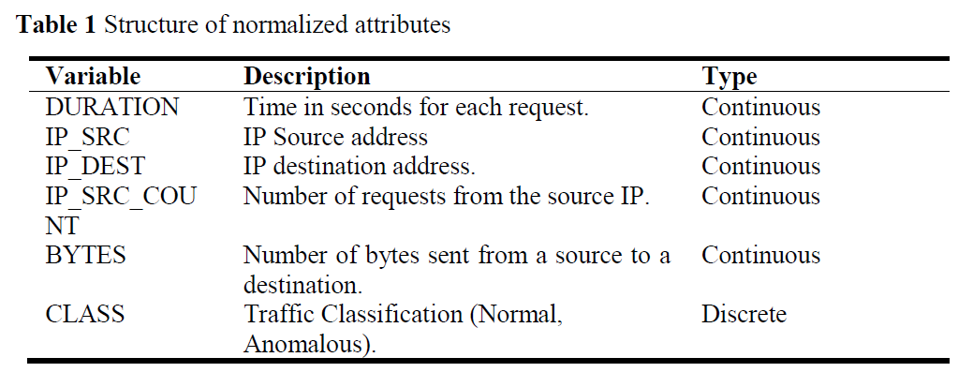
Results
sent a set of normal and abnormal requests for parallel and sequential process ,five iterations of 500 requests over a period determined time of 15 minutes.
Total pooled and stored records 2698 between normal and anomalous
traffic were normalized. The complete data normalized traffic (normal 1349,
anomalous 1349), are divided into the training stage, randomly selecting 60% of the
dataset (normal 809 abnormal 809), the other 40% (normal 539 abnormal 539) for
evaluation. With the percentage defined training and evaluation, proceed to perform
the respective tests the prototype, in order to determine if it has an acceptable level
of detection.
26年 11月 8日

Slide 10
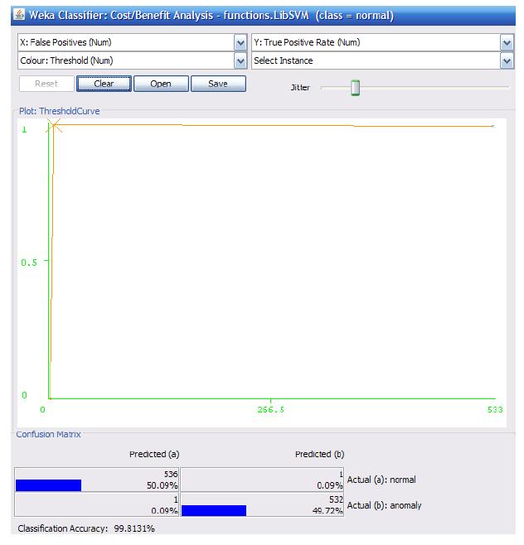
ROC curves based viewing rate of false positives
and true positives (detection rate) are shown in Figure 3. In the same way as in the
training phase in the X axis is the false positive and in the Y axis is the true positive,
if the value on the Y axis is close to 1 and the value on the X axis approaches to 0, it
means that the events will be better able to detect and therefore greater ability to
discriminate between normal and anomalous behavior.
26年 11月 8日

Slide 11
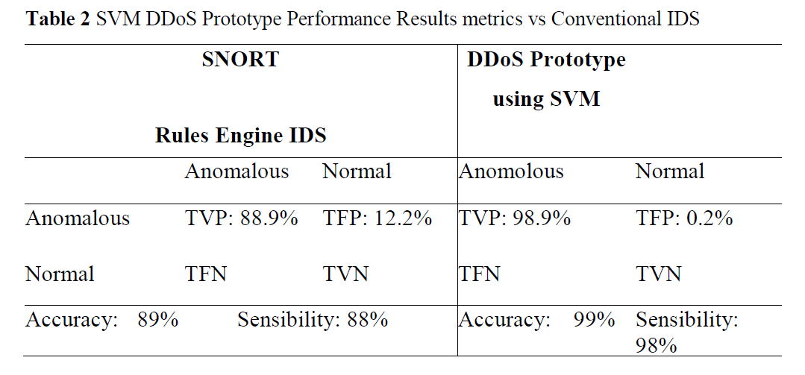
The prototype implemented the SVM technique had a significant improvement (approximately 10%) in the classification accuracy when compared with the intrusion detection system SNORT using the rules defined by human experts.
The internal statistical model of SVM identified anomalous or normal data in the evaluation phase without the need to add or modify the rules as another IPS (Intrusion Prevention Systems), causing the intrusion detection process is carried out quickly, automatically and without human interaction.
26年 11月 8日

Slide 12
Conclusions
The training process and tuning the Machine Learning from the standard data set
are the basis for the generated model and it has an acceptable percentage of classification
at the time of the evaluation of the prototype in a production environment
with real information. The selection of metrics in the intrusion detection problem:
false positive rate, false negative rate, rate classification, ROC curves, allow having
a standard of comparison against other models. The application of techniques
with supervised training as SVM model, has large advantages over the technique
based on rules, since the generation of the model is based on a statistical model
that changes its behavior according to the input parameters defined in the training
and based on rules it requires human interaction. In the prototype evaluation was
found a better classification rate for normal and anomalous requests in the training
phase, is directly related to standardization and proper selection of input parameters,
allowing output variables to be generated with minimum percentage of misclassification,
generating reliability in the generated model and the detection of
these behaviors.
26年 11月 8日

Slide 13
예제…
행동패턴 Attribute가 3개이다. (온도, 비, 바람)
온도 | 비 | 바람 | 밖에 나가 놀까?
5 |  | O | 아니요
10 |  |  | 예
8 |  |  | 아니요
6 | O |  | 아니요
24 |  | O | 예
30 |  |  | 예
33 |  |  | 아니요
32 |  |  | 아니요
30 | O |  | 아니요
15 | O |  | 아니요
16 |  | O | 예
26年 11月 8日

Slide 14
Q / A
감사합니다.

